Slide 1

NATURAL LANGUAGE PROCESSING
THAPAR UNIVERSITY
STUDENT CHAPTER
ANSHUL AGGARWAL

Slide 2
What is AI?

Slide 3
INTRODUCTION
1

Slide 4
Computer Language vs. Natural Language
Computer Language – 0s and 1s.
Natural Language – The one we use in daily life.
Timeline of communication with a computer:
Manual binary inputs
Programming Languages
Natural Languages
Early days of Computers
Today

Slide 5
Natural Language Commands
Two types of Assistive AIs:
Passive
Active
Passive AI: Lower level of interaction (“commanding”), somewhat hardcoded set of commands. Eg. Siri, Cortana, Google Assistant, chatbots.
Active AI: Conversational level of interaction (“talking”), not command based. Unachieved goal.

Slide 6


NLP in Passive AI
Objectives:
Convert speech to text, and text to speech.
Find keywords, and some contextual information to recognize commands.
Action command
Activation command
Task item
Hey Siri, tell me a joke
One of the pre-defined responses in category “joke”
Why did the chicken cross the road?
…

Slide 7
ACTIVE AI - CONVERSATIONAL
PASSIVE AI
Hey Siri, tell me a joke
Hey Siri, what’s funny?
Why did the chicken cross the road?
…
Searching for “what’s funny” on the internet…
ACTIVE AI
Hey Siri, what’s funny?
Tell me, why did the Roman chicken cross the road?
I don’t know
She was afraid someone would Caesar!

Slide 8
Language Processing
Human Language Task | Equivalent NLP Task
Reading | Natural Language Understanding
Writing | Natural Language Generation
Listening | Speech-to-text
Speaking | Text-to-speech

Slide 9
Key Terms
2

Slide 10
Morpheme, Stem AND LEMMA
The smallest meaningful grammatical unit of a language is called Morpheme.
E.g.
un, inspire and ing are all morphemes
Stem is the basic meaningful unit of a word.
In the above example, inspire is the stem
Lemma is the dictionary form of the stem.
E.g.: The dictionary form of better is good.
un ∙ inspir ∙ ing

Slide 11
CORPUS
Plural - corpora
A collection of text documents, generally related in genre, is a corpus.
E.g.: The Reuters News Corpus, Shakespeare Corpus, etc.
A corpus may contain additional information about the text contained, from metadata of the documents to part-of-speech tags for words.
These corpora can also be used as the training dataset for creating different Machine Learning models for various uses.

Slide 12
PLATFORM USED
Natural Language Toolkit (NLTK) & Python3
http://www.nltk.org/
(Alternatives: Stanford CoreNLP - Java, Apache OpenNLP – Java )

Slide 13
Syntax Analysis
3

Slide 14
Tokenization and Sentence Segmentation
Tokenization: The process of segmenting text into independent words.
E.g.: The above sentence is tokenized into “The”, “process”, “of”, “segmenting”, “text”, “into”, “independent”, “words”
This is done with the help of whitespaces. All punctuation is removed in this process.
Sentence Segmentation: The process of separating individual sentences in the document. This is done with the help of punctuation marks like ‘?’, ‘!’, ‘.’ which are followed by whitespaces.
E.g.: “His name is Mr. John Doe. He is a professional cricket player.” is segmented into
1. His name is Mr. John Doe.
2. He is a professional cricket player.

Slide 15
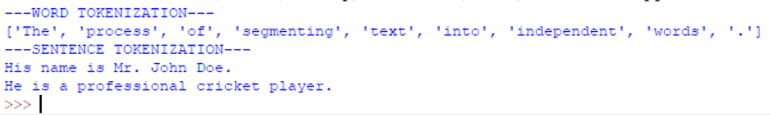
Sample code - 1
from nltk.tokenize import word_tokenize, sent_tokenize
print("---WORD TOKENIZATION---")
sentence = "The process of segmenting text into independent words."
words = word_tokenize(sentence)
print(words)
paragraph = "His name is Mr. John Doe. He is a professional cricket player."
sentences = sent_tokenize(paragraph)
print("---SENTENCE TOKENIZATION---")
for sent in sentences:
print(sent)

Slide 16
STEMMING
Words can be viewed as consisting of:
A Stem
One or more Affixes – Prefixes, Suffixes or both
Stemming extracts the stem from any word.
Popular stemming algorithms: Porter Stemmer, Snowball Stemmer
This process involves a set of rules, that are applied if they satisfy some condition. One such rule, concerning ‘s’ at the end, is:
SSES → SS
caresses → caress
IES → I
ponies → poni
SS → SS
caress → caress
S → є
cats → cat

Slide 17
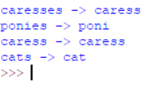
Sample Code - 2
import nltk
from nltk.stem.snowball import SnowballStemmer
stemmer = SnowballStemmer("english")
words = ['caresses', 'ponies', 'caress','cats']
for word in words:
print(word, "->", stemmer.stem(word))

Slide 18
Fill in the blank:
Microsoft issued a new security ____

Slide 19
N-GRAM
A useful part of the knowledge needed to allow Word Prediction can be captured using simple statistical techniques
We'll rely on the notion of the probability of a sequence (a phrase, a sentence)
N-Grams are sequences of tokens.
The N stands for how many terms are used
Unigram: 1 term Bigram: 2 terms Trigrams: 3 terms
N-Grams give us some idea of the context around the token we are looking at.

Slide 20
Part-of-speech tagging
Annotate each word in a sentence with a part-of-speech marker.
Lowest level of syntactic analysis. E.g.:
Useful for subsequent syntactic parsing and word sense disambiguation.
Amit saw the saw and decided to take it to the table.
NNP VBD DT NN CC VBD TO VB PRP IN DT NN
Notes:
NNP: Proper Noun Singular
VBD: Verb (Past Tense)
DT: Determinant
CC: Coordinating Conjunction
TO: to
PRP: Personal pronoun
IN: Preposition

Slide 21
POS TAGS – Some Examples
NN noun chair, bandwidth, pacing
VB verb study, debate, munch
JJ adjective purple, tall, ridiculous
RB adverb unfortunately, slowly
IN preposition of, by, to
PRP pronoun I, me, mine
DT determiner the, a, that, those
21
Notes:
21

Slide 22

Sample Code - 3
import nltk
from nltk import word_tokenize
txt = Hello my name is John Doe and my favourite number is twenty-seven"
tokens = word_tokenize(txt)
pos = nltk.pos_tag(tokens)
print(pos)

Slide 23
Grammar Rules
Every language needs a set of rules to form valid sentences, called grammar.
The sentence should conform to the grammar, to be a part of a language.
As a prerequisite of understanding the meaning of a sentence, we need to parse the sentence, using some defined grammar rules.

Slide 24
Parsing Using grammar rules
S
GRAMMAR RULES
S → NP VP
NP → DT NN | NP PP
VP → VB NP | VP PP
PP → P NP
NP → papa
NN → caviar | spoon
VB → spoon | ate
P → with
DT → the | a
NP
VP
papa
VP
PP
VB
NP
P
NP
ate
DT
NN
with
DT
NN
the
caviar
a
spoon

Slide 25
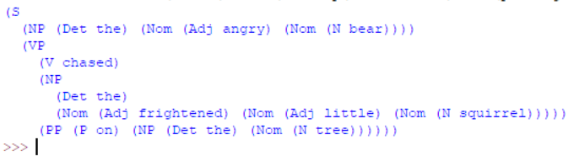
Sample code - 4
import nltk
from nltk import CFG
grammar1 = CFG.fromstring("""
S -> NP VP
NP -> Det Nom | PropN
Nom -> Adj Nom | N
VP -> V Adj | V NP | V S | V NP PP
PP -> P NP
Det -> 'the' | 'an' | 'a'
N -> 'bear' | 'squirrel' | 'tree'
Adj -> 'angry' | 'frightened' | 'little' | 'short'
V -> 'chased'
P -> 'on' | 'at'
""")
parser = nltk.RecursiveDescentParser(grammar1)
sentence1 = "the angry bear chased the frightened little squirrel on the tree".split()
for t in parser.parse(sentence1):
print(t)
Notes:
Mention Left Recursion

Slide 26
WordNet
A lexical semantic network relating word forms and lexicalized concepts.
Four main categories of relations:
Hyponyms: A more specific meaning for a generalized term. E.g.: Spoon and Cutlery
Meronyms: These words refer to the whole while mentioning a part. E.g.: “I see several familiar faces present.” Here, faces is a meronym for people.
Antonyms: Words with opposite meaning. E.g.: lose and win
Synonyms: Words with similar meaning. E.g.: win and victory

Slide 30
SEMANTIC Analysis
4

Slide 31
Named Entity Recognition (NER)
Identifying named entities in text.
Different from POS tagging, which identifies nouns at the word (token) level.
NER identifies only entities, with meaning into consideration.
E.g.: The IEEE Student Chapter of Thapar University organized a seminar on Natural Language Processing.
Named Entities identified:
IEEE Student Chapter
Thapar University
Natural Language Processing

Slide 32
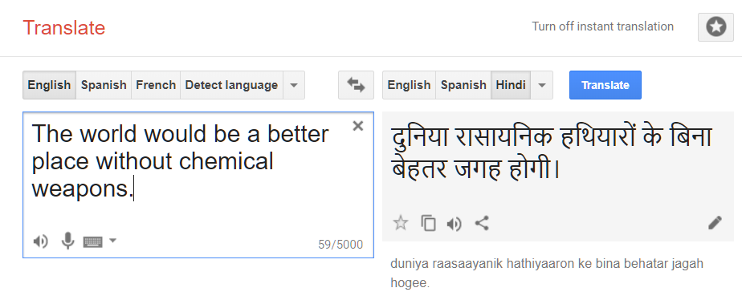
MACHINE TRANSLATION
Converting one natural language into another using a machine is Machine Translation (MT).
Complete MT has not yet been achieved.
Online platforms like Google Translate – some level of MT.

Slide 33
The Machine Translation triangle
Meaning
(interlingua)
NLG
NLU
Synthesis
Analysis
Transfer-based
Phrase-based SMT, EBMT
Word-based SMT, EBMT
Word
Word

Slide 34
Question Answering
The vastness pf the WWW brings a problem. It is becoming more and more difficult to find answers on the WWW using standard search engines.
Aim - To present the user with a short answer to a question rather than a list of possibly relevant documents.
Question answering can be approached from one of two existing NLP research areas:
Information Retrieval: QA can be viewed as short passage retrieval.
Information Extraction: QA can be viewed as open-domain information extraction.
Notes:
Of course it is a difficult area to evaluate the performance of systems as different people have different ideas as to what constitutes an answer, especially if the systems are trying to return exact answers.

Slide 35

Paragraph Segmentation -
Split a piece of text into paragraphs based on independence of content – TextTiling.
Block Comparison: Compare consecutive blocks of text, usually with the same word count.
Boundary Identification: Mark split point where there is significant difference.
similar
not similar
similar
 |  |  | split

Slide 36
SENTIMENT ANALYSIS
Classification of pieces of text based on opinion – positive, negative or neutral/no sentiment.
Use word-level semantics – whether a given word represents positive or negative emotion. E.g.: magnificent, wholesome (positive); abominable, shambles (negative).
Consider negations while detecting sentiment words. E.g.: not good, isn’t evil.
Limitation: cannot detect sarcasm.
Sentiment words and relations found in SentiWordNet.
Other methods use machine learning and deep learning.
Uses of Sentiment Analysis?

Slide 37
Discourse Analysis
5

Slide 38
reference Resolution
Resolve references or pronouns to corresponding named-entities.
Largely unsolved problem, but some progress made by using sentence structures.
E.g.:
Victoria Chen, Chief Financial Officer of Megabucks Banking Corp since 2004, saw her pay jump 20%, to $1.3 million, as the 37-year-old also became the Denver-based financial-services company’s president. It has been ten years since she came to Megabucks from rival Lotsabucks.

Slide 39
Automatic Summarization
Generate a summary of any document, to convey the central idea or concept.
Two types of Automatic Summarization:
Extractive - Pick the best, most informative sentences out of the whole document and use them as-is to form a summary. Use sentence scoring by giving scores to individual words, based on frequency of occurrence.
Abstractive - Construct a summary with completely new sentences. Closer to human-generated summaries. Somewhat unsolved problem.

Slide 40
Speech Analysis
6

Slide 41
Text-to-speech
Needs large sample dataset of narrated word-collocations, to build vocabulary. This generates a more “natural” sound.
The voices are sampled from real recorded speech and split into phonemes, a small unit of human speech. This is called Concatenation synthesis. This is used for words not in vocabulary, where the word is broken down into syllables for speech synthesis. This generates a more “artificial” sound.
These sounds are combined by altering pre-recorded frequencies for a smooth flow of sound.
Try speaking:
It is what it is. What is it?

Slide 42
Speech-to-text
This process involves four steps:
Signal processing: Convert the audio wave into a sequence of feature vectors
Speech recognition: Decode the sequence of feature vectors into a sequence of words
Semantic interpretation: Determine the meaning of the recognized words
Dialog Management: Correct errors and help get the task done
The process is assisted by word-collocation dictionaries, to correct errors or predict upcoming words.

Slide 43

Anshul Aggarwal
anshulaggarwal987@gmail.com | 98144 99764
linkedin.com/in/anshul-aggarwal
Thanks for your patience!
Content and Code Samples available at
github.com/anshul-aggarwal/NLP-IEEE-TU
Try building NLP applications without significant programming using IBM Watson:
https://www.ibm.com/watson/

