Slide 1


Auto EA-SORAN: Weekly Progress Update
AI-Driven 5G RAN Energy Optimization
Team: NoWiresAttached

Slide 2
Agenda for Today
Summary of Weekly Accomplishments
Key Findings from Literature Review
Guidance from Project Advisors
Finalized System Architecture and Flow
Agent Implementation Progress & Code Walkthrough
Plan for the Upcoming Week

Slide 3
Weekly Accomplishments
Literature Review Completed
Advisor Consultation
Extensive review detailing our implementation framework.
Discussion with Vishnu sir and Preksha ma'am on validation frameworks.
Architecture Visualized
Base Code Implemented
Finalized and charted the multi-agent system.
Prediction and Optimization agents' foundational code is complete.

Slide 4

Deep Dive: Literature Review
Scope & Focus Areas
Each team member reviewed approximately 10 research papers, focusing on three core areas:
Simu5G/OMNET++: Digital twin capabilities, API for external control, and dynamic parameter modification.
5G gNodeB Energy Models: Established linear and state-based power consumption models.
3GPP Energy Efficiency (EE) Standards: Official KPIs and performance metrics.
Outcome
Synthesized findings into a comprehensive technical report, now serving as our implementation blueprint. This robust foundation ensures our approach is grounded in leading research and industry standards.

Slide 5
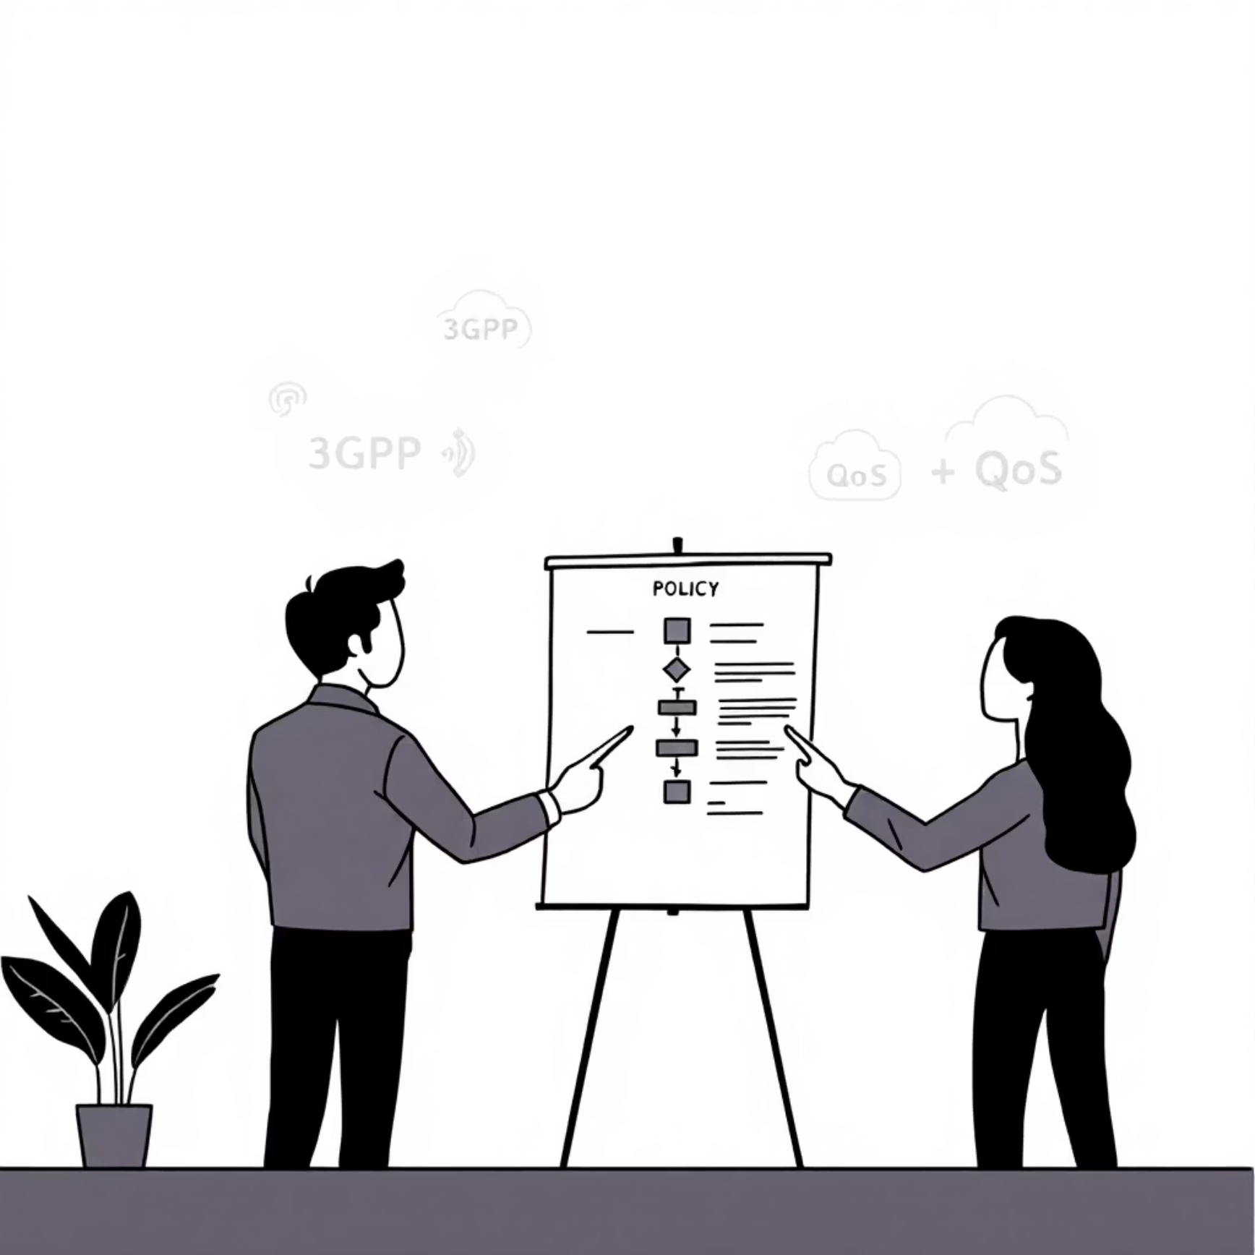
Guidance on Policies & Thresholds
Consultation & Key Recommendation
We consulted with Vishnu sir and Preksha ma'am for insights on defining operational policies for our Feedback Agent.
"Instead of creating arbitrary thresholds, align validation logic with established 3GPP standards for Energy Efficiency (EE) and Quality of Service (QoS)."
Action Taken
This feedback prompted a deeper review of 3GPP EE documentation, which will directly inform the logic of the Feedback Agent. This ensures our energy-saving policies are both effective and industry-compliant.

Slide 6
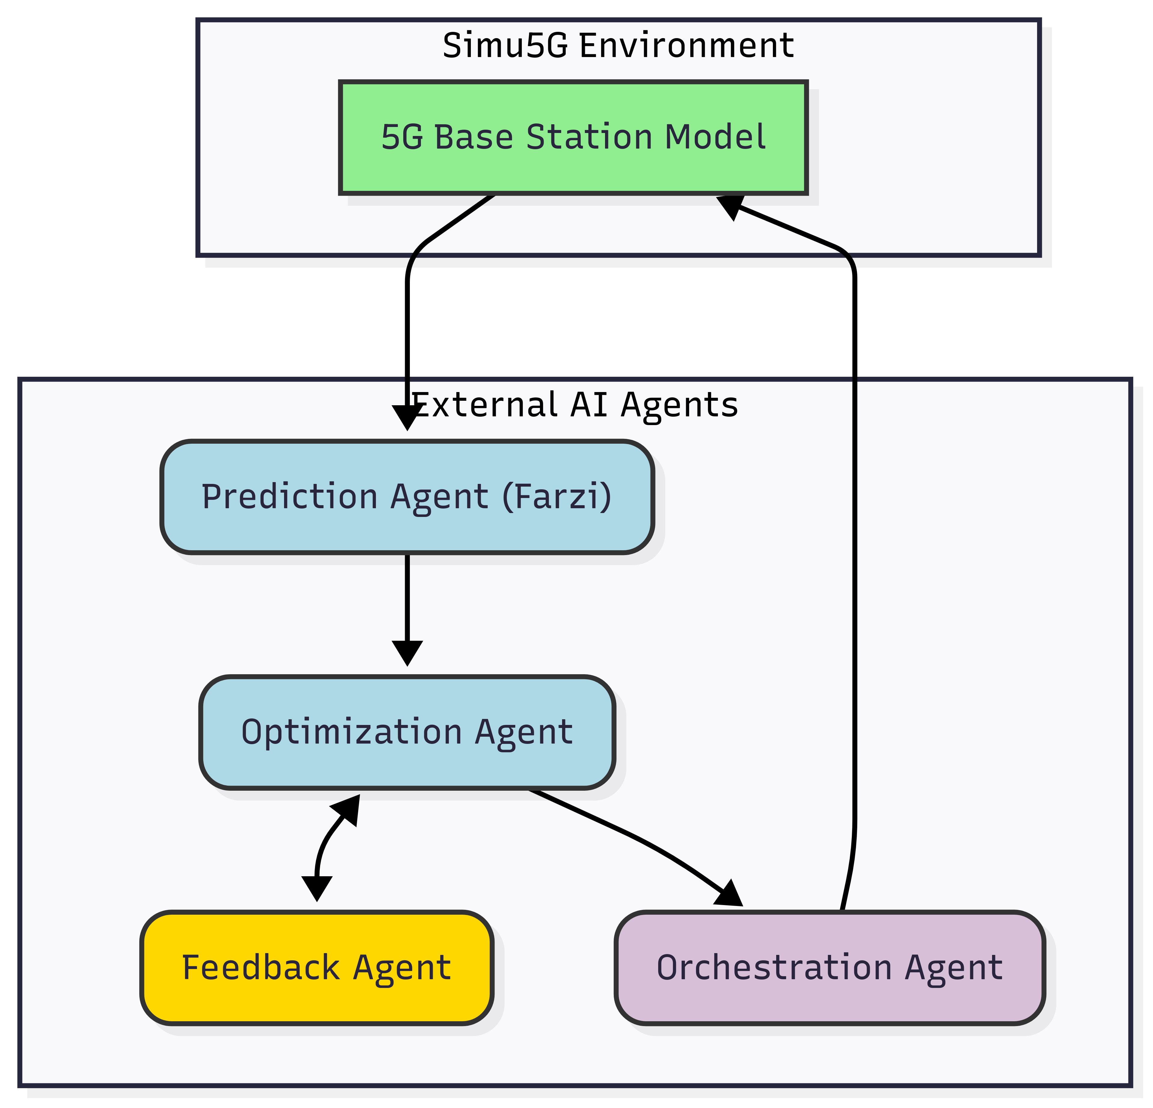
System Architecture Finalized
To clarify the interaction between components, we've created a definitive
architectural flowchart.
The system is split into two main parts: the Simu5G Environment acts as the digital twin, and the External AI Agents handle all decision-making. This clear separation of concerns is a core design principle.

Slide 7




Agent Interaction Flow
The agents operate in a continuous closed loop, ensuring dynamic and optimized energy management.
State Export
Predict & Optimize
The 5G Base Station Model in Simu5G sends current network state data (e.g., PRB usage) to the agents for analysis.
The Prediction Agent forecasts energy use, and the Optimization Agent formulates an energy-saving plan.
Validate
Actuate
The Feedback Agent checks the plan against 3GPP-based policies, ensuring QoS is not compromised, and can force revisions.
The final, validated plan is sent to the Orchestration Agent, which executes the changes in the Simu5G environment.

Slide 8
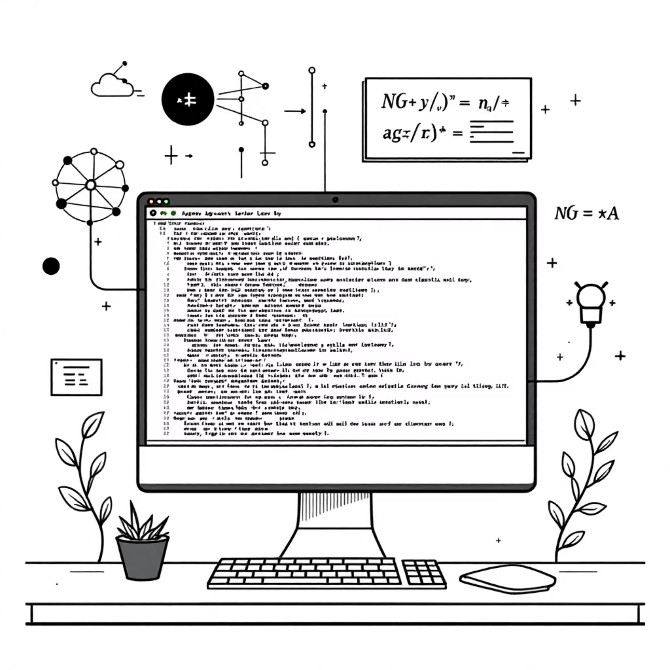
Agent Implementation Progress
Foundational Code Complete
The foundational Python code for the first two agents in the chain is complete and operational.
Prediction Agent: Base implementation ready, designed to ingest network state data and forecast energy consumption.
Optimization Agent: Core logic for generating energy-saving plans is in place, ready to formulate efficient strategies.
Next Steps
We are now ready to proceed with a live code walkthrough to demonstrate the implemented functionalities and discuss integration points.
Next: Live Code Walkthrough

Slide 9
Plan for Next Week
Agent Development
Integration
Simulation Setup
Begin implementation of the Feedback Agent, focusing on integrating 3GPP policy checks. Develop the Orchestration Agent and its in-simulation proxy for seamless control.
Establish the ZeroMQ (ZMQ) communication channel between the Python environment and the Simu5G C++ environment, enabling real-time data exchange.
Begin implementing the custom gNodeB energy consumption model within Simu5G to accurately reflect real-world power dynamics.

