Slide 1

Superstore Data Analytics Project
Transforming raw transactional data into actionable business intelligence — a full-stack pipeline from Python to MySQL to Power BI.
PROJECT REPORT

Slide 2

Project Architecture & Methodology
The project was executed across three distinct phases to ensure data integrity and scalable analysis.
Business Intelligence
Data Cleaning
Ingest raw data, fix missing values, standardize types
Build Power BI dashboard with DAX measures and slices
Database Engineering
Load via SQLAlchemy/PyMySQL, run business_analysis.sql
Each phase builds on the last — from raw ingestion to structured querying to interactive executive reporting.

Slide 3
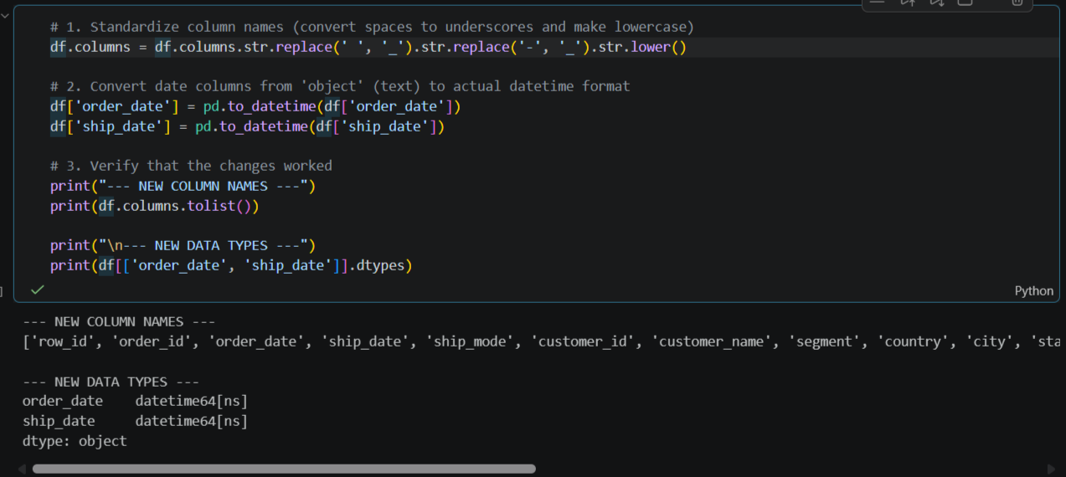
Phase 1: Data Cleaning with Python
Ingestion
Standardization
Raw data loaded via pandas from the Superstore transactional dataset.
Missing values handled; dates and numerical figures standardized across all fields.
Verification
Anomalies filtered to produce a verified baseline dataset: clean_superstore.

Slide 4
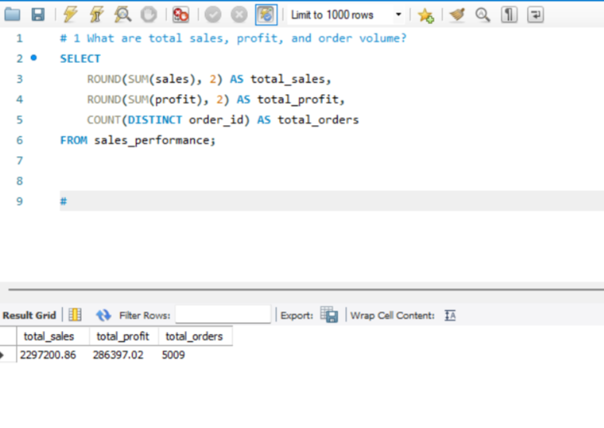
Phase 2: Database Engineering with MySQL
Structured Storage
The cleaned dataset was programmatically injected into a local MySQL instance using sqlalchemy and pymysql.
Analytical Querying
A unified script — business_analysis.sql — was developed containing comprehensive relational queries to extract:
Key Performance Indicators (KPIs)
Time-series trends
Segment and category breakdowns

Slide 5
Core Business Metrics
$2.30M
$286.4K
5,000
Total Revenue
Net Profit
Orders Processed
Indicating a highly robust market footprint across the historical timeline.
Yielding an overall net profit margin of approximately 12.4%.
Discrete transactions processed across the full historical timeline.

Slide 6
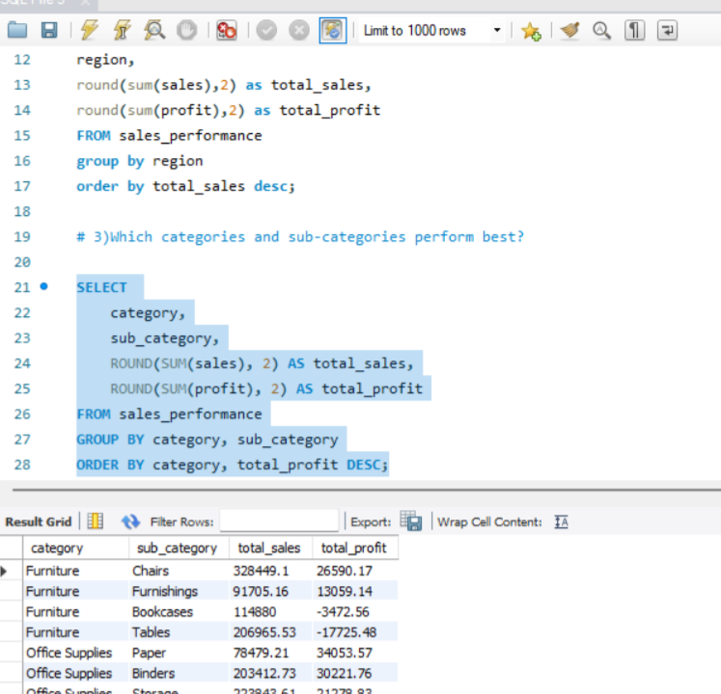
Profitability Leaks by Sub-Category
Top Performers
Copiers and Phones emerged as the primary profit engines, driving the highest net margins and volume.
The Critical Deficit
The Tables sub-category consistently yields negative net profit margins despite substantial sales volume — production, shipping, or heavy discounting is actively destroying value.

Slide 7
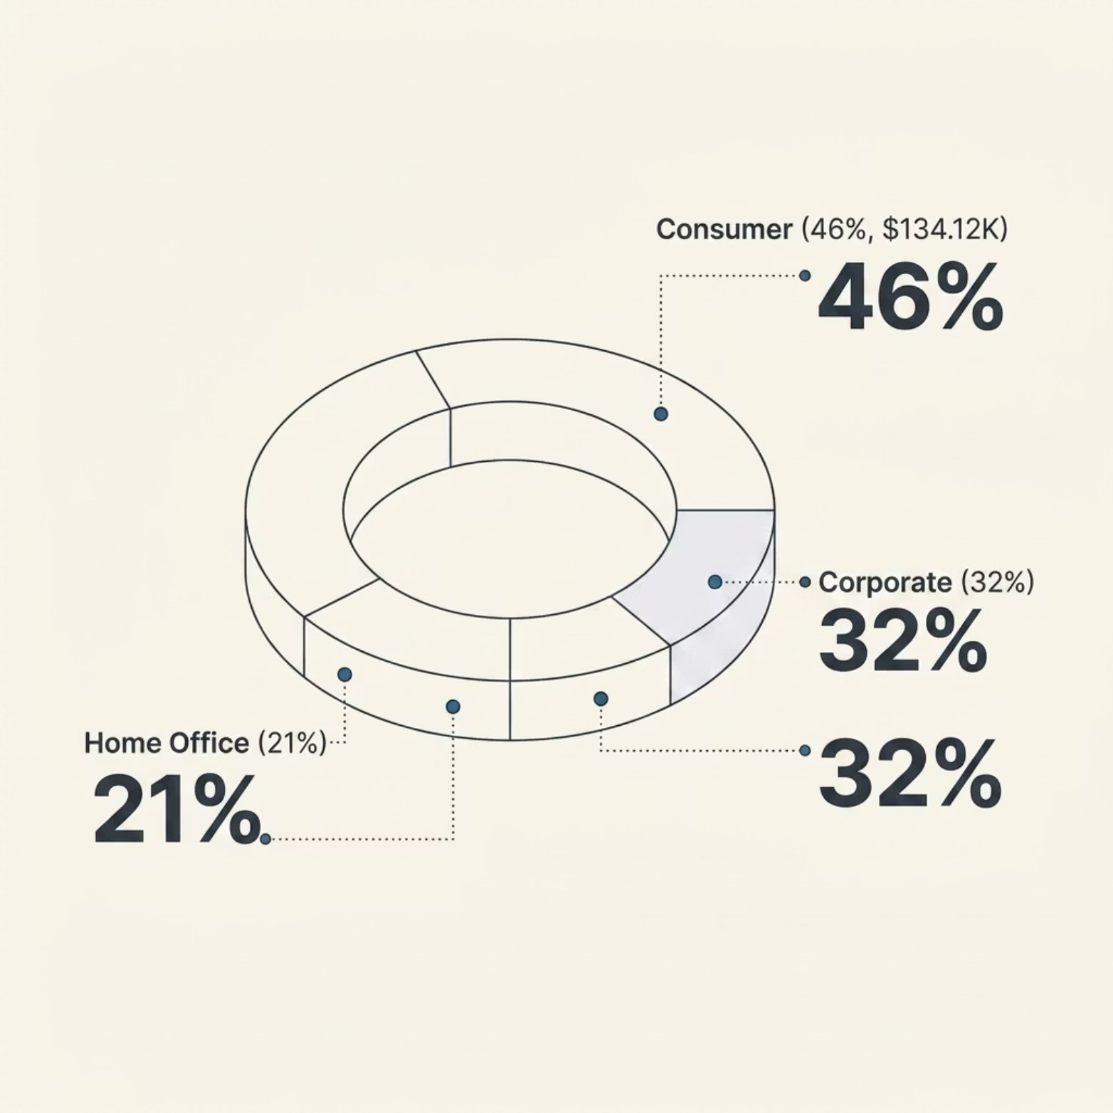

Time-Series Trends & Customer Segmentation
Seasonal Patterns
Sales and profits show a clear upward year-over-year trajectory. Monthly rolling totals reveal recurring spikes concentrated in Q3 and Q4, aligning with corporate purchasing cycles and holiday retail surges.
Segment Performance
Consumer: 46% of profitability — $134.12K
Corporate: ~32% of profitability
Home Office: ~21% of profitability

Slide 8
Power BI Dashboard Design
A single-page executive dashboard using a four-tier hierarchical grid architecture for stakeholder data exploration.
1
2
Top Navigation Banner
Left-Hand Control Sidebar
Prominent header: Superstore Executive Performance Dashboard.
Order Date slider, Category & Ship Mode dropdowns, and a Vertical Tile Slicer for Region.
3
4
Upper Summary Cards
Analytical Body Grid
Three high-impact cards: Total Orders, Total Profit, Total Sales — with automated unit scaling.
Donut chart (segment profit), bar chart (sub-category rank), line/column chart (temporal trends), customer matrix, scatter plot (discount vs. profit), and state-level sales bar chart.

Slide 9
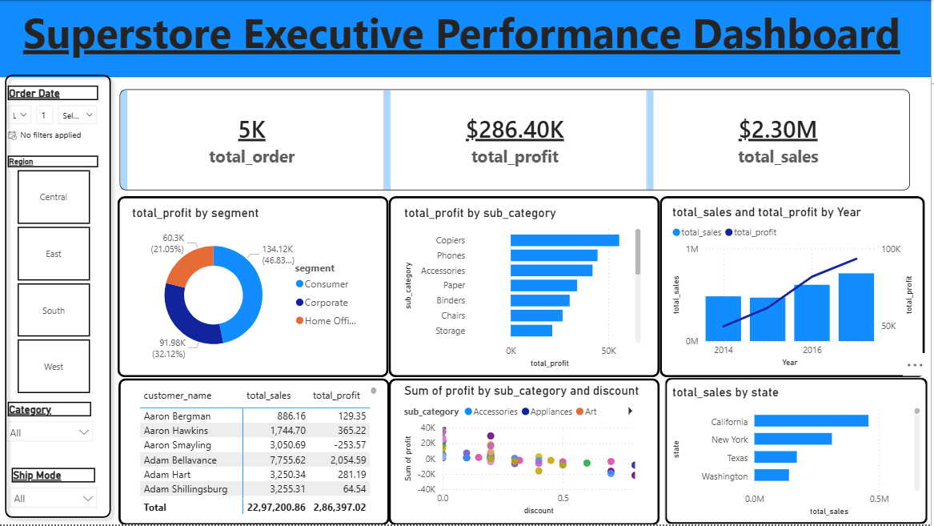

DAX Formulation
Explicit Measures
Data fields were decoupled from visuals. Processing is driven by explicit DAX stored in a dedicated calculations directory:
Total_sales = SUM(clean_superstore[Sales])
Total_profit = SUM(clean_superstore[Profit])
Total_orders = DISTINCTCOUNT(clean_superstore[Order_ID])
Automated unit scaling ensures executive-friendly display across all card visuals.

Slide 10

Strategic Recommendations
Restructure the Tables Portfolio
Review pricing, supplier agreements, and fulfillment. Implement a strict discount ceiling to stop negative-margin erosion.
Optimize Q3/Q4 Supply Chains
Reallocate inventory and logistics ahead of predictable holiday demand surges to minimize delays.
Deploy Targeted Consumer Campaigns
Focus marketing spend on high-value acquisition in California and New York; introduce loyalty frameworks for top buyers.
Implement Discount Guardrails
Use scatter plot insights to cap promotional discounts at levels that maintain positive net margins across low-performing lines.

