Slide 1

E-Commerce Executive Analytics Report
End-to-End Data Pipeline · SQL Business Analysis · Power BI Visualization
PREPARED BY ANSHUL SHRIVASTAVA · DATA ANALYST · JULY 2026

Slide 2

Project Overview
An end-to-end analytics solution analyzing 100,000+ real-world e-commerce transactions across Brazil (2016–2018). The project transforms a complex, multi-relational database into a scalable data pipeline — from raw CSV files to a cleaned warehouse, through SQL business queries, to an interactive 3-page Power BI Executive Dashboard.
The dashboard empowers leaders to assess revenue health, logistics bottlenecks, regional market penetration, and customer payment habits.
Data Ingestion & Cleaning
SQL Exploratory Analysis
Standardize raw data, resolve nulls, translate Portuguese categories
Complex queries on sales trends, category performance, delivery speeds
Data Modeling
Executive Visualization
Star Schema in Power BI with optimized DAX measures
3-page dashboard: KPIs, operational efficiency, payment insights

Slide 3
Tech Stack & Tools
MySQL / SQL
Python (Pandas & NumPy)
Primary data warehouse for ingestion, multi-table JOINs, aggregations, and window functions.
Data hygiene, datetime parsing, feature engineering, and Portuguese-to-English translation.
Power BI Desktop
DAX
3-page interactive dashboard with dynamic slicers, KPI cards, and polished design.
Custom measures: Total Revenue, AOV, Delay Rate %, and 5-Star Review %.

Slide 4

Business Problem
Olist is Brazil's largest marketplace, connecting small businesses nationwide to major e-commerce channels. Operating at scale introduces significant logistical, financial, and operational complexity.
Logistics & Delivery Delays
Customer Experience Gaps
Payment & Financing
Seller Quality Control
Identify high-risk states and logistics corridors impacting satisfaction.
Quantify how delivery delays reduce 5-star ratings.
Gain visibility into installment distributions and payment-type revenue.
Identify underperforming sellers via localized scorecards.

Slide 5
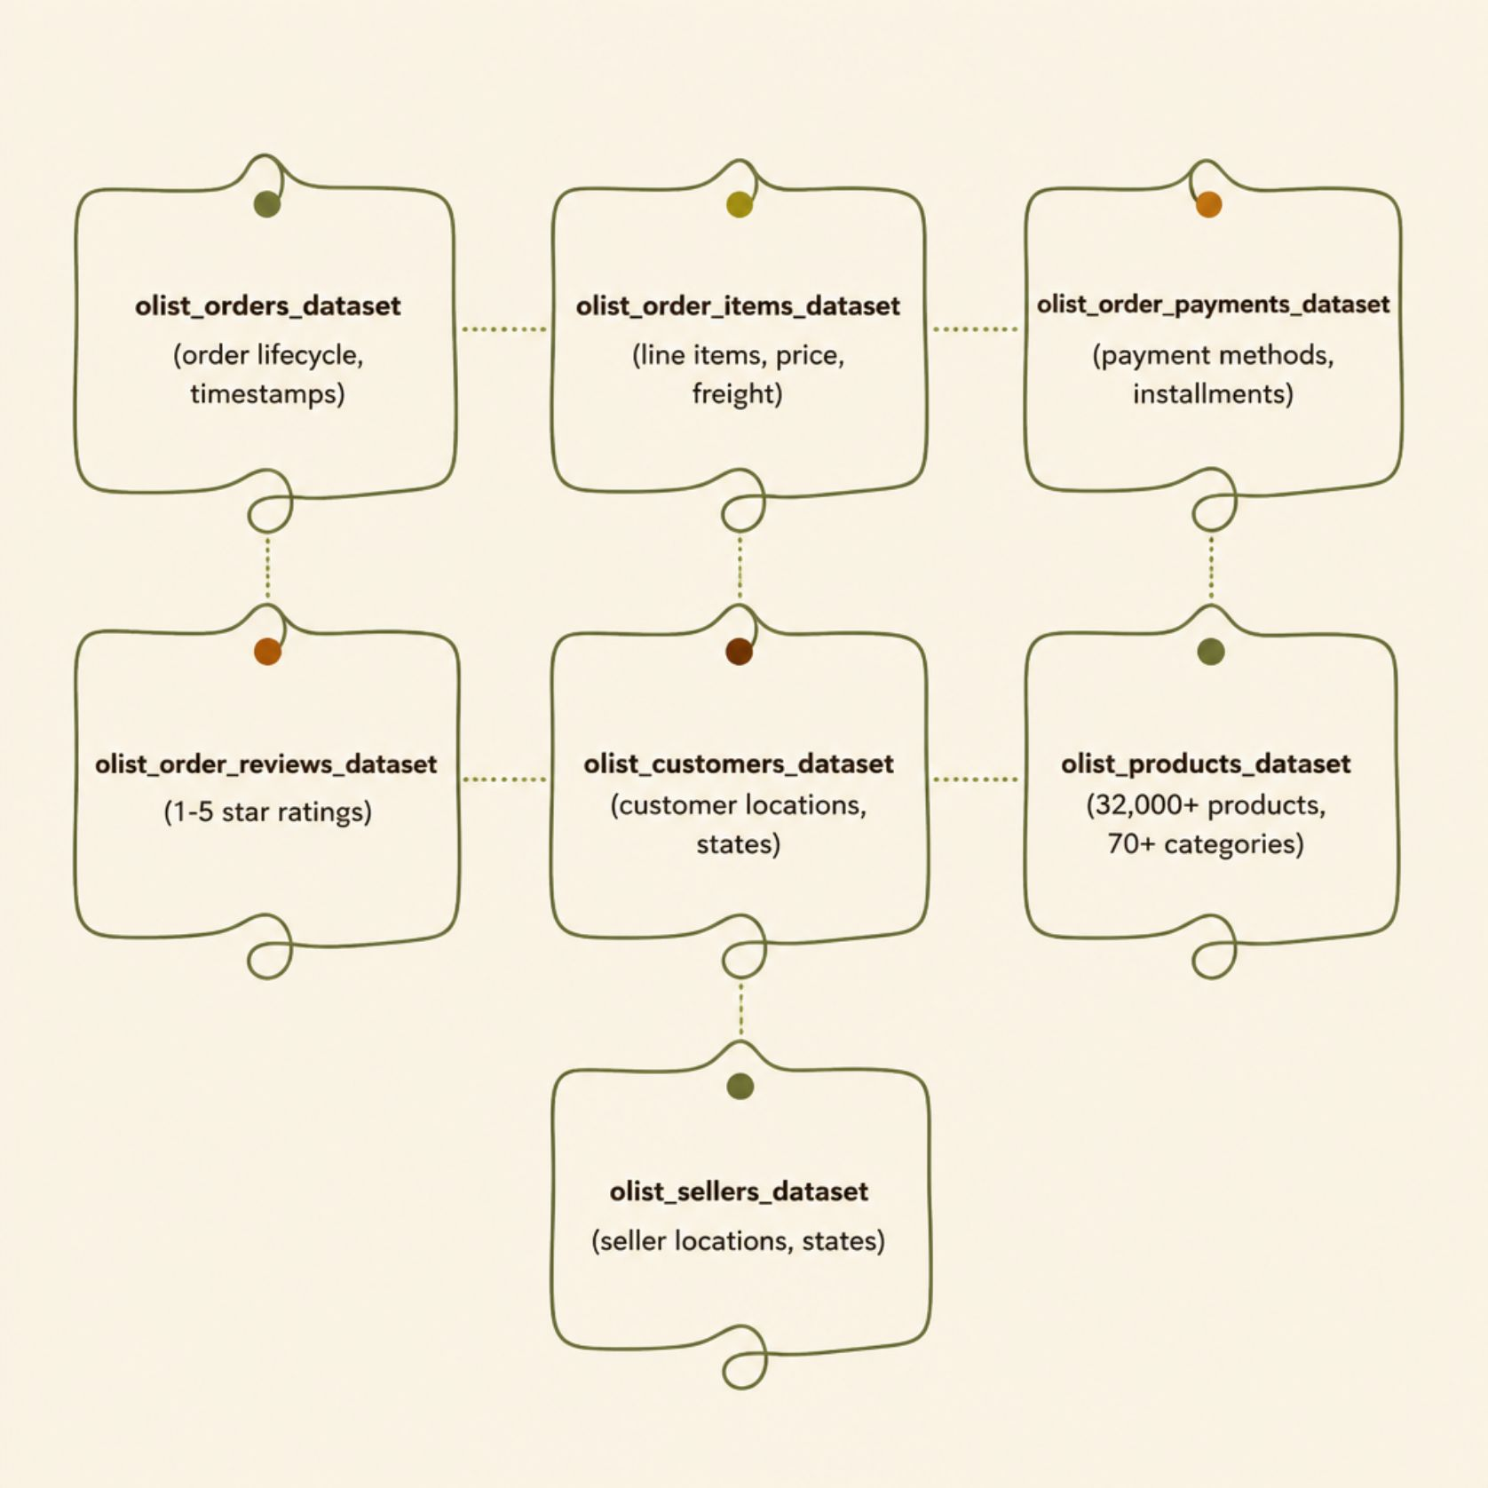
Dataset Description
The Olist Brazilian E-Commerce Public Dataset contains anonymized data on 100,000+ orders (Sept 2016 – Oct 2018), capturing the full transaction lifecycle across Brazil.
Key Data Highlights
5 timestamps per order enabling precise delivery lag calculations
All 27 Brazilian states covered; volume concentrated in Southeast (SP, RJ, MG)
32,000+ unique products across 70+ categories (translated to English)
Credit card installments ranging from 1 to 24 months

Slide 6

Project Architecture
Data flows sequentially through six structured phases — from raw source files through engineering and analysis, culminating in the executive dashboard.
Ingest CSVs
Initial EDA
Clean & Transform
Analytics & Dashboard
Each phase enforces data quality gates before advancing to the next stage, ensuring a reliable, audit-ready analytical output.

Slide 7

EDA, Cleaning & Transformation
Initial EDA
Data Cleaning
Verified 100k+ orders, confirmed primary key integrity, identified datetime type mismatches. Found ~3% missing delivery dates (canceled orders) and 50% null review comments.
Standardized timestamps to datetime64, isolated canceled orders, translated Portuguese categories to English, filtered corrupted records (installments = 0).
Feature Engineering
Created Delivery Lead Time, Fulfillment Delay Days, and Is Delayed binary flag. Built regional groupings (5 macro-regions) and installment bins (1x, 2–3x, 4–6x, 7–10x+).

Slide 8
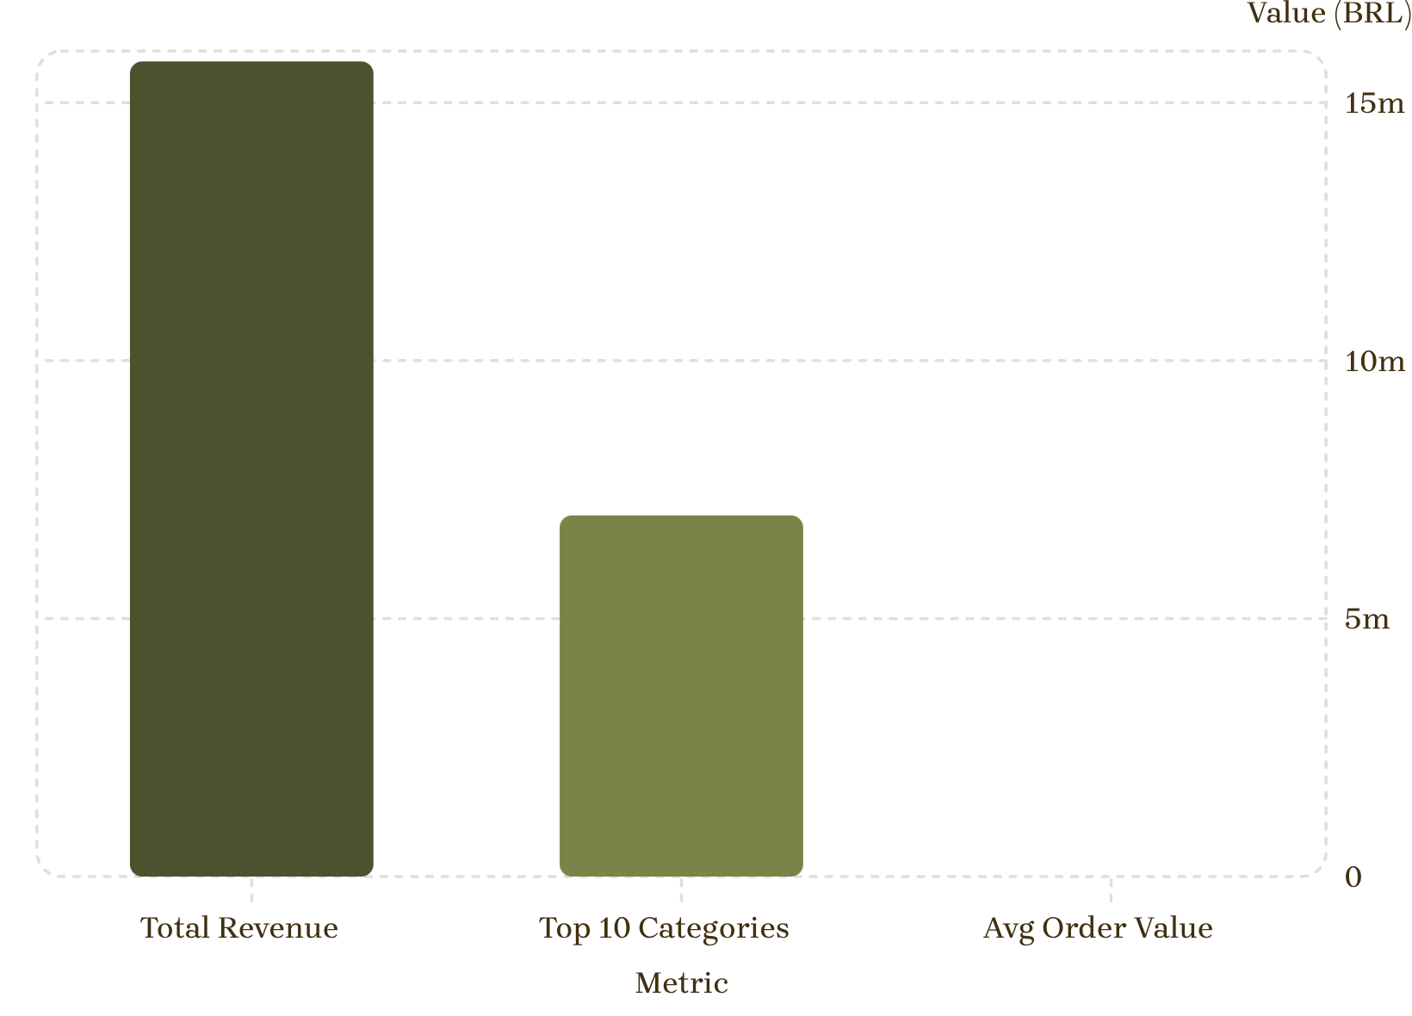
Business Analysis & Findings
Key Discoveries
Revenue: $15.8M BRL across 100k+ orders; top 10 categories = ~45% of merchandise value
Logistics: Southeast delivery: 8–11 days vs. Northern states: 20–28+ days
Satisfaction: On-time orders avg 4.2★; delayed orders drop to 1.6★ — a 60%+ decline
Payments: Credit cards = 75%+ of revenue; 45%+ of transactions use 2–10+ installments
Scale Disparity Note: Avg Order Value (~150 BRL) appears invisible because it shares a 15M BRL Y-axis scale with Total Revenue.

Slide 9

Power BI Dashboard Development
Data Modeling
Star Schema with central fact tables (Orders, Order Items, Payments, Reviews) linked to dimension tables (Customers, Products, Sellers, Date).
Core DAX Measures
Total Revenue, AOV, Avg Delivery Lead Time, Delay Rate %, Avg Review Score, 5-Star Review %.
3-Page Dashboard Architecture
01
02
03
Executive Sales Overview
Delivery & Logistics Performance
Payment & Customer Insights
KPI cards, monthly revenue trends, state heat map
Fulfillment bottlenecks, delay impact on review scores
Payment method breakdown, installment preferences

Slide 10


Key Insights & Recommendations
Shipping Delays Drive Negative Reviews
1
On-time orders: 4.2★; delayed: 1.6★ — a 60%+ drop. → Implement automated delay-alert systems and stricter SLA tiers for fulfillment partners.
Severe Regional Logistics Bottlenecks
2
Southeast: 8–11 days; Northern states: 20–28+ days. → Partner with regional 3PL centers in Northern hubs to decentralize inventory.
Zero-Interest Installment Reliance
3
Credit cards = 75%+ of revenue; 45%+ use 2–10+ installments. → Expand banking gateway partnerships (zero-interest terms, Boleto discounts) for high-value categories.
Project Impact: Successfully transformed 100k+ raw transaction records into an end-to-end analytical pipeline — connecting data engineering with business intelligence to deliver actionable strategic insights.

