Slide 1
TRACE.SPACE
01 / 08
Trace. Space
MARKETING STRATEGY
A zero-budget campaign.
TEAM 02
AK
SV
AS
SM
Anusha
Shubhangi
Anshul
Sarah
Kurma
Varma
Shrisvastava
Madhavan

Slide 2
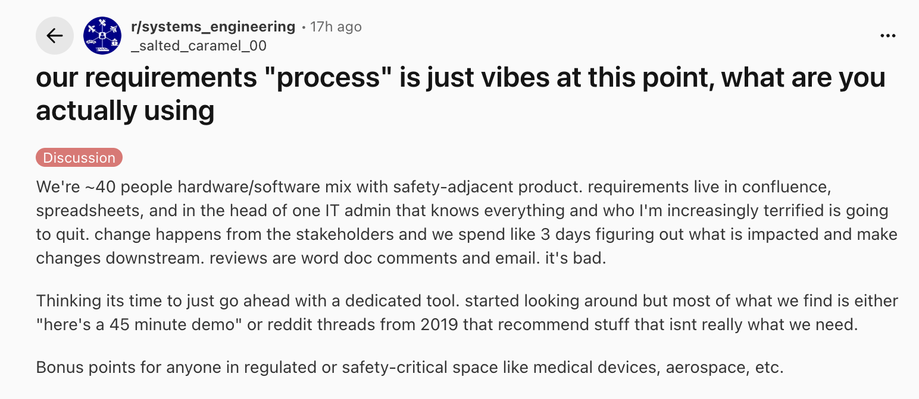
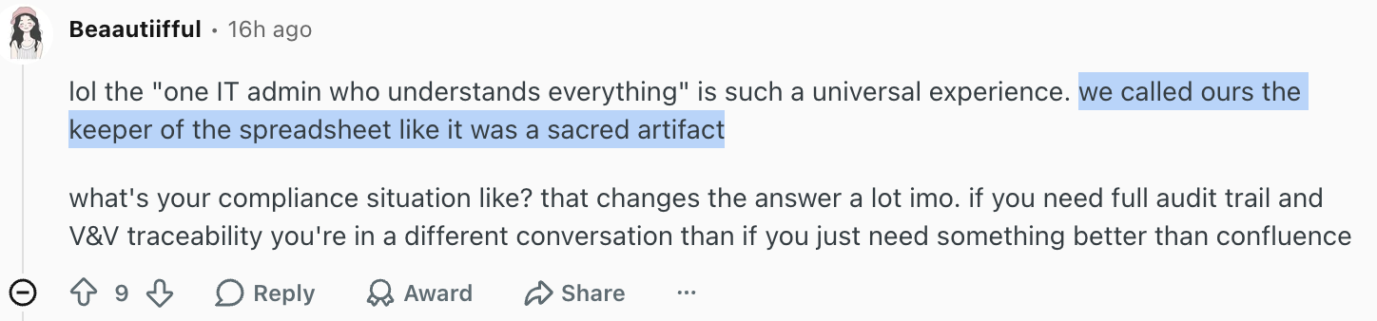
TRACE.SPACE
02 / 08
The systems engineer today
WHO THEY ARE · WHAT THEY DO · WHY THEY RANT
WHO THEY ARE
Their rants.
The responsible adults.
Building the systems that planes, cars, surgical robots, and defense platforms depend on. If a missing trace link kills someone — that's on them.
WHAT THEY DO
Translate ambiguity into proof.
Turn vague specs into testable shall-statements. Hold the trace chain together through every change. Run impact analysis. Defend the design at every audit.
WHAT MAKES THEM TICK
r/MBSE 184 ▲
Craft, not hype and questionable stack.
Proud of well-formed requirements. Done copy-pasting between DOORS, Jama, Excel, and Jira. Underserved by every "AI for engineering" tool actually built for someone else.

Slide 3
TRACE.SPACE
02 / 07
Trace.Space today
STRONG PRODUCT. QUIET PRESENCE.
PRODUCT
LINKEDIN
REDDIT
COMMUNITY
Strong
Limited
Absent
Missing
Differentiated AI built inside the traceability chain — not a chatbot bolted on.
Reach into the actual ICP — systems engineers and technical leaders — is thin.
Essentially no active, credible presence where the real conversations are happening.
No owned home base for systems engineers to gather, learn, and contribute.
The product is ready. The voice isn't there yet.

Slide 4
TRACE.SPACE
03 / 07
Campaign concept: #Trace the Rant
LISTEN. TRANSLATE. DEMONSTRATE. INVITE.
01
02
03
04
Listen
Translate
Demonstrate
Invite
>>
>>
>>
Collect anonymized rants from Reddit and LinkedIn — exact words, real friction.
Reshape each one into a clean systems engineering requirement and test scenario.
Show concretely how Space Agent would handle it — 10–100x faster.
Encourage engineers to submit their own examples and tag #TraceTheRants.
COMMUNITY BUILT ON THREE PILLARS.
PILLAR I
PILLAR II
PILLAR III
Relatable
Credible
Uplifting
Show we live their pain. Laugh with them, not at them.
Show up in Reddit threads with non-spammy, technical replies.
Spotlight the engineers and their craft — not the product.

Slide 5
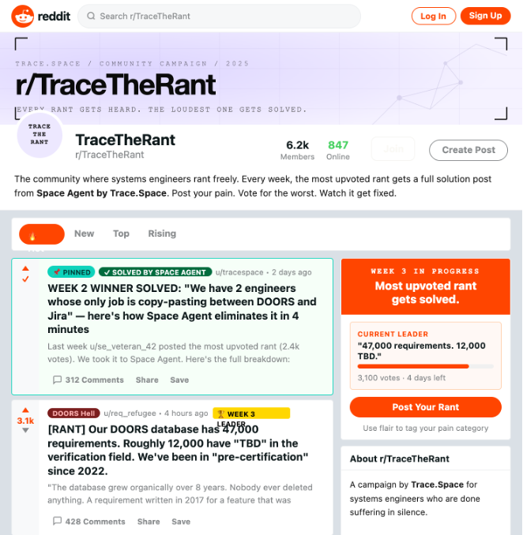
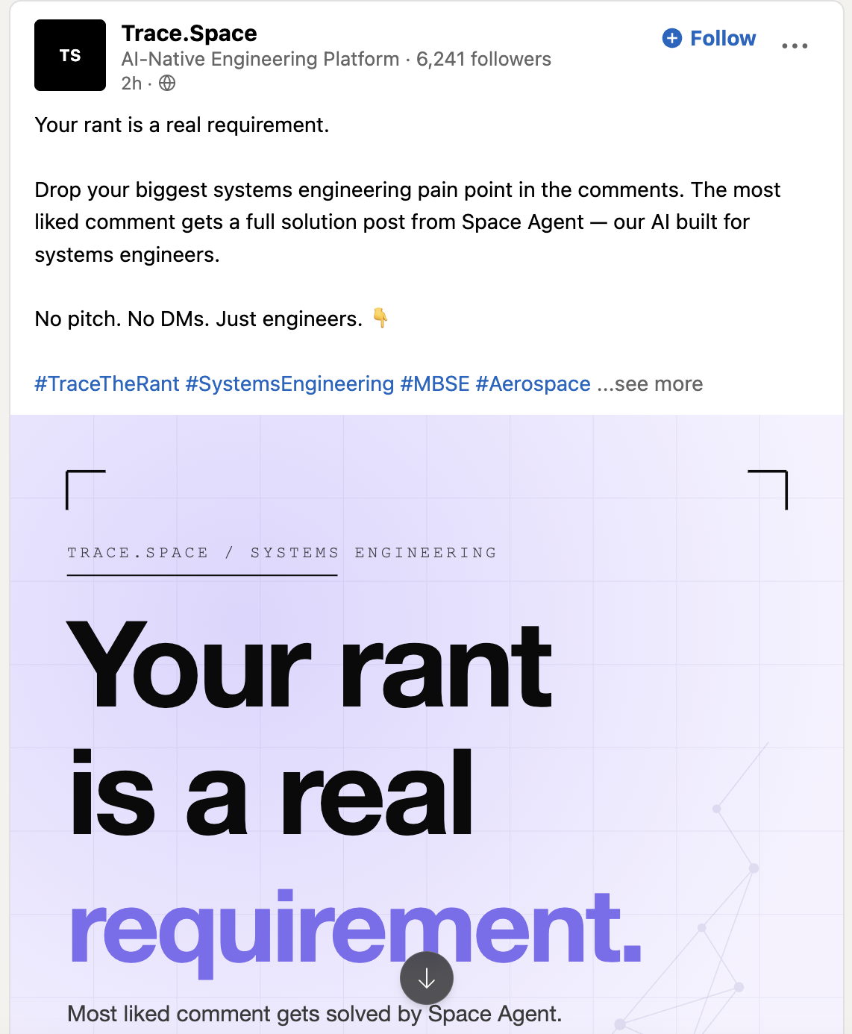
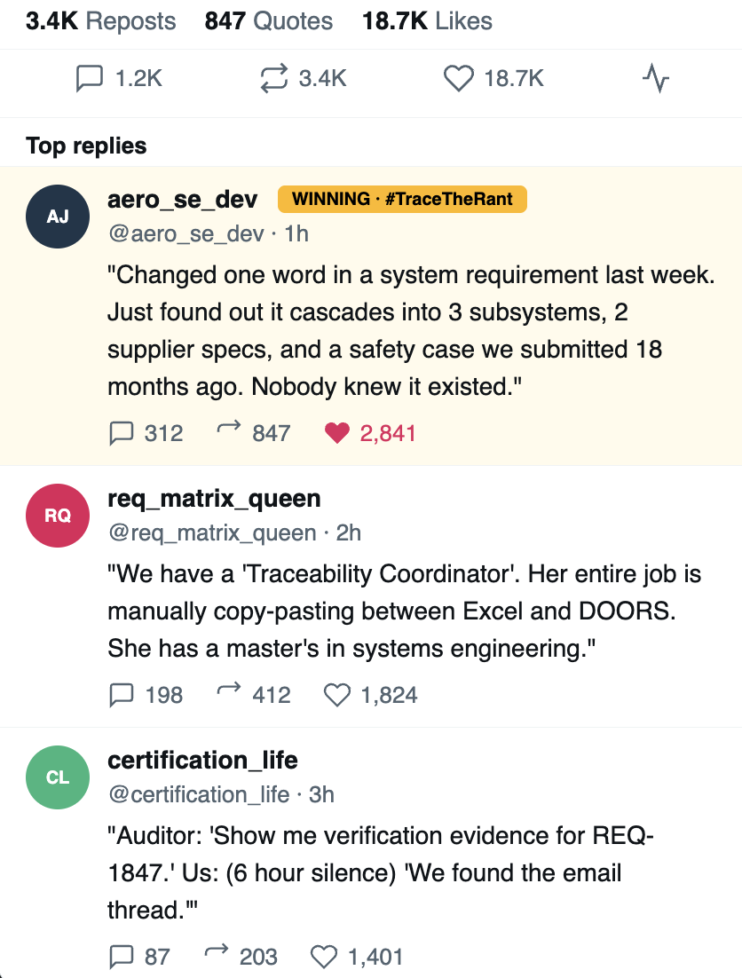
TRACE.SPACE
05 / 08
Pillar 1 — Relatable
WHERE THE RANTS LIVE
Reddit, discord and slack is where systems engineers have candid technical conversations, LinkedIn is where they maintain a professional presence, and Twitter extends visibility to the wider engineering audience.

Slide 6
TRACE.SPACE
05 / 07
Pillar 2 — Credible
SHOW UP WHERE THEY RANT
DEMO LINK
MOCKED REDDIT THREAD · EXAMPLE REPLY
THE REDDIT RESPONSE AGENT
r/systemsengineering
u/orbit_eng_77 6h
Drafted by an agent. Vetted by humans.
How are you handling change impact when DOORS modules are split across teams?
Listens
"We just got a v17 spec drop and our coverage view is stale across three modules. The PM wants impact in 24h. How are you not losing your minds?"
Reads posts in r/systemsengineering, r/MBSE, r/aerospace, r/embedded, r/AutonomousVehicles.
Drafts
▲ 142 37 comments saved by 23
Replies in the engineer's own language; offers 1–2 concrete, vendor-neutral tips rooted in SE practice.
Soft-links
u/trace_space_team 4h verified
Points to a deeper Trace.Space blog or LinkedIn breakdown — only when it adds value.
Two things that have actually saved us in this exact scenario:
1. Run impact analysis across the live trace chain — start from changed clauses in v17, not your last good baseline.
2. Lock down well-formedness on the new requirements first — verifiable, testable, traceable.
Human-vetted
Every reply reviewed and edited by Trace.Space humans before posting. No auto-posting. No spam.

Slide 7
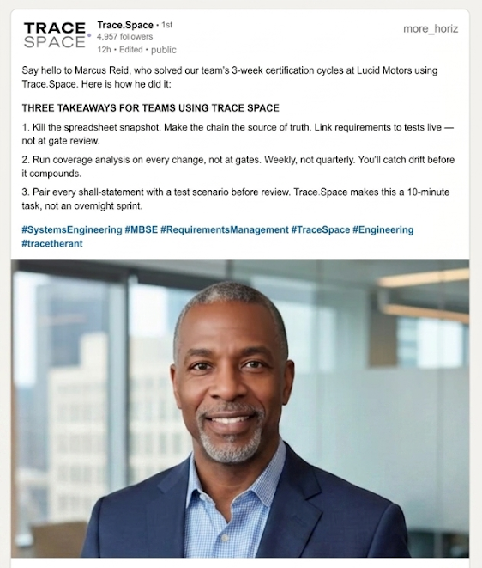
TRACE.SPACE
06 / 07
Pillar 3 — Uplifting
SPOTLIGHT THE CRAFT
Show the craft, not the product.
Short interviews and co-written posts with systems engineers about how they actually solved a hard traceability or certification problem. Not a generic testimonial — a craft story their peers will save.
WHAT MAKES IT WORK
Specificity
Name the tools, the spec version, the workaround. Real artifacts beat polished narrative.
Useful exhibits
Coverage diagrams, real RTM excerpts, decision trees — things peers can copy.
Engineer-led
They're the protagonist. Trace.Space is just the publisher and editor.
Notes:
"Our third key marketing pillar is to uplift the members of our community and create credibility through LinkedIn.
We’re going to regularly feature the stories of systems engineers who have solved real-world problems using Trace.
Rather than polished testimonials, these will be granular, problem-solution deep dives. Each post will document a specific technical hurdle—such as managing requirement volatility or complex traceability—and the exact Trace.Space feature used to resolve it.
This doesn't just give us credibility—when engineers see their peers from the same field featured, it builds trust and aspiration. To the system engineers this creates a space where they feel they belong, they can engage, and they see their work represented.
This builds a community of practice where engineers see Trace.Space not as a vendor, but as a standard tool in a modern engineer’s toolkit."
This is how we foster a real community, drive organic engagement, and give our product a human face that engineers trust and relate to.

Slide 8
TRACE.SPACE
07 / 07
How we'll measure success
FIRST 30 DAYS
01
02
03
LINKEDIN
REDDIT
EARNED
ICP engagement
Credible traction
One real opportunity
Impressions, comments, and shares from systems engineers and technical leaders — not generic followers.
Upvoted and saved threads where Trace.Space participates without being downvoted, removed, or flagged as spam.
A podcast invitation, a niche industry newsletter feature, or a community talk — earned off the back of the campaign.
Quality of audience over raw count.
Saved > upvoted > commented.
One concrete, named invitation.
MEANINGFUL TRACTION IN 30 DAYS · ZERO BUDGET · EARNED ON CRAFT
Notes:
“Success for us in the first 30 days is not going to be measured by vanity metrics like huge follower counts or paid reach. Since we are an early-stage startup, our focus is on building meaningful traction within the systems engineering community itself. The first metric we’ll track is ICP engagement on LinkedIn. Our ideal customer profile includes systems engineers, technical program leads, integration engineers, and engineering managers working in complex systems So instead of measuring raw impressions, we care about who is engaging with us. If experienced engineers are commenting on our posts, sharing them, or starting discussions around our content, that is a strong signal that the market resonates with the problem we are solving. We want quality of audience over quantity. The second metric is credible traction on Reddit. Reddit communities are very difficult to win over because engineers immediately reject anything that feels overly promotional or inauthentic. So our goal is not aggressive advertising. Instead, we want to participate genuinely in technical discussions, share relatable engineering pain points, post memes and workflow insights, and slowly become a trusted voice within those communities. Success here means our posts are being upvoted, saved, discussed, and engaged with organically rather than ignored or flagged as spam. That gives us authentic validation from real engineers. The third metric is earned opportunities. As a startup, one of the strongest indicators that people are beginning to trust the product is when opportunities start coming to us organically. This could be a podcast invitation, a request to speak at an engineering community event, a niche industry newsletter featuring us, or a systems engineering influencer wanting to collaborate. Even one meaningful invitation in the first 30 days would indicate that the campaign is creating credibility and visibility in the right circles.
Our short-term objective is to position Trace.Space as the recognizable standard for AI-native requirements management. we do not need to mass market. By replacing manual, error-prone tracing with intelligent, automated workflows, we are helping engineers focus on design rather than documentation. If the community begins associating us with the solution to 'requirements hell,' we have built the right foundation for long-term growth. This is our marketing campaign approach for Trace space to gain traction in the next 30 days. That can be achieved easily with the available man power and skills. I hope this helps. Thank you. “Success for us in the first 30 days is not measured by vanity metrics like follower counts or paid reach. As an early-stage startup, our priority is building high-fidelity traction within the systems engineering community.
We are tracking three core pillars of credibility:
1. ICP Engagement Velocity (LinkedIn)
We aren't looking for raw impressions. We are tracking engagement from our Ideal Customer Profile: systems engineers, technical program leads, and integration engineers—specifically those managing complexity in regulated industries (like Aerospace, Automotive, and Defense).
The Goal: Quality over quantity.
The Signal: If a Lead Engineer at an OEM comments on a post or starts a discussion around our technical approach, that is a direct validation that our solution resonates with the people who actually feel the pain of legacy requirements management.
2. Technical Peer Validation (Reddit)
Reddit is the ultimate litmus test for engineering tools. Our goal is to avoid the ‘marketing’ trap and participate as peers. We will share relatable workflow insights, discuss the friction of manual traceability, and contribute to technical debates in communities like r/systemsengineering.
The Goal: To move from 'outsider' to 'trusted voice.'
The Signal: We will measure success through organic saves and sentiment. When our content is saved as a resource or debated technically without being flagged as promotional, we have achieved authentic validation from a highly skeptical audience.
3. Inbound ‘Earned’ Opportunities
The strongest indicator of trust in a technical product is Market Pull. We want to see Trace.Space being pulled into the ecosystem rather than pushed.
The Goal: Secure at least one high-authority organic invitation within 30 days.
The Signal: A request to speak at an industry event, an invitation to a niche engineering podcast, or a mention in a respected systems engineering newsletter. This proves we are viewed as a credible solution, not just another tool.
The Vision
Our short-term objective is to position Trace.Space as the recognizable standard for AI-native requirements management. By replacing manual, error-prone tracing with intelligent, automated workflows, we are helping engineers focus on design rather than documentation. If the community begins associating us with the solution to 'requirements hell,' we have built the right foundation for long-term growth.”

