Slide 1
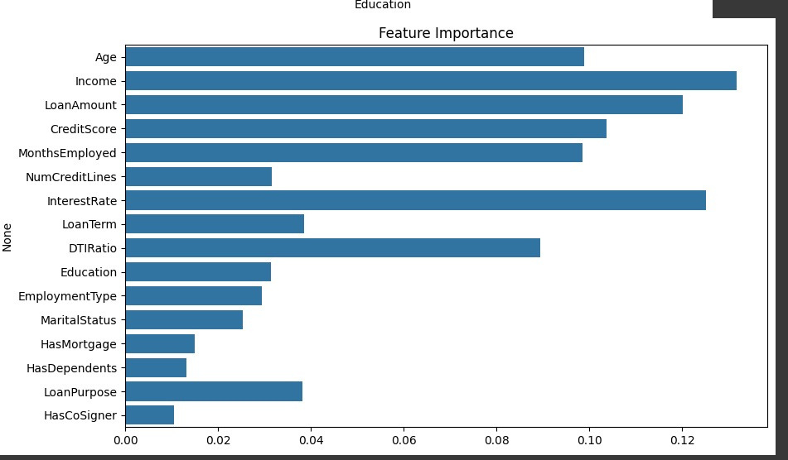
Dataset used and feature engineering
Dataset
Feature Engineering
Dataset has 2.5 lakh rows and 16 different parameters for classification.
Highly influential parameters used in banking for lending loans are used.
Minimal correlation between features
Debt to income ratio
Credit score
Outstanding loan

Slide 2
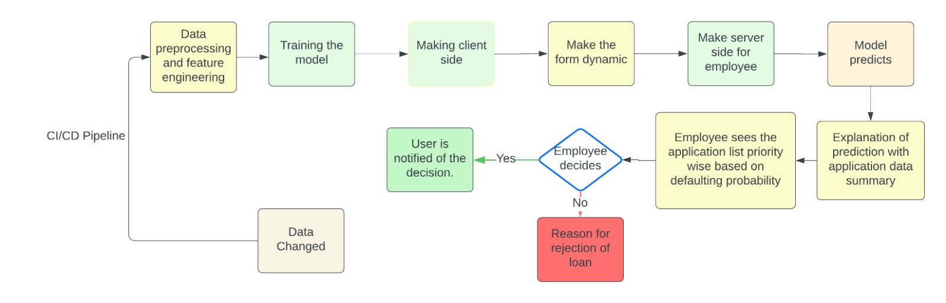
ML AI algorithm for analyzing loan applicant data

Slide 3

Unique Selling Point
In 2008 USA wall street crisis occured due to banks lending loans and creating mortgage securities which were out of bounds for the applicant to pay but which was ignored by larger banks to just make profits.
We are using AI agent for making our form dynamic such that the number of defaulting entries are reduced and priority sorting is done such that ambiguous probabilities lying around 0.5 which include human attention are displayed first.
The employee support dashboard consists of data visualizations based on conclusion received from AI.
The solution is not data rigid as model auto trains itself based on dataset received as input.
video link :-
https://drive.google.com/file/d/1Bkb53c7kB3ZlbVbgXZJXffhtvEjDiPsY/view?usp=sharing

