Slide 1
PROJECT STATIC WEB PAGE
- Anshul Shende.

Slide 2
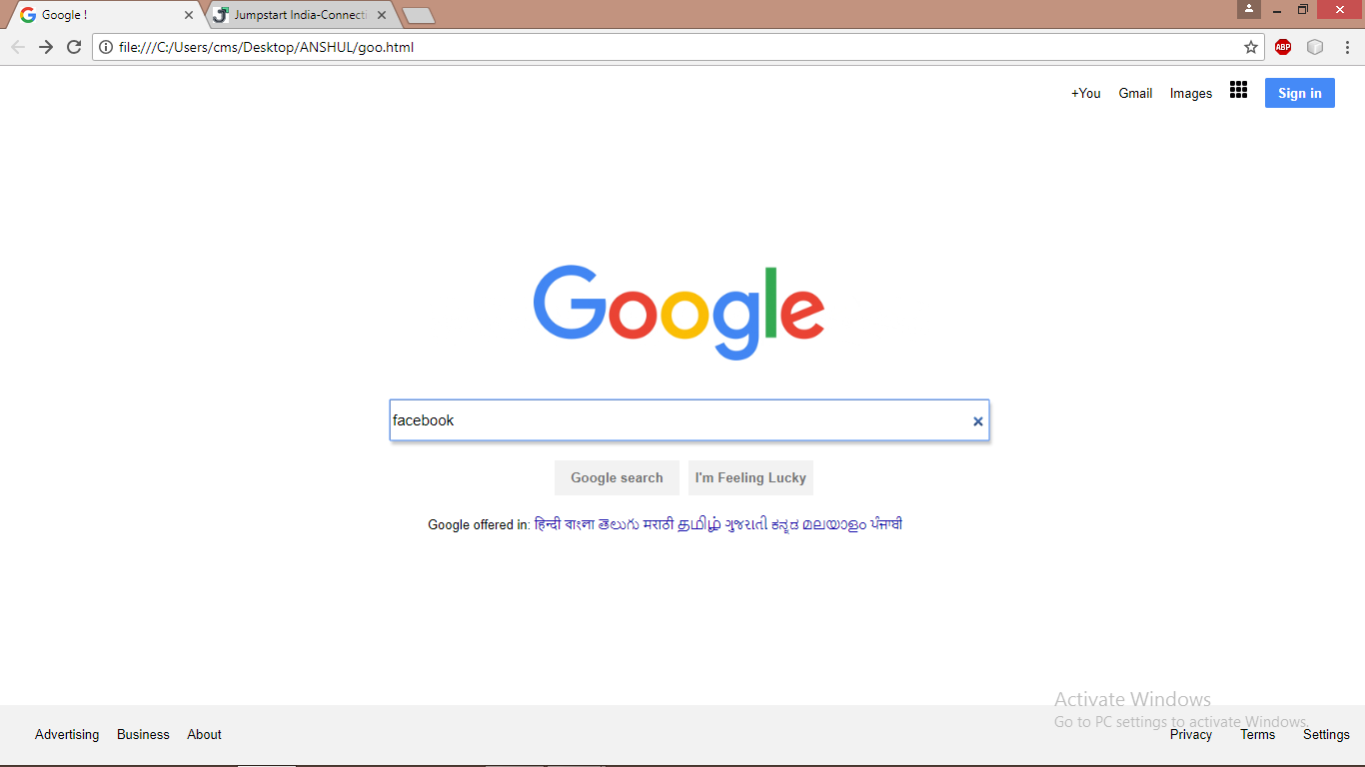
Google-Main Page

Slide 3
The above web page is created using HTML5 and CSS3.
Starting with Navigation bar , it includes a unordered list having List items “+you”, “gmail”, “images”, “grid-icon” and “Sign in” button.
The Google logo is replicated by inserting a jpeg image and was aligned using style sheet.
Then followed by the Search bar obtained through input tag in html and then the two buttons “Google Search” and “I’m Feeling Lucky” similarly through the input tag.
Lastly ,the web page contains a navigation bar in the footer which includes an unordered list containing the required elements .
The Google Search button is linked to the facebook login page as shown in the next slide.

Slide 4
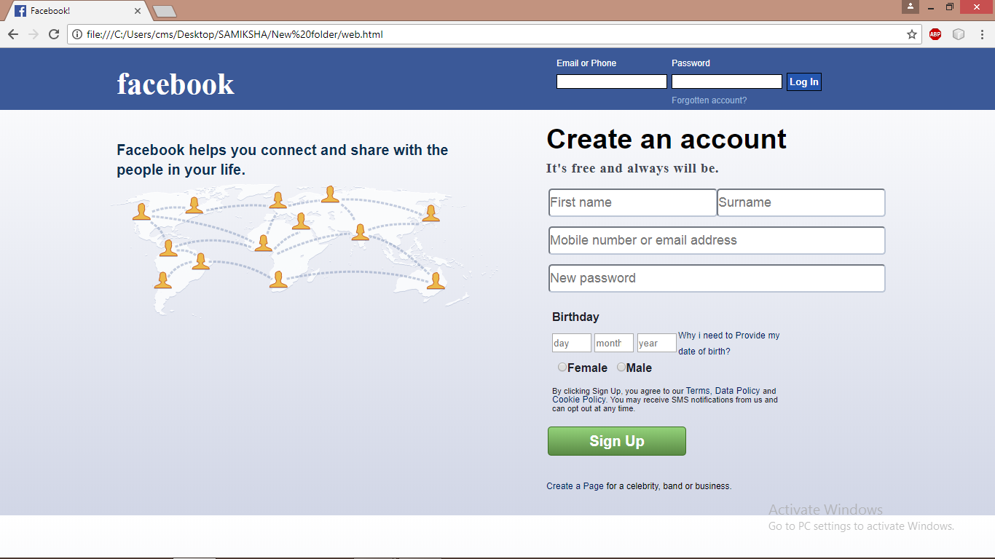
Facebook -Main Page

Slide 5
The Facebook login page also starts with a navigation bar, divided into two divisions left and right.
The left div in the navigation bar includes the Facebook logo and the right div includes the text and password box obtained through input tag in html.
The main body includes an image of “Facebook connectivity of the world” at the left side of the body section.
The right section of the body contains a signup page created through the use of form tag in html .
It includes various types of input elements such as text box, radio button, password box, number box as per the required elements.
The main body includes a background created through the linear gradient style available in cascading style sheet .

Slide 6
THANK YOU

