Slide 1
IBM University Engagement Project Submission
“Exploring the Power of Agentic AI with IBM Granite and LangFlow”

Slide 2

Project Tile – Startup Blueprint Generator AI
Domain of Project – Entrepreneurship & Business Development
Student Name | Recent Passport Photo | Email ID | Mobile number [WhatsApp]
Anshul Pravin Bhusal |  | AICTE/IBM SKILLBUILD: anshulbhusal@gmail.com EDUNET: 202501040341@mitaoe.ac.in | +91 9175884651

Slide 3
Problem Statement -
Problem Statement : Startup Blueprint Generator Agent
The Challenge
Aspiring entrepreneurs often struggle with structuring raw ideas into actionable business plans, identifying funding options, and navigating legal requirements. Information on market research, government schemes, and legal processes is scattered across unreliable, disconnected sources. Without personalized, structured guidance, many founders face delays and confusion turning an idea into a launch-ready business.
The Objective
Build an AI-powered Startup Blueprint Generator Agent that delivers complete, actionable business blueprints for aspiring entrepreneurs. The solution should:
Business Model Canvas Generation – Automatically build all 9 BMC blocks tailored to the user’s specific idea.
Startup Data RAG Retrieval – Fetch and summarize funding options, government schemes, and legal requirements from trusted sources.
Budget & Revenue Planning – Estimate startup budgets and recommend suitable revenue models.
Go-to-Market Strategy – Generate a structured GTM plan covering positioning, channels, and launch phases.
Knowledge Domains Covered –
Government Schemes (Startup India, MSME, state-level schemes)
Funding & Investors (angel networks, VCs, incubators)
Legal & Compliance (registration, GST, IP, contracts)
Business Frameworks (BMC, revenue models, GTM templates)
Investor Connections – Suggest relevant investor types and funding stage guidance based on the idea.

Slide 4
Proposed Solution -
Proposed Solution: AI-Powered Startup Blueprint Generator Agent
The proposed solution is a RAG-powered Startup Blueprint Generator Agent built using IBM watsonx Orchestrate, IBM Granite, and Retrieval-Augmented Generation to transform a founder’s raw startup idea into a complete, structured business blueprint. The system addresses challenges in business planning, funding discovery, and legal navigation through an intelligent, knowledge-grounded architecture.
At its core, the solution uses a Retrieval-Augmented Generation (RAG) pipeline to fetch accurate startup information from a curated knowledge base covering government schemes, funding directories, legal checklists, and business frameworks. This data is retrieved and grounded using Granite models to generate blueprint sections that are structured and non-fabricated.
The system is built around a single orchestrated agent with the following capabilities:
Business Model Canvas Generation builds all 9 BMC blocks tailored to the specific startup idea.
Funding & Government Scheme Matching retrieves relevant schemes, incubators, and investor types based on the idea’s sector and stage.
Legal & Compliance Guidance recommends a registration type and outlines key compliance steps (GST, DPIIT recognition, IP).
Go-to-Market Strategy Generation produces a phased launch plan covering positioning, channels, and early traction metrics.
The solution includes a conversational chat interface (built on watsonx Orchestrate) that lets users describe their idea in plain language and receive a structured blueprint instantly.
watsonx Orchestrate is used to configure the agent’s behavior, knowledge, and guardrails, while IBM Granite powers reasoning, retrieval-grounded generation, and structured output formatting.
Overall, this solution delivers an end-to-end AI startup advisor that eliminates ambiguity and accelerates the journey from idea to implementation.

Slide 5
Technology Used
IBM watsonx Orchestrate -For building, configuring, and orchestrating the agent visually via Agent Builder
IBM Granite model - for eg – granite-3-8b-instruct – For natural language understanding, reasoning, and structured blueprint generation
IBM Cloud Lite – It provides the infrastructure to build, deploy, and host the Startup Blueprint Generator Agent. IBM Cloud Lite enables a reliable, scalable environment for deploying the agent.
RAG– RAG to fetch real startup data first, then generate intelligent blueprints, making the agent more trustworthy and grounded.
IBM Watsonx.ai - For Prompt Lab testing and Granite model configuration
Knowledge Base (Upload Files) – For RAG-based retrieval of schemes, funding, legal, and business framework documents

Slide 6
watsonx Orchestrate component Used -
1) Profile – Defines the agent’s name, description, and purpose so it’s discoverable and usable.
2) Knowledge (RAG) - Uploaded reference documents (government schemes, funding directory, legal checklist, BMC & revenue templates) that ground the agent’s responses.
3) Name of IBM Granite model - granite-3-8b-instruct → Used for reasoning, retrieval-grounded generation, and structured output
4) Behavior -Defines the system instructions enforcing the 9-section blueprint structure and response tone
5) Guidelines - Guardrail rules preventing fabricated scheme/investor details, keeping responses structured, and redirecting off-topic queries
6) Toolset (Exa web search/fetch) – for live market and competitor research when needed

Slide 7

Role of Agentic AI in the solution
Role of Agentic AI in Startup Blueprint Generator
Agentic AI enables the Startup Blueprint Generator to function as an intelligent, autonomous advisor rather than a simple chatbot. Using IBM watsonx Orchestrate and IBM Granite models, it grounds every response in retrieved knowledge before generating structured business guidance.
The agent performs multiple roles within a single session—retrieving relevant schemes and funding data, generating a tailored business model canvas, estimating budgets, and producing a go-to-market plan—while working within defined guardrails. This guideline-governed approach ensures consistent, non-fabricated, and well-structured results.
Agentic AI also brings context awareness, asking clarifying questions when a startup idea is vague before generating the full blueprint. It supports tool-augmented reasoning, using web search when current market or competitor information is required.
Additionally, the agent applies behavior instructions and guidelines consistently across every response, ensuring the same structured format and quality regardless of how the conversation unfolds.
Overall, Agentic AI makes the system proactive, grounded, and goal-driven, acting like a smart digital startup advisor that helps founders move from idea to implementation with clarity.

Slide 8
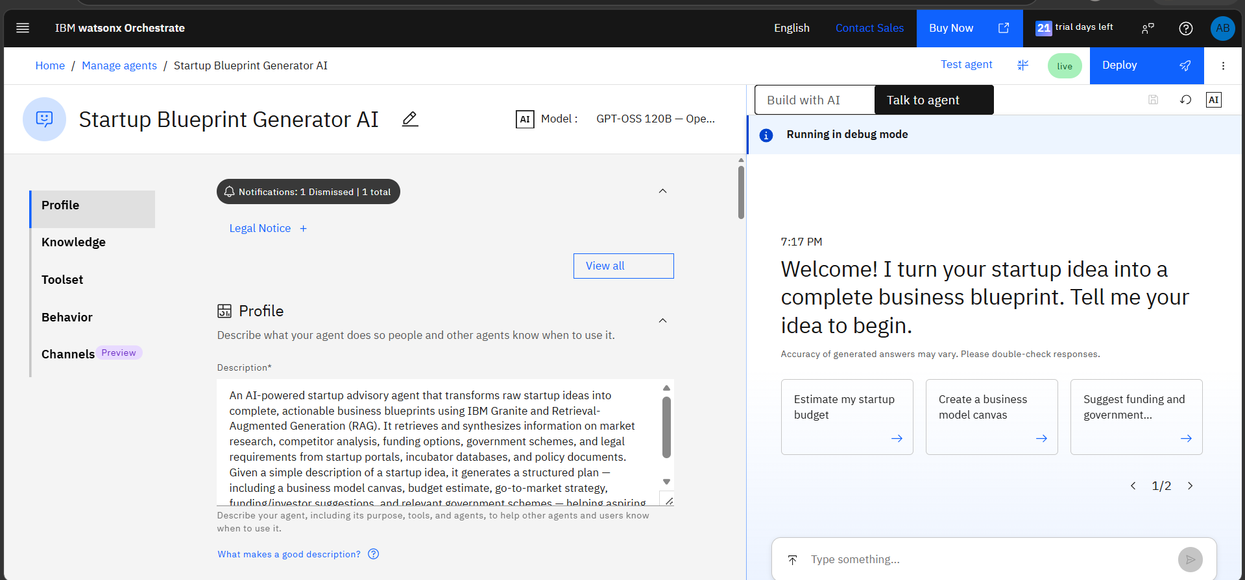

Slide 9
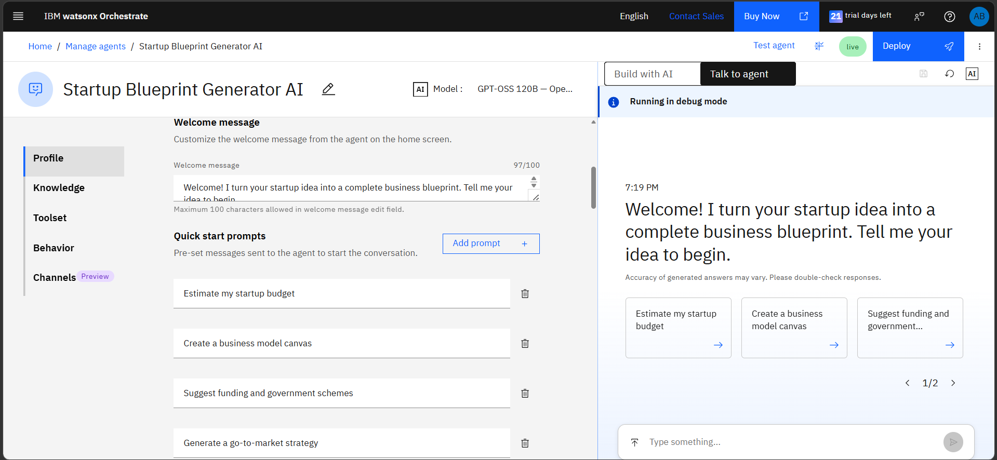
Welcome Message & Quick Start Prompt :

Slide 10
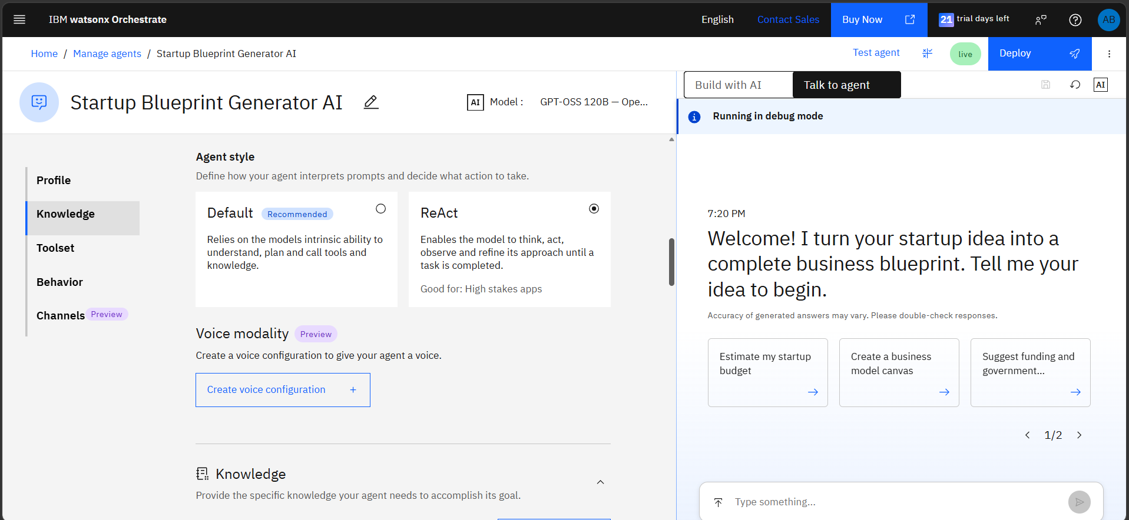

Slide 11
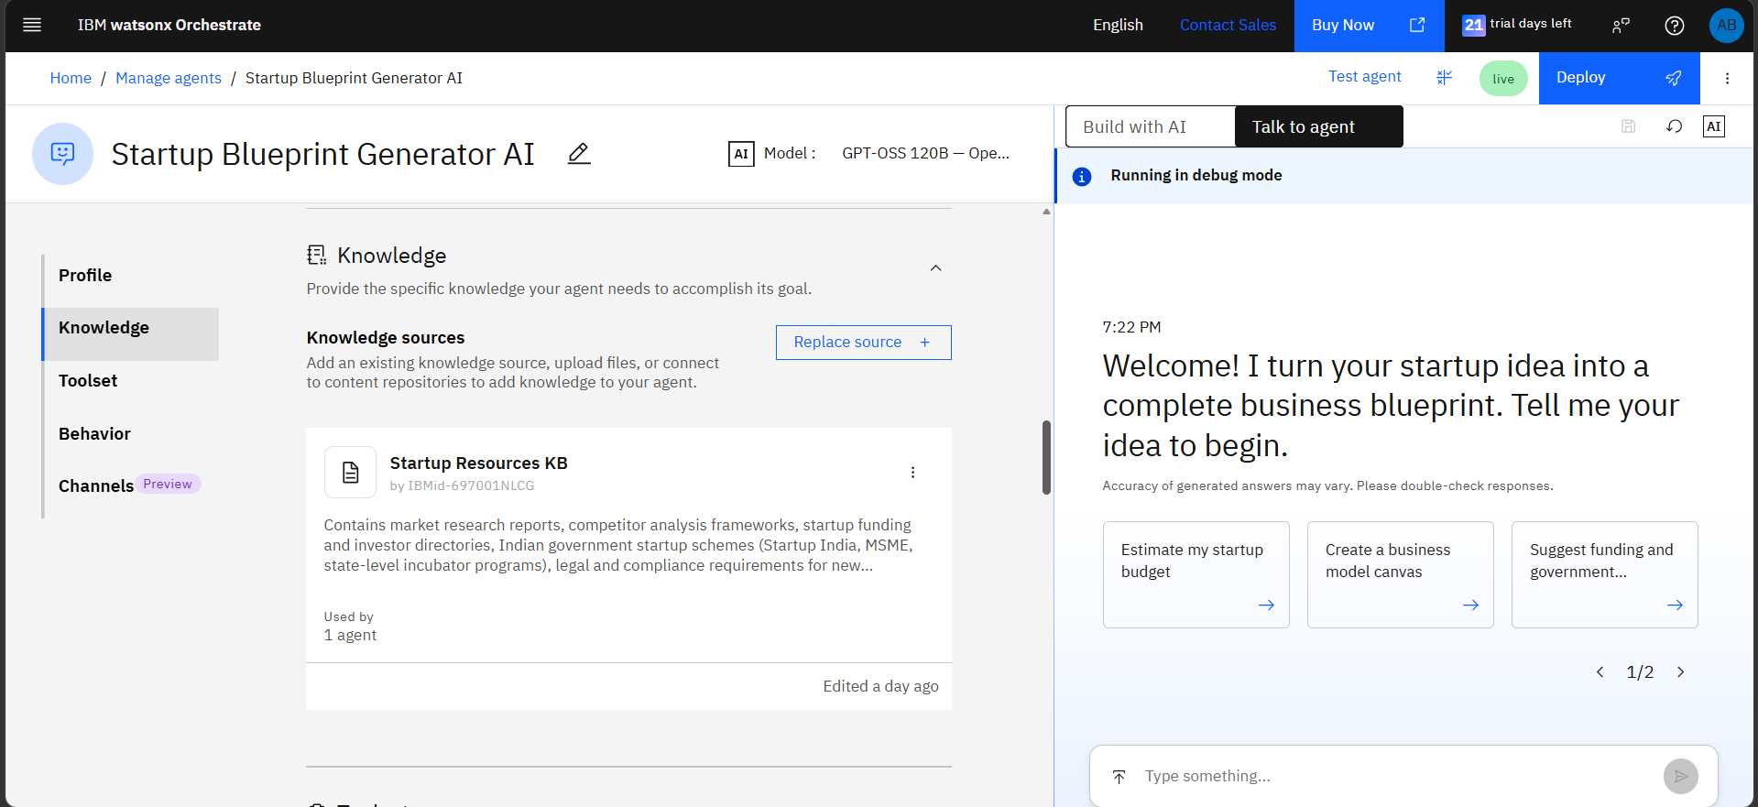

Slide 12
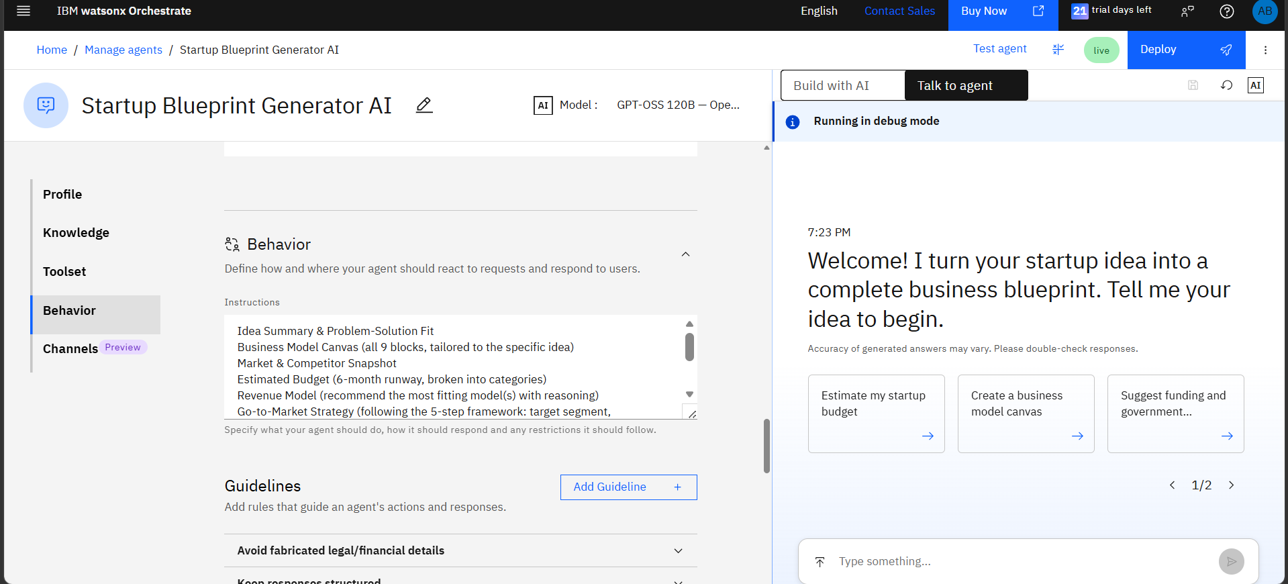

Slide 13
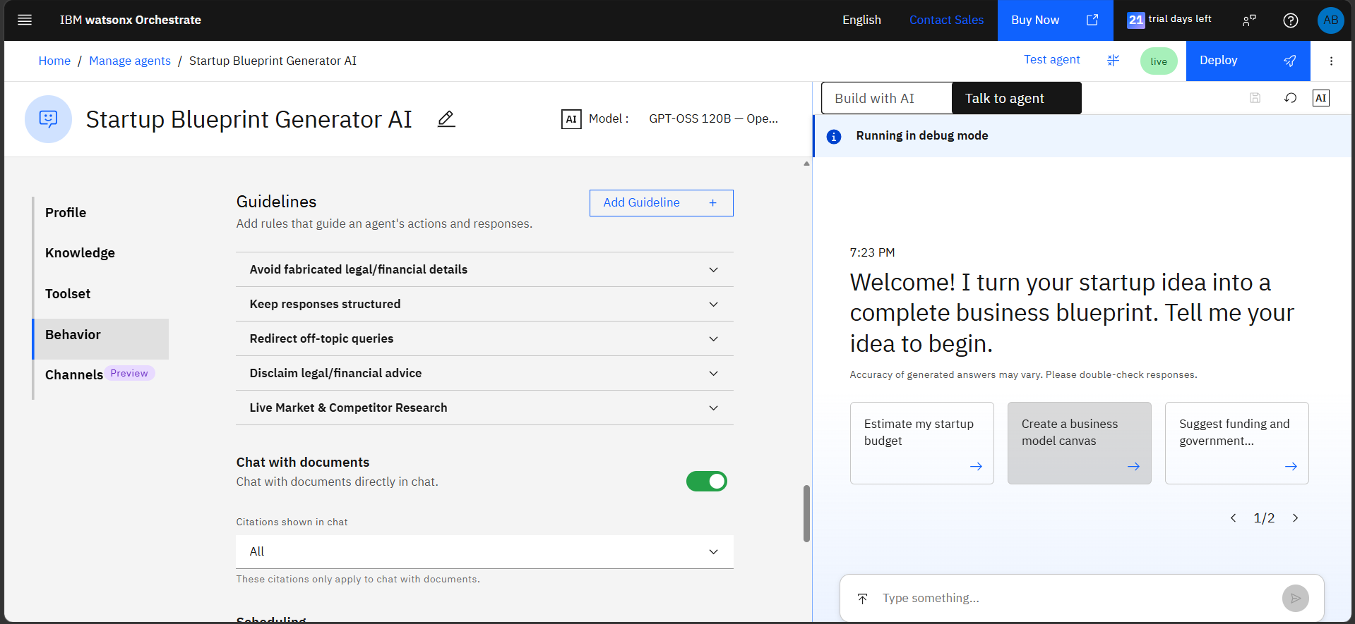

Slide 14
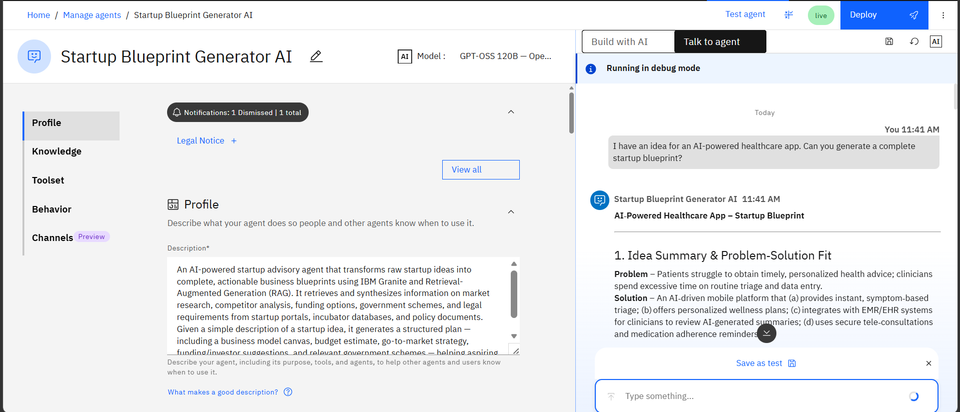
Test Agent:
·
·
·

Slide 15
Novelty and Uniqueness
The proposed Startup Blueprint Generator stands out by combining Agentic AI, RAG, and structured business planning into a single intelligent system.
Grounded RAG Accuracy – Retrieves real startup information from a curated knowledge base instead of relying purely on model memory, reducing fabricated schemes or investor names.
Structured Blueprint Output – Always generates a consistent 9-section business blueprint, not a loosely structured chat response.
Guideline-Governed Guardrails – Explicit rules prevent fabrication, enforce structure, and redirect off-topic queries.
Tool-Augmented Research – Integrates live web search for current market and competitor data alongside static knowledge.
India-Specific Context – Knowledge base is tailored to Indian startup schemes, MSME programs, and the DPIIT recognition process.
End-to-End Coverage – Goes beyond ideation to cover funding, legal compliance, and go-to-market planning in one flow.
Scalable & Enterprise-Ready – Built on IBM watsonx Orchestrate with IBM Granite models, ensuring reliability and governance.
This makes the solution a smart, adaptive, and proactive startup advisor, not just a static idea-to-text generator.

Slide 16
Git Hub Link
Create a public GitHub repository (enable Add README while creating) with format:
Paste your working GitHub URL here:
Link - https://github.com/anshulbhusal-gif/IBMEdunet
Upload these 4 files: 1) app.json 2) README 3) Problem Statement 4) Presentation ppt
·
·
·

Slide 17
Future Scope
1.Multi-Agent Collaboration for Deeper Analysis –
The system can be expanded into specialized collaborator agents—for market research, legal compliance, and investor matching—that work together under the main orchestrator, enabling deeper, more detailed analysis for each blueprint section.
2.Direct Investor & Incubator Matchmaking –
Enhancing the system with live integrations to incubator and investor databases would allow the agent to suggest, and eventually facilitate, warm introductions based on the startup’s sector, stage, and location, moving beyond static directory information.
3. Multi-Lingual Support Expanding the agent to understand and respond in regional Indian languages (Hindi, Marathi, etc.) would make it accessible to a much wider base of first-time entrepreneurs from non-English-speaking backgrounds, especially in Tier 2/3 cities.
·
·
·

Slide 18
4. Pitch Deck Auto-Generation
Beyond the text-based blueprint, the agent could generate a ready-to-present pitch deck (slides) summarizing the business model, market opportunity, and funding ask — saving founders additional manual work before investor meetings.
5. Real-Time Compliance Tracking
Integrating with government portals (like the Startup India DPIIT dashboard) could let the agent track a founder's actual registration/compliance status and proactively remind them of pending steps or deadlines,
6. Financial Projection Modeling
Adding a dedicated module for multi-year financial projections (revenue forecasts, break-even analysis, unit economics) would give founders a more investor-ready financial model beyond the initial 6-month budget estimate.
7. Community & Mentor Matching Connecting founders with a peer community or relevant mentors/advisors based on their sector and stage, using the existing incubator/investor knowledge base as a foundation for matchmaking.

Slide 19
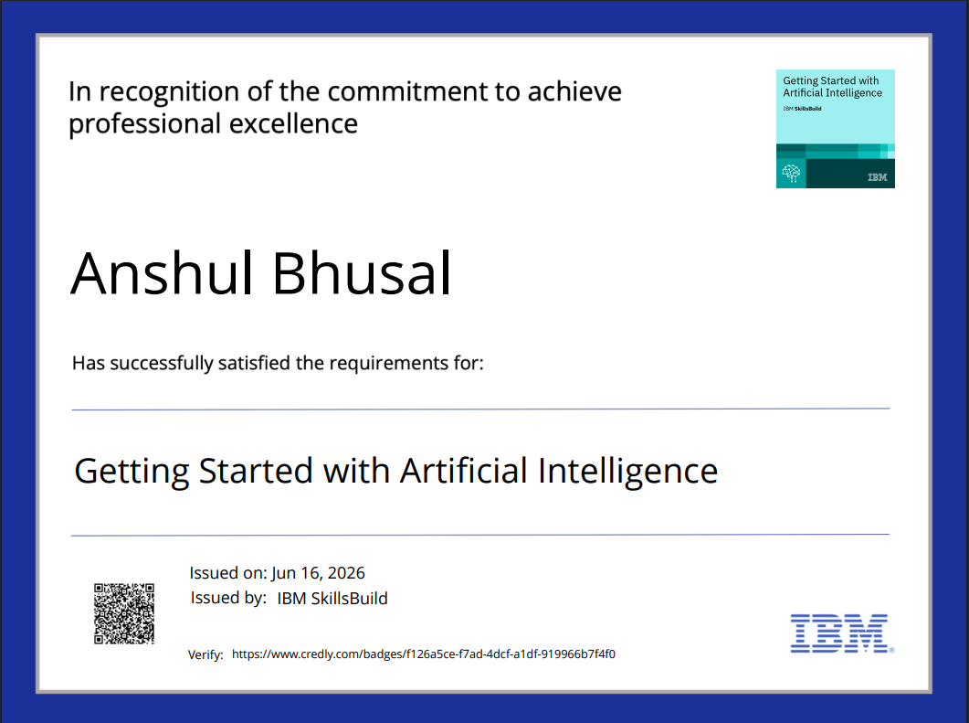
Certificates Earned:

Slide 20
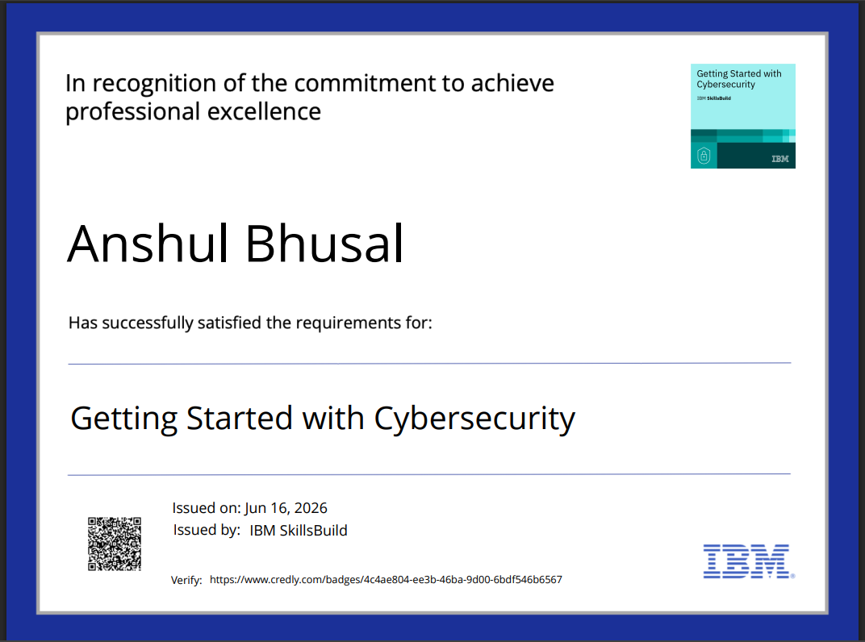

Slide 21
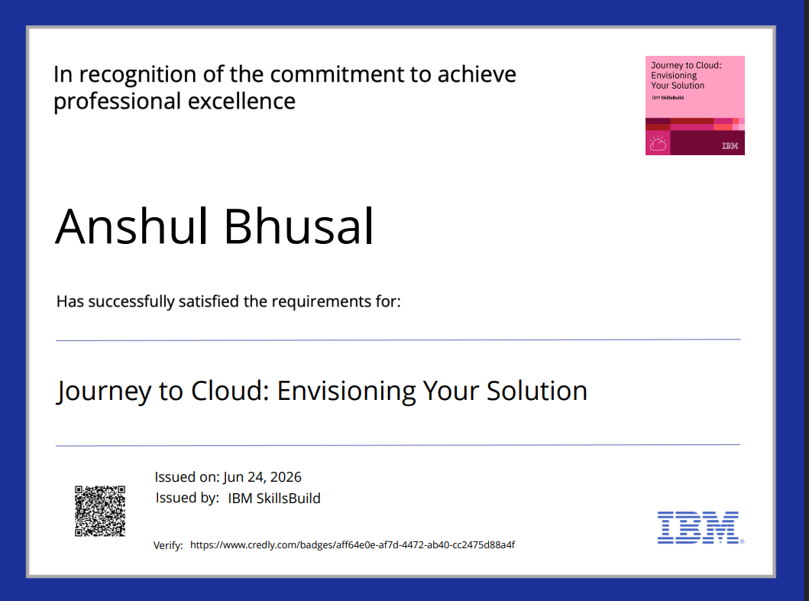

Slide 22
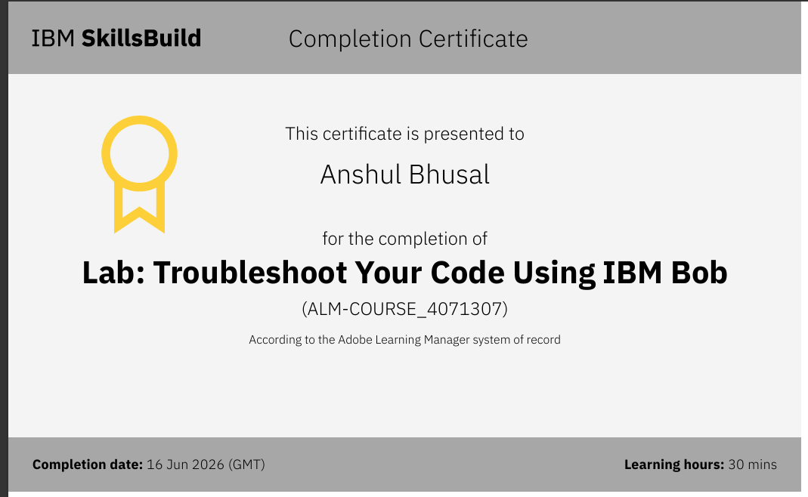
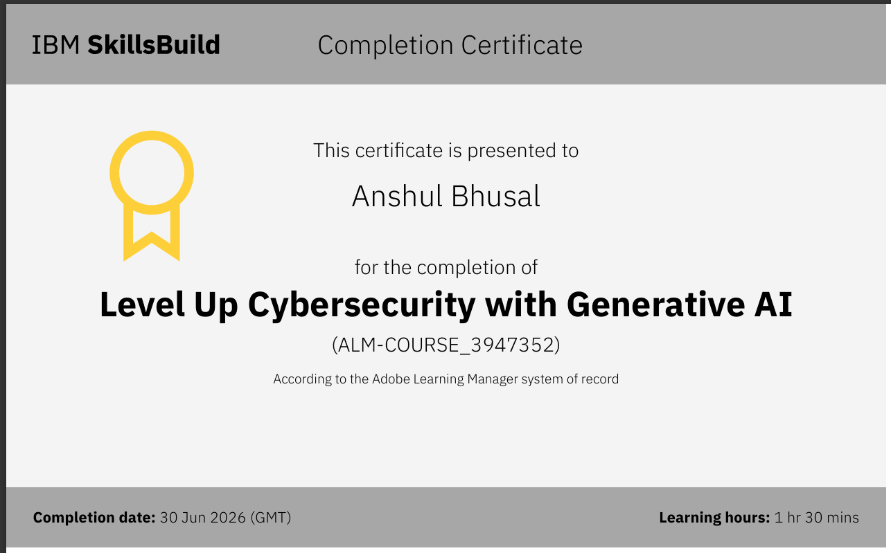
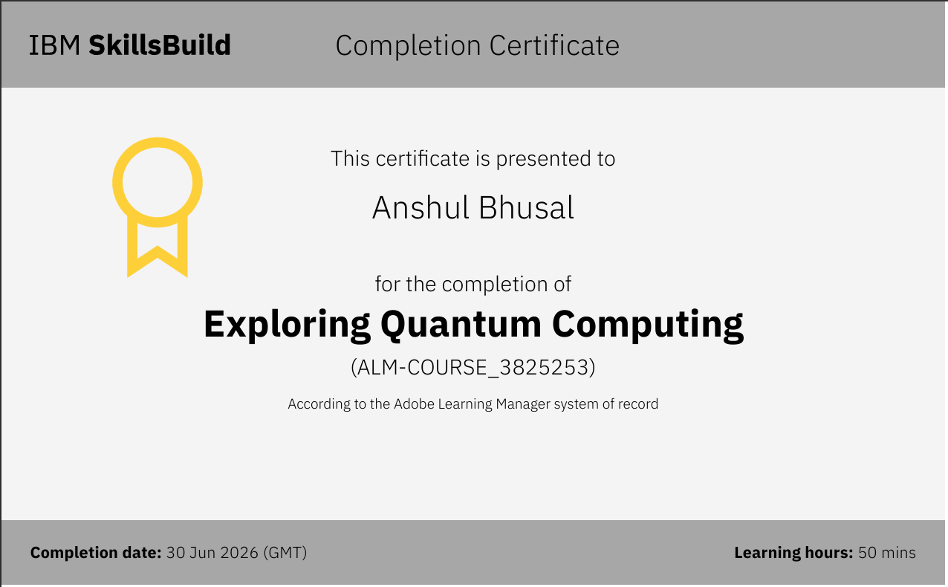
​

Slide 23


