Slide 1
All-Optical Digital-to-Analog Conversion Using Nonlinear Optical Loop Mirrors
ANSHUL SHAH

Slide 2
Introduction
Implementation of the paper All-Optical Digital-to-Analog Conversion Using Nonlinear Optical Loop Mirrors by Shoichiro Oda and Akhiro Maruta ( Osaka University )
Main Contributions of the paper :
An all optical DAC using Nonlinear Loop Mirrors
Can be applied to both standard and gray code

Slide 3
Why All Optical DAC ?
Break the inherent limitation of electronics
Benefits :
Header Processing Techniques
Provide ultra-high speed processing of optical labels
Can avoid optical-electronic-optical convertors thus reducing latency

Slide 4
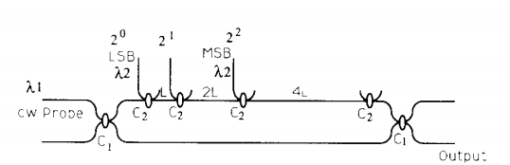
Other Methods
Saida et .al : Thermo-optic switch based DAC
Requires precise control of phase and time delays
Jeong and Marhic : NOLM based , using XPM
Output has a sine square dependence. Not linear for all ΔΦ and hence requires suitable biasing.
Maximum Length is walkoff length
Nishitani : using Pulse pattern recognition
Different correlation filter functions are applied to the duplicates.

Slide 5
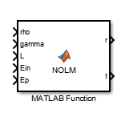
Non Linear Optical Loop Mirror Block
Pulse : Gaussian Pulse @ 1559 nm of pulsewidth 7ns
Pump : Trapezoid pulse @ 1553 nm of pulsewidth 20ns
Zero dispersion wavelength : 1556 nm
If the wavelength allocations of the control and probe pulses are symmetric with respect to the zero dispersion point and are of the same absolute value with the opposite sign, the control and probe pulses travel with the same group velocities, and the walk-off problem does not exist.
For the simulation, I have neglected the effects of dispersion in the fiber
Clockwise pulse travels along with the injected pump. Hence the CW and CCW pulse see each other for a very short time. Thus neglecting the cross phase modulation term due to that.

Slide 6





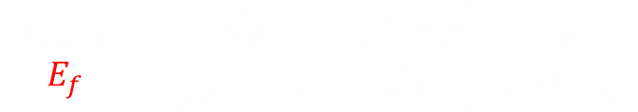


Deriving the Transfer function of NOLM
$$\left[\begin{matrix}E_{cw} \\ E_{ccw}\end{matrix}\right]=\left[\begin{matrix}√0.5 & j√0.5 \\ j√0.5 & √0.5\end{matrix}\right]\left[\begin{matrix}E_{in} \\ 0\end{matrix}\right]$$
$$E_{cw}=√0.5E_{in}$$
At the 3dB coupler
$$→$$
$$E_{ccw}=j√0.5E_{in}$$
Clockwise Wave
At the 10dB coupler
$$\left[\begin{matrix}E_{out 3} \\ E_{f}\end{matrix}\right]=\left[\begin{matrix}√ρ & j\sqrt{1−ρ} \\ j\sqrt{1−ρ} & √ρ\end{matrix}\right]\left[\begin{matrix}E_{p} \\ √0.5E_{in}\end{matrix}\right]$$
$E_{f}=$ $jE_{p}\sqrt{1−ρ}+E_{in}√ρ√0.5$
10
dB
OBPF
3
dB
At the end of loop
after OBPF
${E_{f}}^{′}=$ $E_{in}e^{j∅_{1}}e^{−αL/2}√ρ√0.5$
$$∅_{1}=γL\left(ρ∗0.5∗\left|{E_{in}|}^{2}∗0.9+2\right|{E_{p}|}^{2}∗\left(1−ρ\right)∗0.9\right)$$
$e^{−αL}$ ~ 0.9

Slide 7


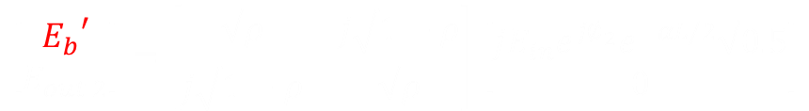

Deriving the Transfer function of NOLM
Anticlockwise Wave
At the 10dB coupler
$$\left[\begin{matrix}{E_{b}}^{′} \\ E_{out 2}\end{matrix}\right]=\left[\begin{matrix}√ρ & j\sqrt{1−ρ} \\ j\sqrt{1−ρ} & √ρ\end{matrix}\right]\left[\begin{matrix}jE_{in}e^{j∅_{2}}e^{−αL/2}√0.5 \\ 0\end{matrix}\right]$$
$${E_{b}}^{′}={jE}_{in}e^{j∅_{2}}e^{−αL/2}√0.5√ρ$$
$$∅_{2}=γL\left(0.5∗{\left|E_{in}\right|}^{2}∗0.9\right)$$
Output waves at 3dB coupler
10
dB
OBPF
3
dB
$$\left[\begin{matrix}E_{reflected} \\ E_{transmitted}\end{matrix}\right]=\left[\begin{matrix}j√0.5 & √0.5 \\ √0.5 & j√0.5\end{matrix}\right]\left[\begin{matrix}{E_{f}}^{′} \\ {E_{b}}^{′}\end{matrix}\right]$$
Assuming an additional 3dB coupler Loss at reflected

Slide 8
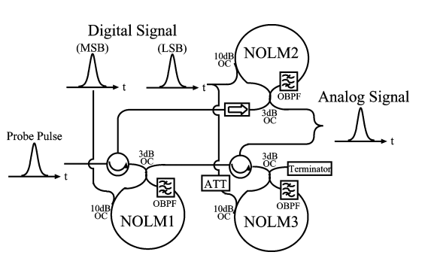
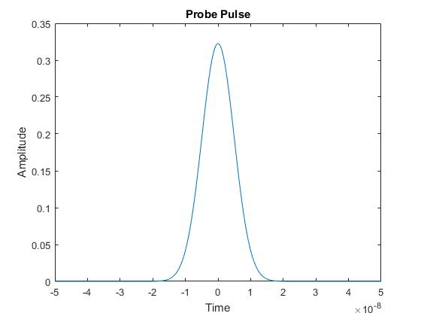
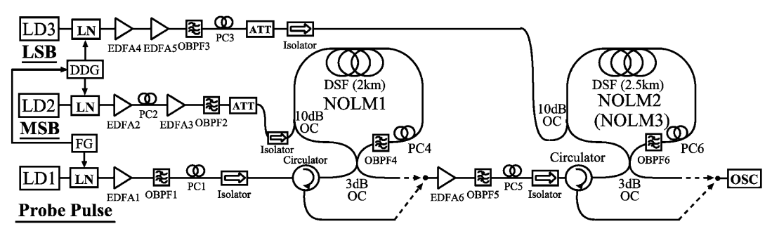
2bit DAC using Gray Code

Slide 9
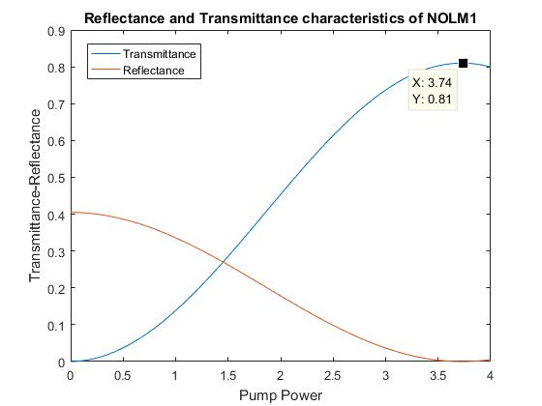
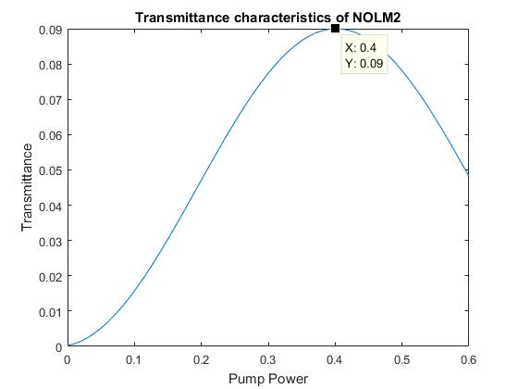
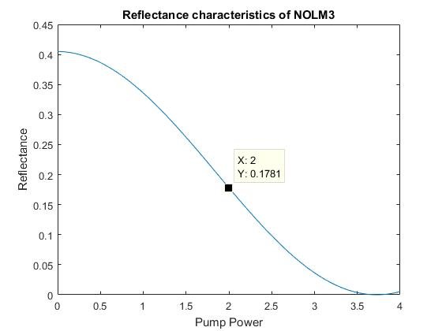






2 bit DAC using Gray Code
$$γ=2.1W^{−1}km^{−1}$$
$$NOLM1 : ρ=0.9 ;pump=3.74W$$
Standard DAC is made by utilizing
Loop unbalancing at zero pump
Pump power.
$$α=0.21dB/km$$
$$NOLM2 : ρ=0.1 ;pump=0.43W$$
$$NOLM3 : ρ=0.9 ;pump=2W$$
$$L=2km$$

Slide 10
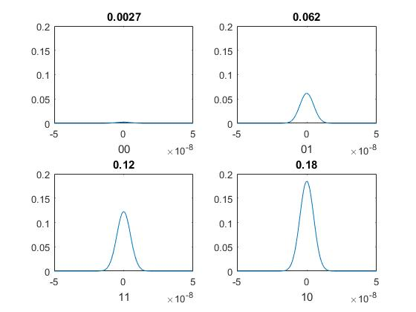
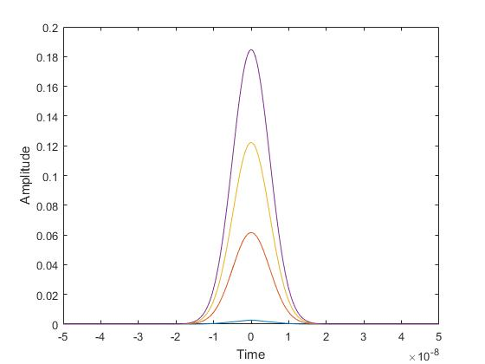
Simulation Results for 3bit DAC

Slide 11
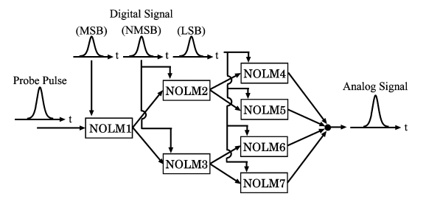
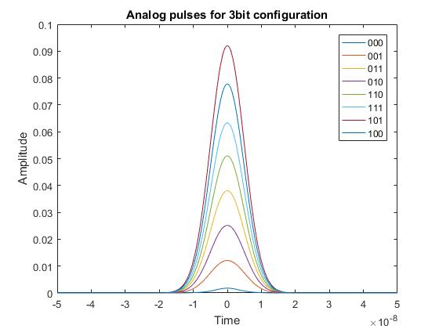
3 bit DAC
Was implemented in a method similar to 2bit DAC.
000 → 0
001 → 1
011 → 2
010 → 3
110 → 4 = 4 + 0
111 → 5 = 4 + 1
101 → 6 = 4 + 2
100 → 7 = 4 + 3

Slide 12
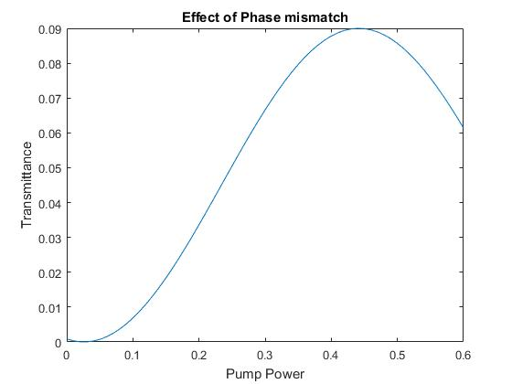

Some design Considerations for Simulation
The 10dB coupler : ρ
Influences the output powers in a drastic way due to 0.1/0.9 factor
Also changes the required switching power by ~9 times
Chose ρ = 0.9 for NOLM1 & NOLM3 and ρ = 0.1 for NOLM2
Effect of unbalanced phase due to input signal
Self-phase modulation terms are slightly unbalanced $0.5∗{|E_{in}|}^{2}$ vs $ρ∗0.5∗|{E_{in}|}^{2}$
This leads to some phase mismatch even at 0 pump power and hence more noisy analog output
To correct for this : offset the pump pulse signal by ~0.04W

Slide 13
Comparisons with the paper
Different power levels were used so the magnitudes differ, but the ratio comes out to be 0:1:2:3 for the 2bit DAC
The paper uses EDFAs to apply gains for the input signals and used ρ = 0.1 for all NOLMs. This led to smaller pump powers but the need for many EDFAs.
Assumed circulator loss to be 3dB and its effect is included in the NOLM
The paper does not clearly give the working principle of 3bit DAC. The approach used in simulation is one possible approach.
The reflectance and transmittance in paper are not calculated with input power reference. Graphs in the presentation, take the effect of losses into account while calculating R and T

Slide 14

Drawbacks of the design
Practical aspects like matching the probe and pump pulse arrival time, NOLM output delays and use of polarization controllers have to be taken care of when actually performing the experiment
The required number of NOLMs for n-bit DAC → $2^{N}−1$ which grows up very quickly
Adjusting the gains and attenuations as more bits are added is not a trivial task

Slide 15
References
Thank You!
Integrated optical digital-to-analogue converter and its application to pulse pattern recognition , Saida et. Al
All-optical analog-to-digital and digital-to-analog conversion implemented by a nonlinear fiber interferometer , Jeong and Marhic
Demonstration and Evaluation of All-optical Digltal-to-analog Conversion Using Pulse Pattern Recogntltlon Based on Optical Correlatlon Processing , Nishitani et. Al
Optical fiber loop mirror applications: A review , Ahmad Atieh
Nonlinear Fiber Optics , Govind Agrawal

