Slide 1
Data science Malignant Comments classification
Submitted by:
Anshul Dubey

Slide 2
Business Problem Framing & Conceptual Background of the Domain Problem
Problem Statement: Our goal is to build a prototype of online hate and abuse comment classifier which can used to classify hate and offensive comments so that it can be controlled and restricted from spreading hatred and cyberbullying.
Multilabel Classification: In multi-label classification, data can belong to more than one label simultaneously.
Internet comments are bastions of hatred and vitriol. While online anonymity has provided a new outlet for aggression and hate speech, machine learning can be used to fight it. The problem we sought to solve was the tagging of internet comments that are aggressive towards other users. This means that insults to third parties such as celebrities will be tagged as unoffensive, but “u are an idiot” is clearly offensive

Slide 3
Analytical Problem Framing
I have used the TF-IDF to vectorize the words so that machine can understand the words.
1. TF – Term Frequency (the number of times the words/terms appear in a document.)
2. IDF - Inverse Document Frequency. (If a word appears in all documents, then it may not play such a big part in differentiating between the documents. IDF is a way of identifying such words)
Document Frequency(term t) = number of documents with the term t/ total number of documents = d(t)/n
Inverse Document Frequency = total number of documents / number of documents with the term t = n / d(t)

Slide 4
Data Set
The data set includes:
Malignant: It is the Label column, which includes values 0 and 1, denoting if the comment is malignant or not.
Highly Malignant: It denotes comments that are highly malignant and hurtful.
Rude: It denotes comments that are very rude and offensive.
Threat: It contains indication of the comments that are giving any threat to someone.
Abuse: It is for comments that are abusive in nature.
Loathe: It describes the comments which are hateful and loathing in nature.
ID: It includes unique Ids associated with each comment text given.
Comment text: This column contains the comments extracted from various social media platforms.

Slide 5
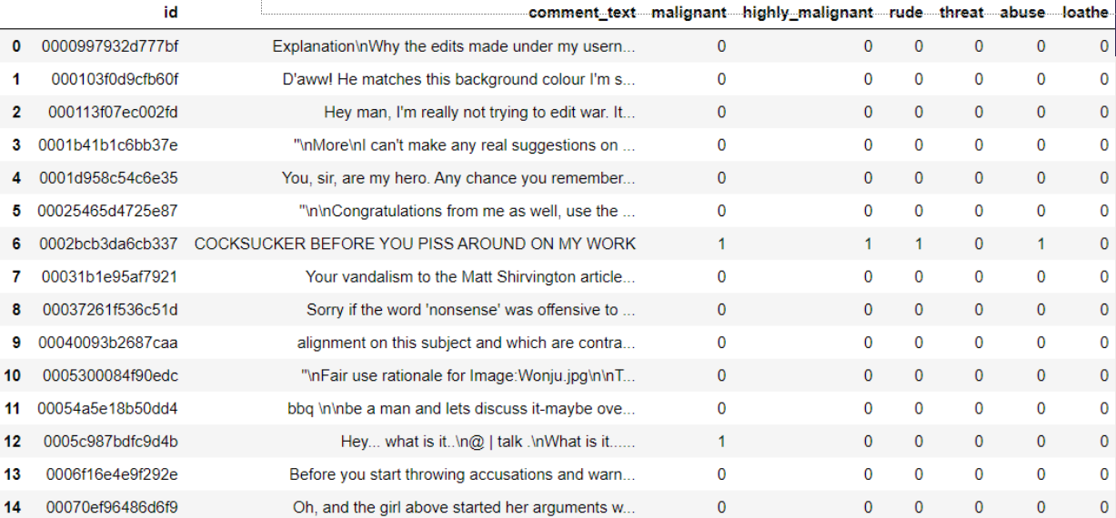
Data Set This is a snapshot of the first 15 rows of the training set. There are 159571 such rows.

Slide 6
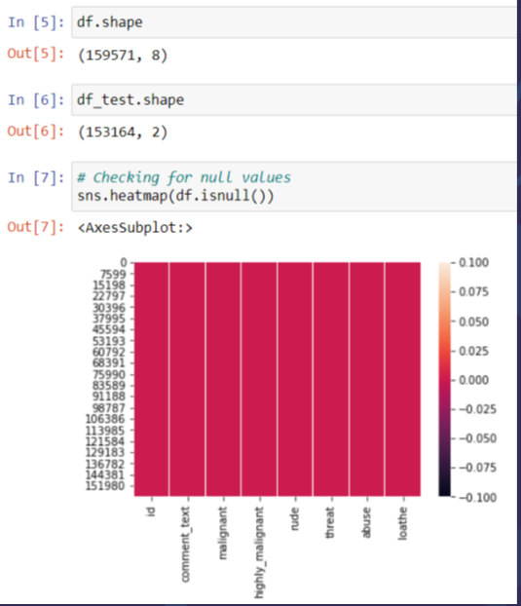
Checking for Null Values in the dataset
The heatmap shows there are no null values in the collected dataset

Slide 7
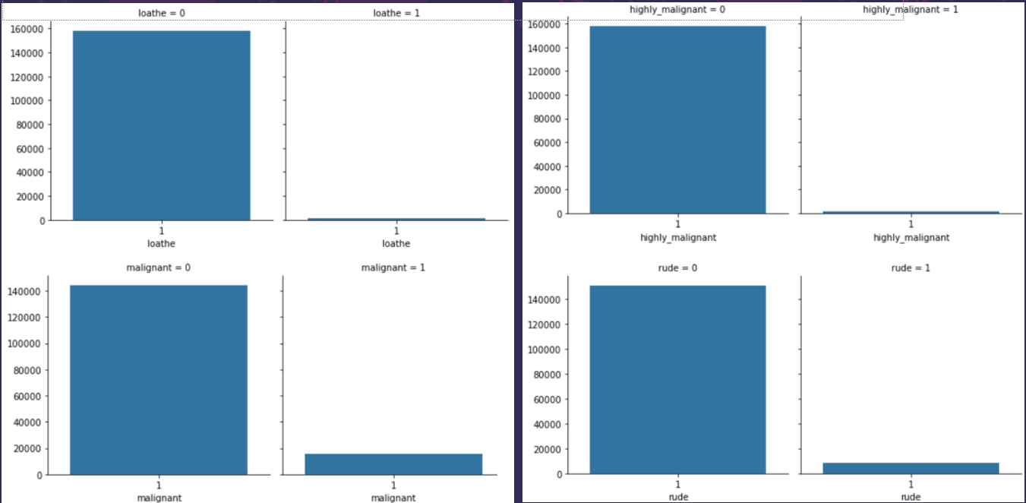
Exploratory Data Analysis (EDA)

Slide 8
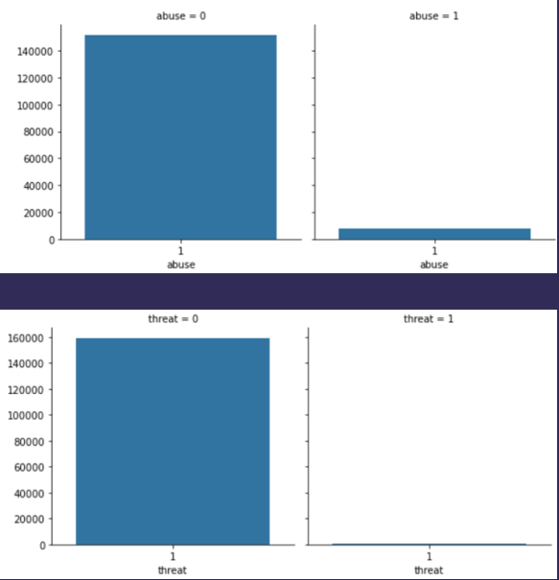
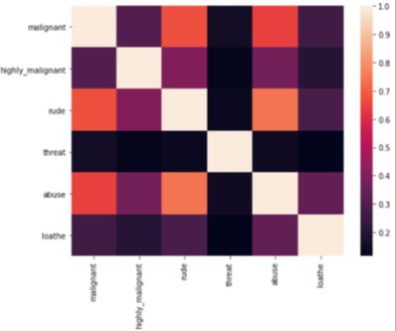
EDA

Slide 9
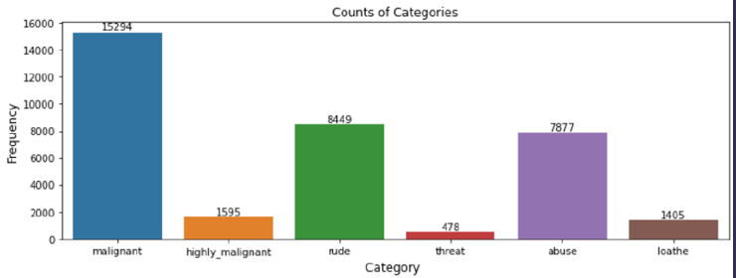
Categories

Slide 10
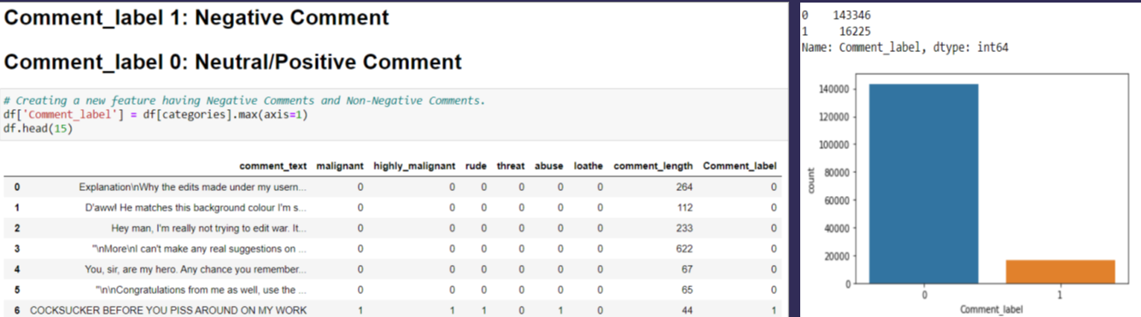
Added New Feature – Comment Label

Slide 11
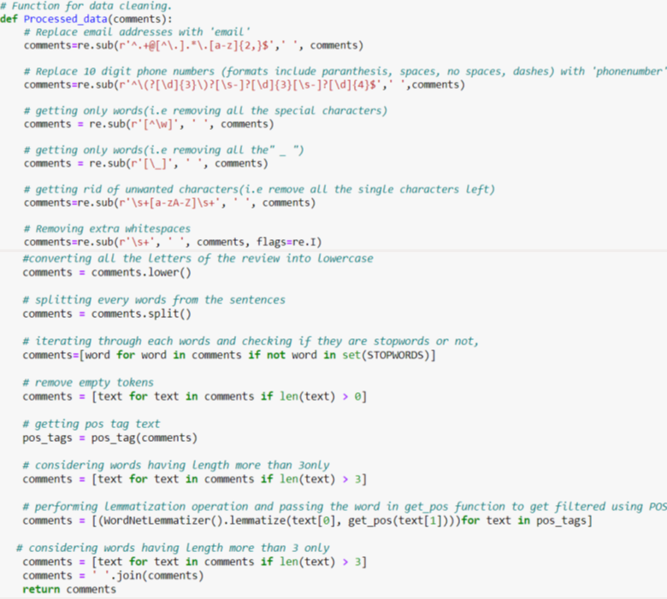
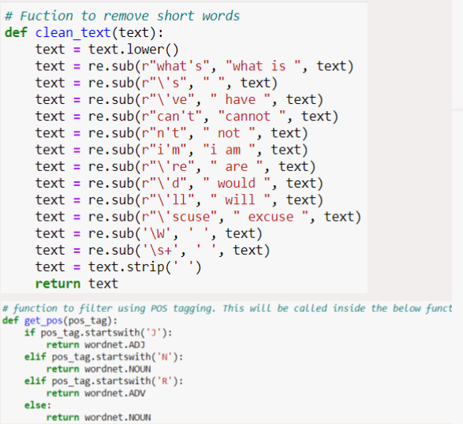
Pre-processing the comments for faster and accurate predictions

Slide 12
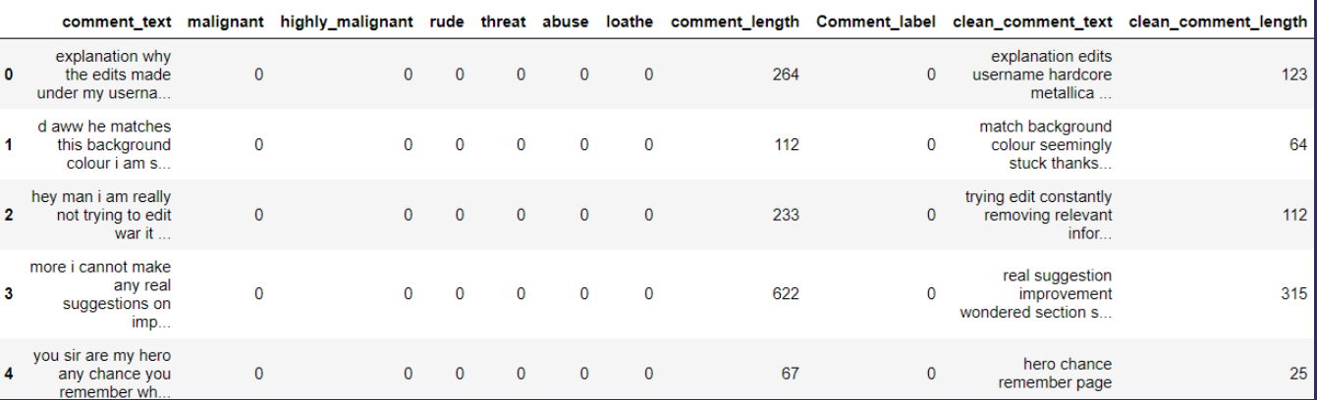
Final Processed Data
The “clean comment text” feature has a notable reduction in the number of characters.

Slide 13
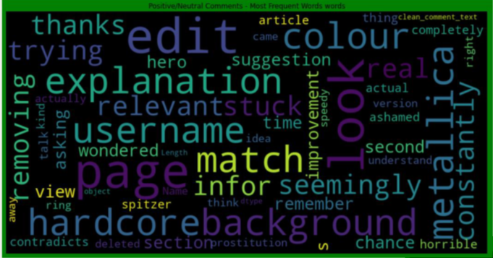
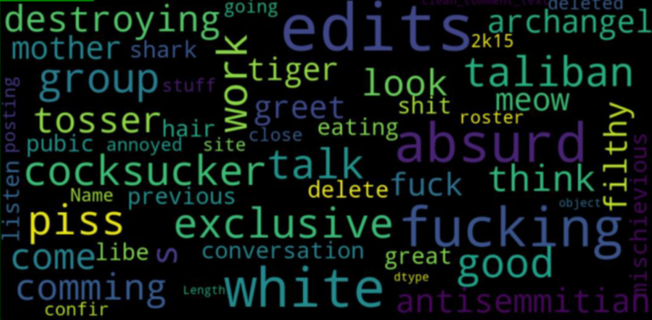
Word-Clouds

Slide 14
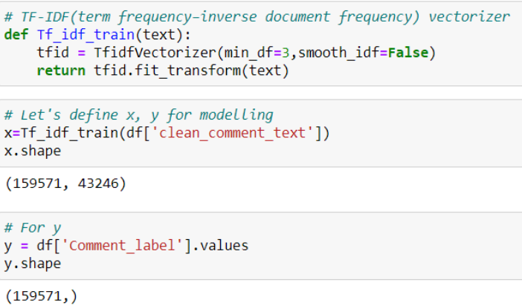
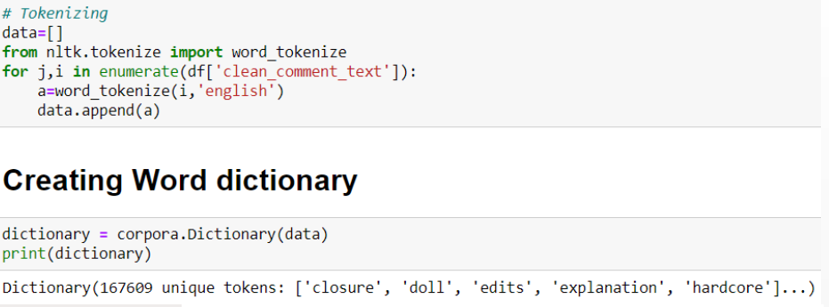
Preparing Dictionary & Vectorization

Slide 15
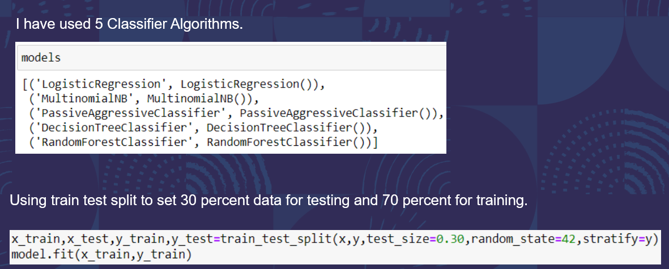
Model Building

Slide 16
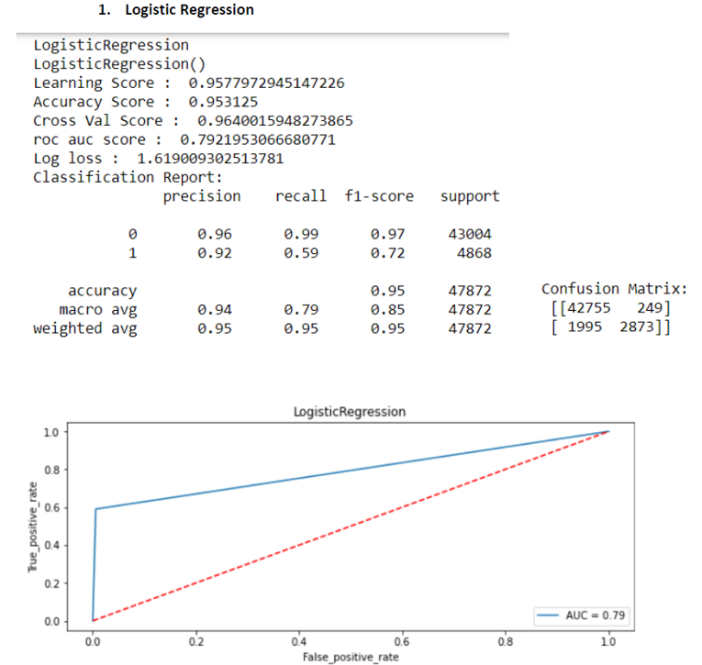
Logistic Regression

Slide 17
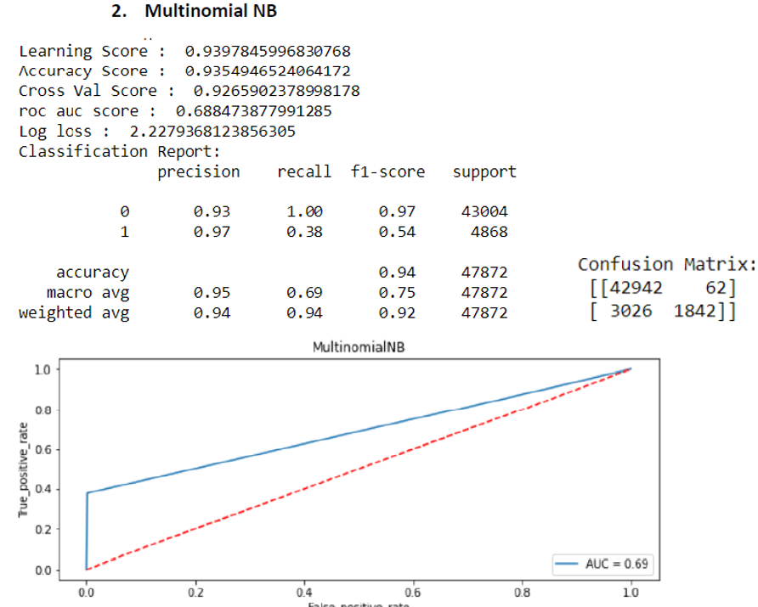
Multinomial NB

Slide 18
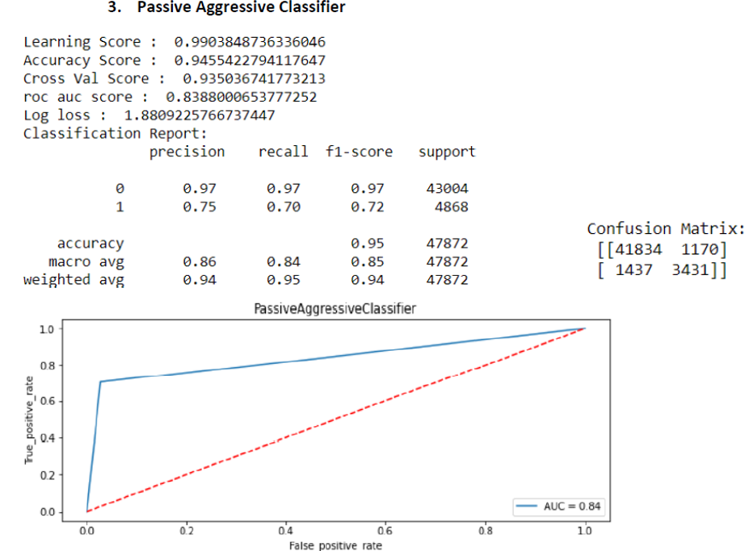
Passive Aggressive Classifer

Slide 19
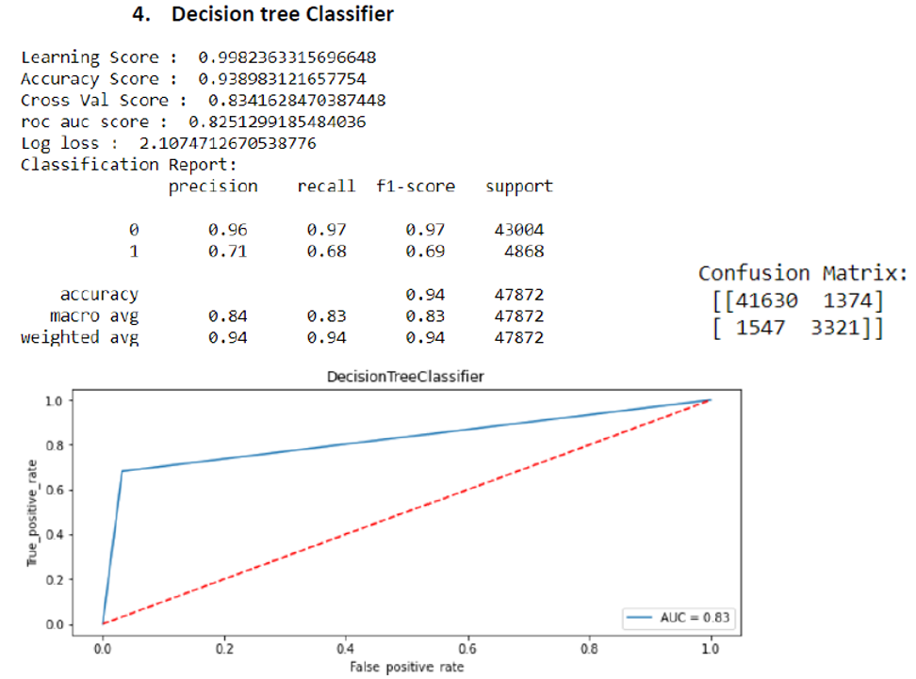
Decision Tree Classifier

Slide 20
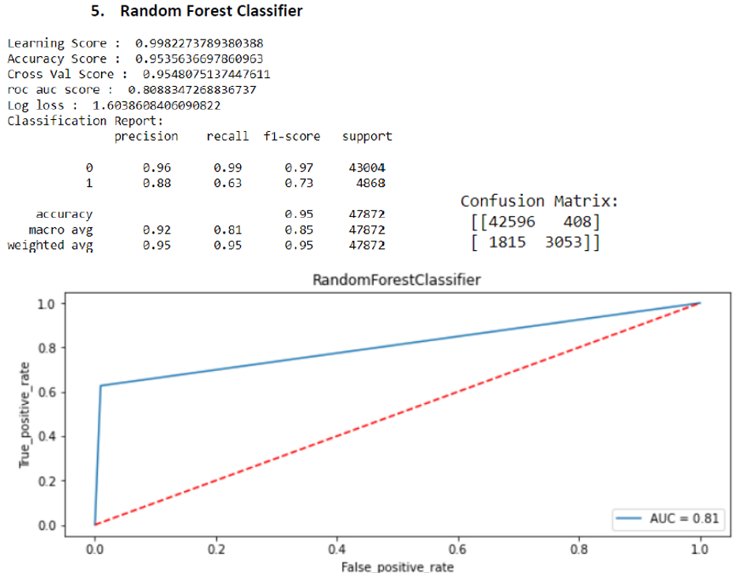
Random Forest Classifier

Slide 21
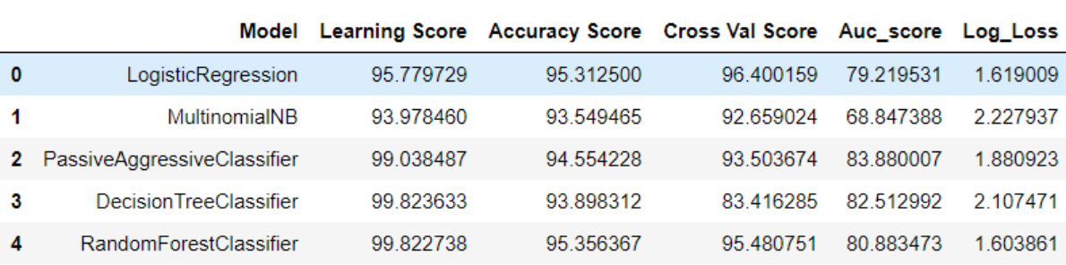
Summary of all Models:
After having a look at all the 5-model performance,
I have selected Random Forest Classifier as the final model
as it has the minimum log loss and highest accuracy score.
All other metrics are also good for Random Forest Classifier

Slide 22
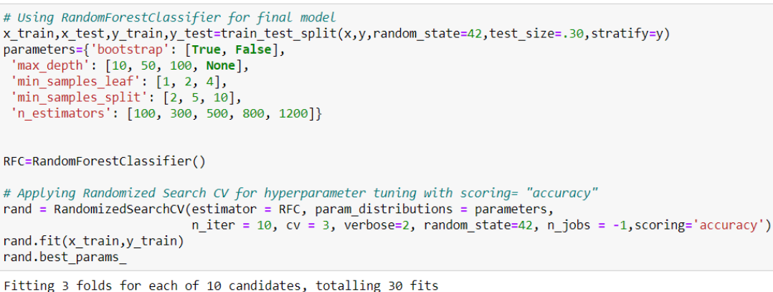
Final Model <Random Forest>

Slide 23
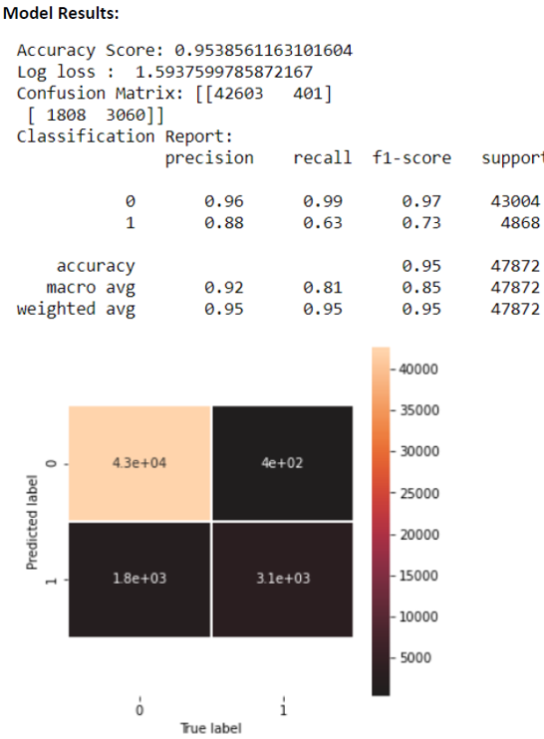
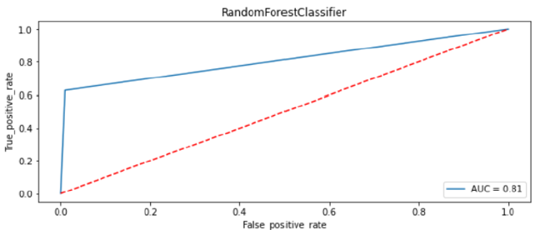
Model Performance

Slide 24
Conclusion
Using a Random Forest Model, I have successfully predicted the comments given in the test data to be Negative vs Non-Negative (Positive and Neutral).
Limitations:
Some of the limitations can be:
The model might not be able to understand sarcasm.
Sometimes non-negative comments can be wrongly classified as negative ones, leading to loss of constructive feedback or comments.

