Slide 1

Floyd-Warshall Algorithm using CUDA and PyBind11
Anshul Devnani ECE 277 Fall 2023

Slide 2
Introduction
The Floyd-Warshall an APSP algorithm. It's used for finding the shortest paths in a weighted graph. It considers all pairs of vertices in the graph and updates the shortest path between every pair if a shorter path is found.
O(n^3) runtime , O(n^2) – space complexity
Purpose: Investigate whether implementing the Floyd-Warshall algorithm on CUDA GPUs yields a speedup compared to a CPU implementation.

Slide 3
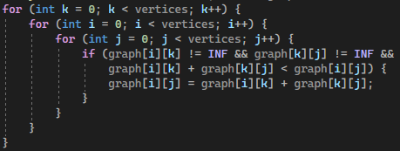
CPU implementation
The algorithm uses three nested loops to iterate over all pairs of vertices (i, j) and an intermediate vertex k.
The outer loop (for (int k = 0; k < vertices; k++)) iterates over all vertices, considering each vertex as a potential intermediate vertex.
The middle loop (for (int i = 0; i < vertices; i++)) represents the source vertex.
The inner loop (for (int j = 0; j < vertices; j++)) represents the destination vertex.
The if statement checks whether there is a shorter path from vertex i to vertex j through the intermediate vertex k
The algorithm continues to iterate through all possible pairs of vertices and intermediate vertices until all shortest paths have been found.

Slide 4
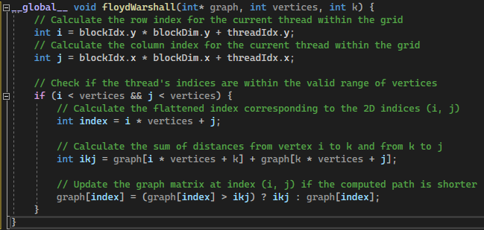

Naïve GPU implementation
Not fully parallel
K+1 iteration of algorithm is dependent on the Kth iteration
Naïve approach
The algorithm is divided into a series of CUDA kernels, each responsible for updating a subset of the graph matrix.
Each thread within a block handles the computation for a specific pair of vertices.
The CUDA kernel is launched in a loop over all possible intermediate vertices.
Each iteration corresponds to one step in the Floyd-Warshall algorithm, updating distances through the chosen intermediate vertex.
This approach is faster than CPU implementation but not optimal

Slide 5
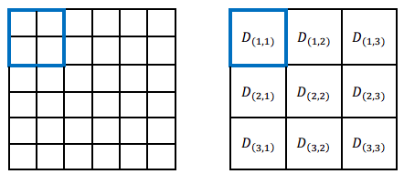
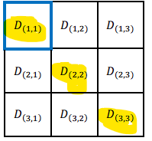
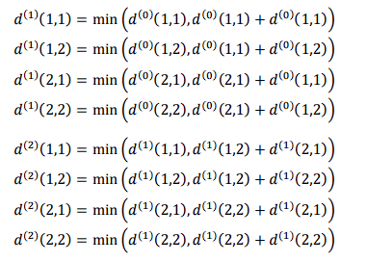

Blocked GPU implementation
Naïve approached can be optimized even further by using blocked approach – much better runtime
Divide the adjacency matrix into blocks and iterate over:
$floor (number_of_vertices + block_dim⁡– 1) / block_dim⁡$ times
6 + 2 – 1 / 2 = floor(3.5) = 3 times
3 phase approach
Phase 1 – Self Dependent Phase
In the 𝐾-th iteration, the 1st phase is to compute 𝐵 × 𝐵 pivot block $D_{K,K}^{(K∗B)}$
Essentially compute Floyd Warshall Algorithm for all blocks down the diagonal
However, can't be done in parallel since need k iteration computed in order to do k+1 computation
Images taken from https://ocw.nthu.edu.tw/ocw/upload/news_attach/482/10710%E5%91%A8%E5%BF%97%E9%81%A0%E6%95%99%E6%8E%88_%E5%B9%B3%E8%A1%8C%E7%A8%8B%E5%BC%8F%E8%A8%AD%E8%A8%88%E4%BD%9C%E6%A5%AD_HW4_rev3.pdf

Slide 6
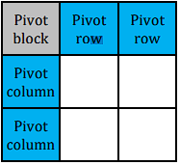
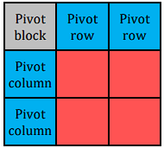
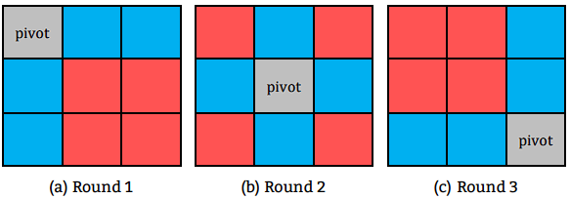

Blocked GPU implementation
3 phase approach
Phase 2 – Compute Row and Column Blocks from the diagonal block
In the 𝐾-th iteration, it computes all $D_{K,h}^{(K∗B)}$and $D_{h,K}^{(K∗B)}$ where ℎ ≠ 𝐾.
Essentially compute FW for the kth row and the kth column of blocks
Phase 3 – Compute all other block
In the 𝐾-th iteration, it computes all $D_{(h_{1}),(h_{2})}^{(K∗B)}$where ℎ_1 and h_2 ≠ 𝐾.
Essentially compute FW for all other blocks
There are 3 total iterations in this example
Images taken from https://ocw.nthu.edu.tw/ocw/upload/news_attach/482/10710%E5%91%A8%E5%BF%97%E9%81%A0%E6%95%99%E6%8E%88_%E5%B9%B3%E8%A1%8C%E7%A8%8B%E5%BC%8F%E8%A8%AD%E8%A8%88%E4%BD%9C%E6%A5%AD_HW4_rev3.pdf

Slide 7
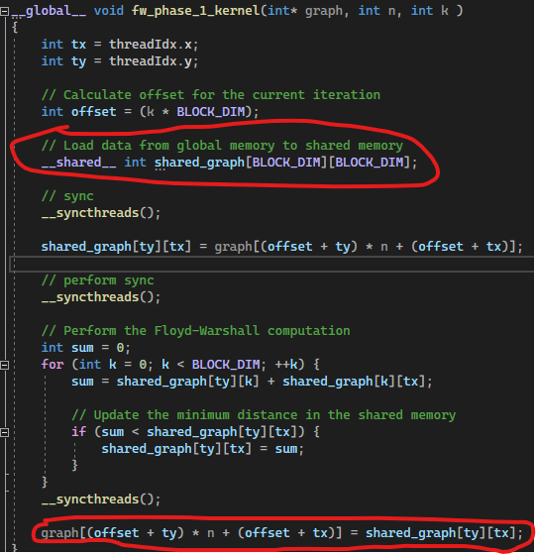
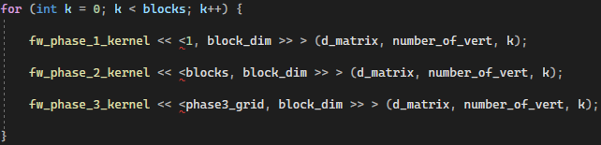
Blocked GPU implementation
Kernel Call
Additional optimizations
Because FW is a memory bound application, faster memory access is very beneficial
Shared memory in all phases
Load each sub graph so all threads can have quick access to the data (TB/s vs GB/s)
Do computation with the shared memory object
Then copy back into global memory

Slide 8
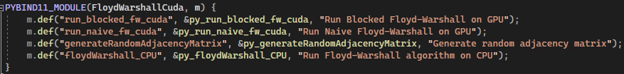
Using Pybind11
4 functions wrapped with pybind11
Profile.py
Python script to profile the CPU / Naive / Blocked approaches to FW Algo
Used to gather results in the next slides
Explained in depth in the Demo

Slide 9
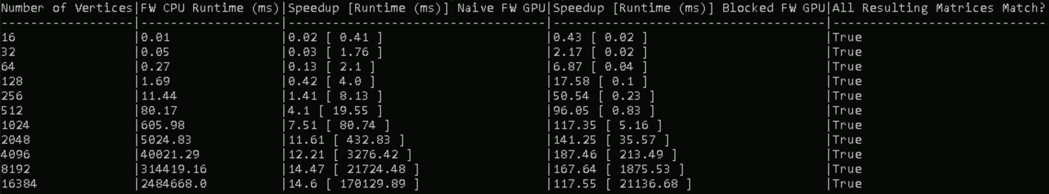
Experiments / Results
2 Experiments
Measure speedup and runtime between the CPU approach vs the naïve/blocked GPU approach’s with varying the number of vertices but keeping block size constant (16)
Measure speedup between the CPU approach vs the block GPU approach with varying the block size but keeping number of vertices at 2048
How was time measured?
CPU – std::chrono
GPU – cudaEvents (start and stop)
Only measures computation time, does not consider memory transfer time on GPU
Used ITS-E4309-02
GPU: NVIDIA RTX A2000
CPU: i7-11700k
# Vertices | Block Size | Speed Up over CPU
2048 | 4 | ~37 times
2048 | 8 | ~98 times
2048 | 16 | ~381 times
2048 | 32 | ~558 times
2048 | 64 | ~ 27218 times

Slide 10
References
https://cse.buffalo.edu/faculty/miller/Courses/CSE633/Asmita-Gautam-Spring-2019.pdf
https://ieeexplore.ieee.org/document/9066330
https://saadmahmud14.medium.com/parallel-programming-with-cuda-tutorial-part-4-the-floyd-warshall-algorithm-5e1281c46bf6
https://arxiv.org/abs/1811.01201
https://dl.acm.org/doi/pdf/10.1145/3431379.3460651

Slide 11
Demo! * Please look at README to run code

