Slide 1

What is RDBMS?

Slide 2
What is RDBMS?
A Relational Database management System is a database management system.
First published by E.F. Codes in 1970.
RDBMS is used to manage Relational database.
It is a collection of organized set of tables from which data can be accessed easily.
In RDBMS, each table has its own primary key.
Today almost all RDBMS (MSSQL, MySQL, Oracle, Infomix, Sybase, MS Access) uses SQL.
SQL is a query language used for storing and managing data in RDBMS.
SQL is used to perform all type of data operations in RDBMS.
Page 2

Slide 3
Why RDBMS?
In traditional approach, information is stored in flat files.
Application programs go through the file system to access these flat files.
Drawbacks of Traditional Approach:
Unable to achieve Data Safety
Concurrent Access
Fault Tolerance
Data Integrity
Reporting
Page 3

Slide 4
RDBMS Language

Slide 5
RDBMS Language
DDL – Data Definition Language
DML – Data Manipulation Language
DCL – Data Control Language
TCL – Transactional Control Language
Page 5

Slide 6
Data Definition Language

Slide 7
Data Definition Language
DDL is abbreviation of Data Definition Language.
It is used to create and modify the structure of database objects in database.
CREATE – Creates objects in the database.
ALTER – Alters objects of the database.
DROP – Deletes objects of the database.
TRUNCATE – Deletes all records and resets table to initial stage.
Page 7

Slide 8
Data Manipulation Language

Slide 9
Data Manipulation Language
DML is abbreviation of Data Manipulation Language.
It is used to retrieve, store, modify, delete, insert and update data in database.
SELECT – Retrieves data from a table.
INSERT – Inserts data into a table.
UPDATE – Updates existing data into a table.
DELETE – Deletes all records from a table
Page 9

Slide 10
Data Control Language

Slide 11
Data Control Language
DCL is abbreviation of Data Control Language.
It is used to create roles, permissions, and referential integrity
It is also used to control access to database by securing it.
GRANT – Gives user’s access privileges to database.
REVOKE – Withdraws user’s access privileges.
Page 11

Slide 12
Data Transactional Language

Slide 13
Data Transactional Language
TCL is abbreviation of Transactional Control Language.
It is used to manage different transactions occurring within a database.
COMMIT – Saves work done in transactions.
ROLLBACK – Restores database to original state since the last COMMIT command.
SAVE TRANSACTION – Sets a SAVEPOINT within a transaction.
Page 13

Slide 14
Data Types in SQL Server

Slide 15
Data Types in SQL Server
String:
Char(n) – Fixed Non-Unicode
Varchar(n) – Variable Non-Unicode
nChar(n) – Fixed Unicode
nVarchar(n) – Variable Unicode
Number:
Int, biginit, smallint and tinyint
Decimal and numeric
Float and real
Money and smallmoney
Page 15

Slide 16
Data Types in SQL Server
DateTime
Date
Time
DateTime
DateTime2
SmallDateTime
Unique Identifier
Page 16

Slide 17
Normalization

Slide 18
What is Normalization?
Normalization is the process of organizing data to avoid duplication and redundancy.
01
Ensures that each individual
data item is stored only once.
Prevents invalid or inconsistent
data after modification.
02
03
“Decomposes” database into
smaller tables.
Stops one column from
containing multiple values.
04
Avoid repeating groups i.e. tables
into tables.
05
Helps with good database design.
06
Page 18

Slide 19
Advantages of Normalization
Better Database Organization
More tables with smaller rows.
Efficient data access.
Greater Flexibility for Queries.
Quickly find the information.
Easier to implement Security.
Allows easy modification.
Reduction of redundant and duplicate data
More Compact Database.
Ensure Consistent data after modification.
Page 19

Slide 20
Normal Forms

Slide 21
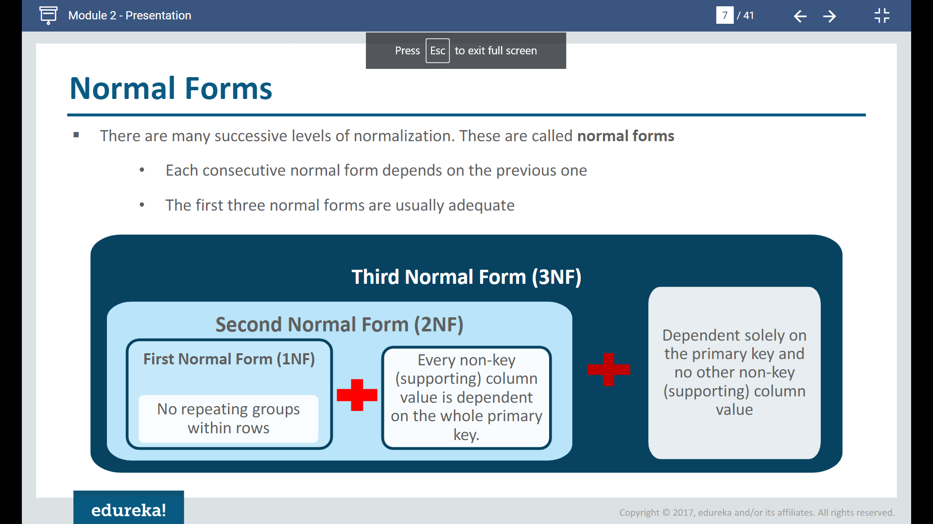
Normal Forms
There are many successive levels of normalization. These are called normal forms.
Each consecutive normal form depends on the previous one.
The first three normal forms are usually adequate.
Page 21

Slide 22
First Normal Form (1NF)
As per First Normal Form, no two Rows of data must contain repeating group of information i.e. each set of column must have a unique value, such that multiple columns cannot be used to fetch the same row.
Each table should be organized into rows, and each row should have a primary key that distinguishes it as unique.
For example: consider a table which is not in First normal form named as Student table:
Student | Age | Subject
Oliver | 15 | Biology, Maths
James | 14 | Maths
Alex | 17 | Maths
Page 22

Slide 23
First Normal Form (1NF)
In First Normal Form, any row must not have a column in which more than one value is saved, like separated with commas.
We must separate such data into multiple rows.
Student | Age | Subject
Oliver | 15 | Biology
Oliver | 15 | Maths
James | 14 | Maths
Alex | 17 | Maths
Student Table following 1NF will be:
Using the first Normal Form, data redundancy increases, as there will be many columns with same data in multiple rows but each row as a whole will be unique.
Page 23

Slide 24
Second Normal Form (2NF)
In the Second Normal Form there must not be any partial dependency of any column on primary key.
It means that for a table that has concatenated primary key, each column in the table that is not part of the primary key must depend upon the entire concatenated key for its existence.
If any column depends only on one part of the concatenated key, then the table fails Second normal form.
In example of First Normal Form there are two rows for Oliver, to include multiple subjects that he has opted for. While this searchable, and follows first normal form, it is an inefficient use of space. Also in the above Table in First Normal Form, while the candidate key is {Student, Subject}, Age of Student only depends on Student column, which is incorrect as per Second Normal Form.
Page 24

Slide 25
Second Normal Form (2NF)
New Student Table following 2NF will be:
Student | Age
Oliver | 15
James | 14
Alex | 17
In Student Table the candidate key will be Student column, because all other column i.e. Age is dependent on it.
Page 25

Slide 26
Third Normal Form (3NF)
Third Normal Form applies that every non-prime attribute of table must be dependent on primary key, or we can say that, there should not be the case that a non-prime attribute is determined by another non-prime attribute.
This transitive functional dependency should be removed from the table and also the table must be in Second Normal Form.
For example, Consider a table with following fields:
Student_Detail Table:
Student_id | Student_name | DOB | Street | City | State | Zip
Page 26

Slide 27
Third Normal Form (3NF)
In the previous table Student_id is Primary key, but Street, City and State depends upon Zip.
The dependency between Zip and other fields is called transitive dependency.
To apply 3NF, we need to move the street, city and state to new table, with Zip as primary key.
New Student_Detail Table:
Student_id | Student_name | DOB | Zip
Address Table:
Zip | Street | City | State
The advantage of removing Transitive Dependency is,
Amount of data duplication is reduced.
Data integrity achieved.
Page 27

Slide 28
Third Normal Form (3NF)
Boyce and Codd Normal Form is a higher version of the Third Normal Form.
This Form deals with certain type of anamoly that is not handled by 3NF.
A 3NF table which does not have multiple overlapping candidate keys is said to be in BCNF.
For a table to be in BCNF, following conditions must be satisfied:
R must be in 3rd Normal Form.
And, for each functional dependency (X -> Y ), X should be a super key.
Page 28

Slide 29
Fourth Normal Form (4NF)
Fourth normal form (4NF) is a level of database normalization where there are no non-trivial multivalued dependencies other than a candidate key.
It builds on the first three normal forms (1NF, 2NF and 3NF) and the Boyce-Codd Normal Form (BCNF).
It states that, in addition to a database meeting the requirements of BCNF, it must not contain more than one multivalued dependency.
A relation R is in 4NF if and only if the following conditions are satisfied:
It should be in the Boyce-Codd Normal Form (BCNF).
the table should not have any Multi-valued Dependency.
Page 29

Slide 30
Fifth Normal Form (5NF)
A relation R is in 5NF if and only if every join dependency in R is implied by the candidate keys of R.
A relation decomposed into two relations must have loss-less join Property, which ensures that no spurious or extra tuples are generated, when relations are reunited through a natural join.
A relation R is in 5NF if and only if it satisfies following conditions:
R should be already in 4NF.
It cannot be further non loss decomposed (join dependency).
Page 30

Slide 31
Boyce-Codd Normal Form(BCNF)
Boyce–Codd Normal Form (BCNF) is based on functional dependencies that take into account all candidate keys in a relation;
however, BCNF also has additional constraints compared with the general definition of 3NF.
To test whether a relation is in BCNF, we identify all the determinants and make sure that they are candidate keys.
A table is in BCNF if every functional dependency X → Y, X is the super key of the table.
For BCNF, the table should be in 3NF, and for every FD, LHS is super key.
Page 31

Slide 32
Denormalization

Slide 33
Denormalization
Denormalization is a technique used by database administrators to optimize the efficiency of their database infrastructure.
This method allows us to add redundant data into a normalized database to alleviate issues with database queries that merge data from several tables into a single table.
The denormalization concept is based on the definition of normalization that is defined as arranging a database into tables correctly for a particular purpose.
Denormalization does not indicate not doing normalization. It is an optimization strategy that is used after normalization has been achieved.
Page 33

Slide 34
How is Denormalization different from normalization?
The denormalization is different from normalization in the following manner:
Denormalization is a technique used to merge data from multiple tables into a single table that can be queried quickly. Normalization, on the other hand, is used to delete redundant data from a database and replace it with non-redundant and reliable data.
Denormalization is used when joins are costly, and queries are run regularly on the tables. Normalization, on the other hand, is typically used when a large number of insert/update/delete operations are performed, and joins between those tables are not expensive.
Page 34

Slide 35
ACID Properties in DBMS

Slide 36
ACID Properties
A transaction is a single logical unit of work that accesses and possibly modifies the contents of a database.
Transactions access data using read and write operations.
In order to maintain consistency in a database, before and after the transaction, certain properties are followed. These are called ACID properties.
The ACID properties, in totality, provide a mechanism to ensure the correctness and consistency of a database in a way such that each transaction is a group of operations that acts as a single unit, produces consistent results, acts in isolation from other operations, and updates that it makes are durably stored.
Page 36

Slide 37
ACID Properties
The expansion of the term ACID defines for:
ACID
Atomicity
Consistency
Isolation
Durability
Page 37

Slide 38
ACID Properties
Atomicity
By this, we mean that either the entire transaction takes place at once or doesn’t happen at all.
There is no midway i.e. transactions do not occur partially.
Each transaction is considered as one unit and either runs to completion or is not executed at all.
Consistency
This means that integrity constraints must be maintained so that the database is consistent before and after the transaction.
It refers to the correctness of a database.
Page 38

Slide 39
ACID Properties
Isolation
This property ensures that the execution of transactions concurrently will result in a state that is equivalent to a state achieved these were executed serially in some order.
Transactions occur independently without interference.
Durability
This property ensures that once the transaction has completed execution, the updates and modifications to the database are stored in and written to disk and they persist even if a system failure occurs.
The effects of the transaction, thus, are never lost.
Page 39

Slide 40
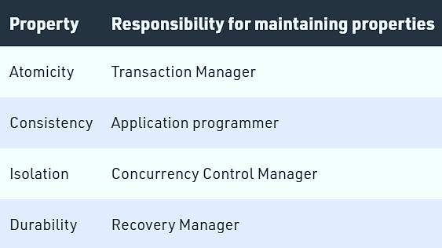
ACID Properties
Page 40

Slide 41
Entities and Relationships

Slide 42
Entities and Relationships
Entities
A person, place, or thing in the real world about which data can be stored in a database.
Tables store data that represents one type of entity.
Example:
A Bank database has a customer table to store customer information.
Customer table stores this information as a set of attributes (columns within the table) for each customer.
Page 42

Slide 43
Entities and Relationships
Relationships
Relation or links between entities that have something to do with each other.
Example:
The customer name is related to the customer account number and contact information, which might be in the same table.
There can also be relationships between separate tables (for example, customer to accounts).
Page 43

Slide 44
Relationship Categories

Slide 45
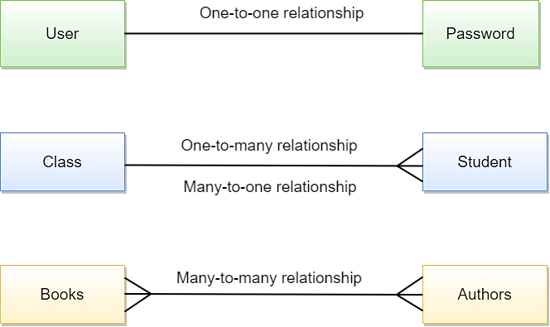
Relationship Categories
Page 45

Slide 46
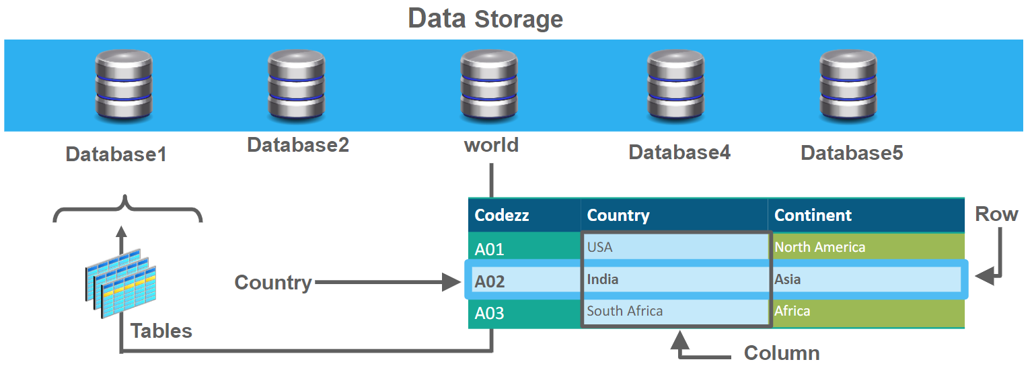
Entities and Relationships
Two-dimensional tables, columns, and rows:
A ordered set of columns (one or more)
An ordered set of rows (zero or more)
Each row has exactly one value in each column.
Page 46

Slide 47
SQL Server Joins

Slide 48
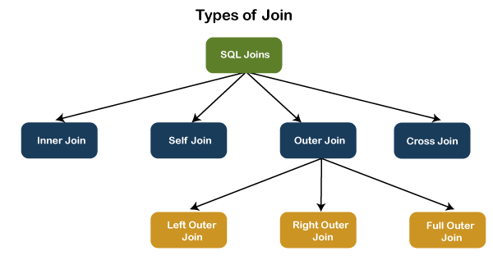
SQL Server Joins
Join: used to extract data from multiple tables.
Joins are further divided in various types:
Page 48

Slide 49
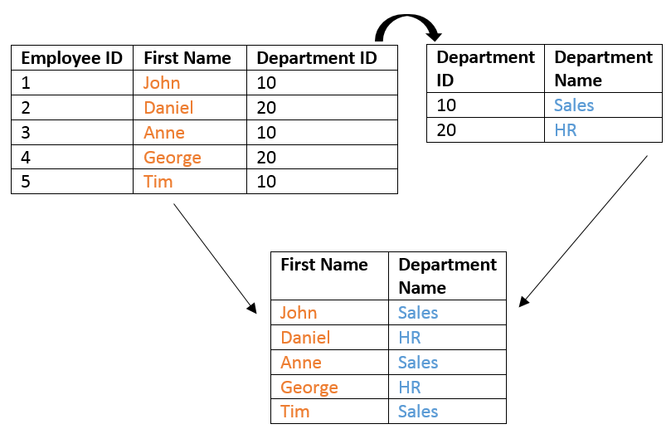
SQL Server - Inner Join
Retrieves only matched rows from Left and Right Table.
Inner joins are also called Simple Joins or Equi Joins.
Page 49

Slide 50
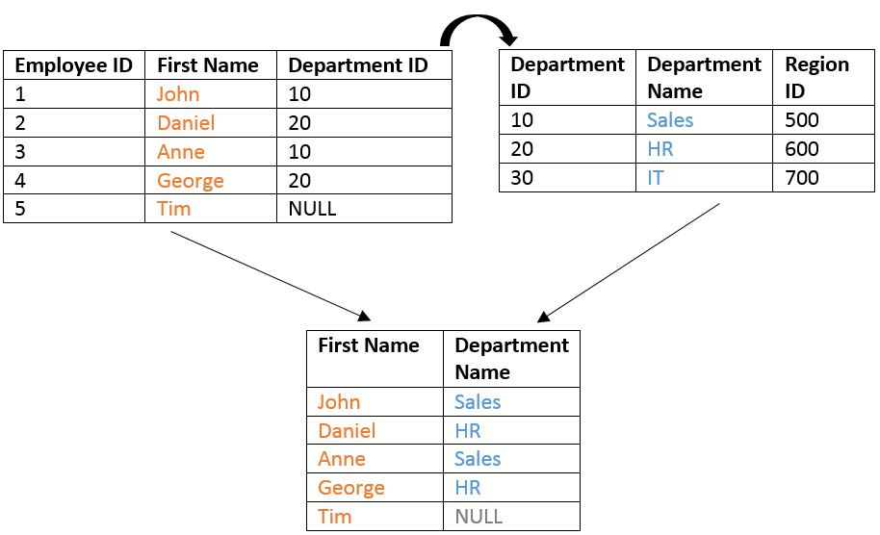
SQL Server - Left Outer Join
Retrieves all the rows from Left table and matched from Right Table.
Page 50

Slide 51
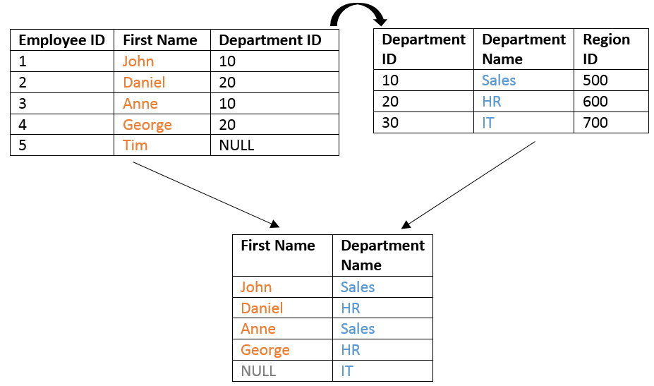
SQL Server – Right Outer Join
Retrieves all the rows from Right table and matched from Left Table.
Page 51

Slide 52
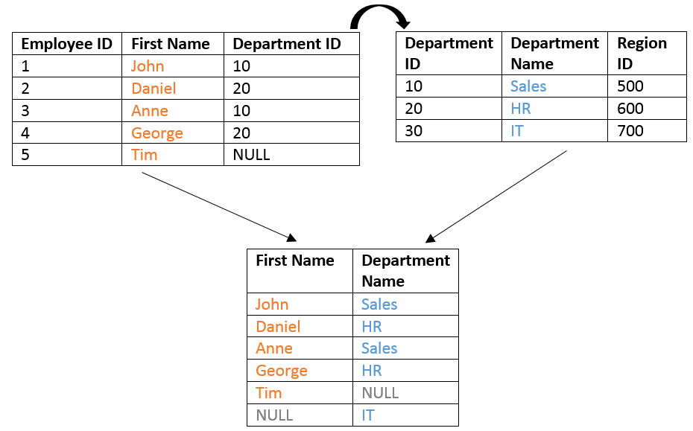
SQL Server – Full Outer Join
Retrieves all the rows from Left and Right Table.
Page 52

Slide 53
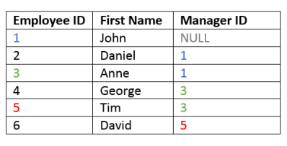
SQL Server –Self Join
The SQL Server Self Join allows joining a table to itself.
Such as an Employee table consists the information of employees and their managers.
Page 53

Slide 54
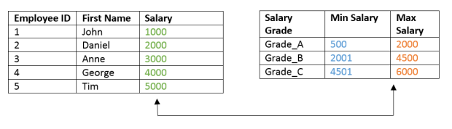
SQL Server – Non-Equi Join
A Non-Equi Join is a join condition containing something other than equality operator.
Example: Sometimes you would like to join two tables that do not have a shared column, and seemingly have no join condition:
Page 54

Slide 55
SQL Server –Cross Join
A cross join is used when you wish to create combination of every row from two tables.
This kind of result is called as Cartesian Product.
This join is applied implicitly applied in two conditions:
If the join condition is omitted.
If the join condition is invalid.
Page 55

Slide 56
SELECT Statement

Slide 57
SELECT Statement
SELECT is the most commonly used DML command for queries.
It retrieves data in the form of rows from tables in a database.
Returns rows as a “result set” in the form of a table.
Page 57

Slide 58
SELECT Statement Syntax
Syntax:
“SELECT [clause options] column_list [FROM table_name] [other clauses]”
Column_list is a list of desired columns, which you want as part of the result set.
If you want to list all the columns just use * in place of column list.
Column_list
Separate the columns in the list with a comma separator (,).
Page 58

Slide 59
SELECT Clauses
Use optional clauses to generate desired query results.
You can use the clauses either alone or in combination as per your query requirement.
Distinct:
Where:
Limit:
Eliminates duplicate rows from the result set.
Filters rows according to specified criteria.
Limits the maximum number oresultf rows in the set.
From:
Order by:
Specifies which table(s) to retrieve data from.
Sorts rows in a specified order.
Page 59

Slide 60
Functions in MySQL Expressions

Slide 61
Functions in MySQL Expressions
Functions perform calculations on data.
A function returns a value that can be used as part of an expression.
General syntax:
“function_name([arg1 [, arg2,…, argn]])”
You must include the parentheses, even if there are no arguments.
Separate multiple arguments with commas.
Examples:
NOW(): Returns the current date and time.
VERSION(): Returns the MySQL Server version currently being used on the host.
Page 61

Slide 62
Functions in MySQL Expressions
There are two categories of MySQL Functions:
Built-in functions:
Built in functions are already implemented in the MySQL server.
These functions allow us to perform different types of manipulations on the data.
These functions can be basically categorized into the following most used categories:
Strings functions – operate on string data types.
Numeric functions – operate on numeric data types.
Date functions – operate on date data types.
Date functions – operate on all of the above data types and produce summarized result sets.
Page 62

Slide 63
Functions in MySQL Expressions
User-defined functions:
MySQL also supports user defined functions that extend MySQL.
User defined functions are functions that you can create using a programming language such as C, C++ etc., and then add them to MySQL server.
Once added, they can be used just like any other function.
Page 63

Slide 64
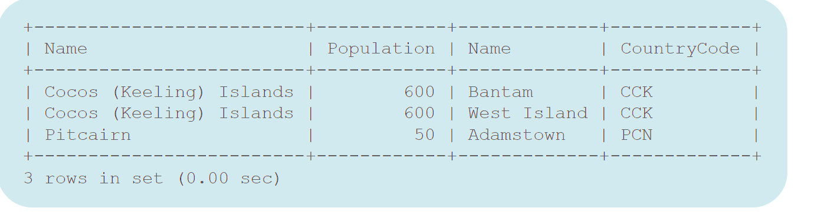
Using Functions
Page 64

Slide 65




Type of Built-In Functions
01
02
03
04
String:
Date and Time:
Math/Numeric:
Advanced:
Operations on character strings.
Operations on character strings.
Operations on numbers and return numbers.
Example: BIN(), DATABASE(), IF() etc.
Page 65

Slide 66

THANK YOU
Page 66

