Slide 1

Normalization and Denormalization in Database
Bhawna Gunwani

Slide 2
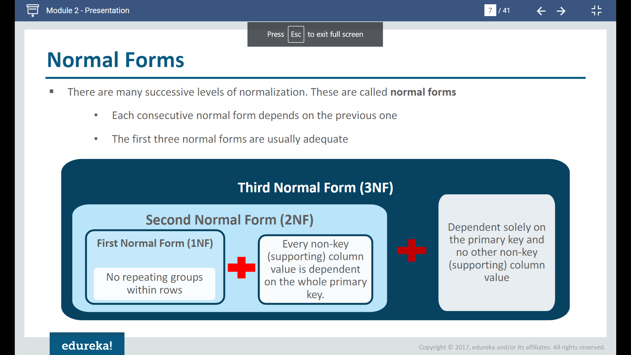
Normalization
Database normalization is the process of organizing data to minimize data redundancy (data duplication), which in turn ensures data consistency.
There are many successive levels of normalization. These are called normal forms.
Each consecutive normal form depends on the previous one.
The first three normal forms are usually adequate.

Slide 3
First Normal Form (1NF)
A table is said to be in 1NF, if 1. The data in each column should be atomic. No multiple values, separated by comma. 2. The table does not contain any repeating column groups. 3. Identify each record uniquely using primary key.
In other words, Each cell should have a single value and we cannot have repeated columns.

Slide 4
First Normal Form (1NF)
In other words, any row must not have a column in which more than one value is saved, like separated with commas in 1 NF. We must separate such data into multiple rows.
For example: consider a table which is not in First normal form named as Employee table:
DeptName | Employees
IT | King, Roger Smith
HR | Sujatha, Sarah

Slide 5
First Normal Form (1NF)
We must separate such data into multiple rows.
Using the first Normal Form, data redundancy increases, as there will be many columns with same data in multiple rows, but each row will be unique.
DeptName | Employee1 | Employee2 | Employee3
IT | King | Roger | Smith
HR | Sujatha | Sarah

Slide 6
Second Normal Form (2NF)
A table is said to be in 2NF, if 1. The table meets all the conditions of 1NF. 2. Move redundant data to a separate table. 3. Create relationship between these tables using foreign keys.
In other words, Every table should describe one-entity, and every column in that table should describe that entity.

Slide 7
Second Normal Form (2NF)
Consider Employees table below. For every employee within the same department, we are repeating, all the 3 department columns Let's say for example, if there 50 thousand employees in the IT department, we would have unnecessarily repeated all the 3 department columns data 50 thousand times. The obvious problem with redundant data is the disk space wastage.
EmployeeName | Gender | Salary | DeptName | DeptHead | DeptLocation
King | Male | 45000 | IT | Gautam | London
Sujatha | Female | 23000 | HR | Sumit | Sydney
Roger | Male | 13450 | IT | Gautam | London
Sarah | Female | 25670 | HR | Sumit | Sydney
Smith | Male | 68900 | IT | Gautam | London

Slide 8
Second Normal Form (2NF)
Another common problem, is that data can become inconsistent.
Let's say, Gautam has resigned, and we have a new department head (STEVE) for IT department. At present, there are 3 IT department rows in the table, and we need to update all of them. Let's assume I updated only one row and forgot to update the other 2 rows, then obviously, the data becomes inconsistent.
EmployeeName | Gender | Salary | DeptName | DeptHead | DeptLocation
King | Male | 45000 | IT | Gautam | London
Sujatha | Female | 23000 | HR | Sumit | Sydney
Roger | Male | 13450 | IT | Gautam | London
Sarah | Female | 25670 | HR | STEVE | Sydney
Smith | Male | 68900 | IT | Gautam | London

Slide 9
Second Normal Form (2NF)
Thus, to reduce the data redundancy, we can divide this large badly organized table into two (Employees and Departments), as shown below. Now, we have reduced redundant department data. So, if we must update department head name, we only have one row to update, even if there are 10 million employees in that department.
DeptId | DeptName | DeptHead | DeptLocation
1 | IT | Gataum | London
2 | HR | Sumit | Sydney
EmployeeName | Gender | Salary | DeptId
King | Male | 45000 | 1
Sujatha | Female | 23000 | 2
Roger | Male | 13450 | 1
Sarah | Female | 25670 | 2
Smith | Male | 68900 | 1

Slide 10
Third Normal Form (3NF)
A table is said to be in 3NF, if the table 1. Meets all the conditions of 1NF and 2NF 2. Does not contain columns (attributes) that are not fully dependent upon the primary key.
In other words, A column in a table should not be derived from other columns.

Slide 11
Third Normal Form (3NF)
The table below, violates third normal form, because AnnualSalary column is not fully dependent on the primary key EmpId. The AnnualSalary is also dependent on the Salary column. In fact, to compute the AnnualSalary, we multiply the Salary by 12. Since AnnualSalary is not fully dependent on the primary key, and it can be computed, we can remove this column from the table, which then, will adhere to 3NF.
EmployeeId | EmployeeName | Gender | Salary | AnnualSalary | DeptID
1 | King | Male | 45000 | 540000 | 1
2 | Sujatha | Female | 23000 | 276000 | 2
3 | Roger | Male | 13450 | 161400 | 1
4 | Sarah | Female | 25670 | 308040 | 2
5 | Smith | Male | 68900 | 826800 | 1

Slide 12
Third Normal Form (3NF)
Let's look at another example of Third Normal Form violation.
In the table below, DeptHead column is not fully dependent on EmpId column.
DeptHead is also dependent on DeptName. So, this table is not in 3NF.
EmployeeName | Gender | Salary | DeptName | DeptHead | DeptLocation
King | Male | 45000 | IT | Gautam | London
Sujatha | Female | 23000 | HR | Sumit | Sydney
Roger | Male | 13450 | IT | Gautam | London
Sarah | Female | 25670 | HR | Sumit | Sydney
Smith | Male | 68900 | IT | Gautam | London

Slide 13
Third Normal Form (3NF)
To put this table in 3NF, we break this down into 2, and then move all the columns that are not fully dependent on the primary key to a separate table as shown below. This design is now in 3NF.
DeptId | DeptName | DeptHead | DeptLocation
1 | IT | Gataum | London
2 | HR | Sumit | Sydney
EmployeeName | Gender | Salary | DeptId
King | Male | 45000 | 1
Sujatha | Female | 23000 | 2
Roger | Male | 13450 | 1
Sarah | Female | 25670 | 2
Smith | Male | 68900 | 1

Slide 14
Denormalization
Denormalization is a technique used by database administrators to optimize the efficiency of their database infrastructure. This method allows us to add redundant data into a normalized database to alleviate issues with database queries that merge data from several tables into a single table. The denormalization concept is based on the definition of normalization that is defined as arranging a database into tables correctly for a particular purpose.

Slide 15
Denormalization
The denormalization is different from normalization in the following manner:
Denormalization is a technique used to merge data from multiple tables into a single table that can be queried quickly. Normalization, on the other hand, is used to delete redundant data from a database and replace it with non-redundant and reliable data.
Denormalization is used when joins are costly, and queries are run regularly on the tables. Normalization, on the other hand, is typically used when many insert/update/delete operations are performed and joins between those tables are not expensive.

Slide 16
ACID Properties in DBMS
Bhawna Gunwani

Slide 17
What is Database Transaction?
A transaction is a logical unit of work that accesses and updates the contents of a database. Read and write operations are used by transactions to access data.
A transaction has several states:
Active
Partially Committed State
Committed State
Terminated State
Aborted State
Failed State

Slide 18
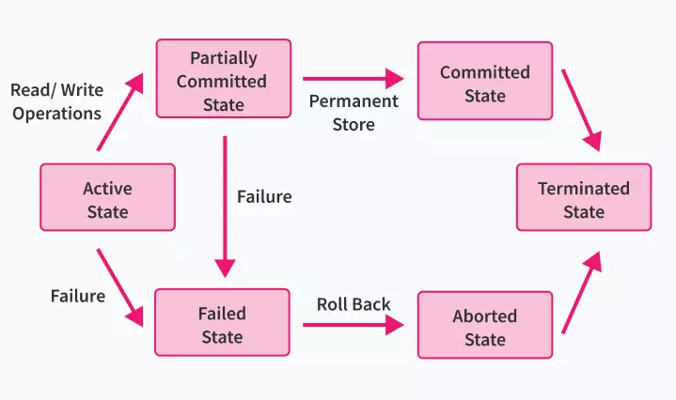
What is Database Transaction?

Slide 19
ACID Properties in DBMS
ACID properties are followed before and after a transaction in order to preserve database consistency.
ACID
Atomicity
Consistency
Isolation
Durability

Slide 20
ACID Properties
Atomicity
By this, we mean that either the entire transaction takes place at once or doesn’t happen at all.
There is no midway i.e., transactions do not occur partially.
Each transaction is considered as one unit and either runs to completion or is not executed at all.
Consistency
This means that integrity constraints must be maintained so that the database is consistent.
Consistency needs to be checked before and after the transaction.
It refers to the correctness of a database.

Slide 21
ACID Properties
Isolation
This property ensures that the execution of transactions concurrently will result in a state that is equivalent to a state achieved these were executed serially in some order.
Transactions occur independently without interference.
Durability
This property ensures that once the transaction has completed execution, the updates and modifications to the database are stored in and written to disk and they persist even if a system failure occurs.
The effects of the transaction, thus, are never lost.

Slide 22
ACID Properties
Property | Responsibilities form maintaining properties
Atomicity | Transaction Manager
Consistency | Application Programmer
Isolation | Concurrency Control Manager
Durability | Recovery Manager

Slide 23




Thank you

