Slide 1


eGramSabha
AI-Powered Digital Gram Sabha Platform
Team Name: Empower Panchayat
Team Leader Name: (see submission form)
Problem Statement: AI-Powered Digital Gram Sabha Platform
empowerpanchayat.org | Apache 2.0 Open Source | "Sashakt Panchayat, Samriddh Bharat"

Slide 2
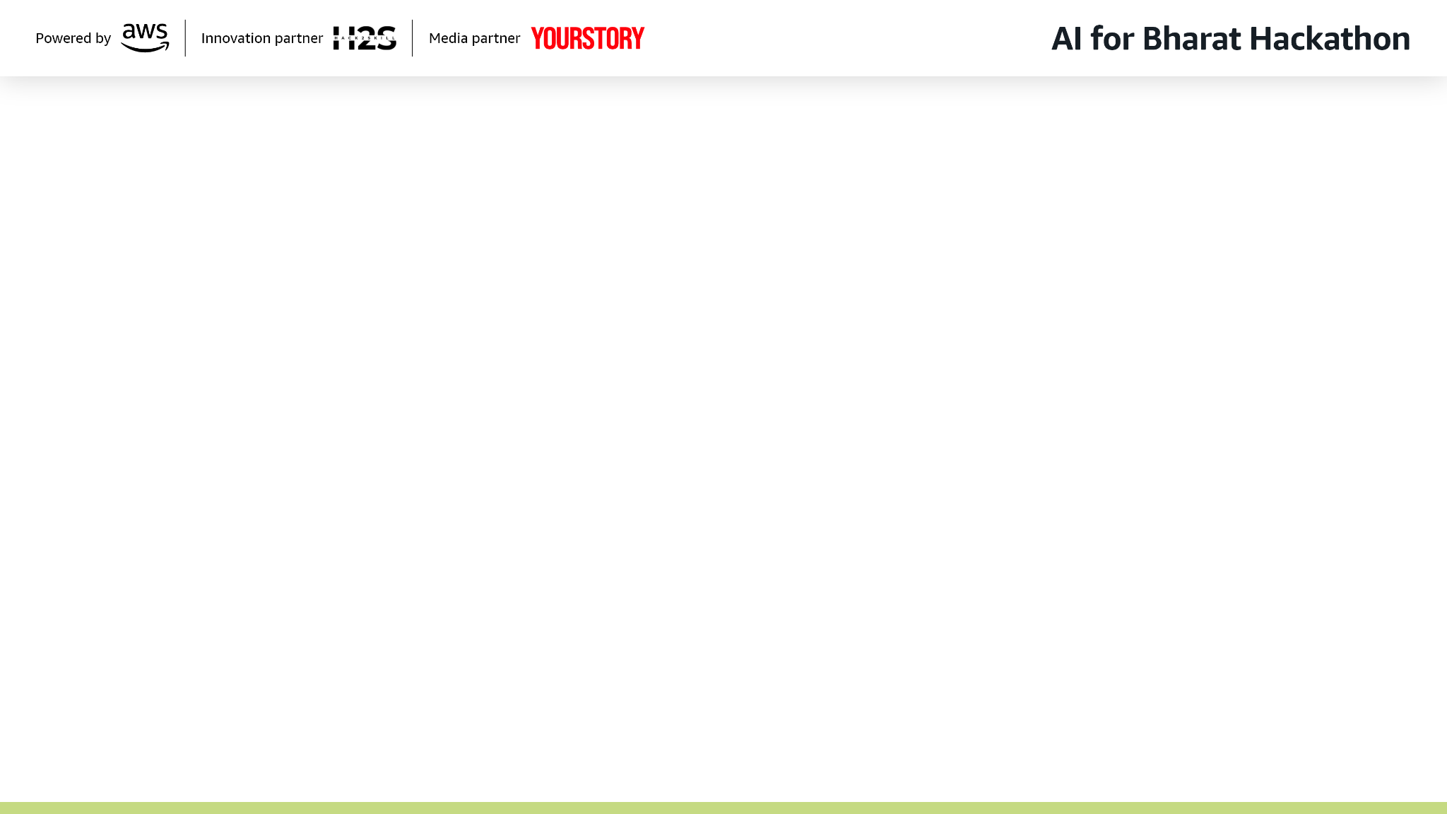
Problem Statement
In 1992, India passed the 73rd Constitutional Amendment — a radical act of faith in its own people. It created 250,000+ Gram Panchayats and mandated Gram Sabhas as the foundation of grassroots democracy where every adult citizen can participate. Three decades later, that promise remains largely unfulfilled.
5-10%
Average Gram Sabha attendance
<3%
Women participation in many states
60%+
Rural Indians with limited literacy
30%
Eligible citizens excluded from welfare schemes
ZERO
Digital trail of Gram Sabha decisions
Barrier | Impact
Paper agendas on notice boards | Low awareness — excludes remote hamlets, women at home, daily wage workers
Paper sign-in sheets | Easy to forge — routinely inflated to show higher attendance numbers
Hand-written minutes by clerk | Subjective, often incomplete, sometimes pre-written before the meeting happens
Single language proceedings | Excludes tribal & minority communities — Gondi, Santhali, Bhili speakers silenced
No issue tracking system | Promises forgotten between meetings — citizens stop attending because nothing changes
Physical presence required | Excludes women (social norms), elderly (mobility), differently-abled citizens

Slide 3
Brief About the Idea
Solution Overview
eGramSabha is a voice-first, face-authenticated platform that digitizes the entire Gram Sabha lifecycle — from citizen registration to issue resolution tracking. It is a direct response to the structural barriers that prevent Gram Sabhas from functioning as the Constitution intended.
Why AI is Required
Voice-First Removes the Literacy Barrier: 60%+ of rural Indians have limited literacy. Paper complaint registers, written agendas, and printed minutes exclude them by design. Voice-first AI lets a tribal woman in Jharkhand or an elderly farmer in Tamil Nadu speak a complaint and have it formally recorded in 3 languages — without writing a single word.
AI Transcription + Grammar Correction + Translation: Raw voice recordings are transcribed by STT (Jio/Whisper/AWS Transcribe — provider-agnostic). Amazon Bedrock then corrects grammar and translates to the original language + English + Hindi. A single voice complaint becomes a trilingual formal issue.
AI Sentiment Analysis + Auto-Priority: Every issue is analysed for sentiment (positive/negative/neutral/mixed), key phrases extracted, and urgency auto-detected. A complaint about 'sewage flowing into drinking water supply' is automatically flagged URGENT — it doesn't wait for the next monthly meeting. Officials see a prioritised dashboard: urgent issues first.
AI-Generated Minutes of Meeting (MOM): Gram Sabha minutes are hand-written by clerks — often days later, subjective, incomplete, sometimes pre-written. AI generates structured MOM instantly: Meeting Overview, Discussion Points, Decisions Taken, Action Items, Next Steps. Auto-translated to 3 languages. For the first time, proceedings exist as a permanent, searchable, verifiable record.
AI-Generated Agendas — Democratic by Default: Current agendas are ad-hoc, influenced by powerful voices. AI generates structured agendas from ALL citizen-reported issues — every voice has equal weight. Officials cannot selectively omit issues.
Text-to-Speech — Information Reaches Everyone: Amazon Polly reads agendas aloud in the citizen's language. The illiterate elderly man who could never read the notice board can now listen to what will be discussed on his phone.
Without AI: An Impossible Scale Problem: 250,000 panchayats x multiple languages x regular meetings = Without AI, this would require an army of clerks, translators, and transcribers at every panchayat. AI makes inclusive governance scalable.

Slide 4
Brief About the Idea (continued)
AWS Services (11 Active + 4 Code-Ready = 15)
Amazon Bedrock (Nova Lite via Converse API): LLM backbone powering 5 AI tasks: MOM generation, agenda creation, grammar correction, sentiment analysis, and translation fallback. Temperature 0.3 for consistent output. Large transcriptions chunked (1500 chars, 200 overlap) to handle hour-long meetings.
Amazon S3 (2 buckets, Intelligent-Tiering): egramsabha-assets: face photos, letterheads, issue attachments, TTS audio cache. egramsabha-transcribe-temp: temporary audio for Transcribe jobs. All uploads use INTELLIGENT_TIERING — auto-moves cold data to cheaper tiers.
AWS Translate: Real-time translation of AI-generated content (agendas, MOMs, corrected transcriptions) across 10+ Indian languages. Auto-detects source language. Used only for AI content — UI uses static translation files.
Amazon Polly + S3 Caching: Text-to-Speech for agenda read-aloud. Aditi voice (Hindi), Raveena (English). SHA256 content hash -> check S3 cache -> synthesize if miss -> cache result. Same text never synthesized twice.
API Gateway (REST, REGIONAL): Single entry point for ALL API traffic. eGramSabha-MOM-API with prod stage. 100 req/s rate limit, 200 burst, 100K requests/day quota. API key (x-api-key header) from frontend. Protects expensive AI endpoints from abuse.
CloudWatch (2 log groups): /egramsabha/backend (Winston + winston-cloudwatch) and /egramsabha/video-mom (watchtower). Centralized structured JSON logging from both Node.js and Python. 30-day retention.
Secrets Manager: Single secret 'egramsabha/prod' storing JWT_ADMIN_SECRET, JWT_OFFICIAL_SECRET, JWT_CITIZEN_SECRET, JWT_REFRESH_SECRET. Loaded at startup, cached in memory. Graceful fallback to env vars for local dev.
EC2 (t3.medium) + EBS (gp3) + Elastic IP: 2 vCPU, 4 GB RAM hosting Docker Compose with 4 containers. Burstable CPU handles AI processing spikes. 20 GB gp3 for persistent volumes. Static IP for DNS and API Gateway.
IAM: Least-privilege policies per service. Each service only accesses AWS APIs it needs. Graceful degradation if permissions are missing.
Code-Ready:
Amazon Rekognition: Server-side face verification. Collections per panchayat. IndexFaces during registration, SearchFacesByImage during login (90% similarity threshold). Activated via FACE_VERIFICATION_PROVIDER=rekognition.
Amazon DocumentDB: Managed MongoDB replacement. All Mongoose schemas are DocumentDB-compatible. Activated via USE_DOCUMENTDB=true. Provides automated backups, multi-AZ failover.
AWS Transcribe: Managed STT supporting Hindi, Tamil, Telugu, Kannada, Malayalam, Bengali, Gujarati, Marathi, Punjabi + more. Code complete — async batch jobs via S3. Activated via STT_PROVIDER=aws_transcribe.
Amazon SNS: SMS notifications for meeting schedules and issue status updates. Direct SMS publish with Transactional type, +91 formatting, sender ID 'eGramSbha'. API calls succeed — delivery needs AWS sandbox exit + India DLT registration.
User | Without AI | With AI
Illiterate citizen (60%+ of rural India) | Cannot report issues — requires writing in a complaint register during office hours | Speaks complaint into phone in any language. AI transcribes, corrects, translates, assigns priority. Issue formally registered.
Panchayat secretary | Hand-writes minutes for hours, often days later. Subjective, sometimes pre-written before meeting. | AI generates structured MOM in seconds: Discussion Points, Decisions, Action Items. 3 languages. Permanent verifiable record.
Women at home (~3% participation) | Must attend male-dominated public meeting. Social norms discourage public speaking. Domestic responsibilities prevent attendance. | Reports issues via voice from home, in her language. Complaint has same formal weight as anyone else's. Face auth — no password needed.
Official creating agenda | Ad-hoc list influenced by powerful voices. No systematic inclusion of citizen complaints. | AI structures agenda from ALL citizen-reported issues. Every voice has equal weight. Democratic by default.
Tribal/minority citizen | Excluded by state language proceedings. Gondi, Santhali, Bhili speakers cannot understand or participate. | Speaks native language. AI translates. Agenda and MOM available in their language. TTS reads aloud.
Block/District administrator | Physical inspection needed to audit Gram Sabhas. Paper records inaccessible. | Digital MOM records, biometric attendance data, issue analytics. Audit remotely. Pattern recognition across panchayats.

Slide 5
List of Features
AI: Voice-First Issue Reporting: Record complaint in any language. AI transcribes, corrects grammar, translates to English + Hindi. No typing required.
AI: Sentiment Analysis + Auto-Priority: Every issue analysed for sentiment (positive/negative/neutral/mixed), key phrases extracted. Health/safety issues auto-flagged URGENT.
AI: Minutes of Meeting Generation: Upload meeting audio. AI generates structured MOM: Overview, Discussion Points, Decisions, Action Items, Next Steps. 3 languages.
AI: Agenda Generation: AI creates structured agenda from citizen-reported issues. Translated to multiple languages. Every voice gets equal representation.
AI: Text-to-Speech Read-Aloud: Amazon Polly reads agendas aloud (Aditi voice Hindi, Raveena English). S3-cached — same text never re-synthesized. Accessibility for illiterate citizens.
AI: Grammar Correction + Translation: Bedrock corrects STT output and produces enhanced_original + enhanced_english + enhanced_hindi. Rural development context-aware.
Face Recognition Authentication: 128-dimension face descriptor via face-api.js. Liveness detection: blink (2 required) + head movement (5 required) via MediaPipe FaceMesh. Euclidean distance matching (threshold 0.4). No passwords, no OTPs.
Biometric Attendance Tracking: Face-verified or manual check-in at Gram Sabhas. Verification method recorded (face/manual). Unforgeable digital attendance record. Eliminates paper sign-in fraud.
Meeting RSVP & Scheduling: Officials schedule Gram Sabha with date, time, location, expected duration. Citizens RSVP before meeting. SMS notifications to all registered citizens (SNS, code-ready).
Issue Lifecycle Tracking: REPORTED -> PICKED_IN_AGENDA -> DISCUSSED_IN_GRAM_SABHA -> RESOLVED / TRANSFERRED / NO_ACTION_NEEDED. Citizens see real-time status. Officials add resolution remarks. Zero promises lost.
Citizen Portal: Face login (last 4 digits of voter ID + face scan), voice/text issue reporting, meeting RSVP, issue status tracking, support tickets. Location-based access via LGD code or cascading dropdowns.
Official Portal: Meeting management, AI agenda generation, AI MOM generation, biometric attendance, issue management (filter by status/category/priority/ward), citizen management, PDF exports with letterhead.
Admin Portal: Panchayat CRUD with LGD code, ward management, official registration (6 roles), letterhead upload/preview, bulk CSV import (citizens/officials/panchayats), platform configuration, support ticket management.
Provider Abstraction: 8 env var switches: STT_PROVIDER, LLM_PROVIDER, TRANSLATION_PROVIDER, TTS_PROVIDER, STORAGE_BACKEND, FACE_VERIFICATION_PROVIDER, USE_DOCUMENTDB, COMPREHEND_ENABLED. Swap any service without code changes.
PDF Export with Letterhead: Attendance reports, MOM documents, issue summaries. Custom panchayat letterhead upload. Hindi font support via jsPDF + html2pdf.js.
Multi-Language UI: English and Hindi interface via React Context language switcher with static translation files. 10+ languages supported. AI content translated via AWS Translate.
Support Ticket System: Citizens and officials can raise help desk tickets. Anonymous submission allowed — protects vulnerable reporters.
4-Layer Security: API Gateway (key + 100K/day quota) -> Nginx (TLS 1.2/1.3 + 10 req/s per IP) -> JWT Auth (3 role-specific secrets, expiry 12h-72h) -> Secrets Manager (encrypted credentials).

Slide 6
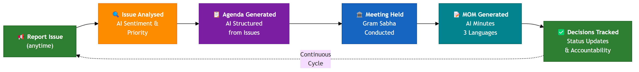
Visual Representations
5-Step Gram Sabha Lifecycle
Continuous Governance Loop
Citizens can report issues at any time -- the cycle is continuous, not tied to meeting dates

Slide 7
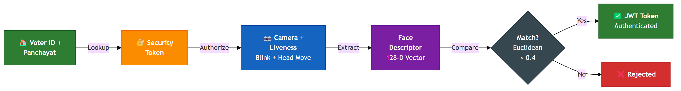
Process Flow: AI Pipelines
Voice Issue Reporting (cronJobs.js:51-53)
MOM Generation (llm_service.py:763-791)
Agenda Generation (llm_service.py)
Face Authentication (citizenAuthRoutes.js:210)

Slide 8
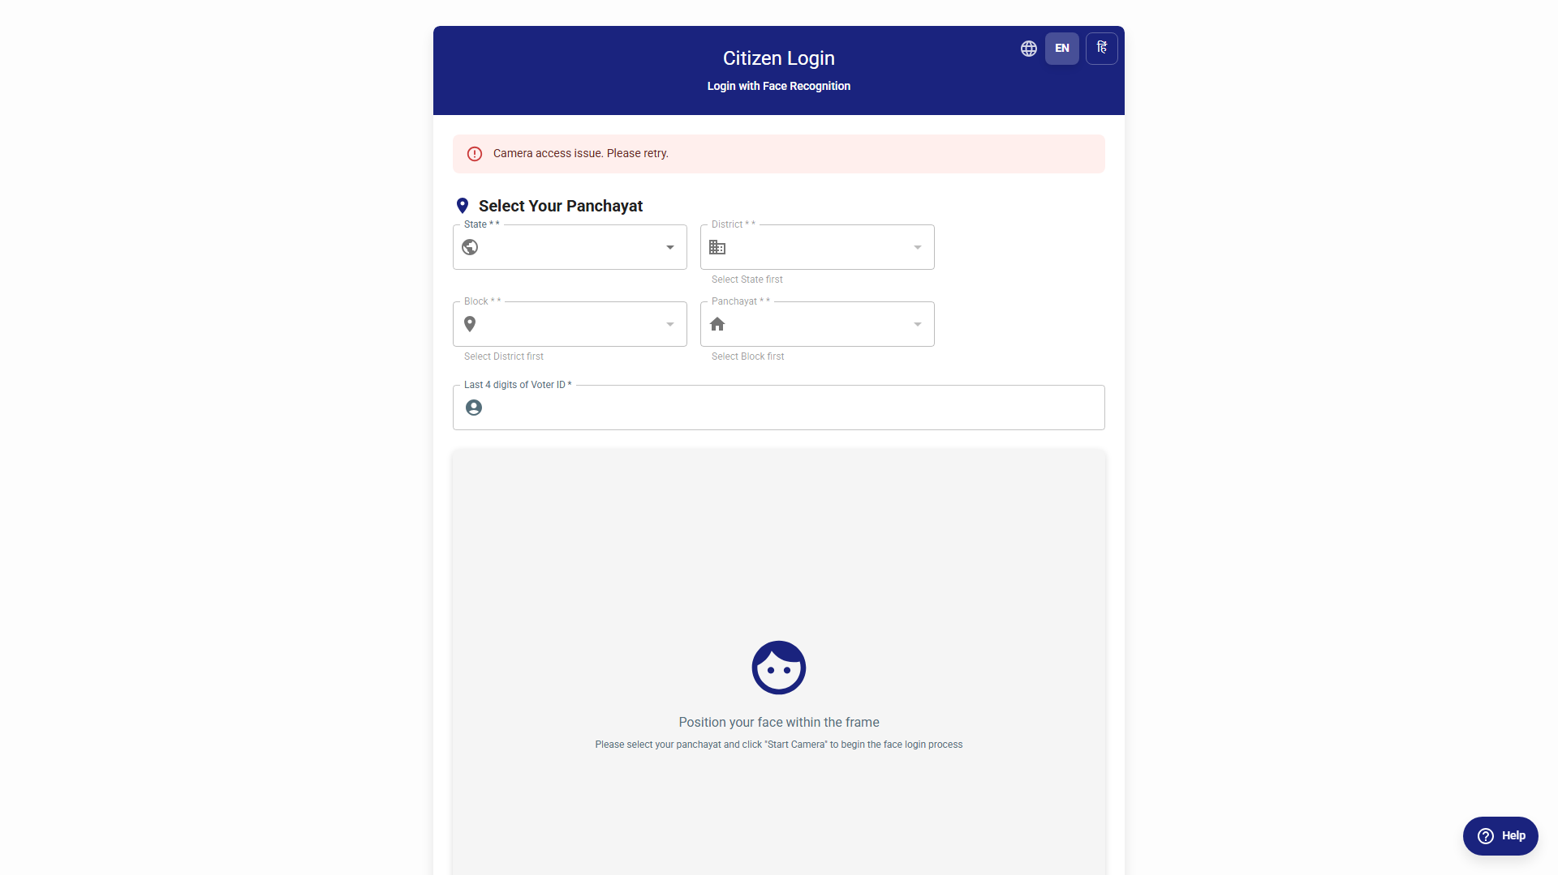
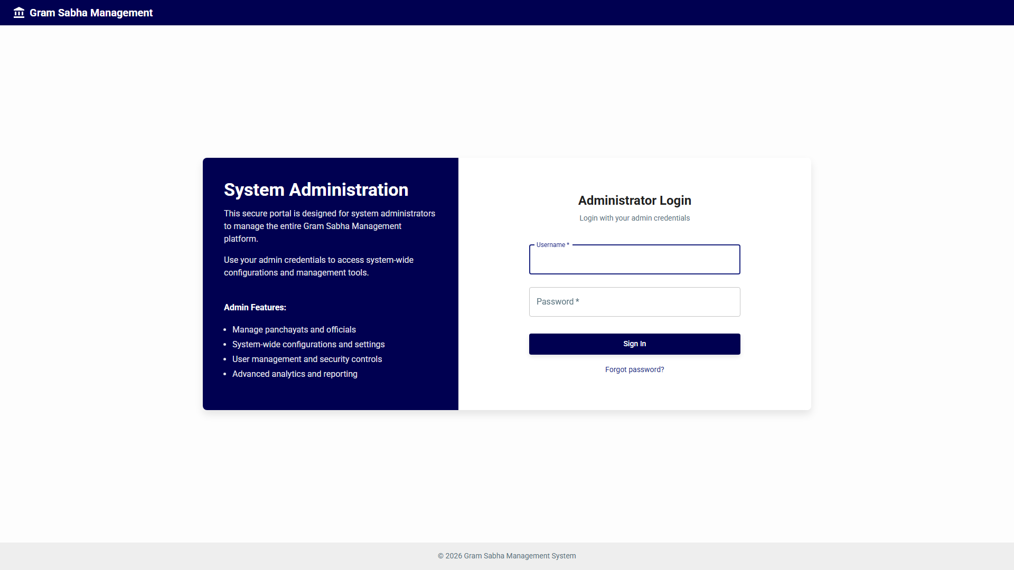
Wireframes / Prototype Screenshots
Citizen Login — Voter ID + Panchayat selection + Face scan with liveness detection overlay
Citizen Dashboard — Welcome card, issue statistics, upcoming meetings, report issue button
Voice Issue Reporting — Audio recorder, file attachments, category & subcategory selector
Issue List — Sentiment badges, priority indicators (URGENT/NORMAL), transcription status (PENDING/COMPLETED)

Slide 9
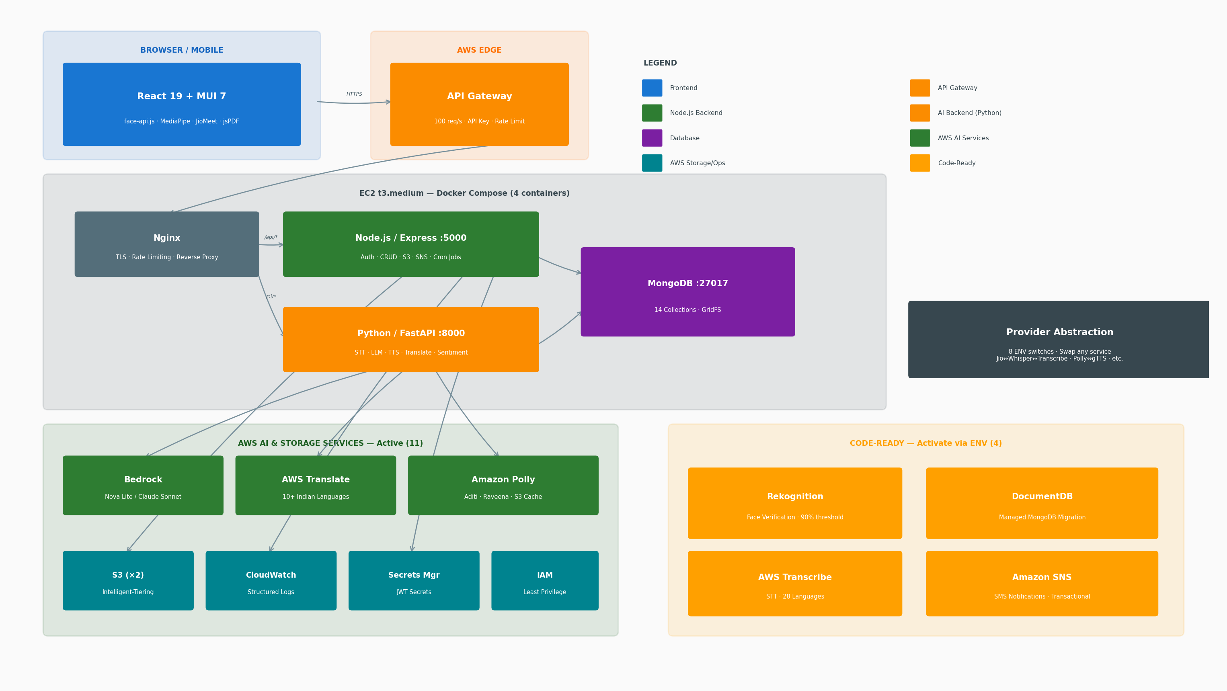
Architecture Diagram
Source: docker-compose.prod.yml, infra/setup-api-gateway.js, frontend/nginx.prod.conf | 4 Docker containers on bridge network | 11 Active + 4 Code-Ready AWS services

Slide 10
Technologies Utilized
Layer | Technology | Purpose
Frontend | React 19, MUI 7, face-api.js, MediaPipe FaceMesh | Single Page Application with client-side face recognition, audio recording, multi-language UI
Backend API | Node.js 20, Express 4, Mongoose 8 | RESTful API for CRUD, JWT authentication, file management, cron jobs, S3/SNS integration
AI Backend | Python 3.11, FastAPI, Motor (async MongoDB) | Asynchronous AI pipelines: STT, LLM, TTS, translation, sentiment. Separate scaling from CRUD.
Database | MongoDB 7 (DocumentDB-compatible) | 14 collections with flexible schemas. 128-dim face descriptor arrays. Nested attendance records. GridFS for files.
AI/LLM | Amazon Bedrock — Nova Lite (Converse API) | 5 AI tasks: MOM generation, agenda creation, grammar correction, sentiment analysis, translation fallback. Temp 0.3.
STT (Speech-to-Text) | Provider-agnostic: Jio STT / Whisper (HuggingFace) / AWS Transcribe | 3 swappable providers via STT_PROVIDER env var. Hindi, Tamil, Telugu, Kannada, Malayalam, Bengali + more.
Translation | AWS Translate (auto-detect source) | AI-generated content translated across 10+ Indian languages. 2M chars/mo free tier.
TTS (Text-to-Speech) | Amazon Polly + S3 content-hash cache | Aditi (Hindi), Raveena (English). SHA256 cache key -> never re-synthesize same text.
Object Storage | Amazon S3 (Intelligent-Tiering, 2 buckets) | Face images, TTS audio cache, letterheads, attachments, transcription temp files.
Security | Secrets Manager + JWT (4 secrets) + Helmet + CORS + xss-clean + hpp | Zero hardcoded credentials. JWT expiry: Admin 12h, Official 24h, Citizen 72h, Refresh 7d. 6-role RBAC with per-resource permissions.
Traffic Management | API Gateway + Nginx reverse proxy | Defense in depth: API key + throttle (100 req/s) + TLS + rate limit (10/s per IP) + security headers.
Logging | CloudWatch: winston-cloudwatch + watchtower | 2 log groups (/egramsabha/backend, /egramsabha/video-mom). Structured JSON. 30-day retention.
Infrastructure | Docker Compose, EC2 t3.medium, EBS gp3, Elastic IP | 4 containers on bridge network. Same Dockerfiles work in ECS Fargate for production scale.
PDF Generation | jsPDF + html2pdf.js | Attendance reports, MOM documents with custom panchayat letterhead. Hindi font support.
Video Meetings | JioMeet SDK | Virtual Gram Sabha participation for citizens who cannot attend in person.

Slide 11
Estimated Implementation Cost
Current Hackathon Cost: $15-20/month
Scale Projections
Service | Monthly Cost | Notes
EC2 (t3.medium, 2 vCPU, 4 GB) | $12-30 | On-demand vs reserved. Burstable CPU for AI spikes.
EBS (20 GB gp3) | $1.60 | 3 Docker volumes: mongodb_data, backend_uploads, temp_storage
Elastic IP | $0 | Free while attached to running instance
S3 (2 buckets) | $0.50 | Intelligent-Tiering. Minimal storage at demo scale.
Bedrock (Nova Lite) | $2-5 | Pay per token. $0.06/1K input + $0.24/1K output tokens.
Translate | $0-1 | 2M chars/mo free tier. AI content only (not UI).
Polly | $0-0.50 | 5M chars/mo free tier. S3 caching reduces repeat calls.
CloudWatch | $0-0.50 | 5 GB/mo free tier. 2 log groups.
Secrets Manager | $0.40 | 1 secret (egramsabha/prod with 4 JWT keys)
API Gateway | $0 | 1M calls/mo free tier. REST API with usage plan.
TOTAL | $15-20/month
Phase | Scale | Monthly | Per Citizen/Yr
Hackathon | 1-5 panchayats | $15-20 | --
Pilot (100 panchayats) | Config changes only: STORAGE_BACKEND=s3, USE_DOCUMENTDB=true | $320 | ~$3/citizen/yr
State (5K panchayats) | ECS Fargate auto-scaling, CloudFront CDN, multi-AZ DocumentDB | $3,250 | ~$0.80/citizen/yr
National (250K panchayats) | Multi-region, full service mesh, Bedrock provisioned throughput | $30-37K | $0.60-0.72/citizen/yr
~100x Cost Reduction
Rs 500+/meeting (physical) vs Rs 5/citizen/year (digital)
Cost Optimizations:
S3 Intelligent-Tiering for auto storage class
Polly S3 caching (generate once, serve many)
API Gateway throttling (100 req/s)
Bedrock low temperature (0.3) for efficiency

Slide 12
Snapshots of the Prototype
Citizen Login — Voter ID entry, panchayat selection (State/District/Block/Panchayat), face scan with liveness overlay
Voice Issue Reporting — Audio recorder with waveform, category selector (6 categories, 20+ subcategories), file attachments
Transcription Result — Original transcription + Enhanced English + Enhanced Hindi, powered by Bedrock grammar correction
Sentiment Analysis — Badge showing POSITIVE/NEGATIVE/NEUTRAL/MIXED with confidence scores, extracted key phrases, auto-priority
AI-Generated Agenda — Numbered items from citizen issues, multi-language tabs, Read Aloud button (Polly TTS)
MOM Output — Structured sections: Meeting Overview, Discussion Points, Decisions Taken, Action Items, Next Steps. 3 languages.

Slide 13
Prototype Performance Report / Benchmarking
Tatarpur Digital Gram Sabha (April 2025) — India's First
Impact Summary
Metric | National Avg | Tatarpur Digital | Improvement
Voter registration | ~10% active participation nationally | 81% registered (650 of 801 eligible voters) | 8x improvement
Issues submitted | Handful (verbal, unrecorded) | 100+ issues submitted in 3 days | Order of magnitude increase
Women participation | Below 3% in many states | Approximately 50% | 16x improvement
Decisions taken | Few, unrecorded or pre-written | Multiple, digitally signed decisions | Permanent record
Time to minutes | Days later (if at all) | Minutes — AI-generated instantly | Instant
Impact Area | Mechanism | Outcome
Citizen Participation | Voice-first reporting, face authentication, phone-based access | 5% -> 30%+ Gram Sabha attendance
Women's Empowerment | Remote voice reporting from home, no public speaking required | 3% -> 50% women participation (Tatarpur benchmark)
Welfare Delivery | Citizen-verified beneficiary lists in Gram Sabha, digital tracking | Reduce 30% exclusion error in welfare schemes
Transparency | AI-generated MOMs, permanent digital records, searchable & auditable | Every decision verifiable — no more pre-written minutes
Accountability | Issue lifecycle tracking: REPORTED -> DISCUSSED -> RESOLVED | Zero promises lost between meetings
Local Economy | Citizens advocate for infrastructure, livelihood schemes via formal channel | Reduce distress migration push factors
Youth Engagement | Mobile-first interface, real-time tracking, transparent process | Younger demographic participating in governance
Administrative Efficiency | Digital records, pattern analytics, automated MOM & agenda | Block/District oversight without physical inspection
Cost Reduction | Digital vs paper-based processes at scale | ~100x cost reduction (Rs 500+/meeting vs Rs 5/citizen/year)
Constitutional Compliance | Regular, documented, inclusive, multilingual Gram Sabhas | 73rd Amendment actually implemented as designed
Concrete outcomes from a single meeting: garbage management system with tenant fees, prioritised road repairs, transgender welfare allocation (Rs 2,100 minimum), and a solar power plant on 24 acres of unused land. Citizens independently decided to levy local taxes and contribute resources — a private company donated a tractor. Door-to-door registration campaign with tablets brought 250 additional participants beyond typical attendance. Women specifically encouraged by female enumerators. This is self-governance working as Gandhi envisioned.
Source: IMPACT.md:14,330-340 | Tatarpur Digital Gram Sabha (April 2025)

Slide 14

Additional Details / Future Development
Immediate (Config changes)
Short-term
Medium-term
Long-term (National)
>> Activate AWS Transcribe — code complete, needs subscription activation. Switch STT_PROVIDER=aws_transcribe
>> DLT registration for SNS SMS — API calls succeed, delivery needs India TRAI DLT entity + template registration
>> Enable Rekognition — server-side face verification. Set FACE_VERIFICATION_PROVIDER=rekognition. 90% threshold.
>> DocumentDB migration — set USE_DOCUMENTDB=true. Automated backups, multi-AZ failover, read replicas
>> Native mobile app (React Native) — extend reach to feature phones and offline-first scenarios
>> e-Gram Swaraj + Panchayat Nirnay integration — feed citizen issues to government planning portal
>> Multi-panchayat escalation — issues affecting multiple villages escalated to Block/District level
>> Block/District analytics dashboards — aggregate issue data reveals systemic problems across panchayats
>> Video Gram Sabha with AI transcription — virtual meeting participation via JioMeet with real-time MOM
>> National rollout to 250,000 panchayats, 250M+ citizens — ECS Fargate multi-region, global DocumentDB
>> Aadhaar integration — biometric identity layer alongside face-api.js for maximum coverage
>> Open API for third-party integrations — CSOs, researchers, government dashboards access Gram Sabha data
>> Scheme delivery tracking — verify whether announced welfare schemes reach intended beneficiaries
"Sashakt Panchayat, Samriddh Bharat" — Strong Panchayat, Prosperous India
Digital India alignment: UPI (350M+ users proves simple inclusive interfaces drive mass adoption), Aadhaar (identity infrastructure), DBT (funds reach beneficiaries — eGramSabha ensures RIGHT beneficiaries selected), CoWIN (scaled to hundreds of millions in months). Well-designed Digital Public Goods, once adopted, scale to hundreds of millions in years, not decades.
GitHub Public Repository: https://github.com/anshuljain90/ai4bharat-empowerpanchayat
Live Deployment: https://empowerpanchayat.org/
Demo Video: (Max 3 minutes — link to be provided)
License: Apache 2.0 — Digital Public Good (DPG)

