Slide 1
Brain Tumor Flipbook - FL with Tumor Overlay
FL Contrast with Tumor Overlay
Longitudinal Brain Tumor Analysis
Generated: 2025-07-24 11:50

Slide 2
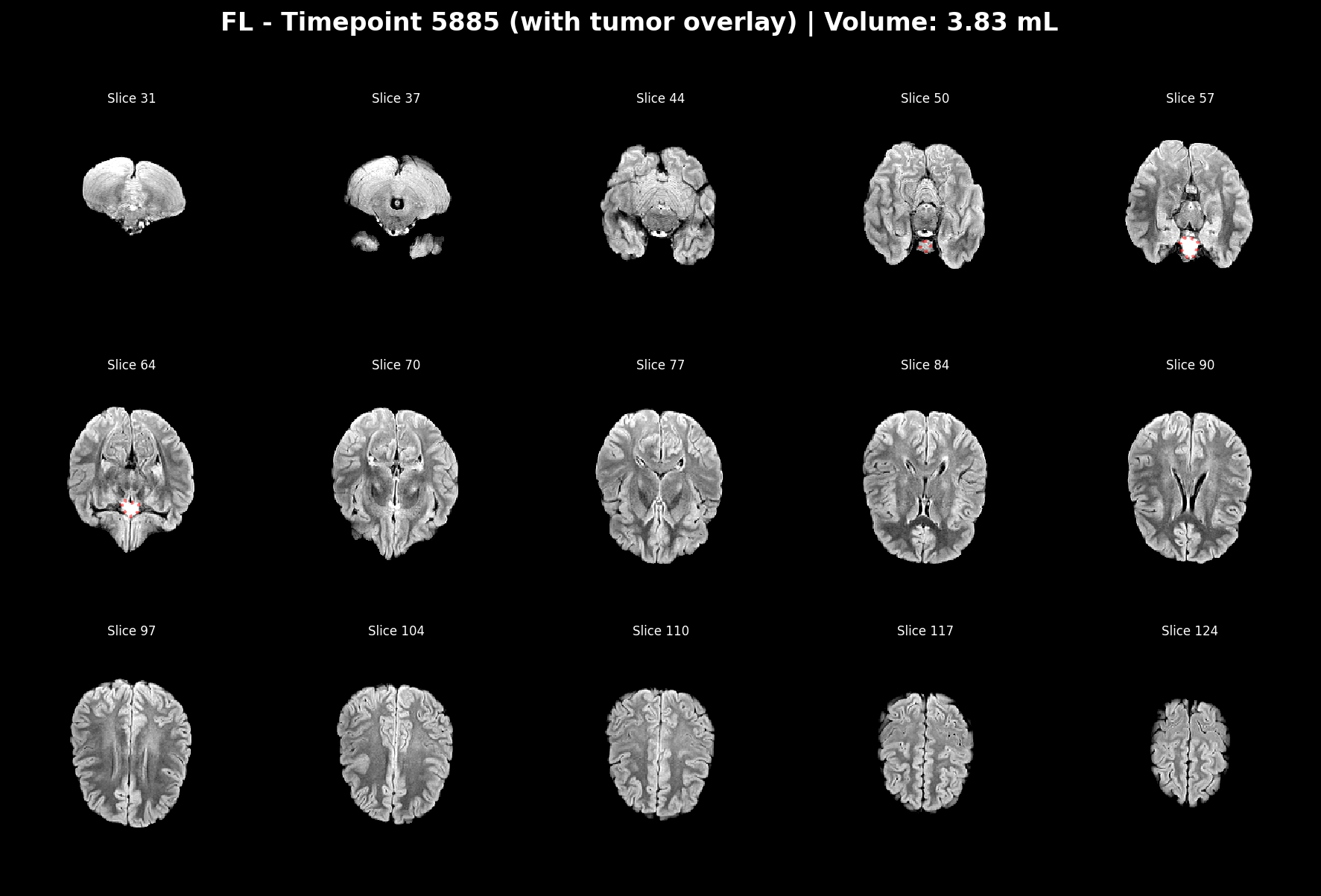

Slide 3
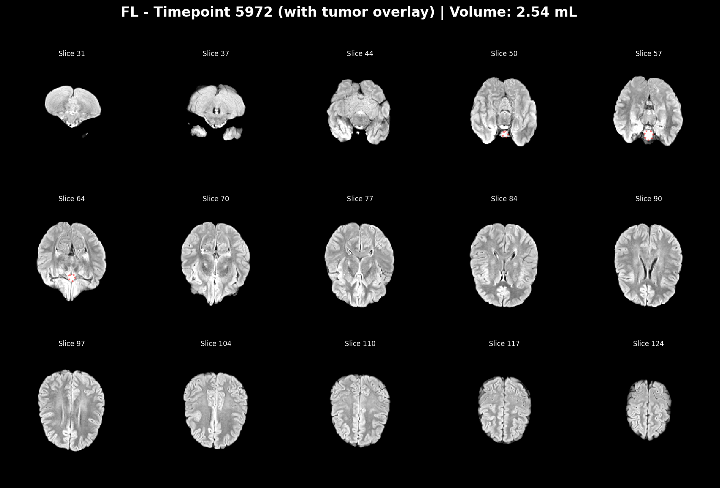

Slide 4
