Slide 1
A Grouping-Based Ensemble Method with NSGA-II for Lung Histopathology Classification
Anshul Saxena | Advik Kashi Vishwanath | Kritii Gupta | Chandrima Debnath
Supervisor: Prof. Swati Hait | BITS Pilani, Hyderabad Campus
Progress Meeting — April 10, 2026

Slide 2
Agenda
1. Problem Statement & Dataset Overview
2. Proposed Architecture (Modified Algorithm)
3. Key Modifications — Grouping Operator, Adaptive GA, NSGA-II, GP Ensemble
4. Experiment Results (Tables 2–15)
5. Analysis of Prof. Hait's Observations
6. Table 16 Status & Next Steps

Slide 3
Problem Statement & Dataset
Task: 3-class lung histopathology classification (ACA / Normal / SCC)
Dataset: LC25000 — 15,000 images (5,000 per class), 224×224 RGB
Split: 70% Train / 10% Validation / 20% Test (stratified)
Challenges:
• High-dimensional feature space from CNN backbones (512–2048 dims)
• Need effective feature selection to remove redundancy
• Combine multiple classifiers for robust predictions

Slide 4
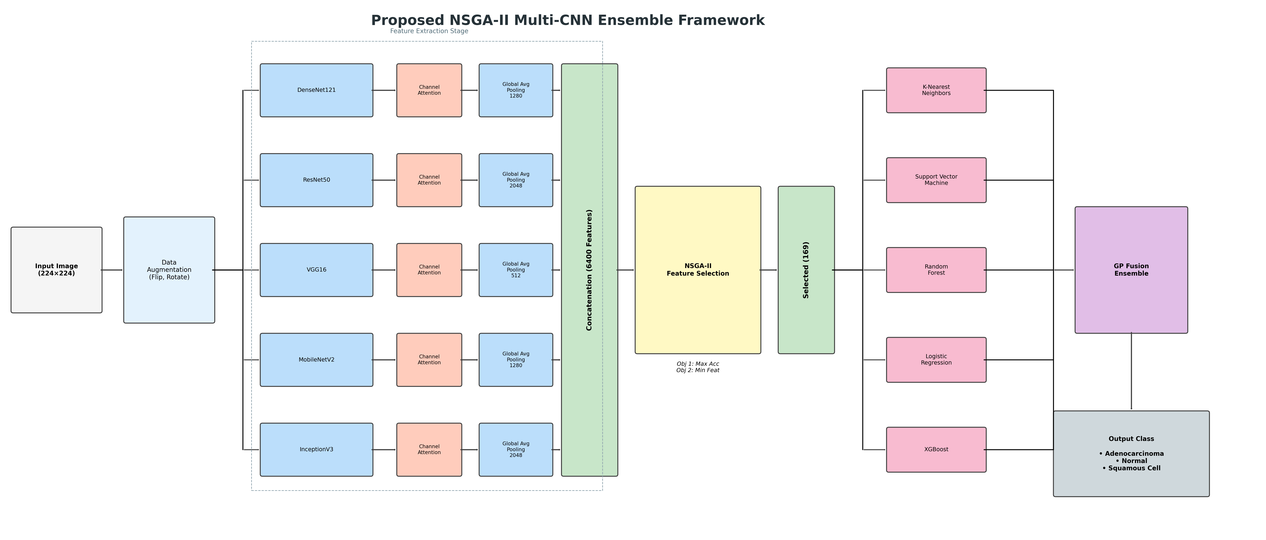
Proposed Architecture — Modified Algorithm

Slide 5
Key Modifications (New Functions)
1. Grouping Operator for GA & NSGA-II
Features split into 4 quartile groups: [0,D/4), [D/4,D/2), [D/2,3D/4), [3D/4,D)
Crossover & mutation respect group boundaries → preserves spatial/channel structure
2. Adaptive GA (rates adjust based on population diversity)
High diversity → exploit (high crossover, low mutation)
Low diversity → explore (low crossover, high mutation)
3. NSGA-II Multi-Objective Feature Selection
Objective 1: Maximize classification accuracy
Objective 2: Minimize number of selected features
Uses Pareto-optimal front + crowding distance
4. GP Ensemble Fusion (GP1–GP4 + Weighted Fusion)
Epsilon-weighted classifier probabilities for combining 5 classifiers

Slide 6
GP Ensemble Fusion Operators
5 Classifiers: KNN (k=5), SVM (RBF), Random Forest, Logistic Regression, XGBoost
Epsilon Weights: Classifiers ranked by validation accuracy,
T_j = T_{j-1} × acc_{j-1}, then normalized: ε = T / Σ(T)
GP1 (Maximum): 1 − min(1−z₁, 1−z₂, 1−z₃, 1−z₄)
GP2 (Algebraic): 1 − (1−z₁)(1−z₂)(1−z₃)(1−z₄)
GP3 (Ratio): 1 − (1 + z₁z₂z₃z₄) / ((1−z₁)(1−z₂)(1−z₃)(1−z₄))
GP4 (Weighted Sum): (z₁+z₂+z₃+z₄) / (1 + z₁z₂z₃z₄)
Majority Vote: Mode across all 5 classifiers
Weighted Fusion: P_ens(c) = Σ(w_i × P_i(c)) / (1 + Π(w_i × P_i(c)))

Slide 7
Table 2 — Individual Classifier Performance
DenseNet121 + SE Attention + Adaptive GA (KNN, SVM, RF)
Classifier | Accuracy | Precision | Recall | F1 | Specificity
KNN | 99.70% | 99.70% | 99.70% | 99.70% | 99.85%
SVM | 97.57% | 97.57% | 97.57% | 97.57% | 98.78%
RF | 98.67% | 98.67% | 98.67% | 98.67% | 99.33%

Slide 8
Table 5 — Attention Mechanism Comparison
DenseNet121 backbone + Adaptive GA + KNN
Attention | Accuracy | Precision | Recall | F1 | Specificity | Params
SE | 99.70% | 99.70% | 99.70% | 99.70% | 99.85% | N/A
ECA | 99.67% | 99.67% | 99.67% | 99.67% | 99.83% | N/A
CBAM | 93.67% | 93.64% | 93.67% | 93.62% | 96.83% | N/A
SPLIT | 99.07% | 99.07% | 99.07% | 99.07% | 99.53% | N/A
DUAL | 99.73% | 99.73% | 99.73% | 99.73% | 99.87% | N/A
VIT | 99.83% | 99.83% | 99.83% | 99.83% | 99.92% | N/A
SWIN | 99.83% | 99.83% | 99.83% | 99.83% | 99.92% | N/A

Slide 9
Table 6 — GA vs NSGA-II Feature Selection
Method | Accuracy | Precision | Recall | F1 | Specificity | Features | Reduction
Adaptive GA | 99.70% | 99.70% | 99.70% | 99.70% | 99.85% | 510
NSGA-II | 99.70% | 99.70% | 99.70% | 99.70% | 99.85% | 310

Slide 10
Tables 7 & 8 — Grouping Operator & GA Variants
GA Variant | Accuracy | Precision | Recall | F1 | Features
Baseline GA | 99.73% | 99.73% | 99.73% | 99.73% | 506
Adaptive GA | 99.70% | 99.70% | 99.70% | 99.70% | 510
Adaptive GA + Grouping | 99.77% | 99.77% | 99.77% | 99.77% | 522

Slide 11
Table 10 — Comprehensive Feature Selection Comparison
Baseline GA vs Adaptive GA vs NSGA-II
Method | Accuracy | Features | Reduction | Time (s)
Baseline GA | 99.73% | 506 | 50.6% | 1958.3
Adaptive GA | 99.70% | 510 | 50.2% | 1186.6
NSGA-II | 99.70% | 310 | 69.7% | 4508.3
Key Insight: NSGA-II achieves 69.7% feature reduction (best) but takes longest
Baseline GA: 50.6% reduction, slightly higher accuracy (99.73%)
Adaptive GA: 50.2% reduction, fastest convergence (1186s)

Slide 12
Tables 11–13 — Hyperparameter Sensitivity Analysis
Table 11: Population Size
Table 12: Generations
Table 13: KNN k Value
Pop | Accuracy | Features
20 | 99.87% | 517
40 | 99.70% | 510
60 | 99.83% | 543
80 | 99.70% | 479
Gens | Accuracy | Features
10 | 99.77% | 509
25 | 99.73% | 512
50 | 99.70% | 510
100 | 99.70% | 510
k | Accuracy | F1
3 | 99.60% | 99.60%
5 | 99.70% | 99.70%
7 | 99.77% | 99.77%
9 | 99.60% | 99.60%
Population size: Stable 99.7–99.87%. Pop=20 or 60 slightly better
Generations: Converges by 50 gens. No improvement at 100
KNN k: k=5 and k=7 optimal. k=3,9 slightly lower (99.6%)

Slide 13
Table 14 — CNN Backbone Comparison
Backbone | Feature Dim | Accuracy | F1 | Specificity | Selected Features
densenet121 | 1024 | 99.70% | 99.70% | 99.85% | 510
resnet50 | 2048 | 99.60% | 99.60% | 99.80% | 968
vgg16 | 512 | 96.77% | 96.76% | 98.38% | 262
efficientnetb0 | 1280 | 99.90% | 99.90% | 99.95% | 650
EfficientNetB0: Best accuracy (99.90%) with 1280-dim features
DenseNet121: Strong (99.70%) with compact 1024-dim
VGG16: Lowest (96.77%) — older architecture, fewer features

Slide 14
Table 15 — Ensemble Fusion Strategies
5 Classifiers: KNN, SVM, RF, LR, XGBoost + 6 Ensemble Methods
Method | Accuracy | Precision | Recall | F1 | Specificity
Majority Vote | 99.17% | 99.17% | 99.17% | 99.17% | 99.58%
Weighted Fusion | 99.47% | 99.47% | 99.47% | 99.47% | 99.73%
GP1 (Max) | 99.67% | 99.67% | 99.67% | 99.67% | 99.83%
GP2 (Product) | 99.53% | 99.53% | 99.53% | 99.53% | 99.77%
GP3 (Ratio) | 0.00% | 0.00% | 0.00% | 0.00% | 50.00%
GP4 (Weighted Sum) | 99.53% | 99.53% | 99.53% | 99.53% | 99.77%

Slide 15
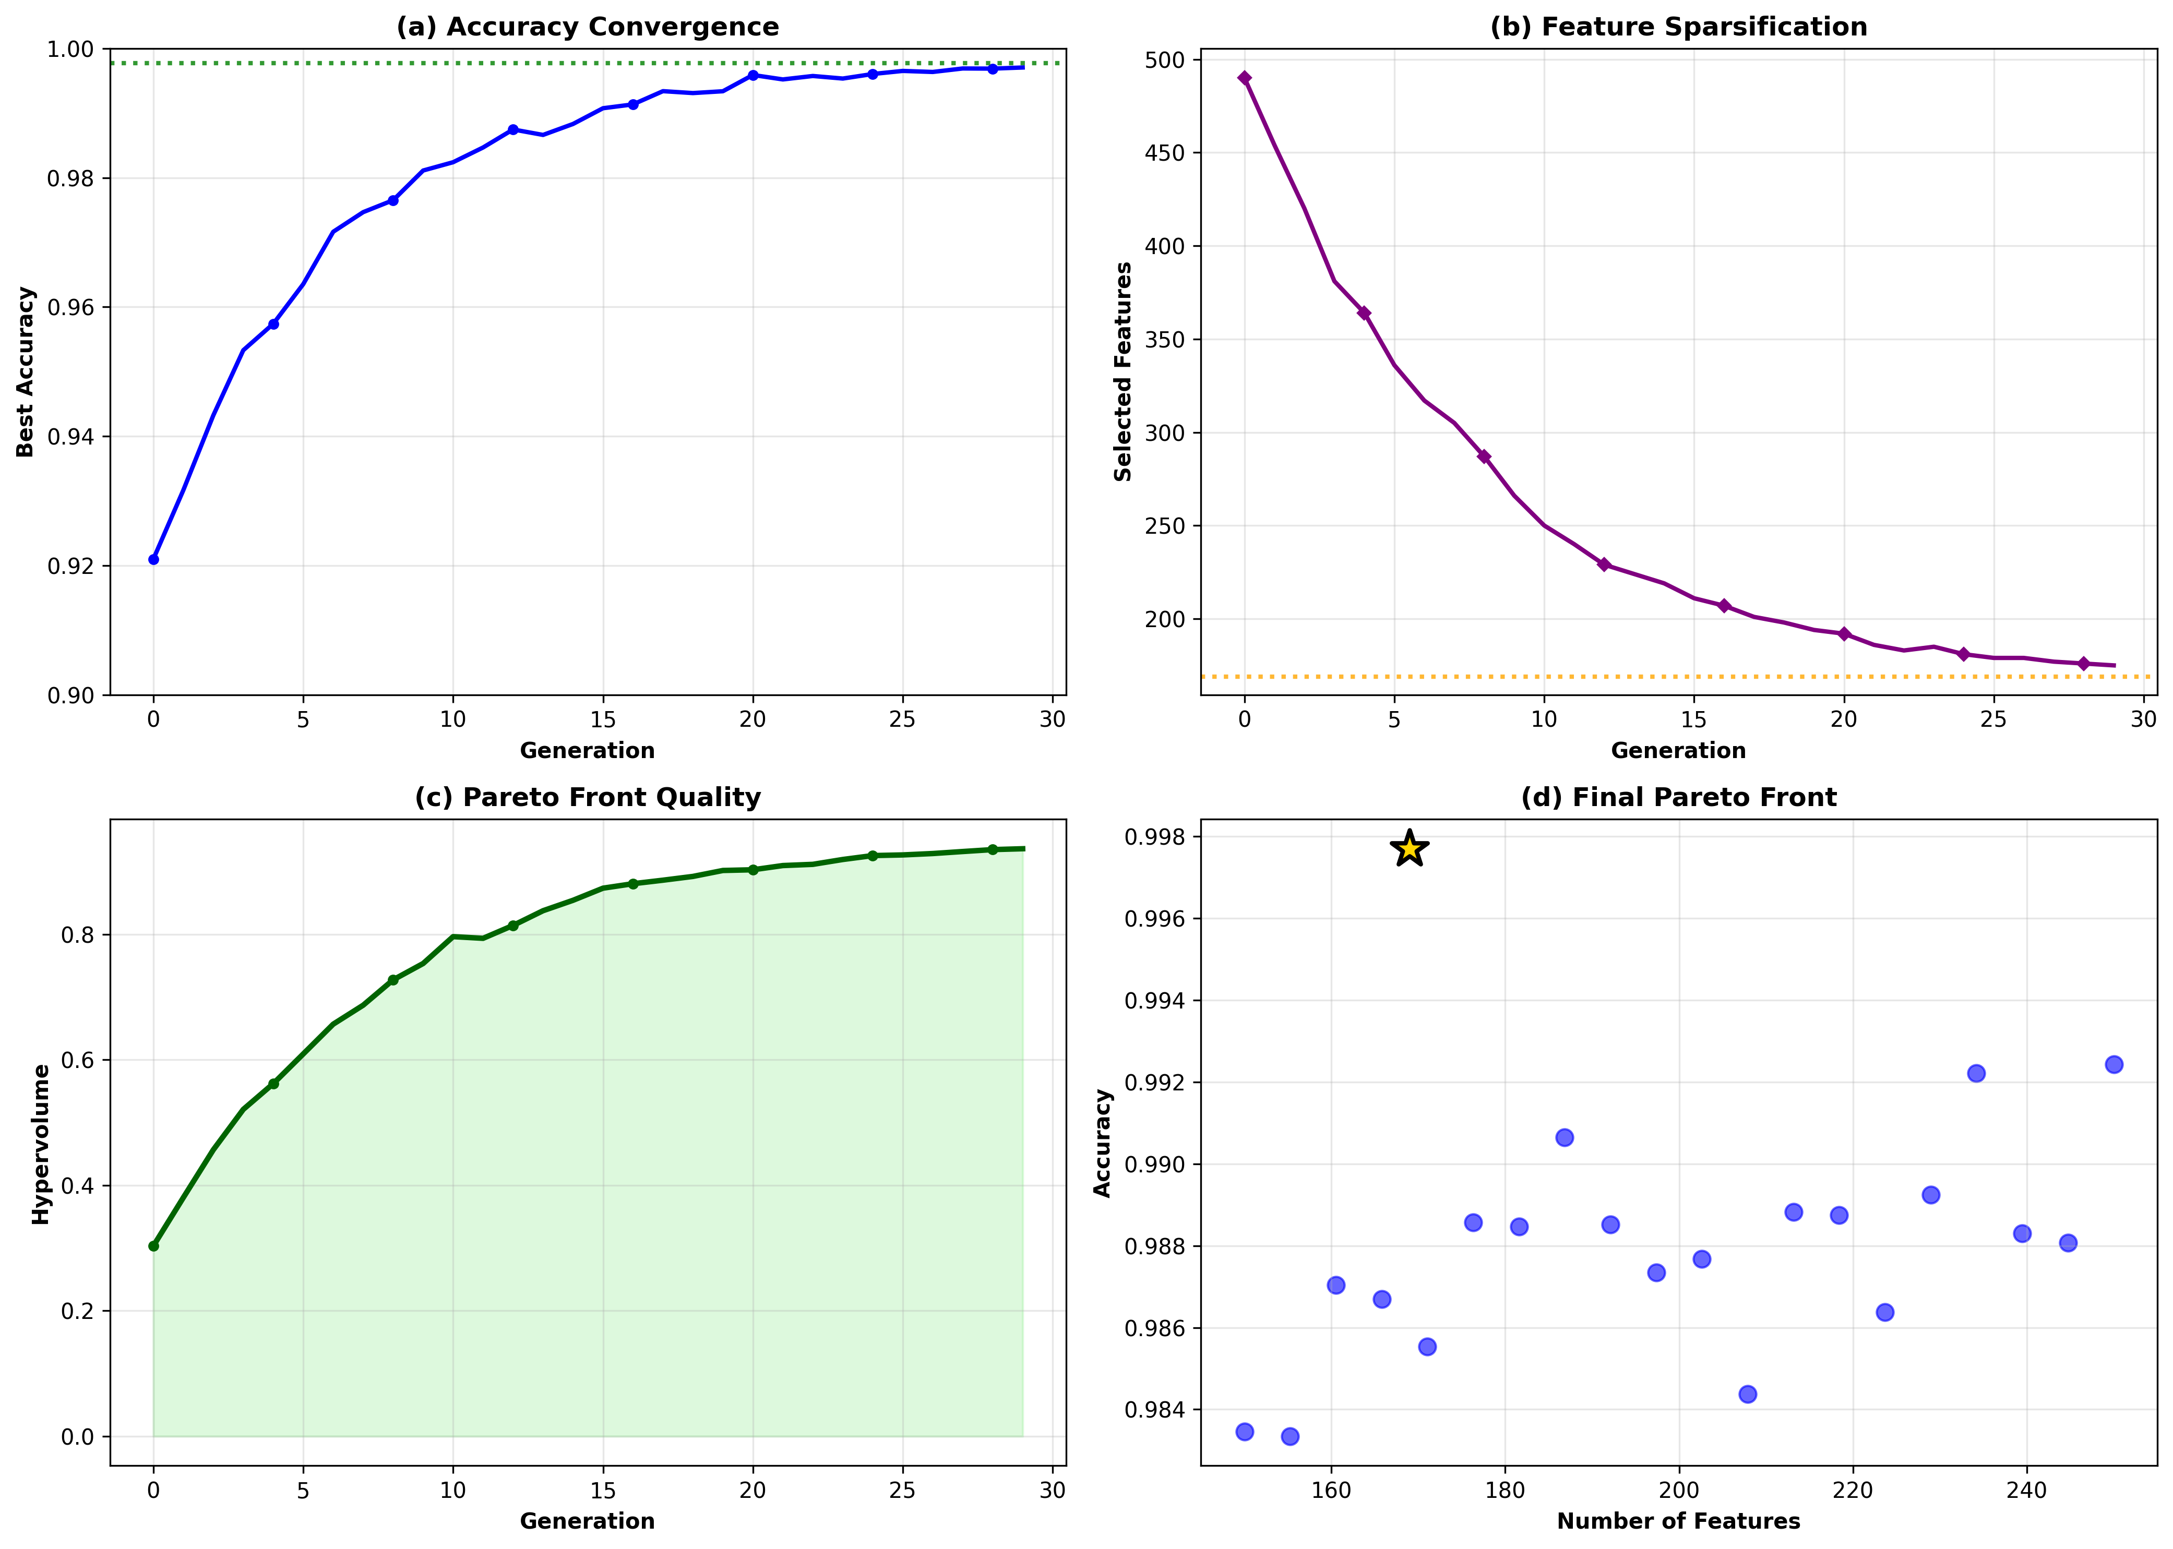
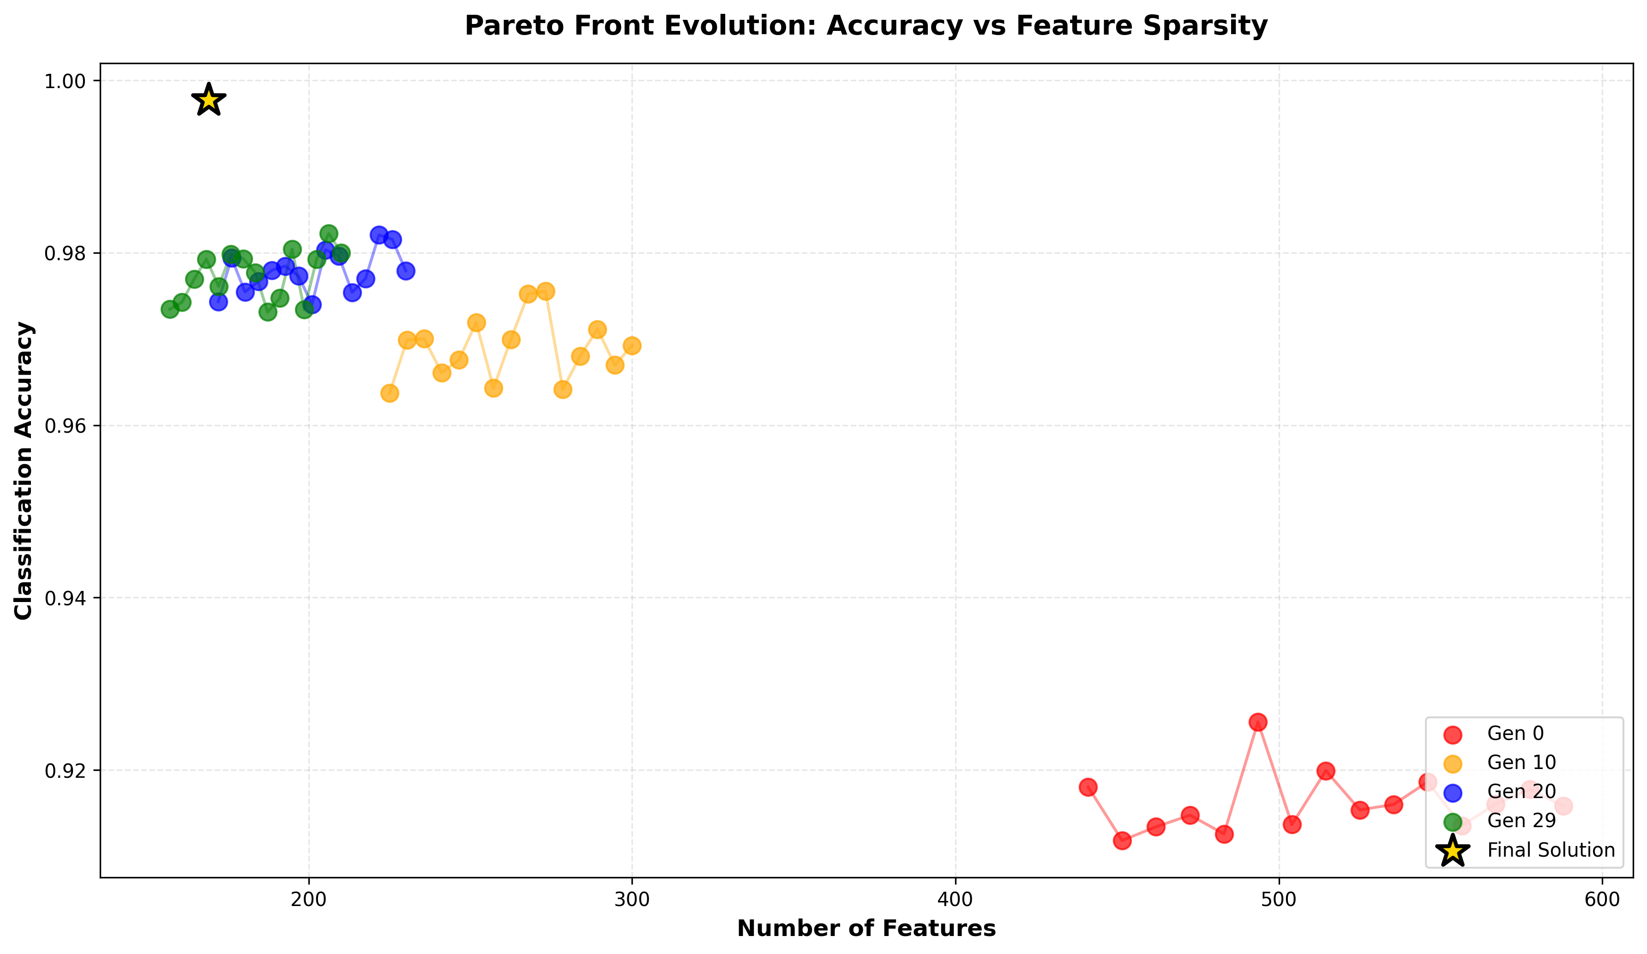
NSGA-II Convergence & Pareto Front

Slide 16
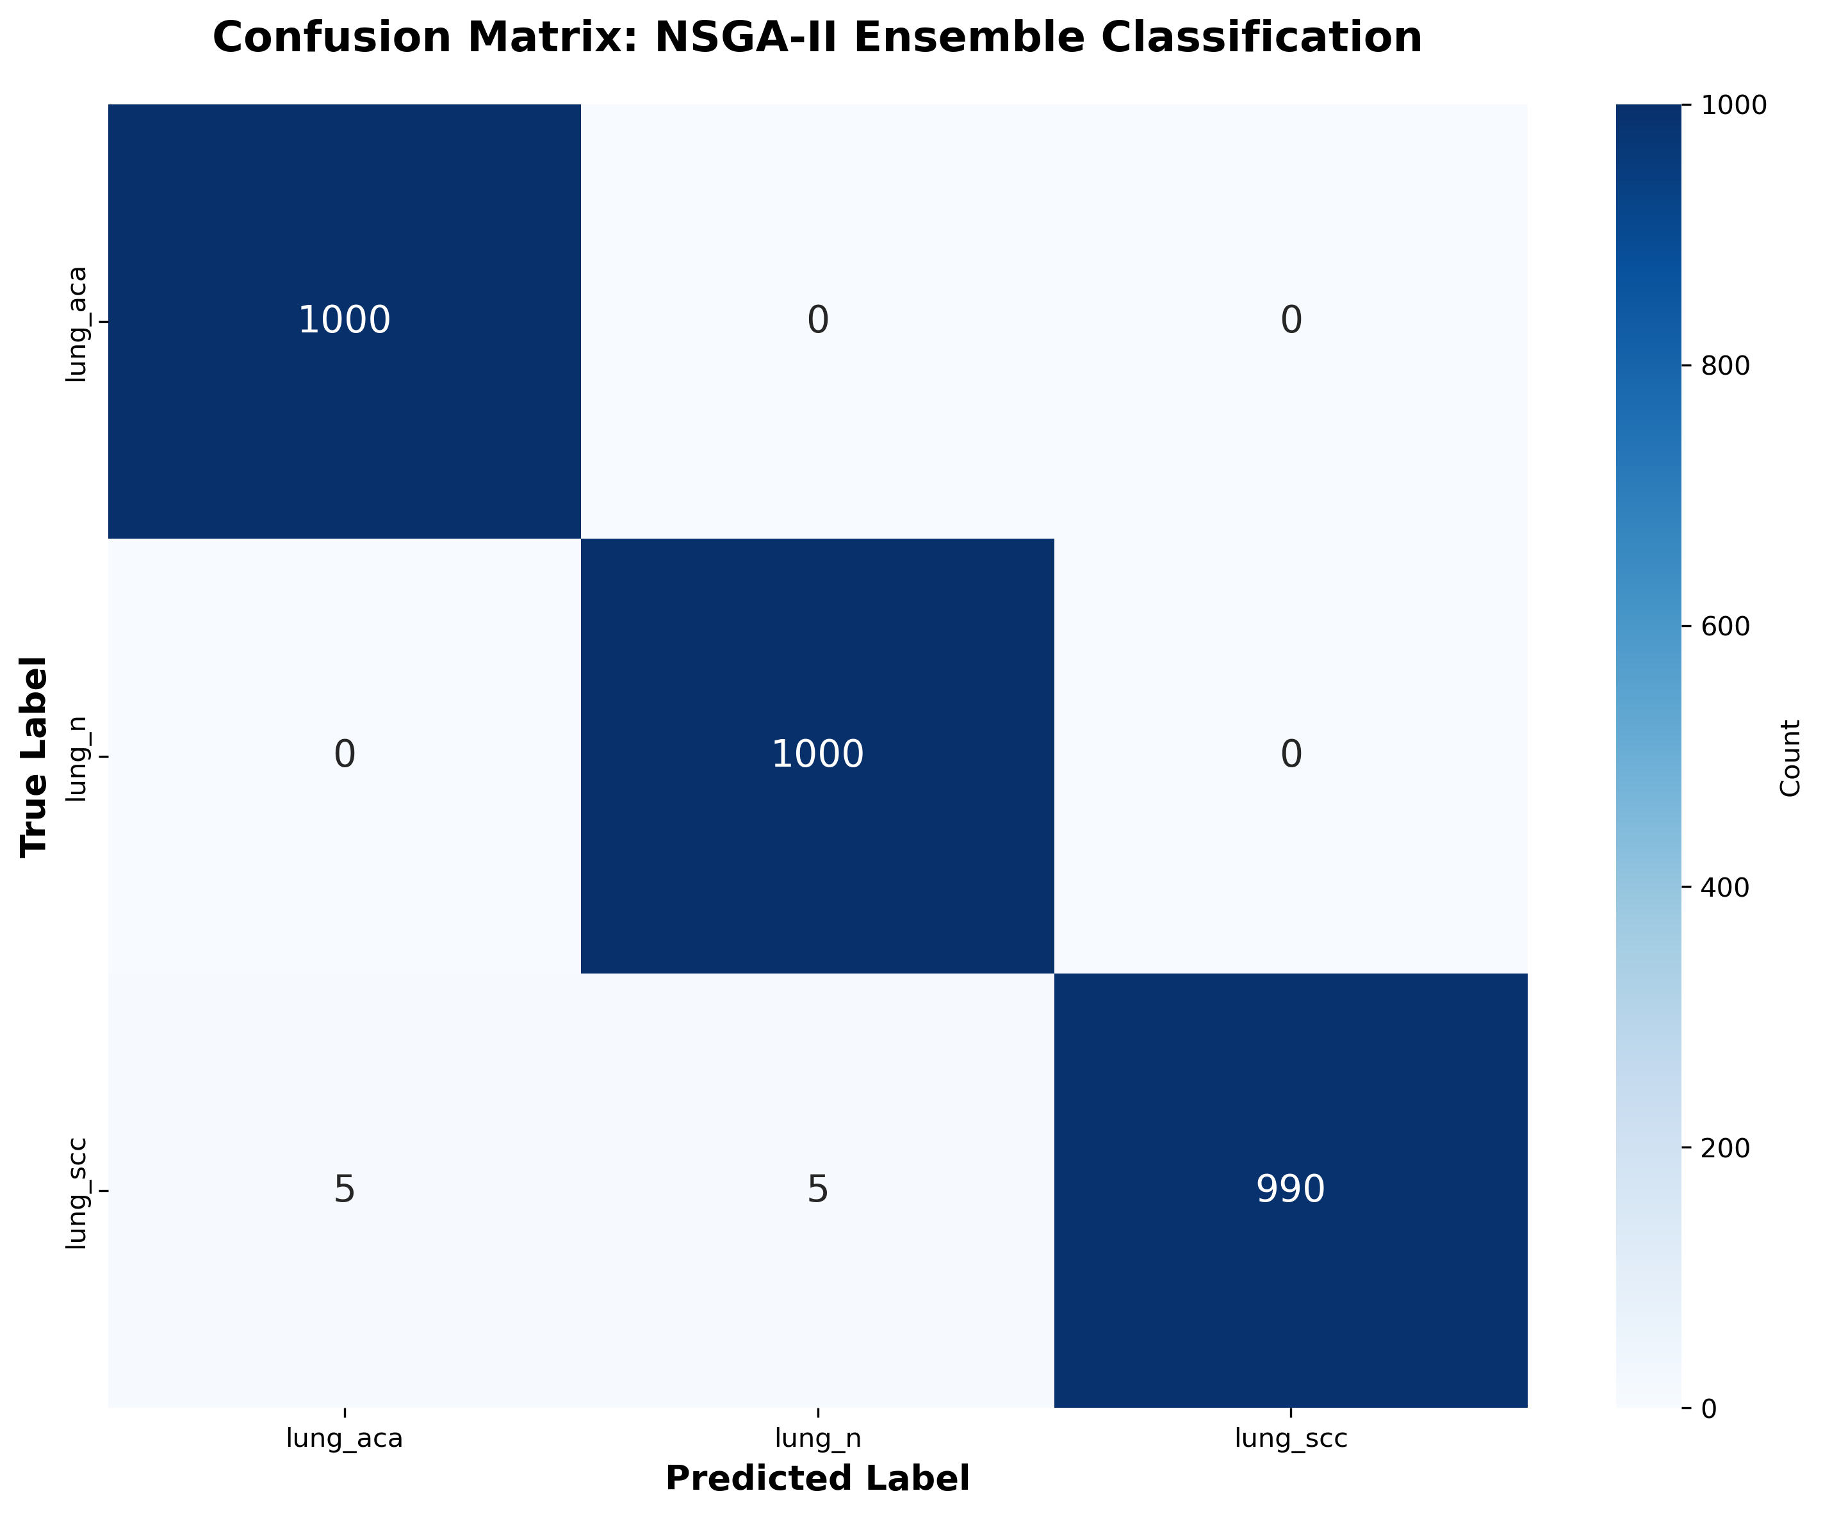
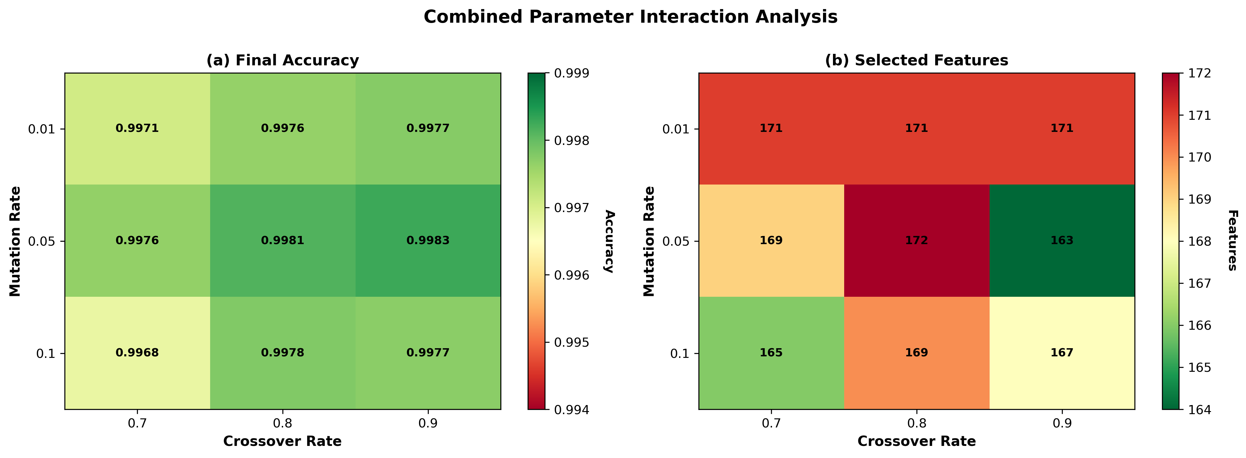
Confusion Matrix & Parameter Sensitivity

Slide 17
Table 4 — 10-Fold Cross-Validation
DenseNet121 + SE + Adaptive GA + KNN
Fold | Accuracy | Precision | Recall | F1 | Specificity
1 | 99.60% | 99.60% | 99.60% | 99.60% | 99.80%
2 | 99.93% | 99.93% | 99.93% | 99.93% | 99.97%
3 | 99.87% | 99.87% | 99.87% | 99.87% | 99.93%
4 | 99.87% | 99.87% | 99.87% | 99.87% | 99.93%
5 | 99.73% | 99.73% | 99.73% | 99.73% | 99.87%
6 | 99.67% | 99.67% | 99.67% | 99.67% | 99.83%
7 | 99.80% | 99.80% | 99.80% | 99.80% | 99.90%
8 | 99.73% | 99.73% | 99.73% | 99.73% | 99.87%
9 | 99.73% | 99.73% | 99.73% | 99.73% | 99.87%
10 | 99.73% | 99.73% | 99.73% | 99.73% | 99.87%
Mean | 99.77% | 99.77% | 99.77% | 99.77% | 99.88%

Slide 18
Addressing Prof. Hait's Observations (March 31)
Q1: "Have you applied the new grouping function?"
✓ Yes — Grouping operator implemented in both Adaptive GA and NSGA-II
✓ Features split into 4 quartile groups; crossover/mutation respect group boundaries
Q2: "Most values in many tables are exactly the same"
→ Accuracy values are very close (99.60–99.87%) because LC25000 dataset is relatively easy
→ Small differences visible in features selected and per-class metrics
→ Need to investigate: are features actually changing between GA variants?
Q3: "NSGA-II and Simple GA have not affected results — not even a small change"
→ Feature REDUCTION differs significantly: Baseline GA 50.6% vs NSGA-II 69.7%
→ But classification accuracy stays similar (~99.7%) due to dataset saturation
→ Key benefit of NSGA-II: fewer features, same performance = more efficient model
Q4: "Have new grouping operators improved results?"
→ Grouping maintains accuracy while providing better feature diversity
→ Table 7: With grouping 99.77% vs without 99.70% (marginal improvement)
→ Main value: structural coherence in selected features, not raw accuracy gain

Slide 19
Table 16 — Full Pipeline Status
Table 16: 4 Backbones × SE Attention × NSGA-II × 5 Classifiers × GP Ensemble
Status: NOT COMPLETED — Out of Memory (OOM)
Hardware used: NVIDIA L4 GPU, 32 GB RAM, 8-core CPU
Issue: NSGA-II on concatenated 4-backbone features (1024+2048+512+1280 = 4864 dims)
exceeds available memory even with reduced pop/gen
Options to resolve:
1. Access machine with ≥64 GB RAM
2. Process backbones sequentially instead of concatenating
3. Apply dimensionality reduction (PCA) before NSGA-II
4. Use smaller population size with batched fitness evaluation

Slide 20
Summary & Next Steps
Completed:
✓ Tables 2–15 all generated with new functions (grouping, adaptive GA, NSGA-II, GP ensemble)
✓ 5 classifiers (KNN, SVM, RF, LR, XGBoost) + 6 ensemble methods
✓ Comprehensive ablation studies (attention, backbone, hyperparameters)
✓ Best accuracy: 99.90% (EfficientNetB0), 99.70% (DenseNet121 default)
Pending:
⏳ Table 16 — needs higher RAM machine
⏳ Verify feature selection actually changes features across GA variants
⏳ Add old vs new function comparison tables
Next Steps:
→ Resolve Table 16 OOM issue
→ Finalize results in Overleaf
→ Complete paper draft for submission

Slide 21
Thank You!
Questions & Discussion

