Slide 1

Campus Recruitment System
Subject: Database Management Systems
Guide: Dr. S. Prince Chelladurai
Team Members:
Anshul Choudhary[RA2411026011202]
Rishabh Choudhary[RA2411026011195]

Slide 2

Week 1 – Team Formation & Problem Statement
Team Formation
The team was formed with clearly defined roles to ensure systematic development of the project:
Database Designer
SQL Developer
Research and Documentation Lead
Problem Statement:
Colleges face difficulty in managing campus recruitment activities due to:
Unstructured student and company data
Manual tracking of applications
Lack of centralized placement information
No automated eligibility checking system
There is no simple database-driven system that:
Objective:
To design and implement a relational database system that manages campus recruitment activities efficiently and automates eligibility verification and selection tracking using SQL logic.
Tracks applications and recruitment status
Checks eligibility criteria automatically
Generates placement reports
Organizes students, companies, and job roles

Slide 3
Week 2 – Identification of Entities and Relationships
Identified Entities
Student
Company
JobRole
Application (Bridge Table)
Department
Relationships
Department → Student (1:N)
Company → JobRole (1:N)
Student ↔ JobRole (M:N)
(Resolved using Application table)
Key Design Elements
Primary Keys for each entity
Foreign Keys to maintain relationships
Composite Key in Application table

Slide 4
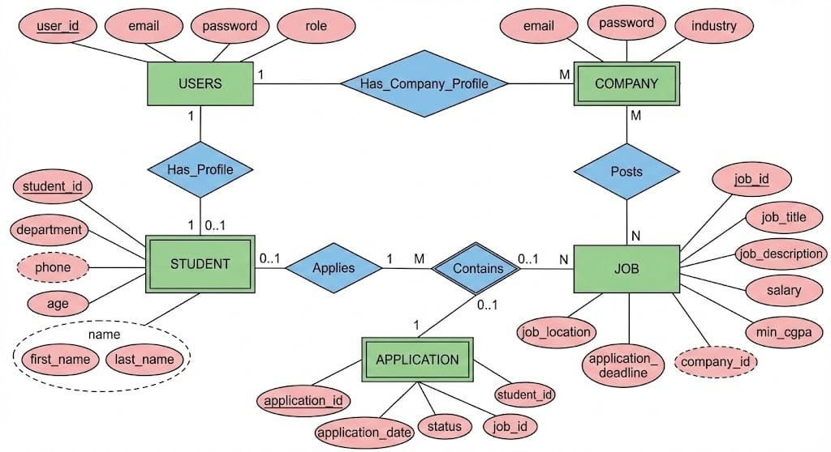
Week 3 – ER Model & Schema Design
Constructed ER diagram with:
• Entities
• Attributes
• Relationships
• Cardinalities
Relational Schema
Department (department_id, department_name)
Student (student_id, student_name, cgpa, email, phone, department_id)
Company (company_id, company_name, location, package_offered)
JobRole (job_id, job_title, min_cgpa, job_type, company_id)
Application (student_id, job_id, application_date, application_status)
Normalization & Integrity
• Database normalized to 3NF
• Primary and Foreign Keys enforced
• Referential integrity maintained
• No redundancy in student-job applications
ER Model

Slide 5
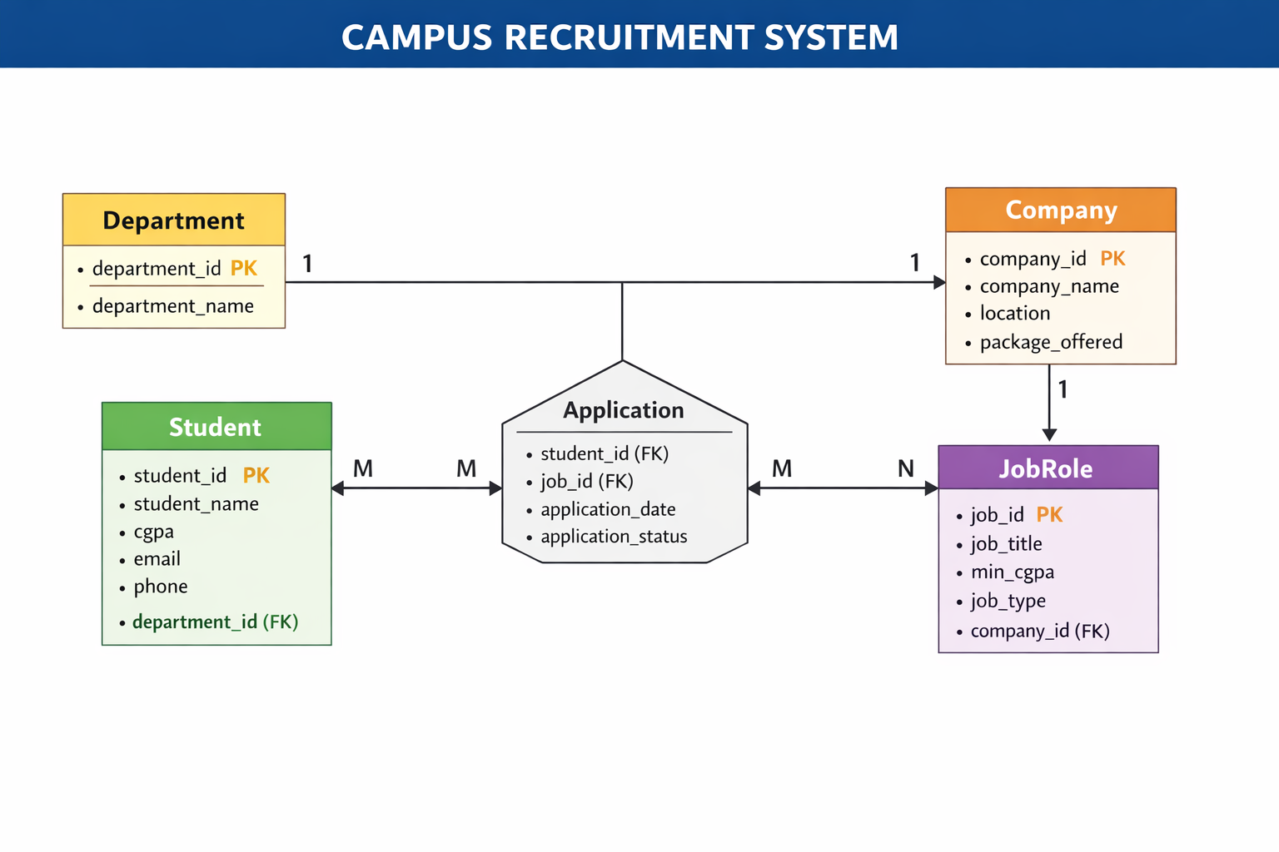
Week 3 – ER Model & Schema Design
Relational Schema Design

Slide 6
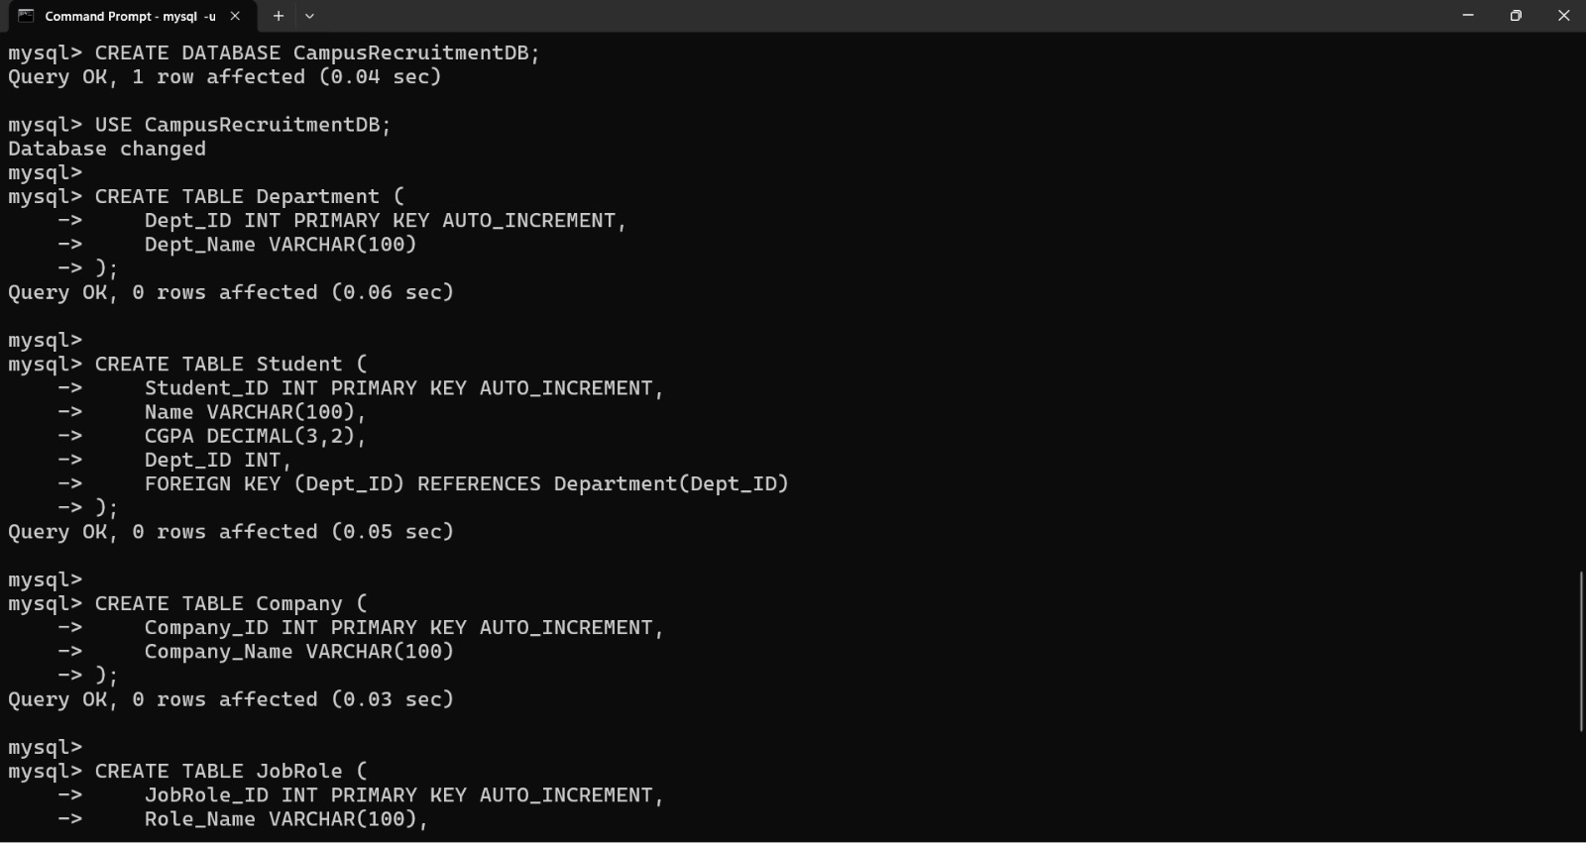
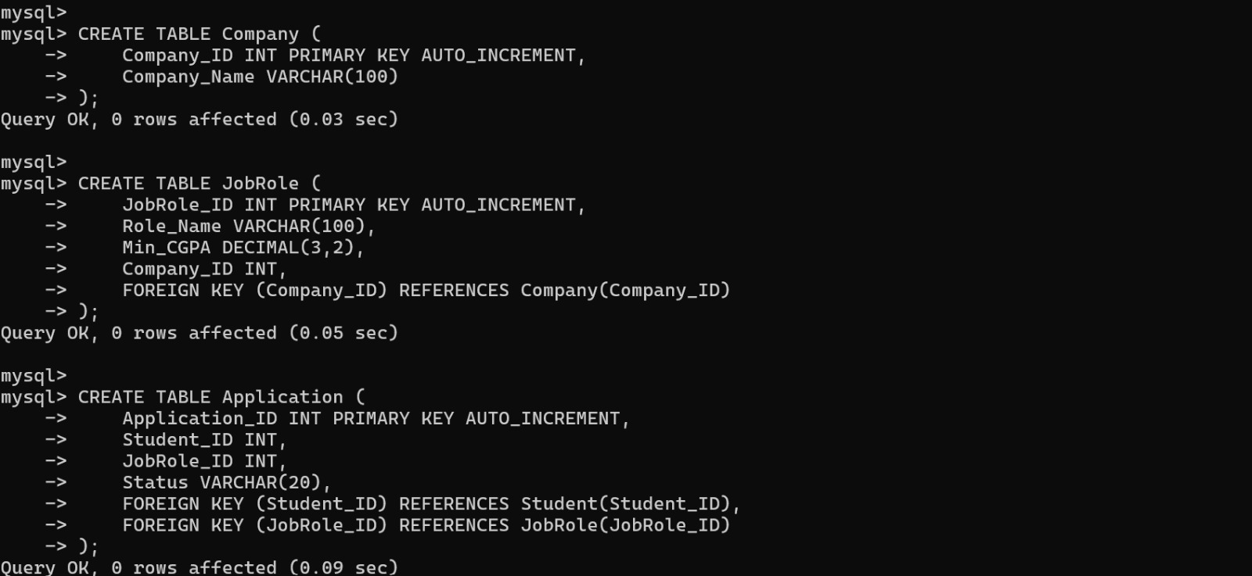

Slide 7

Selection Evaluation Method
The selection status is determined based on student eligibility criteria and recruitment process stages stored in the database.
Eligibility Formula
Eligibility Status = IF (Student_CGPA ≥ JobRole_Min_CGPA)
Where:
Student_CGPA represents the academic performance of the student
JobRole_Min_CGPA represents the minimum CGPA required by the company
Students not meeting criteria are automatically restricted from applying
Selection Status Logic
Application Status is updated based on recruitment stages:
Applied
Shortlisted
Interviewed
Selected
Rejected
Final placement status is determined dynamically from application records.
SQL Implementation
JOIN operations are used to retrieve student, company, and job role data
WHERE clause checks eligibility conditions
UPDATE queries modify application status
COUNT and SUM functions generate placement reports
Final selection results are computed dynamically using SQL queries
Rating Formula

Slide 8
Key Outcomes
Successfully designed a normalized relational database for campus recruitment management
Modeled one-to-many (Department–Student, Company–JobRole) and many-to-many (Student–JobRole) relationships
Implemented primary key, foreign key, and referential integrity constraints
Developed dynamic SQL-based eligibility verification and selection tracking system
Automated application status management (Applied, Shortlisted, Selected, Rejected)
Generated department-wise and company-wise placement reports using SQL queries
Created a scalable and structured Campus Recruitment Management System

