Slide 1
Document Extraction

Slide 2
Introduction
Purpose :
The project aims at extracting information from an uploaded pdf document through an API interface. The purpose is to convert the document in the required formats and extract necessary details.
Dataset :
A basic pdf document of an organisation. The document consists of multiple pages having various doctypes.

Slide 3
Technology Used
Python
Tesseract OCR
API - Flask Restplus with Swagger UI
Database toolkit - SQLAlchemy
Database Management System – MySQL
pdftables_api

Slide 4
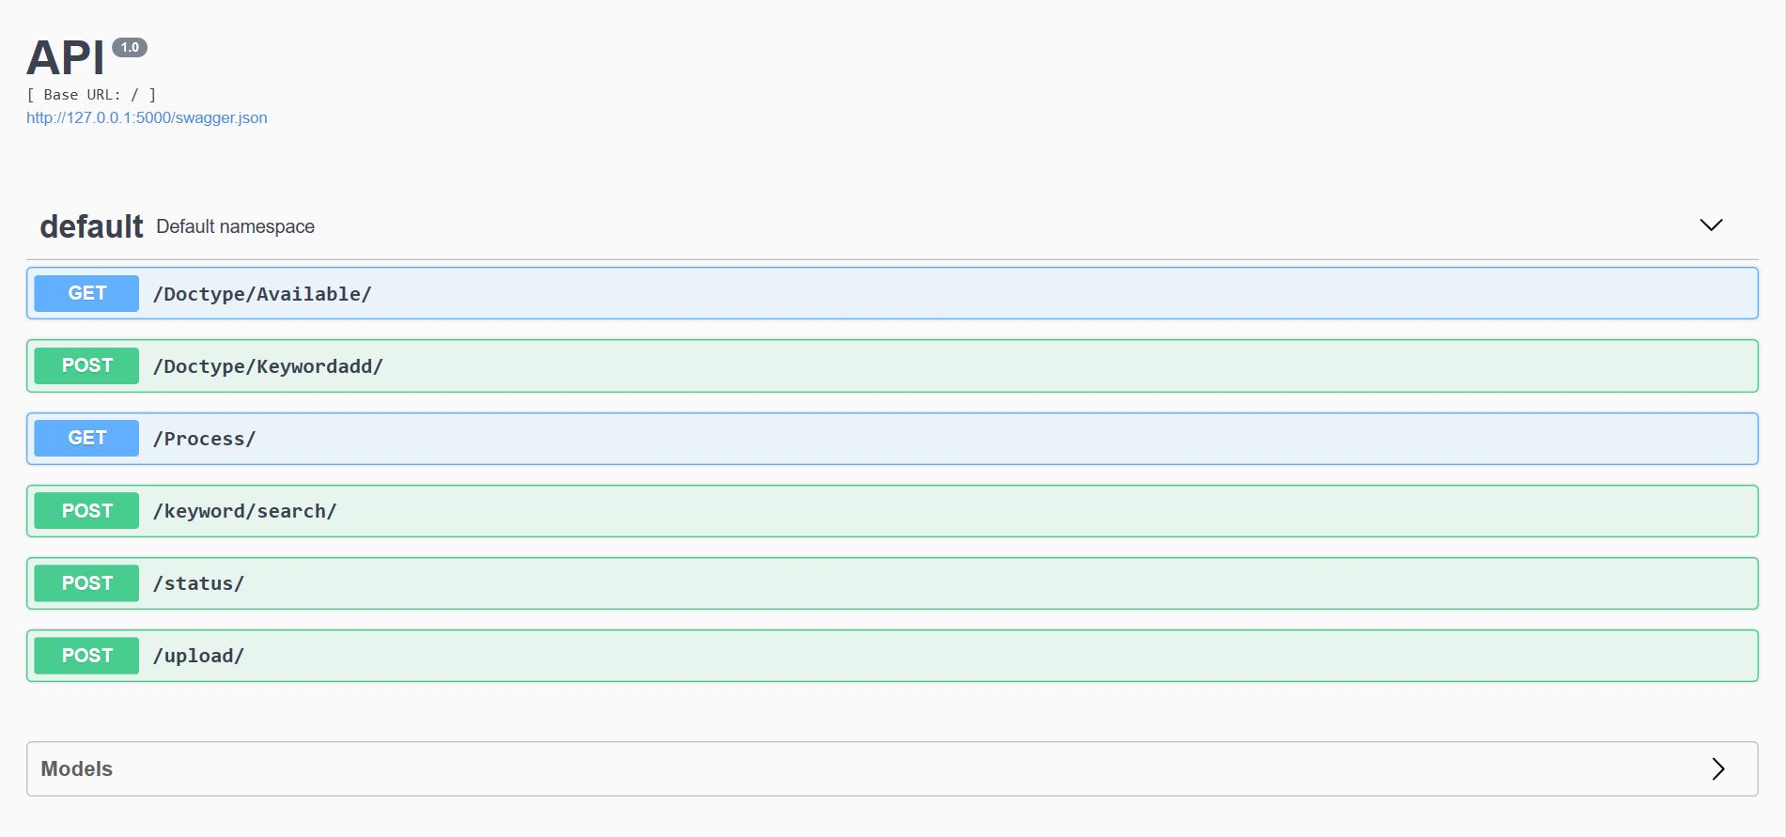
API

Slide 5

Database
Database Tables
Info_table
Key_table

Slide 6
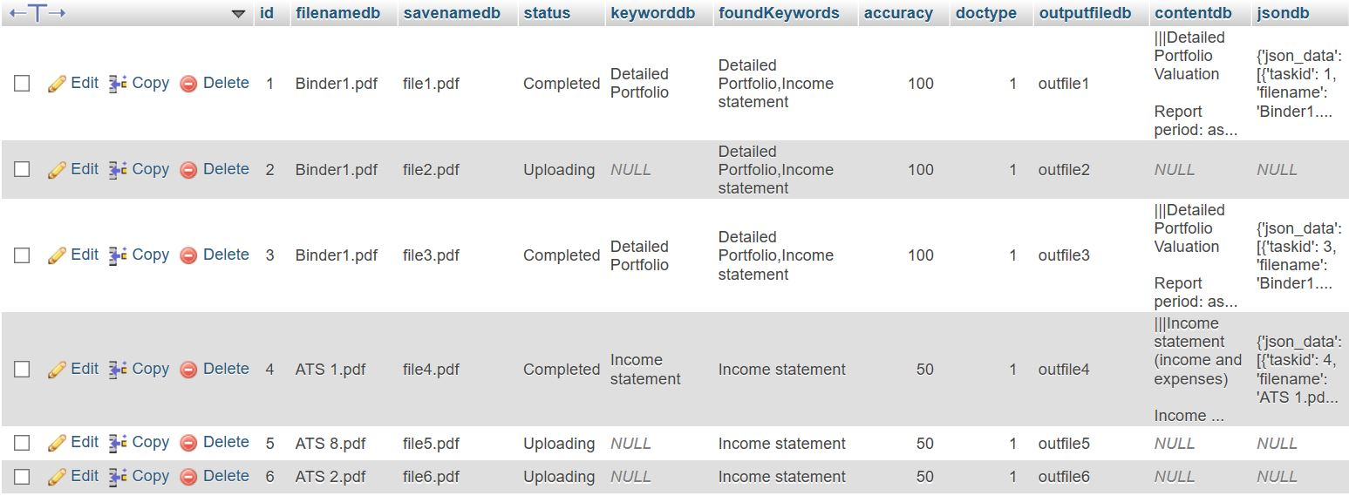
info_table key_table

Slide 7

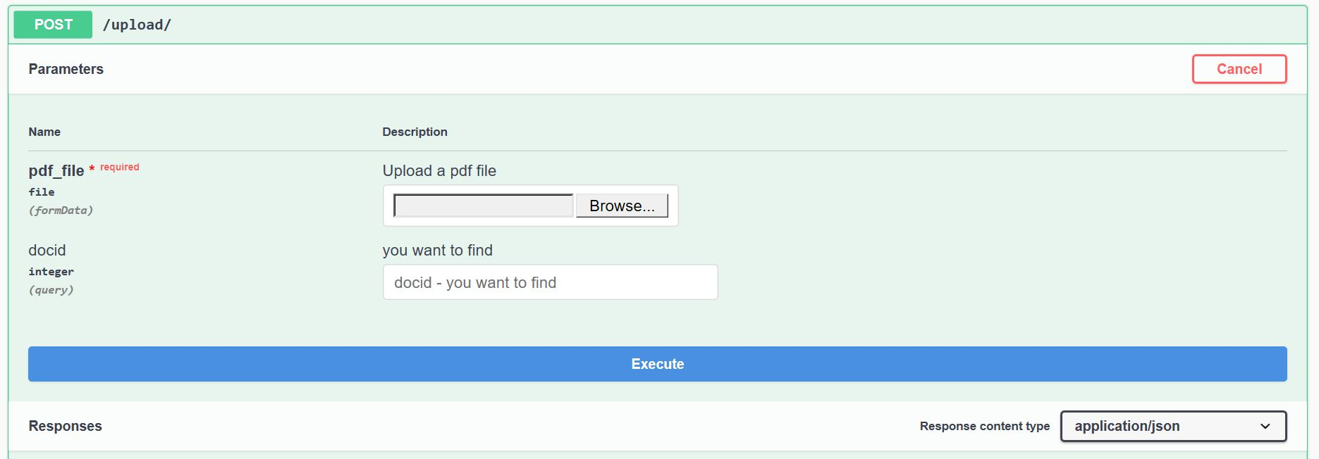
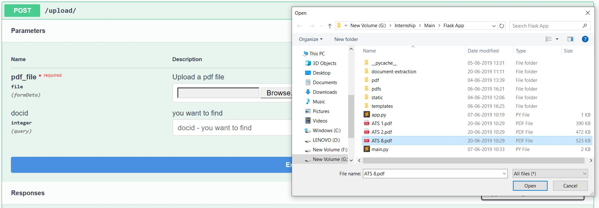
Uploading file
Endpoint : /upload/
Select file by browsing

Slide 8
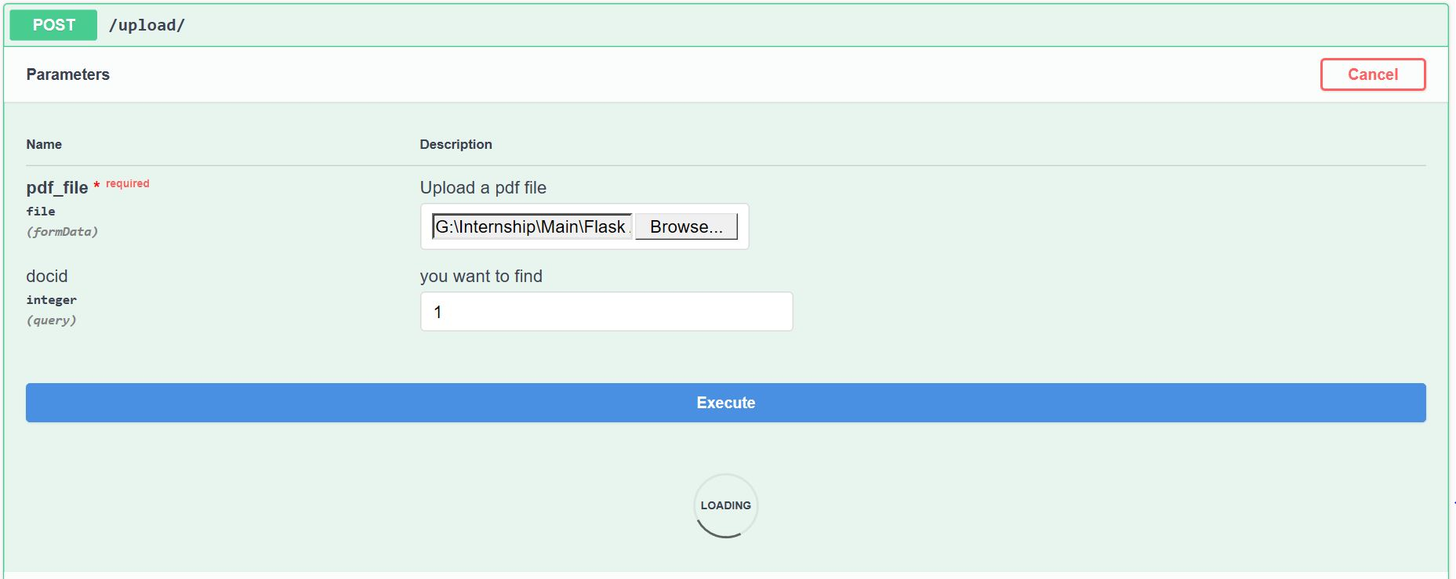
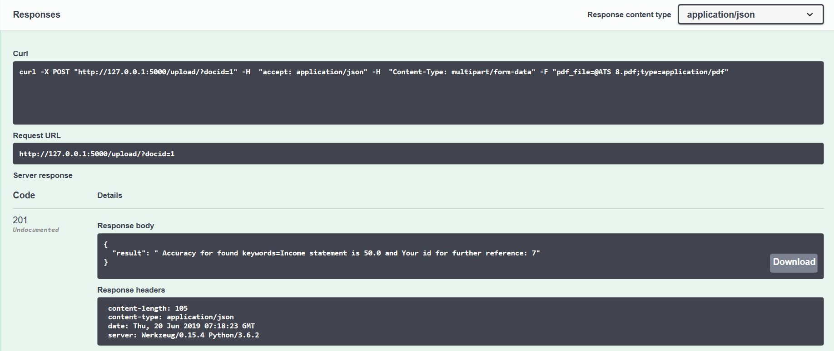
Endpoint : /upload/
Add docid
Response : Accuracy and content details
Database entry : Filename and status

Slide 9
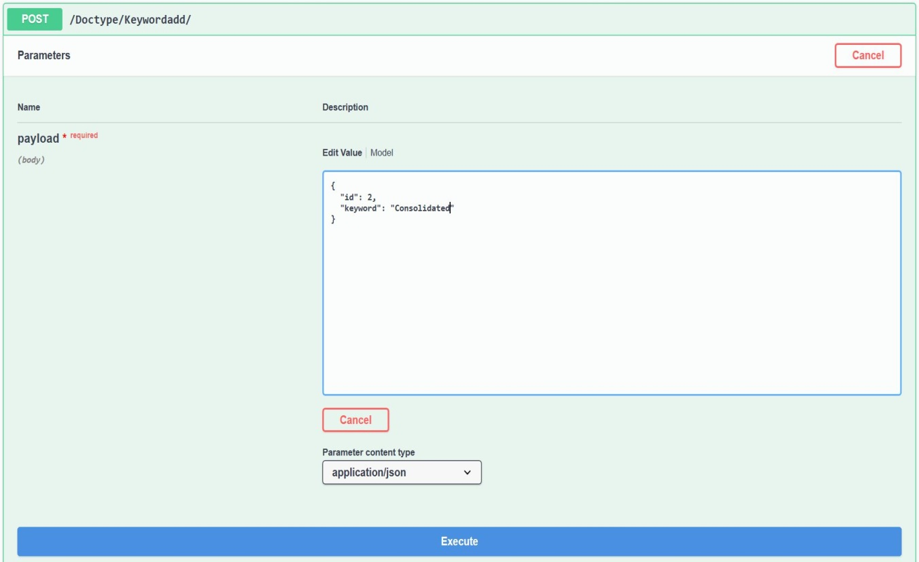
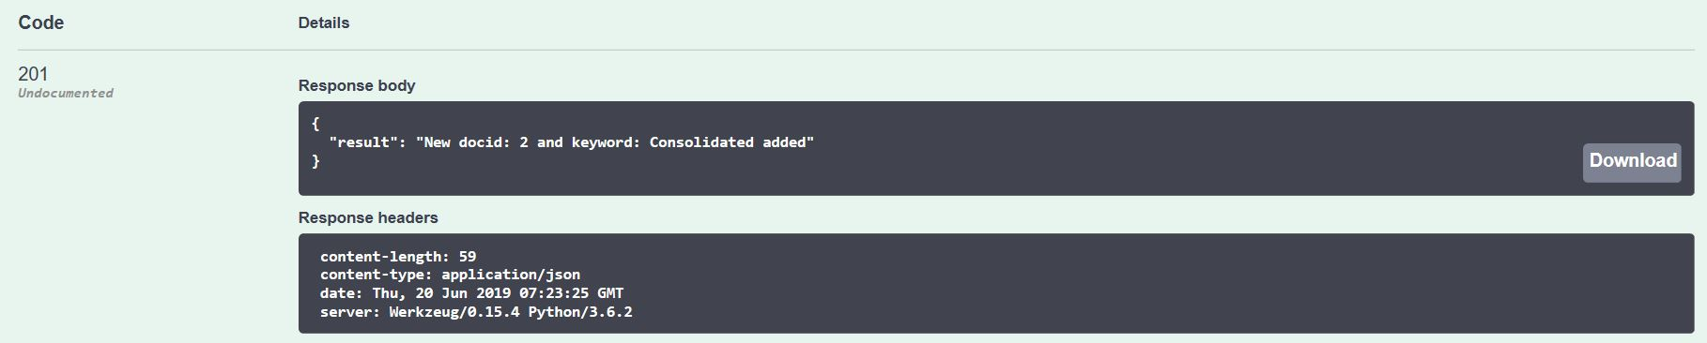
Adding Keywords
Endpoint : /Doctype/Keywordadd/
Adding keyword –
Database Table : key_table

Slide 10
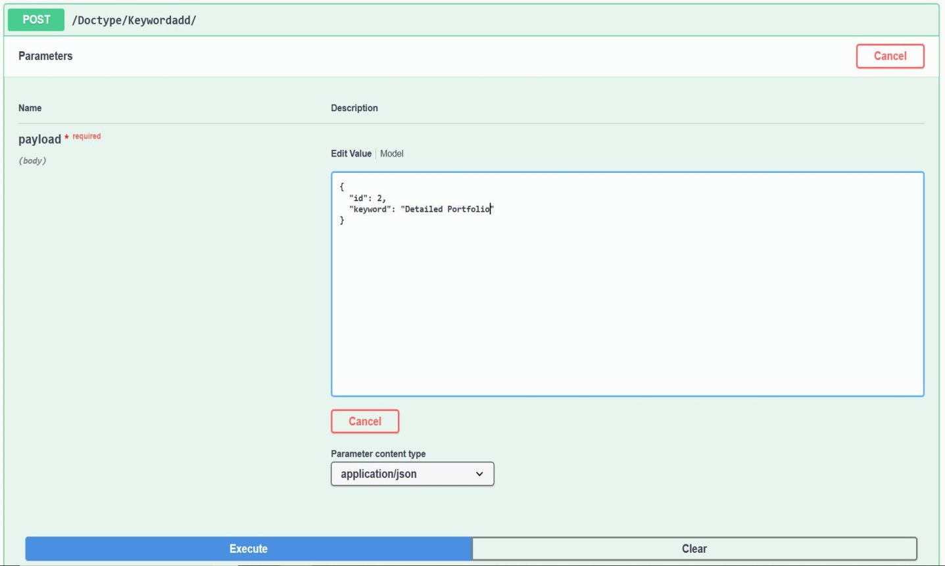
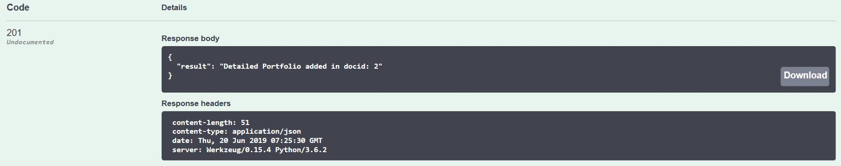
Endpoint : /Keywordadd/
Adding another keyword
Display keyword with docid

Slide 11
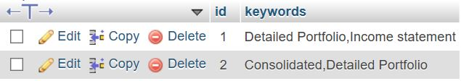
Database table : key_table
Included keywords in the database table with id

Slide 12
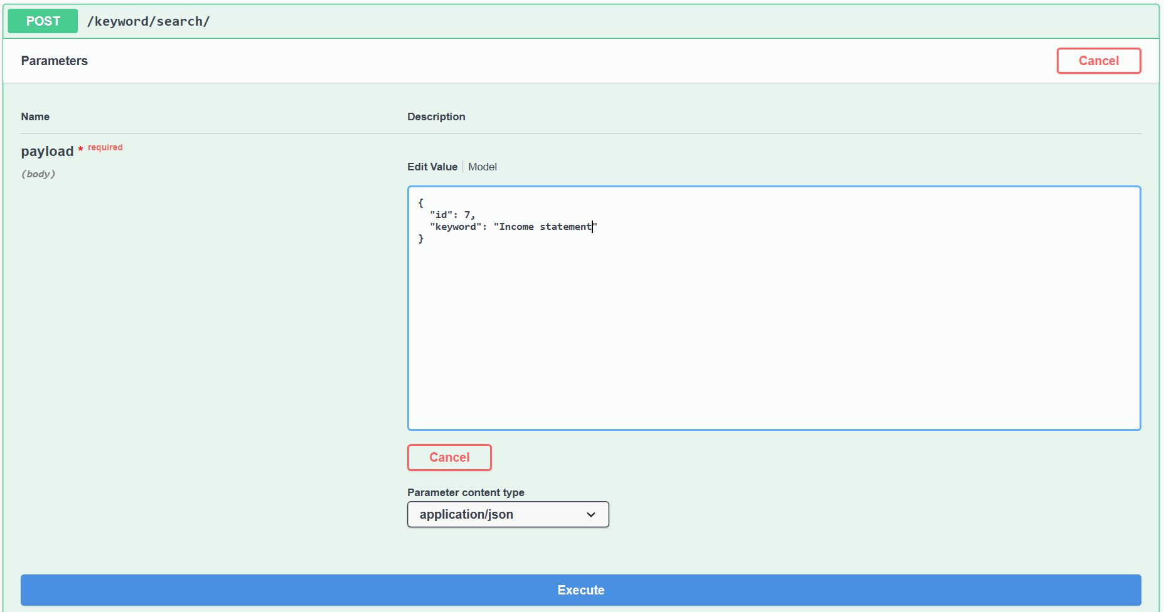
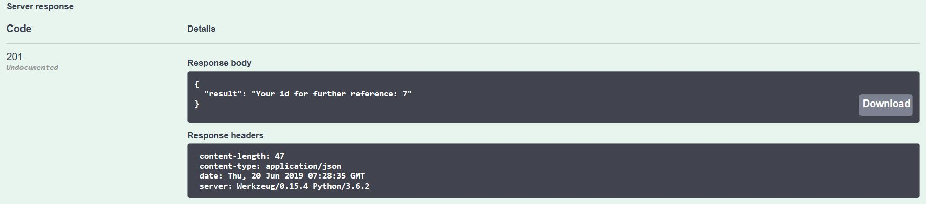
Keyword Search Endpoint : /Keyword/search/ Enter keyword to be searched

Slide 13
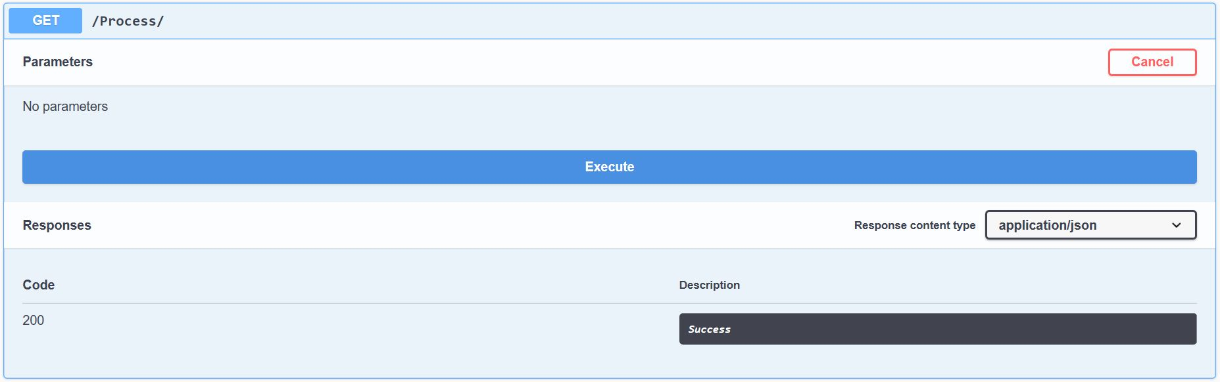
Process
Execute the Endpoint : /process/

Slide 14
Running Process…
After file content is stored in required JSON format.

Slide 15
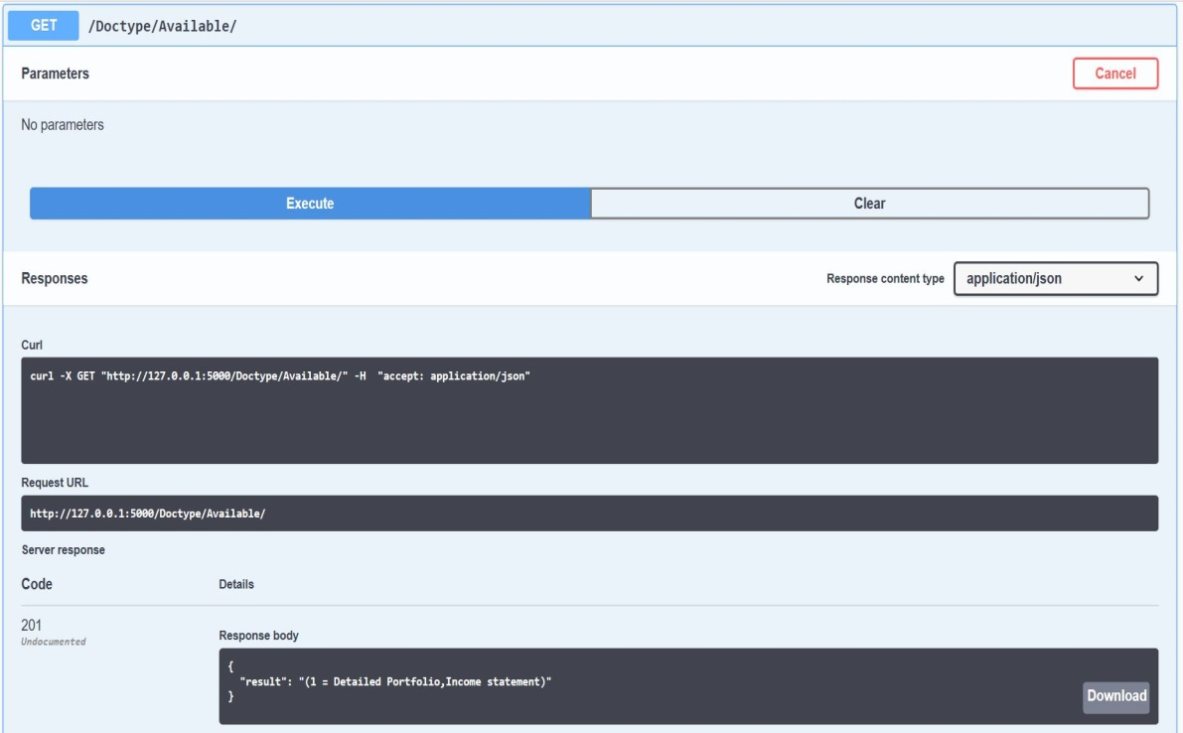
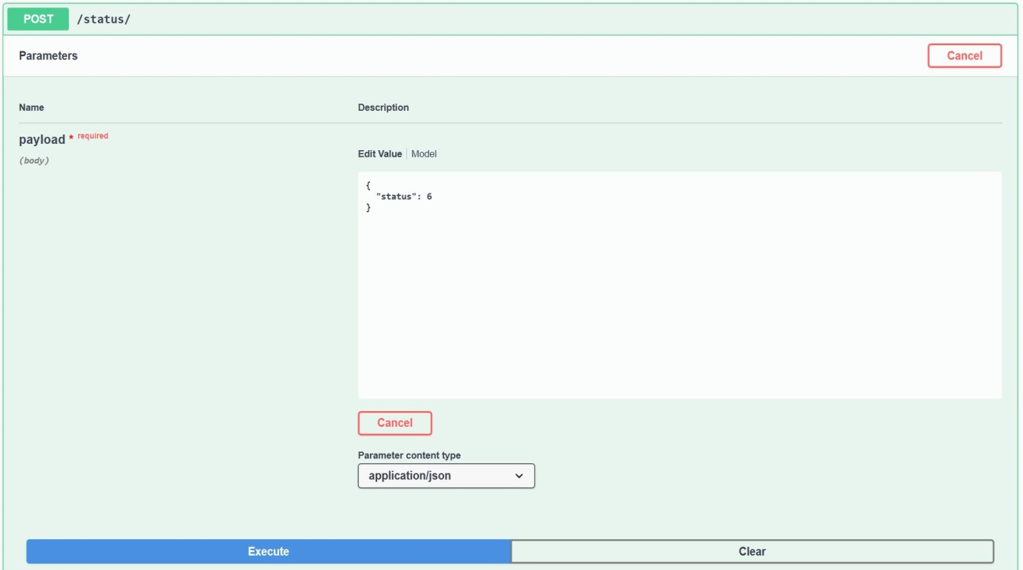
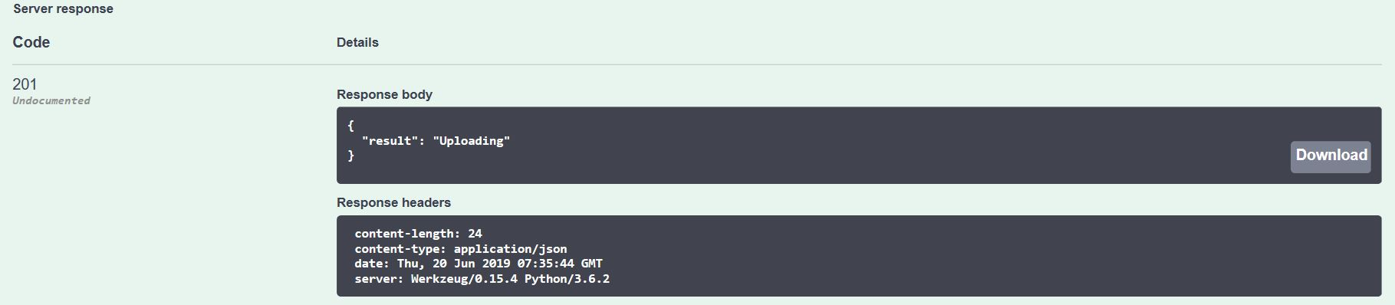
Extra Functions

Slide 16
PROS
Highly compatible : runs on any machine
Uploaded pdfs can be converted to many formats including JSON, xlsx, jpeg, etc.
Python provides with many free libraries, therefore affordable.
Continuous storage in database gives an easy access of required details whenever needed.

Slide 17
CONS
Format conversion of document is time consuming.
Memory requirement is more.
Devices with faster processing unit are required.
Data extraction is not always 100% accurate.
pdftables_api provides the accessible key for only a short duration.

Slide 18
What NEXT…?
Automating the identification of doc_type of the uploaded document
Using concept of multi-threading to set up uploading and processing task asynchronously
Using NLP algorithms to extract key information from the converted excel file

Slide 19
THANK YOU

