Slide 1
Credit Intelligence Dashboard
AI-Powered Credit Scoring & Risk Assessment
(Backend: FastAPI + ML | Frontend: React Dashboard)

Slide 2
Problem Statement & Objective
Traditional credit scoring systems are static and lack transparency.
Objective: Build an intelligent, explainable, and interactive credit scoring system.

Slide 3
System Architecture
• Backend: FastAPI with Random Forest model
• Explainability using SHAP values
• Frontend: React with Tailwind & Chart.js
• Integration via REST API

Slide 4
Machine Learning Model
• Random Forest Classifier trained on financial + sentiment features
• Features:
- Debt Ratio
- Revenue Growth
- Sentiment Score
• SHAP values provide feature-level explanations for transparency

Slide 5
Dashboard Overview
The dashboard provides:
• Credit Score & Risk Metrics
• Score Trends over time
• Risk Assessment Factors
• Customer Insights
• Recent Activities
• Quick Actions for analysis

Slide 6
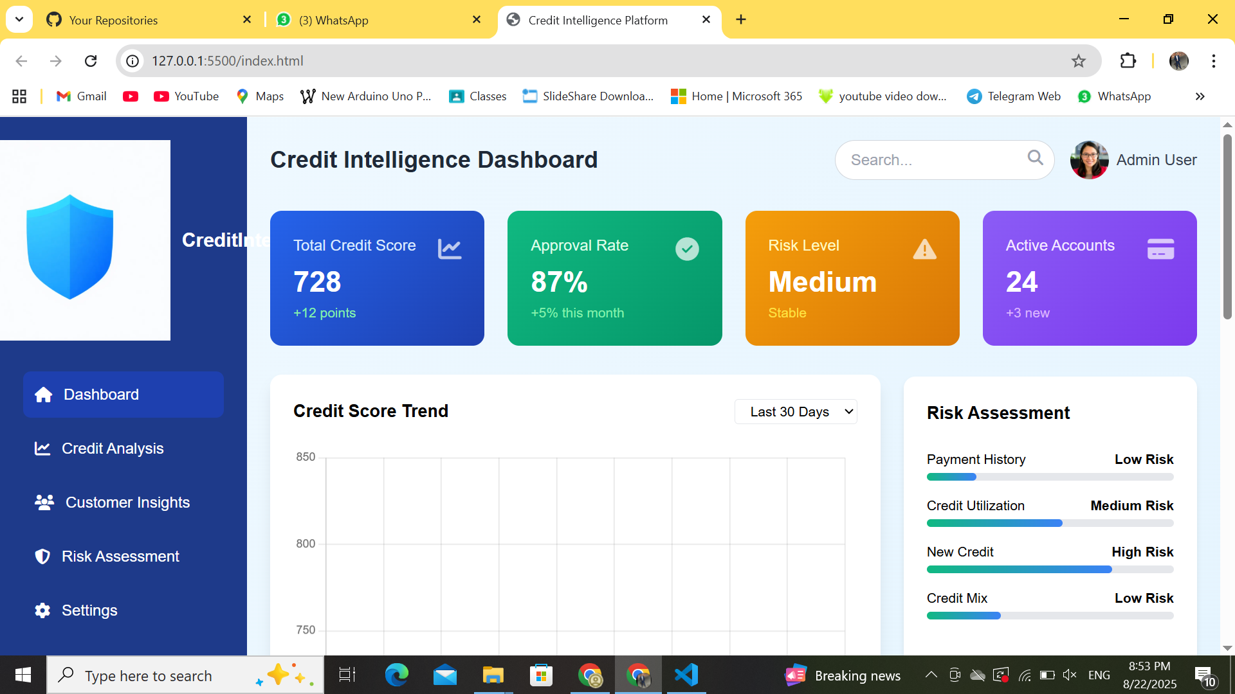

Slide 7
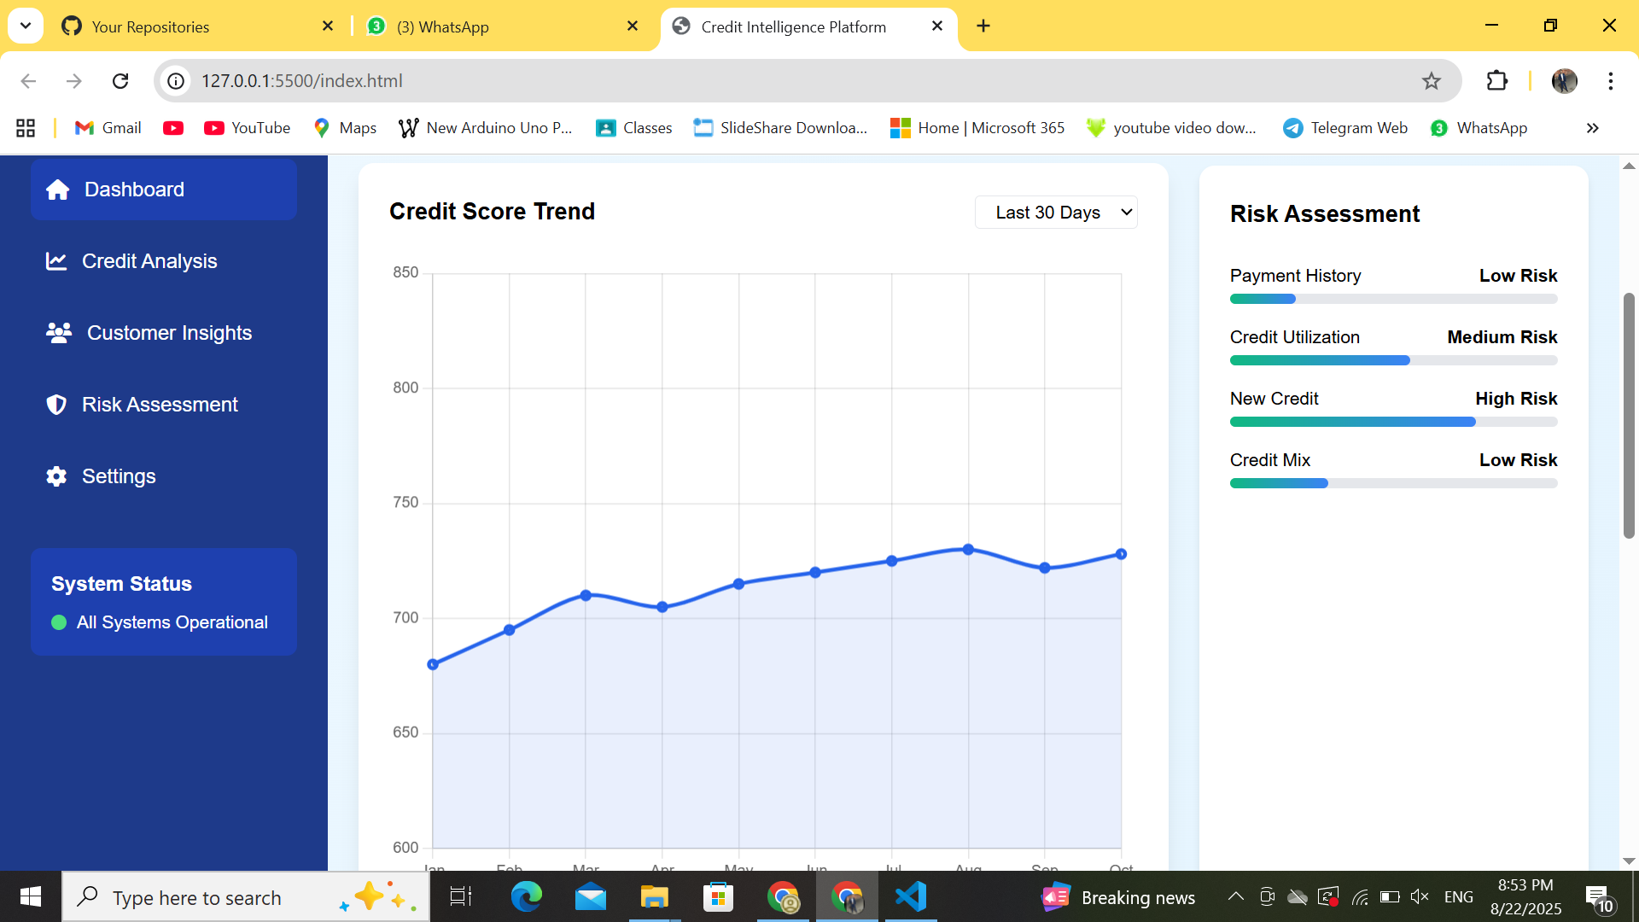

Slide 8
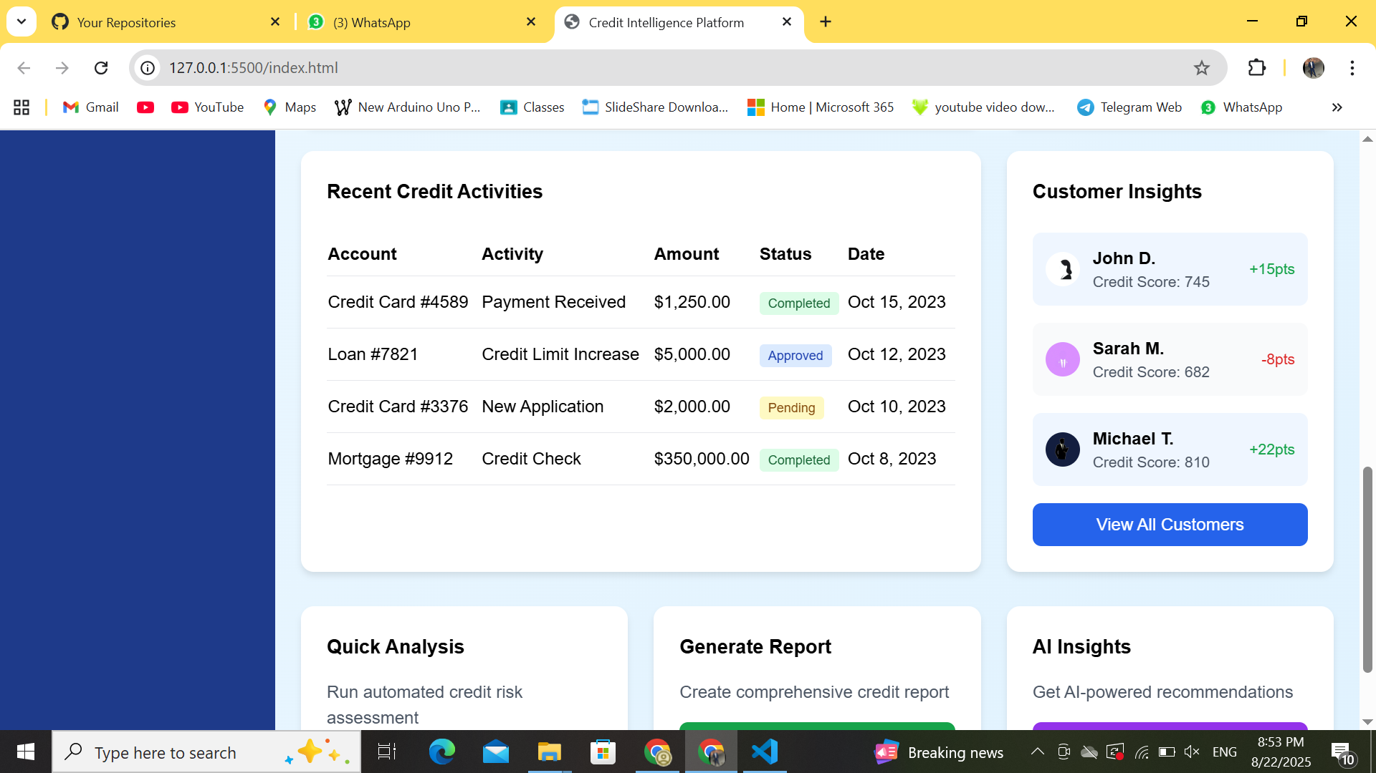

Slide 9
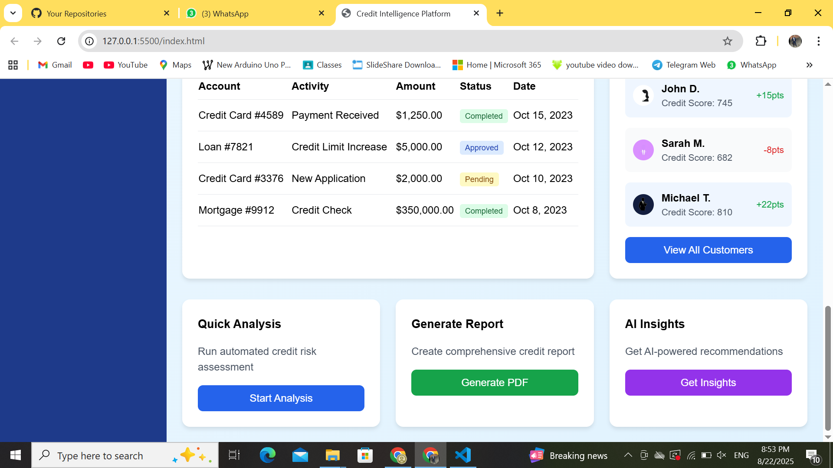

Slide 10
Key Features & Benefits
• Real-time credit scoring
• Explainable AI with SHAP
• Interactive dashboard
• Visual risk assessment
• Customer-level insights

Slide 11
Conclusion & Future Scope
Conclusion:
The platform integrates ML models with a modern dashboard to provide explainable, real-time credit intelligence.
Future Scope:
• Deploy on cloud
• Add more financial datasets
• Advanced visualization & predictive analytics

Slide 12
Thank
You

