Slide 1

Investigation of Mass Transfer in Gas Liquid Taylor flow
By
Anshul Patel
210107012
Under The Guidance of
Prof. Raghvendra Gupta

Slide 2
Introduction
What is Taylor Flow?
Taylor flow (also called slug flow or segmented flow) is when a gas and liquid travel together through a small tube or channel. It looks like a pattern of long gas bubbles with sections of liquid in between them. Taylor Flow stands out for its superior heat and mass transfer capabilities when compared to other flow patterns. This special liquid-gas flow arrangement allows heat and materials to move more efficiently within confined channels than alternative flow types.

Slide 3
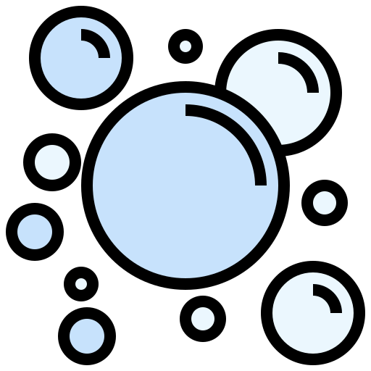

Characteristics of Taylor Flow
Consists of elongated gas bubbles alternating with liquid slugs, separated by a thin liquid film at the channel wall
Features distinctive recirculation patterns with counter-rotating vortices within liquid slugs, enhancing mixing and mass transfer efficiency
Exhibits regular, stable flow pattern with predictable bubble/slug lengths that depend on the gas-liquid flow rate ratio

Slide 4
Objective
1
To investigate the difference in mass transfer characteristics between the first and second bubbles in Taylor flow.
2
To determine how variations in flow conditions such as Reynolds number affect the mass transfer coefficient.
3
To determine the terminal velocity achieved by Taylor bubbles under varying flow conditions and to analyze the factors influencing this velocity.

Slide 5
Methodology
The study employed computational fluid dynamics using OpenFOAM interTransportFoam solver with adaptive time stepping.
Volume of Fluid (VOF) method was implemented to capture the gas-liquid interface dynamics by tracking volume fractions in each computational cell (α=0 for gas, α=1 for liquid, 0<α<1 at interfaces). This technique effectively models the complex interface deformations in Taylor flow.
The Continuous Compressive Species Transfer (CCST) method was applied to accurately simulate mass transfer across the moving gas-liquid interfaces. This advanced technique enables precise tracking of species concentration across gas-liquid interfaces within the Volume of Fluid (VOF) framework.

Slide 6


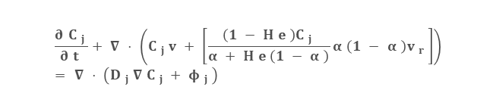


Governing Equations
VOF
CCST
Continuity Equation:
Species Transfer Equation:
$$\frac{∂ρ}{∂t}+∇⋅\left(ρ\vec{u}\right)=0$$
$$\frac{∂C_{j}}{∂\text{t}}+∇⋅\left(C_{j}v+\left[\frac{\left(1−\text{He}\right)C_{j}}{α+\text{He}\left(1−α\right)}α\left(1−α\right)v_{r}\right]\right)=∇⋅\left(D_{j}∇C_{j}+φ_{j}\right)$$
Momentum Equation:
$$\frac{∂\left(ρ\vec{u}\right)​}{∂t}+∇⋅\left(ρ\vec{u}\vec{u}\right)=−∇p+∇⋅μ\left(∇\vec{u}\right)+F_{σ}+ρg$$
Diffusivity:
Advection equation:
$$D_{j}=\frac{α D_{1 j}+He\left(1−α\right) D_{2 j}}{α+He\left(1−α\right)}$$
$$\frac{∂α​}{∂t}+∇⋅\left(α\vec{u}\right)+∇⋅\left(α\left(1−α\right)\vec{u_{r}}​\right)=0$$
The third term in the advection equation and part of second term in the species transfer equation are compression terms, used to reduce numerical diffusion at the interface which significantly improves numerical stability and accuracy at realistic mesh resolutions.

Slide 7
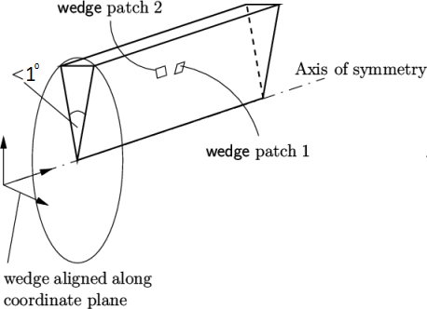
Goemetry and Mesh
Geometry:
Original 3D cylindrical domain converted into a 2D axisymmetric wedge utilizing axisymmetry of the cylinder.
Reduces computational costs while maintaining accuracy.
Mesh:
Radius of the channel was chosen to be 0.00025 m and the length 0.01 m.
Mesh dimensions were 125 x 5000, so the total number of cells were 625000.
A fine-resolution grid was generated to ensure solution accuracy.

Slide 8
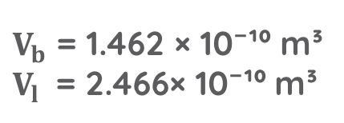
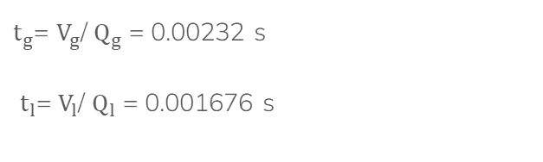
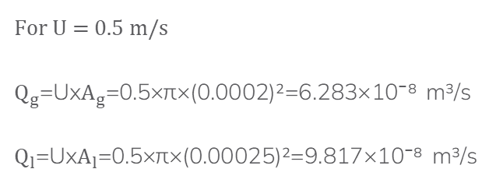
Inlet Time Calculation
The inlet time is calculated such that the volume of gas and liquid is same for different velocities
$t_{g}$= $V_{g}$/ $Q_{g}$ = 0.00232 s
$t_{l}$= $V_{l}$/ $Q_{l}$ = 0.001676 s
$V_{b}$ = 1.462 × 10⁻¹⁰ m³
$V_{l} \text{=}$ 2.466× 10⁻¹⁰ m³
Velocity(m/s) | Gas inlet time(s) | Liquid slug inlet time(s)
0.3 | 0.00388 | 0.00279
0.4 | 0.00291 | 0.00209
0.5 | 0.00232 | 0.001676
0.7 | 0.00166 | 0.00119
0.85 | 0.00137 | 0.00098
1 | 0.00116 | 0.00084
For U = 0.5 m/s
$Q_{g}$=Ux$A_{g}$=0.5×π×(0.0002)²=6.283×10⁻⁸ m³/s
$Q_{l}$=Ux$A_{l}$=0.5×π×(0.00025)²=9.817×10⁻⁸ m³/s

Slide 9
Terminal Velocity
Gas bubbles reach terminal velocities 10–15% higher than initial gas-phase velocity.
Phenomenon occurs specifically in confined two-phase flow systems.
Velocity enhancement results from unique hydrodynamic interactions.
Contributing factors include interfacial forces, liquid recirculation, and pressure gradients.
Initial Velocity | Terminal Velocity
0.3 m/s | 0.325 m/s
0.4 m/s | 0.44 m/s
0.5 m/s | 0.555 m/s
0.7 m/s | 0.8 m/s
0.85 m/s | 0.98 m/s
1 m/s | 1.17 m/s

Slide 10
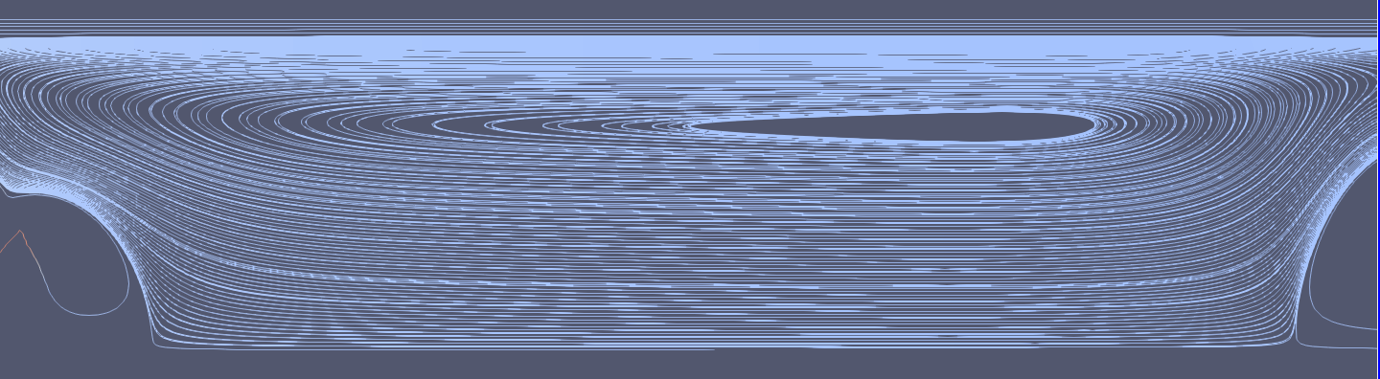
Streamline
Vortices observed between bubbles confirm characteristic Taylor flow pattern.
Velocity difference between bubbles and liquid creates recirculation zone
Simulation results match theoretical predictions and experimental observations.
Recirculation enhances mixing and interfacial mass transfer efficiency.

Slide 11
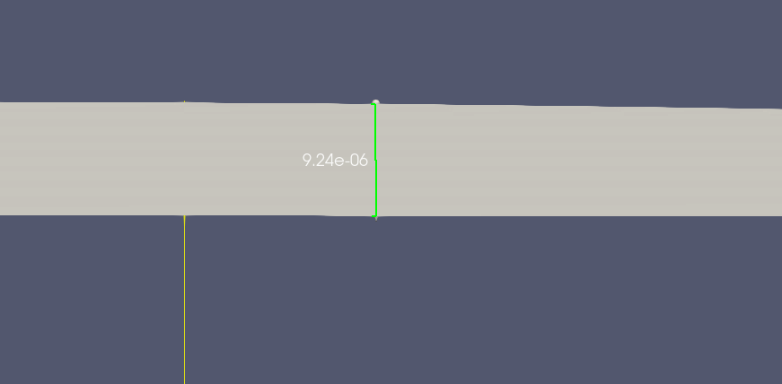
Film Thickness
Simulated film thickness (9.24 µm) aligns well with literature values.
Classical correlations predict similar thicknesses (10-11 µm) at comparable Capillary numbers
Recent studies report consistent values (10-12 µm) for similar conditions
Results validate VOF method accuracy for Taylor flow film dynamics in microchannels

Slide 12
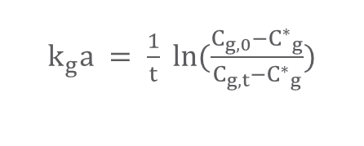
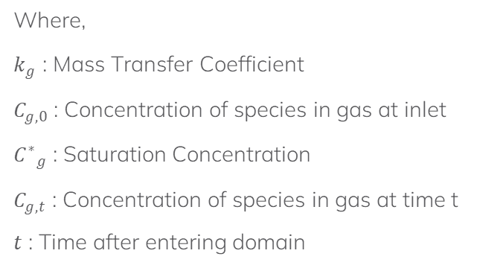
Mass Transfer Coefficient Calculation
$k_{g}a = \frac{1}{t} ln⁡(\frac{C_{g,0}−{C^{∗}}_{g}}{C_{g,t}−{C^{∗}}_{g}})$
The overall gas-phase mass transfer coefficient was calculated using the logarithmic concentration ratio method, which is derived from the integrated form of the mass transfer rate equation
Where,
$k_{g}$ : Mass Transfer Coefficient
$C_{g,0}$ : Concentration of species in gas at inlet
${C^{∗}}_{g}$ : Saturation Concentration
$C_{g,t}$ : Concentration of species in gas at time t
$t$ : Time after entering domain

Slide 13
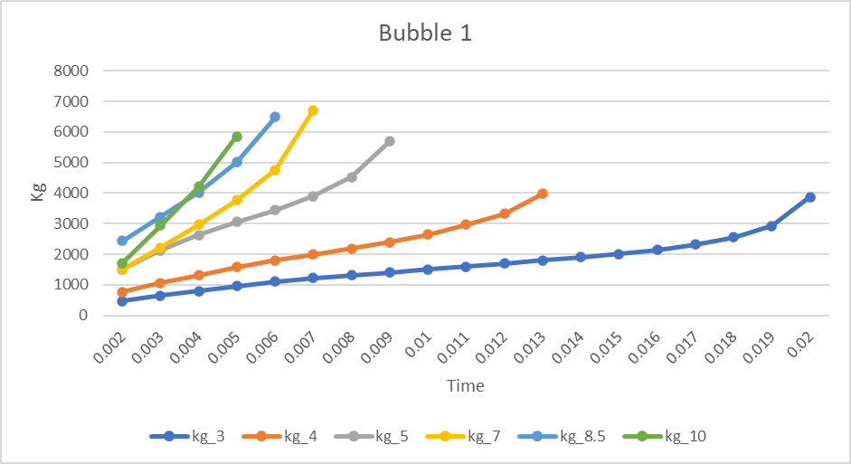
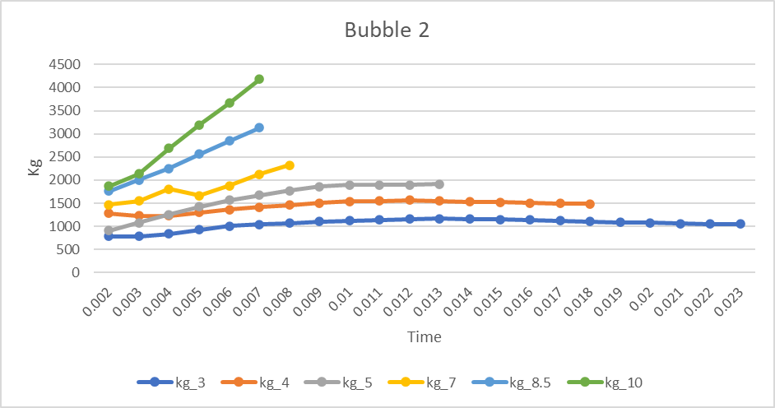
MTC Comparison b/w Bubble 1 & 2
For Bubble 1:
For Bubble 2:
Higher mass transfer coefficient.
Encounters unsaturated liquid.
Maximum concentration gradient.
Lower mass transfer coefficient.
Travels through partially saturated liquid.
Reduced driving force for mass transfer.

Slide 14
Effect of Reynolds Number on Mass Transfer
As observed from the graph Mass transfer coefficient increases with Reynolds number.
Higher flow velocity creates more intense recirculation.
Enhanced internal circulation promotes effective mixing.
Reduces concentration boundary layer thickness.
Creates steeper concentration gradient at interface

Slide 15
Future Work
1
Study curved microchannel effects on Taylor flow dynamics and mass transfer in practical microreactors.
2
Investigate temperature gradient impacts on mass transfer coefficients and interfacial dynamics.
3
Examine long-term mass transfer evolution to capture saturation effects in extended channels.

Slide 16
References
[1] Mohammad Anzar Hussain, Raghvendra Gupta (2024). Development and Validation of a Computational Methodology to Model Mass Transfer in Gas−Liquid Taylor Flow in a Circular Microchannel. Industrial & Engineering Chemistry Research.
[2] Hirt, C.W., & Nichols, B.D. (1981). Volume of Fluid (VOF) Method for the Dynamics of Free Boundaries. Journal of Computational Physics.
[3] Gupta, R., Fletcher, D.F., and Haynes, B.S. (2010). Taylor Flow in Microchannels: A Review of Experimental and Computational Work. Journal of Computational Multiphase Flows.
[4] Azadeh N. Asadullah, Raghvendra Gupta, David F. Fletchern, Brian S. Haynes (2011). CFD approaches for the simulation of hydrodynamics and heat transfer in Taylor flow.
[5] Shao, N., Gavriilidis, A., and Angeli, P. (2010). Mass transfer during Taylor flow in microchannels with and without chemical reaction. Chemical Engineering Journal. Chemical Engineering Science.
[6] Thulasidas, T.C., Abraham, M.A., and Cerro, R.L. (1997). Flow patterns in liquid slugs during bubble-train flow inside capillaries. Chemical Engineering Science.

Slide 17
Thanks!

