Slide 1
trace.
DSA through recorded execution
A learning workspace for students and online teachers
trace-six-theta.vercel.app
Notes:
Project: https://github.com/anshulr0019/trace-dsa. Public demo: https://trace-six-theta.vercel.app/. This is a project demonstration, not evidence of measured learning outcomes.

Slide 2
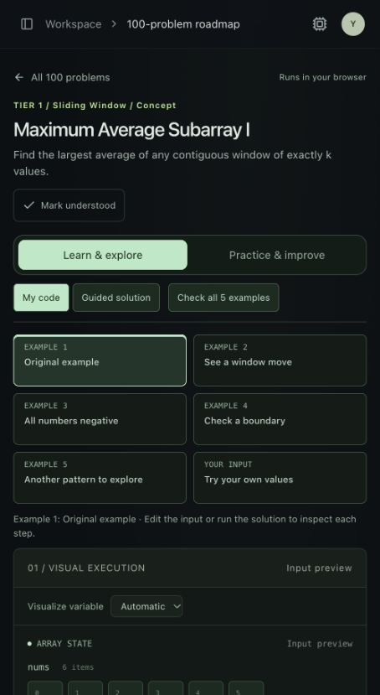
An example students can change
Choose an input and follow the recorded state.
Five authored examples per problem help learners investigate different conditions.
Playback connects the visualization with highlighted code.
Predictions, hints and personal notes support explanation and revision.
Notes:
Screenshot captured from the existing public Trace app on 30 September 2026, in input preview. It shows the established mobile workspace before this product-feature deployment. Features: platform/components/curriculum/curriculum.tsx and platform/components/product/learning-tools.tsx.

Slide 3
Curriculum and learner tools
100
25
4
problems
DSA patterns
languages
Python, C++17, Java 8 and JavaScript
Bookmarks and revision notes stay with each problem.
Concept learning paths give beginners a starting point.
Notebook export preserves drafts and practice history.
Notes:
Counts from platform/lib/curriculum/catalog.ts, platform/lib/curriculum/playground.ts and source maps. Notebook features from platform/components/product/notebook.tsx. Learning path names describe problem subsets; the project has no accredited assessment claim.

Slide 4
A lesson built around a question
01
Create
Choose a problem, language, custom input and teaching prompt.
02
Share
Send a lesson link that students open without an account.
03
Present
Expand the workspace for a class demonstration.
04
Review
Assign to a class and read student explanations and code.
Class assignments and results require Supabase configuration.
Notes:
Teacher workspace: platform/components/product/teacher.tsx. Sharing and presentation work locally without account configuration. Cloud classes and submissions are implemented but inactive without the project URL, publishable key and schema. Scores are learner-reported educational feedback.

Slide 5
How Trace runs
On the learner’s device
With a configured account
Disposable browser workers execute bounded learning inputs.
Python records line states. C++ and JavaScript support checkpoints and supported automatic tracing. Java uses explicit checkpoints.
Supabase handles email sign-in and application data.
Row access policies scope notebooks and class submissions.
Notebook transfer uses explicit save and restore.
Java business use needs a suitable CheerpJ licence. Browser scores are learner-reported.
Notes:
Sources: platform/lib/curriculum/runtime-client.ts; platform/docs/INTERACTIVE-EXECUTION.md; platform/supabase/schema.sql. Auth: https://supabase.com/docs/guides/auth/auth-email-passwordless . Java licensing: https://cheerpj.com/docs/licensing.html . Browser workers isolate program state and keep execution off the UI thread; they are not a hardened network security boundary. Supabase project provisioning and cloud acceptance testing remain pending.

Slide 6
A small classroom pilot
One teacher. One DSA topic.
Use a lesson alongside an existing class. Ask students to explain a state change before practising a fresh case.
Discuss which steps became easier to explain and where the visualization remained confusing.
Next: owner acceptance testing and cloud configuration
Notes:
Proposed pilot, not an existing customer engagement. No learning outcome claims or customer metrics. Demo recording plan and outreach draft: platform/docs/DEMO-AND-PITCH.md.

