Slide 1
Michigan Investment Banking Club Valuation of Dollar General
Team 4: Linda Chiu, Brian O’Connor, Anshul Rana
December 11th 2019
Notes:
Anshul

Slide 2
Agenda
Executive Summary
Company Overview
Industry Overview
Risks and Mitigants
Public Comparables
Precedent Transactions
Revenue Build
DCF Assumptions
Valuation
Conclusion
Appendix
Notes:
Anshul

Slide 3
Executive Summary
Share Price | Multiples | Value and Convenience Proposition | Business Model
$153.55 Representing a 1-year increase of 47.5% | EV/EBITDA: 19.43x Price/EPS: 25.72x | Dollar General strives to deliver highly competitive prices on national and private-label products at convenient store locations | Dollar General utilizes a low-cost operating model that focuses on growing a store base and continuing a profitable store growth strategy
Notes:
Anshul

Slide 4
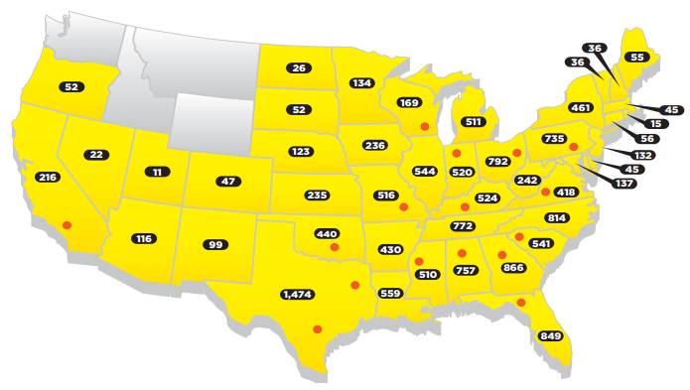
Dollar General
Company Overview
Key Facts
Share Price (12/04/2019): $153.55
Shares Outstanding: 259,518,801 (as of March 2019)
Founded: 1939
Headquarters: Goodlettsville, Tennessee
CEO: Todd J. Vasos
Industry: Discount Retailer
Segments:
- Consumables
- Seasonal
- Home Products
- Apparel
Number of Locations: 15,472
Key Financials
Historical Stock Price (1 Year)
2019 2nd
Quarter
Earnings
$153.55
+47.5%
$104.10
Firm Overview
Store Locations
Dollar General was publicly traded from 1968-2007, when it was acquired by KKR. It became publicly traded again Nov 2009
Dollar General has a market cap of $38.9b
Merchandise consists of national and private brand products, priced at <$10
In 2018, achieved the 29th consecutive year of positive same-store sales growth
Consumables is the largest merchandise category, and makes up an increasing percentage of total sales
Notes:
Linda

Slide 5
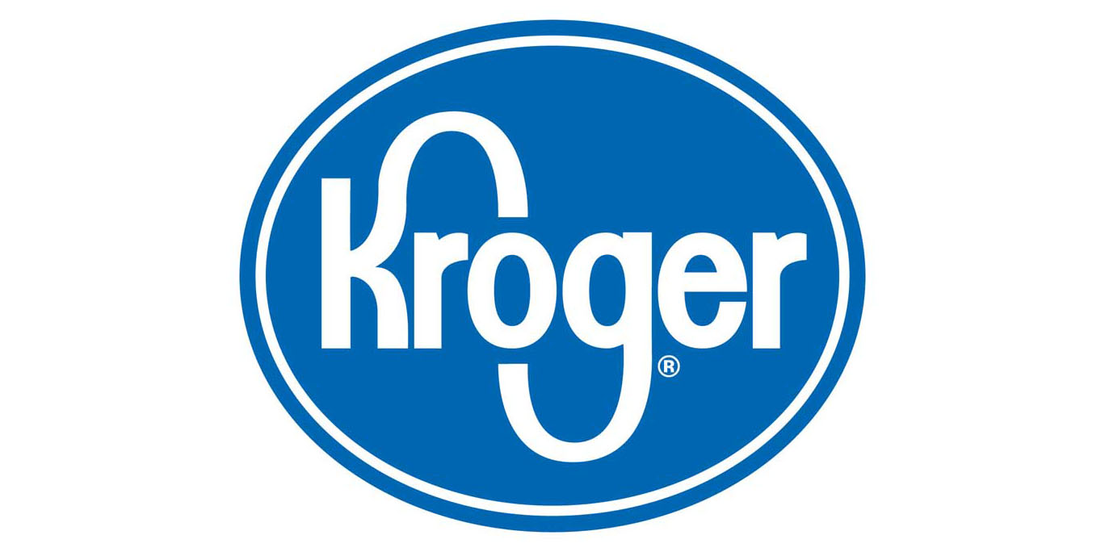
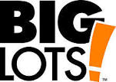

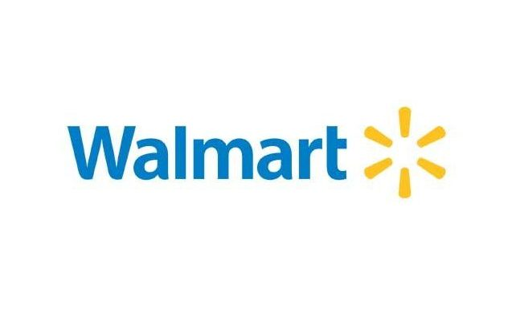
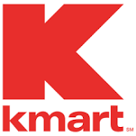

Industry Overview
Key Drivers
Industry Outlook
Level of consumer disposable income is a key component for industry performance. The target consumer profile is lower-middle class workers, many of whom are heavily affected by changes in unemployment rates, wage rates, and healthcare and housing costs among other economic factors
E-commerce and international retailers provide fierce incentive for innovation in cost, service, last-minute delivery, efficiency, and overall consumer experience
Fear of recession contributes to increased growth and profitability for discount retailers until 2021 when experts predict the recession to end
“Retail apocalypse” of 2017 and 2018 has ended, the number of bankruptcies is predicted to decrease in future years
Private labels are predicted to grow in market share, increasing brand recognition and online visibility is key to profitability
Competitors
Notes:
Linda

Slide 6
Risks and Mitigants
Risks
Mitigants
Low Income Class Shopping: Inability to increase prices due to the pressures on personal incomes. Dollar General relies on low income customers and communities to generate revenue
Competition: Oversaturation of market as competitors seek to expand store base. The competitive landscape is fierce, including smaller, more nimble companies as well as larger multinational chains with significantly more resources. The environment increases the risk of needing to lower prices and contract margins in order to maintain market share
China: Dollar General has a supply chain reliance on sourcing from China and is subject to uncertainty over the US-China trade war
Dollar General continues to gain market share because convenience of location means there are increases in number of customer visits. Carrying more private label products also allows Dollar General to cut prices against competitors like Walmart. Additionally, Dollar General has increased discounts to incentivize consumers
Dollar General is better positioned than its competitors: Dollar Tree is still working to fully integrate Family Dollar, has taken a $2.7b write-down and will shut down up to 390 Family Dollar stores. Additionally, while other competitors target solely lower or middle class consumers, Dollar General targets both segments
Dollar General is steadily reducing reliance on China by incorporating more US suppliers in their supply chain. Any effects from the US-China trade war are not unique to Dollar General and will also influence other competitors in the industry
Notes:
Brian

Slide 7
Public Comparables
A brief look into the firm’s main comparable companies
Comparable Companies
Notes:
Linda

Slide 8
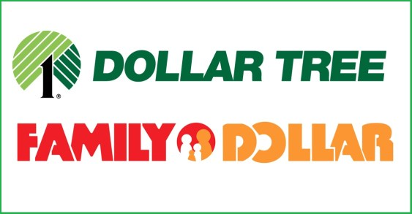
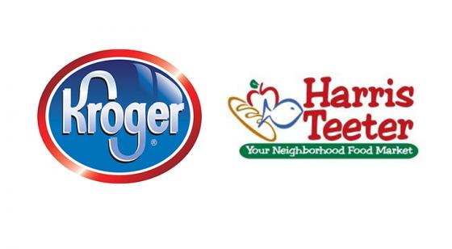

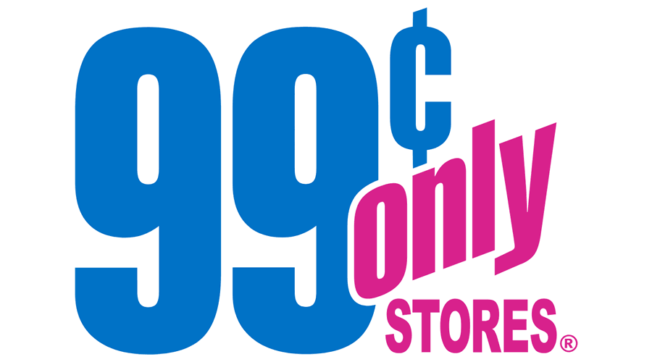
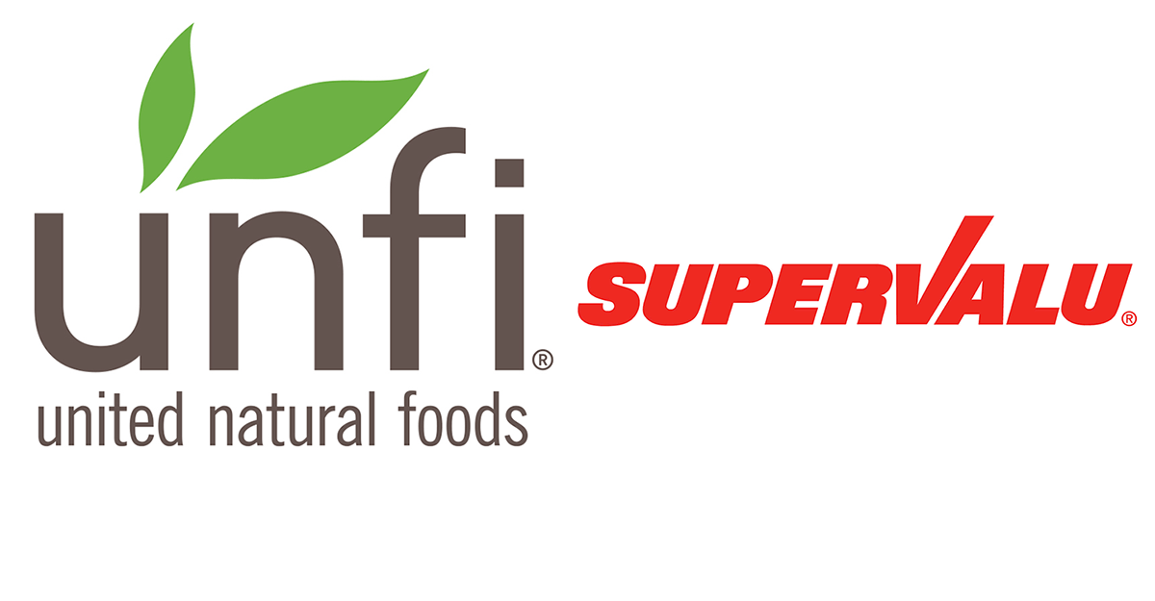
Precedent Transactions
Most Applicable Precedents
Dollar Tree/Family Dollar
Kroger/Harris Teeter
Dollar Tree’s acquisition of Family Dollar made them one of the leading discount retailers back in 2014
Great synergies between the companies because of similarities in business models
Allowed them to target a much broader range of customers
Harris Teeter has stores in affluent vacation destinations, university communities, and markets where populations are growing faster than the U.S. average
Helped Kroger in its battle for market share against Walmart and more specifically, their direct competitor, Publix, its chief rival rival in the Southeast
Ares/99 Cent
United Natural Food/SuperValu
Ares Private Equity Group seeks to acquire middle market companies with strong business franchises
Acquired 99 Cents Only due to its quality value and attractive merchandise, seeks to utilize its capital to serve as a catalyst for 99 Cents Only’s growth
United Natural Foods sees opportunities for growth through the acquisition of Supervalu, allowing for larger scale, more diverse business
The acquisition diversifies customer base, enables cross-selling opportunities, delivers significant synergies, and accelerates growth
Notes:
Anshul

Slide 9
Revenue Build
Store Growth
Method for Store Growth
Method for Sales Growth
Estimated revenue growth/year based on analyst estimates, and Fiscal 3rd quarter earnings call citing store growth as the main revenue driver. “Prioritize New Store Expansion” – Todd J. Vasos.
Dollar General has been consistently opening stores over the past years and have released future store openings.
Calculated Selling square ft. over sales per square foot for each historical year. Estimated a 1:2 correlation between selling square feet growth and proportion
Revenue Build
Notes:
Brian

Slide 10
DCF Assumptions
Average EBITDA multiple of 14.24x, weighted according to comps’ enterprise values
More and more people moving into the low income class until 2021,
Dollar General keeps up store growth, but at a slowing rate
Effective tax rate of 21%
New federal tax rate
Steady Depreciation and Amortization for the next five years
Percentage of average percentage of Revenue has stayed relatively constant
Rising Capital Expenditures over the next 5 years due to store expansion, until 2021
Notes:
Linda

Slide 11
Valuation
Valuation Method | Assumptions Overview
Comparable Company Analysis | Range of enterprise value is calculated through min/max of EV/EBITDA and EV/Sales multiples from comparable companies Used P/E ratio of comparable companies and diluted EPS of Dollar General. to estimate share price Comparable Companies include Dollar Tree,
Precedent Transactions | We used EV/EBITDA to generate enterprise value Comparable precedent transactions were gathered based on acquisitions in the retail industry Transactions include
Discounted Cash Flow Analysis | Using perpetuity growth method we had a long term growth rate of 1.5% and a WACC of 5.39% Revenues were taken from SEC filings and quarterly earnings reports, and projections were based on company 10k’s and industry trends
Current Price: $153.55
Notes:
Anshul

Slide 12
Conclusion
Based on our model and market projects, Dollar General has an upside of 20.89%
Our current price is $153.55, and our target price is $185.63
The discount retail industry is poised for growth in future years due to the probable impeding recession
Dollar General’s simple business model of focusing on store growth allows them to drive profitable sales growth, capture growth opportunities, enhance their position as a low-cost operator, and invest in people as a competitive advantage
A possible acquirer for Dollar General is Target
Target is currently competing against traditional brick-and-mortar stores such as Walmart, as well as new online giants such as Amazon
Acquiring a discount store with a customer segment separate from Target’s current customer base will help hedge against a coming recession
Notes:
Brian

Slide 13
Appendix

Slide 14
Appendix

