Slide 1

Regression
Group - 5

Slide 2
GROUP MEMBERS
NAMES
ANSHUL SAHARE
HARSHA CHETLAPALLI
PRADUMN SINGH JADON
NAVEEN NAGAPPA NAGANURI
VEDANT SINGH
SOWMYA P
DEOYANI DEORAO CHOUDHARI
EMAILS
anshulsahare1994@gmail.com
chetlapalli.harsha@gmail.com
pradhumn122003@gmail.com
naganurinaveen8@gmail.com
vedants953@gmail.com
sowmyap021@gmail.com
choudharideoyani7691@gmail.com

Slide 3
WHAT IS REGRESSION (MEDICAL EXPENSES)?
In the context of medical expenses, regression analysis is a statistical method used to predict or estimate the value of a dependent variable (like medical costs) based on the values of one or more independent variables (like age, BMI, smoking status, etc.). It essentially helps to understand how different factors relate to and influence healthcare costs.

Slide 4
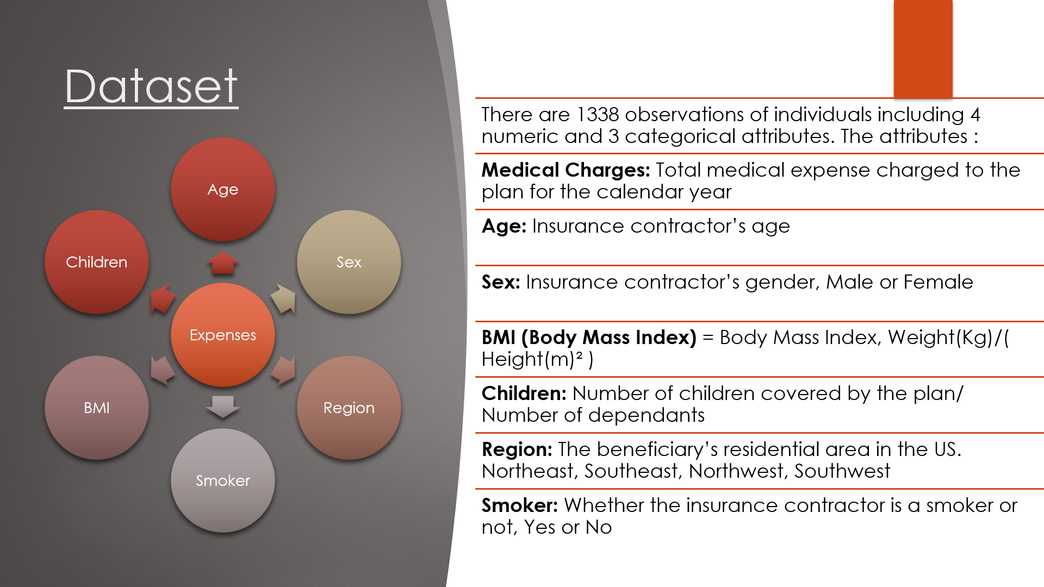

Slide 5
OBJECTIVE
This project addresses the challenge of rising healthcare costs by predicting individual medical expenses. The primary objective is to identify and interpret the key demographic and personal factors that significantly influence insurance charges, such as age, BMI, and smoking habits.

Slide 6
ABOUT DATASET
Data Pre-processing: The initial dataset of 1,338 observations was cleaned by identifying and removing outliers from the charges and bmi variables, resulting in a refined dataset of 1,116 observations for modeling.
Exploratory Data Analysis (EDA): A correlation matrix and pair plots were used to understand the initial relationships between variables.
Model Development & Selection: Three distinct linear regression models were developed, including a baseline model, a model with a custom interaction term (smoker & obesity), and a log-transformed model.

Slide 7
Uses insurance.csv with the following columns:
age: Age of the beneficiary
sex: Gender
bmi: Body Mass Index
children: Number of dependents
smoker: Smoking status
region: Residential region (US)
expenses: Medical insurance cost (target)

Slide 8
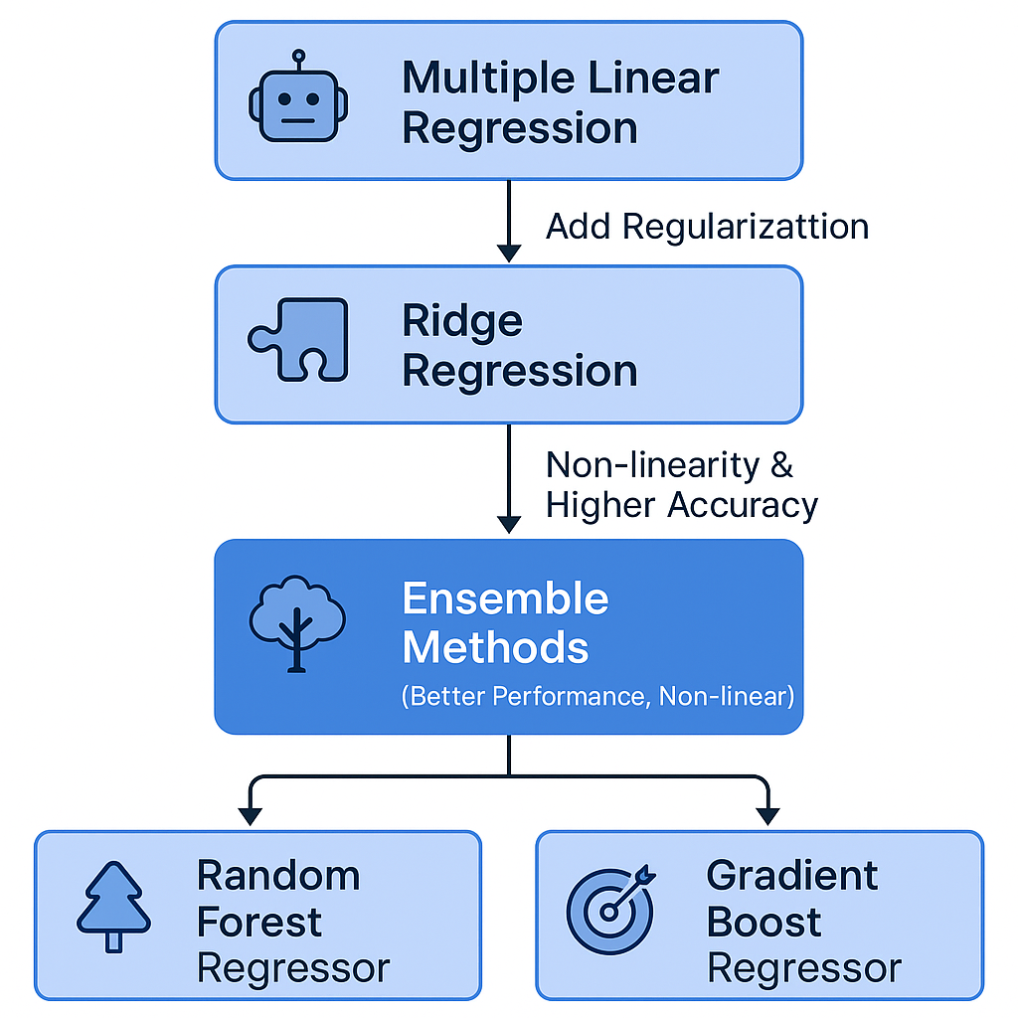

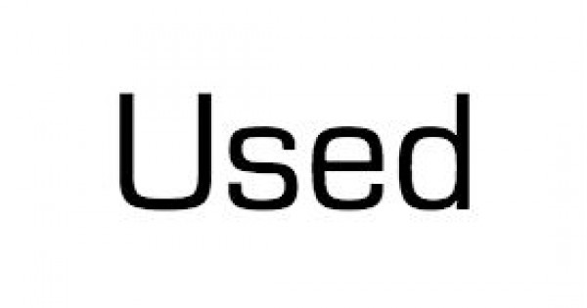

Slide 9
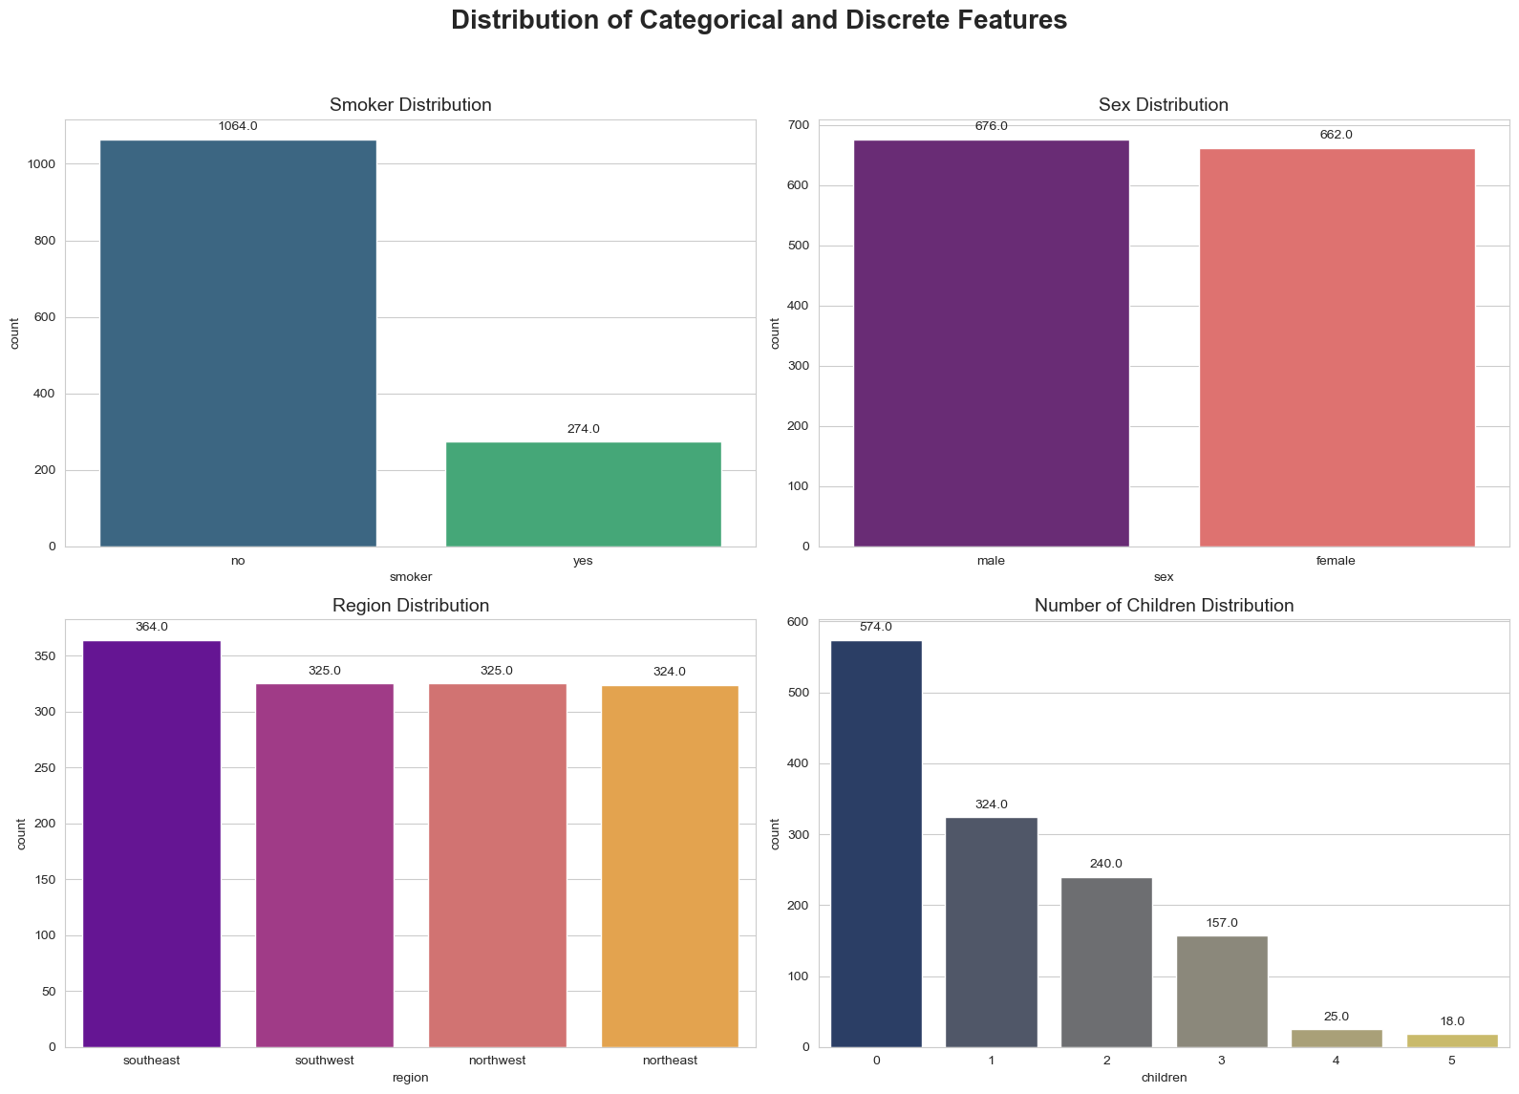
VISUALIZATION OF DATA (EDA)

Slide 10
Categorical Feature Distribution Summary
This multi-panel bar plot, generated using Seaborn and Matplotlib, provides a quick visual summary of four key categorical and discrete features in the dataset:
Smoker Distribution: The dataset is heavily skewed towards non-smokers (1064 vs. 274 smokers), indicating a class imbalance.
Sex Distribution: There's a near-equal representation of males (676) and females (662), showing good balance.
Region Distribution: Individuals are fairly evenly distributed across all four regions, with a slight lean towards the southeast (364).
Number of Children Distribution: Most individuals have no children (574), with counts decreasing significantly as the number of children increases.
This chart is crucial for Exploratory Data Analysis (EDA), helping to understand data composition, identify imbalances, and guide preprocessing decisions for modeling.

Slide 11
MODEL BUILDING:
Multiple Linear Regression: Served as a baseline model.
Ridge Regression: Tested regularization impact on linear models.
Gradient Boosting Regressor: Captured complex, non-linear relationships.
Random Forest Regressor: Another ensemble model tested for performance and robustness.
Evaluation Metrics:
R-squared (R²): Measures how well the variance in the target is explained.
Mean Absolute Error (MAE): Measures average prediction error in dollar terms.
Root Mean Squared Error (RMSE): Penalizes larger errors more than MAE.
Models were trained on 80% of data and tested on 20%.

Slide 12
MODELs scores
Gradient Boosting:
R-squared: Approximately 0.86
MAE: Approximately 2000
Random Forest:
R-squared: Approximately 0.84
MAE: Approximately 2000-2200 (slightly higher than Gradient Boosting)
Ridge Regression:
R-squared: Approximately 0.82
MAE: Approximately 3000-3200
Linear Regression:
R-squared: Approximately 0.82
MAE: Approximately 3000-3200

Slide 13
Why Gradient Boosting Regressor?
Predicts Medical Costs: Effectively models non-linear relationships and interactions (age, BMI, smoker status).
Highest Accuracy: On test data :
Best R-squared (~0.86)
Lowest MAE (~2000)
Handles Complex Data: Captures intricate patterns in medical expense datasets.
Identifies Key Factors: Reveals important features like smoking or BMI.
Customizable: Fine-tuning prevents overfitting and boosts accuracy.
Robust: Performs well even with outliers/skewed data.

Slide 14
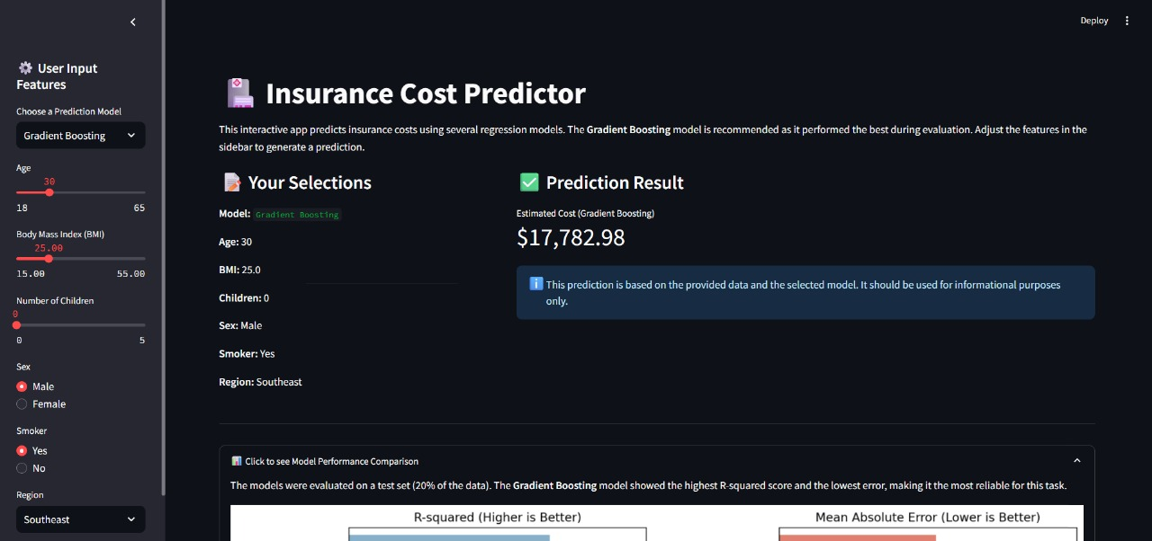
DEPLOYMENT

Slide 15
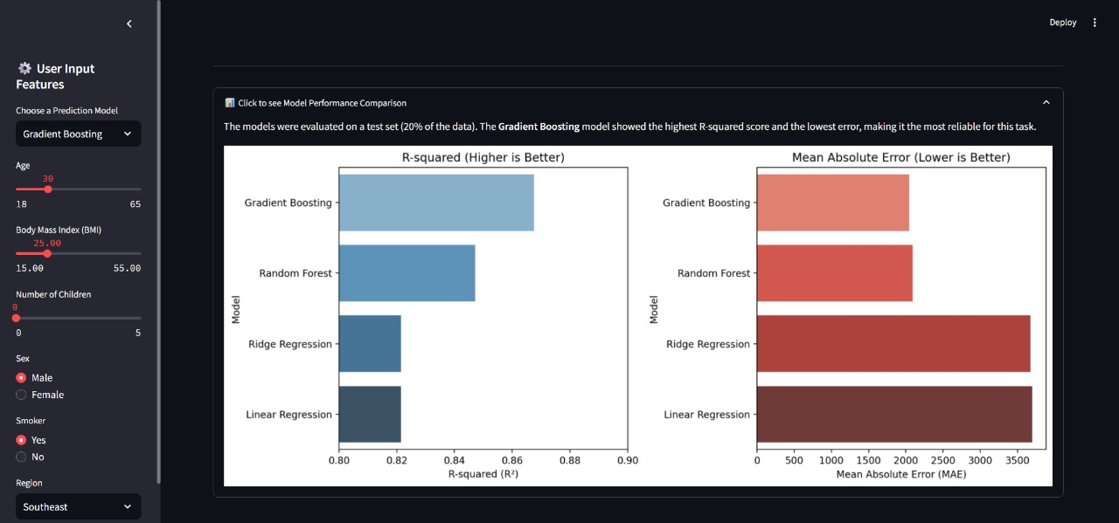

Slide 16
challenges faced
Small Dataset Limitations
Model may overfit → poor real-world performance.
Users may misreport BMI or smoking status.
Limited Feature Scope
Few inputs = less accurate predictions in varied scenarios.
Scalability Issues
Model may not generalize well across large or diverse populations.

Slide 17


