Slide 1

EcoFind
Don’t let those Paws disappear

Slide 2
Intention
To study the a specific animal behavior and its surroundings.
The application is designed to provide you information about animal’s habitat and its change in body according to its environment.
The aim is to save and protect wildlife by recording vulnerabilities.
Our Sensor will observe relatively fine scale movements or migratory patterns in free ranging wild animals.

Slide 3
Functionality
The sensors will capture the analog and locational data along with thermal readings and it will convert it into digital readings .
The digital data retrieved from the sensors will be displayed on the STATUS page on the screen.
The user also has an option to download the pdf copy of the analytical readings according to his desirable timespan . For example: readings from last 24hrs, last year , last week.
The user has an option to add undesirable number of sensors/animals to his profile.

Slide 4
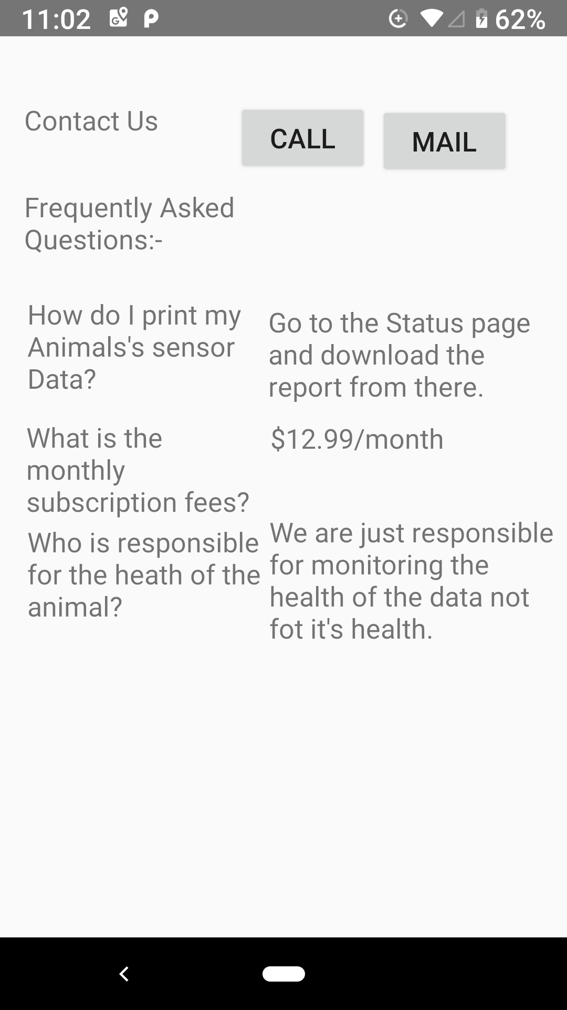
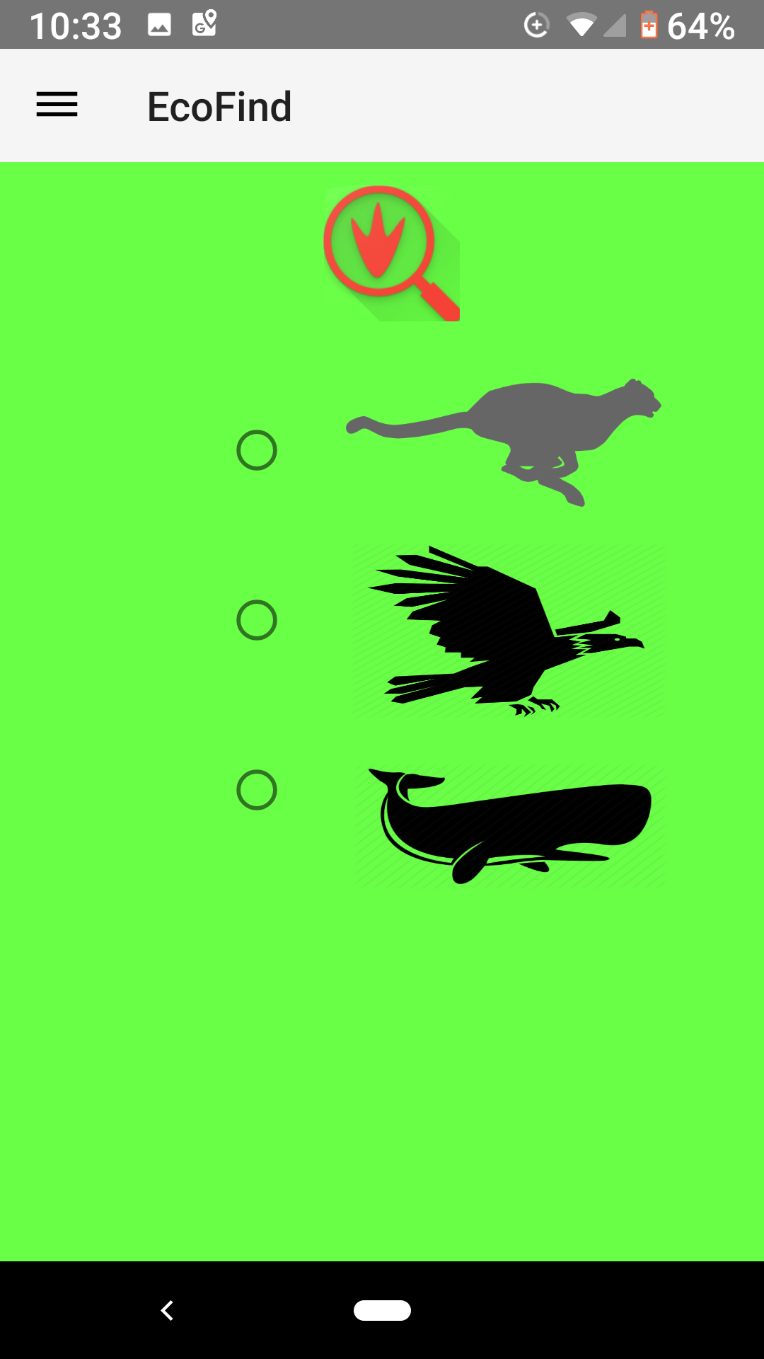
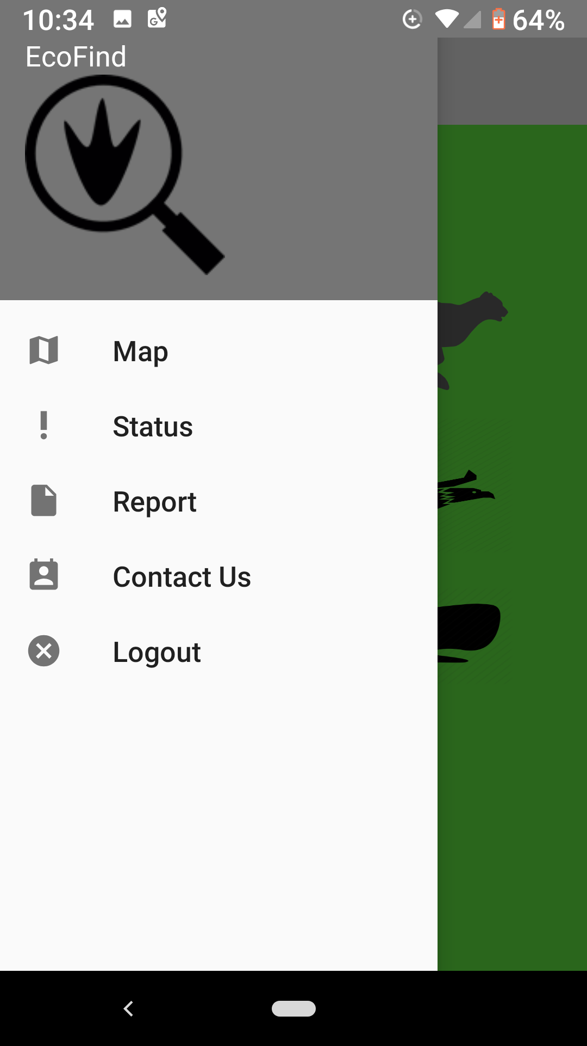
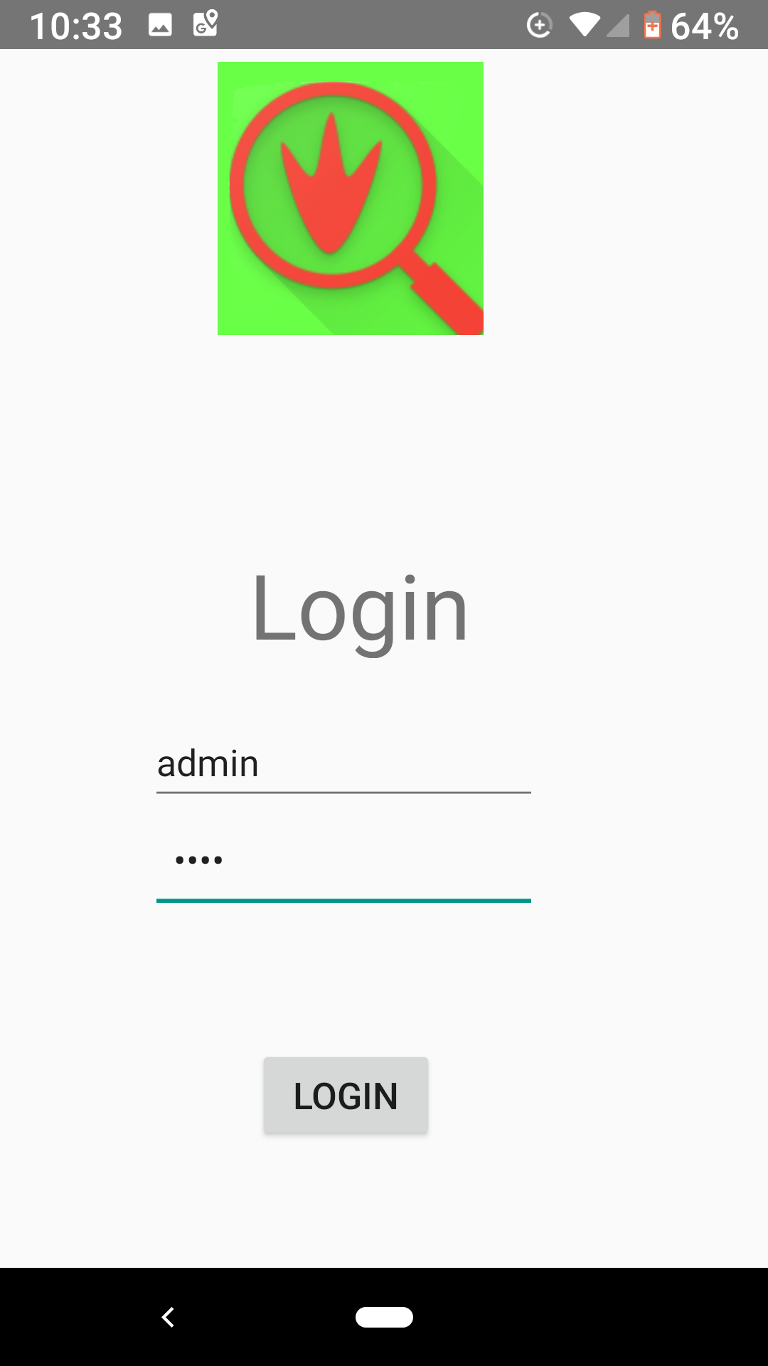
Design
For now , the GUI is basic but will be complex in the future.
The GUI consists of several interfaces such as navigation drawer and buttons and map.

Slide 5
Implementation
This application will work on android devices with SDK version 21 and above i.e. (Lollipop and above).
It will require user permission including : Access to Wi-Fi/Mobile Data, Access to Location, Access to Device Storage .
It will also require the support of Google Play Service, API Support ,etc.
The sensors used are as follows : Accelerometer, GPS ,Magnetometer, Light sensor
After pairing with the sensors, the app will transmit readings over the internet depending on the presence of Wi-Fi or Mobile Data and will store it in the database.

Slide 6
Credits
Wild Rangers :
Anshul Sanan (N01203103)
Jay Jadav (N01205600)
Simarjeet Brar (N01149380)

