Slide 1
HIFBox Wearable

Slide 2
Budget
Description | Supplier | Site | Part NO. | Unit price | Quantity | Taxes/Shipping | Total
The NXP Precision 9DoF breakout combines two of the best motion sensors we've tested here at Adafruit: The FXOS8700 3-Axis accelerometer and magnetometer, and the FXAS21002 3-axis gyroscope. | AdaFruit Elmwood Electronics | https://www.adafruit.com/product/3463 https://elmwoodelectronics.ca/products/adafruit-precision-nxp-9-dof-breakout-board-fxos8700-fxas21002 | 3463 | $9.51 | 2 | N/A | N/A
Humber's student parts kit | Humber College | N/A | N/A | $120 | 1 | 13% | $135.60
A small and affordable computer that you can use to learn programming | Sayal Electronics | N/A | N/A | $45 | 1 | 13% | $50.85
Male-to-female and male-to-male jumper cables | Sayal Electronics | N/A | N/A | $25 | 1 | 13% | $28.25
 |  |  |  |  |  |  | $214.70
Final cost was around $50 (including duties)

Slide 3
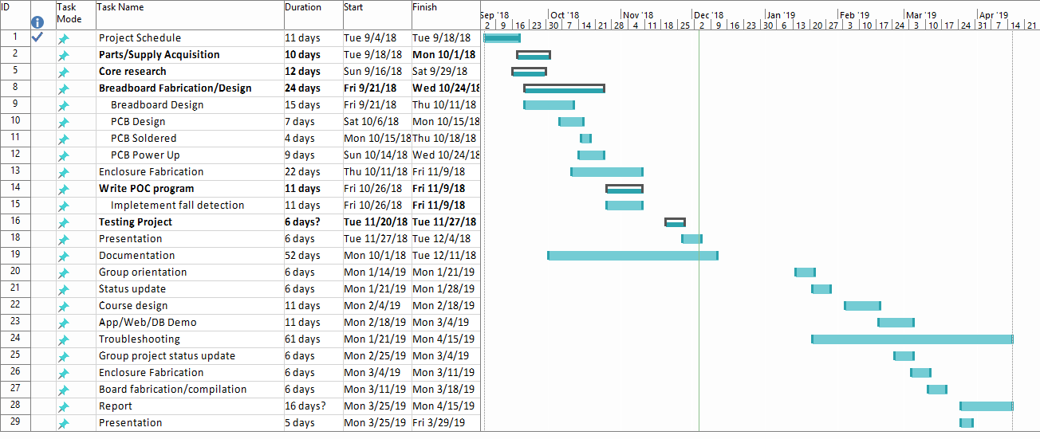
Schedule

Slide 4
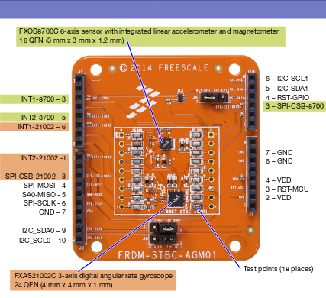
Hardware

Slide 5
Address Capture

Slide 6
Course Utilization
CENG 200
Typical BASH command line commands (ls, cd, pwd, mv, mkdir, touch, etc.)
CENG 252
Developed a familiarity with the Raspberry Pi’s quirks (RDP & SSH over link-local Ethernet)
CENG 256
Cursory knowledge of PHP helped in the development of the POC script

