Slide 1

Aid Escalating Internet Coverage
Group Name : Ragnarok
Anshul Sharma Chinmay Kavimandan
MT2022143 MT2022031

Slide 2
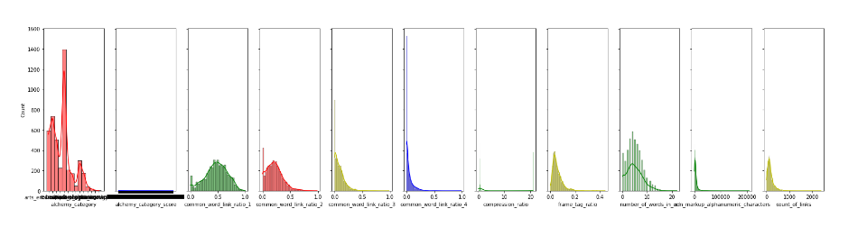
DATA ANALYSIS :
We have given Train and Test data separate.
In Train data we have 4437 rows and 24 columns.
In Test data we have 2958 rows and 23 columns.
We didn’t have any Null value in data but many of rows has “?”.
Some of Column’s maximum entries are Zero.
In “page description” column we have text data.
In “alchemy category” column we have categorical data.
Some columns has very low correlation with Output “label”.

Slide 3
Preprocessing :
Drop some columns based on low correlation with output these columns are: “embed_ratio,frame_based,has_domain_link”
Some columns have very large value so we have Normalize them with formula : Min-Max Scaling : (X – Min)/(Max-Min)
Replace the “?” from alchemy_category column with “others”.
Apply Label Encoding using category codes approach that assign each category a unique value.
Replace “?” from alchemy_category_score with mean of that column.

Slide 4
Exploratory Data Analysis :
Now we have to preprocess text based column that is : page_description.
Using gensim.utils.simple_preprocess we remove the special character from the text and it converts the character into lower case, this function return sentence in form of list of words then we have to join them together in a sentence.
Now convert the text data into numeric data with TFIDF (Term frequency Inverse Document Frequency).
This return data into a Matrix form for some models we have to convert this into array form using toarray() function.

Slide 5
Intermediate Model for alchemy category
Divide the dataframe in two parts based on value “?” of alchemy category
Use the data which does not contain “?” for training of the model
These columns are used for training of the model :
'common_word_link_ratio_1','common_word_link_ratio_2','common_word_link_ratio_3','common_word_link_ratio_4','link_word_score'

Slide 6
We used alchemy category values for predicting alchemy category score
After predicting values for “?” we used one hot encoding to convert each individual alchemy category into column and used these columns for training of the model
These columns are used for training of the model :
'arts_entertainment','recreation','sports','computer_internet','health','gaming','unknown'
Intermdiate
Model for alchemy category score

Slide 7
We combine the dataset splitted earlier for predicting the values of alchemy category and score
We trained the model by applying TF-IDF on page description column and then convert the sparse matrix into a data frame.
These columns are inserted in the dataframe formed by TF IDF :
'common_word_link_ratio_1','common_word_link_ratio_2','common_word_link_ratio_3','common_word_link_ratio_4','link_word_score',’alchemy_category_score’
Features use for training the model

Slide 8
Removing punctuations like . , ! $( ) * % @
Removing Stop words
Tokenization
Lower casing
Stemming
Lemmatization
We use genism to remove special characters, lowering the words and tokenization
Use STOPWORDS for remove the common words.
Text-Preprocessiong

Slide 9
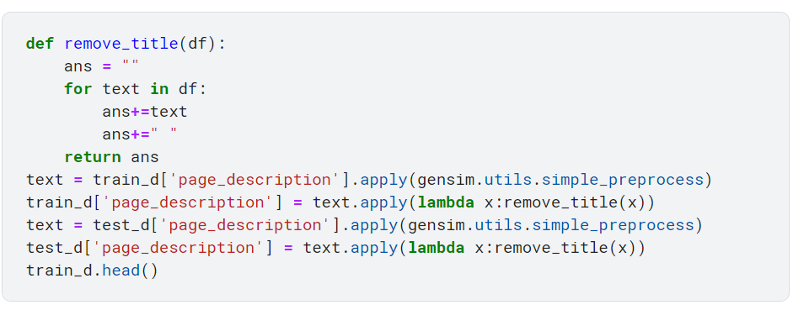
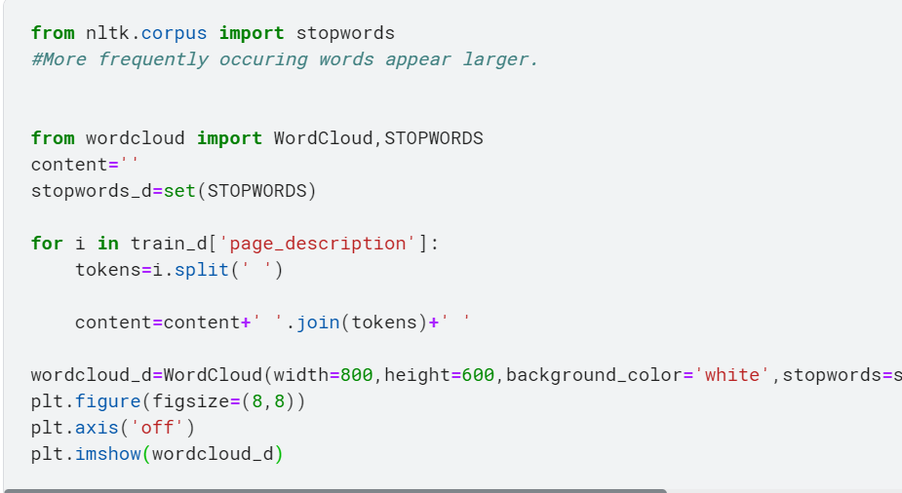
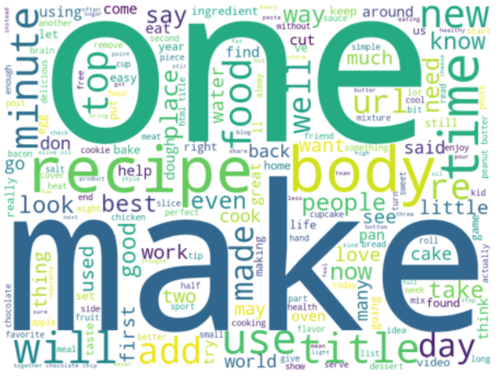
Functions use in code :
Function use to remove the special word, make token of sentences and lowering the words :
Function use for print most frequent words:

Slide 10
Parameters use in TF-IDF are max_features = 45000 & ngram = 1 to 5.
We have used word2Vec feature vectors for training the RBF SVM, also used gridSearchCV to find out the optimal parameters for training SVM
We use Google news data set to train Word2vec
TF-IDF & Word2vec
w2v_model=KeyedVectors.load_word2vec_format('GoogleNews-vectors-negative300.bin', binary=True)

Slide 11
We use Logistic Regression, Svm and random forest
When Logistic is used with TF-IDF the maximum accuracy we get is 0.8773.
In svm we use kernel = ‘rbf’, and svm with TF-IDF give 0.8763
In Random forest we use n_estimators = 100.
In Decision tree we use random_state=42 and max_depth = 2
Model Used

Slide 12
Tables of Models and score :
Preprocessing | Model | Hyperparameters | Local score | Kaggle score
Database columns + TF-IDF features | Random Forest | n_estimator = 100 | 0.8890 | 0.8603
Database columns + TF-IDF features | Logistic Regression |  | 0.8710 | 0.8777
TF-IDF features | Logistic Regression |  | 0.8663 | .8773
TF-IDF features | Random Forest Classifier | n_estimator = 100 | 0.8553 | .8754
TF-IDF features | SVM | Kernel = ‘rbf’ and | 0.8683 | 0.8773
TF-IDF features | Kneighbors Classifier | n_neighbors = 60,leaf_size = 5 | 0.85 | 0.81

Slide 13
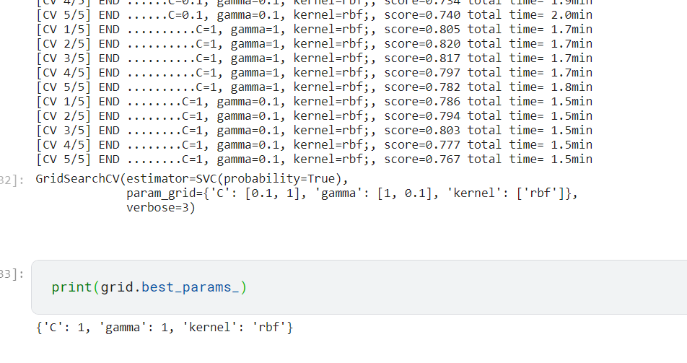
Use GridserchCV for Hyperparameter Tuning.
Apply GridserchCV on SVM with C = “0.1”, “1”, ”10” and kernel =‘rbf’ , gamma = ‘1’ , ‘0.1’, 0.01’
Now we get best Hyperparameter for SVM
Hyperparameter Tuning

Slide 14
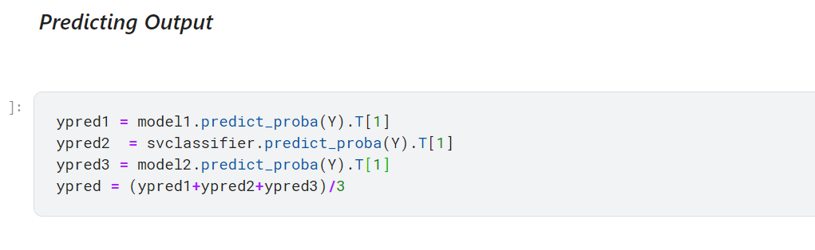
Slacking is done for optimize prediction in which Logistic Regression, Random forest and SVM were taken and the resultant submission score was 0.8783 for TF-IDF.
Slacking

Slide 15
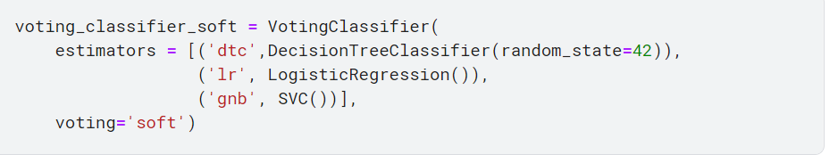
Voting is one of the simplest ways of combining the predictions from multiple machine learning algorithms
If 'hard', uses predicted class labels for majority rule voting. Else if 'soft', predicts the class label based on the argmax of the sums of the predicted probabilities, which is recommended for an ensemble of well-calibrated classifiers.
We use Logistic Regression, Decision Tree and SVM in Voting
Voting

Slide 16
Work done by both team mates :
Work done by Anshul Sharma:
Text Processing using genism and stopwords.
Apply various models to test various accuracy.
Apply slacking with various models.
Apply TF-IDF with different parameters.
Apply voting to get best accuracy.
Work done by Chinmay:
Normalising columns link_word_score,non_markup_alphanumeric_characters,count_of_links and number_of_words_in_url
Prediction of ‘?’ in Alchemy Category and Alchemy Category score using intermediate model
Implementing word2Vec to find feature vector for column page description
Using GridSearchCV for finding optimal parameters for SVM model

