Slide 1

HOPEBRIDGE
BRIDGING GAPS WITH HOPE AND SUPPORT

Slide 2
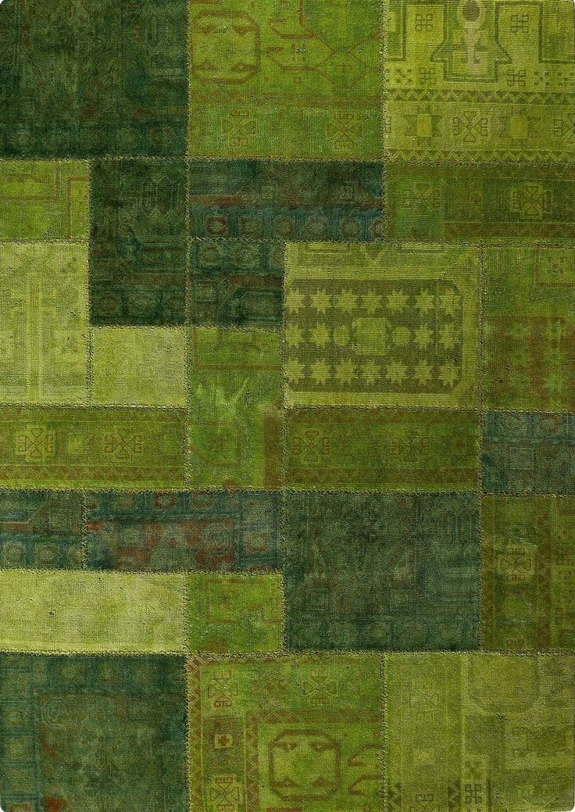
ABOUT
Code Crusaders
We are a team of four passionate developers – Nimish Trivedi, Nuzhat Hussain, Aparna Soni, and Anshul Singhal – who joined forces to participate in HACKGENESIS'25. Driven by a desire to make a positive impact, we developed a user-friendly mobile application designed to streamline the process of charitable giving and volunteering.

Slide 3
PROBLEM STATEMENT
SOLUTION
Our proposed solution would be a mobile app connecting donors and volunteers on a single platform. Donors could register donations and choose self-delivery or volunteer pickup. Volunteers could select collection or donation drives. The app would also include volunteer-donor counseling and a health tracker. This would streamline donations, optimize resources, engage the community, and promote well-being.
A significant disconnect exists between surplus goods and those in need. While donations are made to NGOs, logistical challenges and a lack of coordination often lead to waste. Simultaneously, potential volunteers lack a centralized platform to connect with NGOs for collection and distribution efforts. This absence of a connecting platform hinders efficient resource allocation, preventing donations from reaching their full potential and leaving needs unmet.

Slide 4


FUTURE SCOPE
The future scope of this donation and volunteer app focuses on enhancing core functionality (smart matching, real-time tracking, verification, gamification, community features, NGO integration, reporting), expanding reach (multi-language support, accessibility, partnerships, broader community support), and incorporating advanced features (AI chatbot, predictive analytics, potential drone delivery). These developments aim to improve efficiency, transparency, user engagement, and ultimately, maximize the app's positive community impact.

Slide 5
SOURCES /MODULE USED
Type here
Kivy - python module
Chatgpt
Claude.ai
Date time module
Plyer module
Sqlite3

Slide 6
THANK YOU

