Slide 1

Major Project Design and Performance Analysis of Electric Motor Drive System for a six seater Electric Vehicle
UNIVERSITY INSTITUTE OF TECHNOLOGY RGPV, BHOPAL
Presented By – Anshul Yadav

Slide 2
TABLE OF CONTENT
05
06
Technical Work Details
Conclusion

Slide 3

Abstract
This six-seater Golf Cart has been designed and developed for UIT RGPV .
All components of the Golf cart like the frame of the vehicle, transmission system, brakes, batteries, motor, tires, and motor controller have been designed and fabricated.
The Golf Cart can sustain a maximum load of 15 KN on the bumpy and terrain road at a maximum speed of 25 Km/hr.
The batteries of the Golf Cart are placed below the seats to minimize the car space and over-turning moments on terrain roads.
The modeling of various components of the Golf cart has been done in CATEA software.
The maximum torque obtained at the 800, 1360 and 1500 RPM are the 2.1 Nm in 0.35 s.
The six-seater Golf Cart works very efficiently and smoothly on the smooth, bumpy, and terrain road.
It is very efficient to take the load of six passengers .
It did not produce noise and air pollution due to use of DC motor.

Slide 4
01
Introduction
Why we perceive with the 6 seater Electric Golf Cart?

Slide 5
Introduction
Electric Golf Cart with 6 Seats
Project Aims
Design a high-quality electric golf cart with 6 seats suitable for
various surfaces, including grassy, muddy, wet, and concrete.
Ensure the vehicle's reliability, comfort, efficiency, and long mileage
by following industry standards and considering cost and technical
aspects.
Contribute to eco-friendliness and cost-effectiveness by eliminating
the need for liquid fuels, oil changes, and complex maintenance.

Slide 6
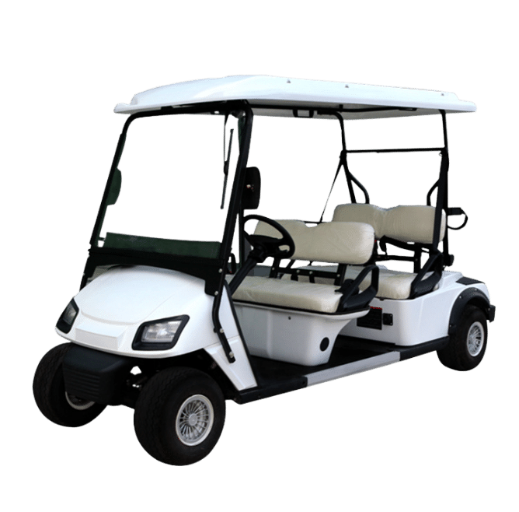
Expected Golf Cart

Slide 7
02
Literature Review
Exploring the Landscape of Electric Motor Drive Systems for EVs

Slide 8
Research Breakdown
Electric Vehicle Technology
Electric Motor Drive System
DC/ BLDC Motor
Induction Motor
PMSM
Motor Control Algorithms
Regenerative Braking System
Vehicle Dynamics in EV’s

Slide 9
Structural Design of EVs
Lightweight EVs Material
Battery Technology for EV’s
Vehicle Dynamics in EV’s

Slide 10
Battery Management System
Charging Infrastructure System
Performance, Emerging Technologies, and Innovation for EV’s
Safety Standards for EVs

Slide 11

Electric Vehicle Technology
Electric Motor Drive System

Slide 12


Electric Vehicle Technology
Barapatre, D. et al. [1] examine the shift from gasoline to electric vehicles, detailing their mechanics, advantages, and drawbacks. The paper offers a glimpse into the future of electric vehicle technology.
Jeon (2010) [2] focuses on the market feasibility of Hybrid Electric Vehicles, Plug-In Hybrid Electric Vehicles, and Electric Vehicles. The study forecasts sales trends until 2030, considering historical factors impacting the U.S. vehicle market.
Amid rising fuel prices and environmental concerns, electric vehicles emerge as a solution despite initial challenges. Barapatre, D. et al. [1] discuss the transition, while Jeon (2010) [2] explores the market potential of various electric vehicle technologies, projecting sales until 2030.

Slide 13
Electric Motor Drive System
Hashemnia and Asaei (2008) [3] compare five electric motor types for EV applications, favoring brushless DC and permanent magnet motors due to lower pollution, fuel consumption, and higher power-to-volume ratio..
Hassanin et al. (2018) [4] focus on sizing a Brushless DC Motor for EVs, considering vehicle specifications and utilizing an eight-switch bridge converter. The study explores motor and EV dynamics, assessing the impact of the control circuit on motor currents.
Loganayaki and Kumar (2019) [5] highlight the advantages of Permanent Magnet Synchronous Motors (PMSMs) for EVs, emphasizing their high torque-to-current ratio, power-to-weight ratio, and efficiency. The paper introduces a PMSM design for EVs developed using Ansys Electronics.
Pryymak (2019) [6] discusses an Induction Motor (IM) Control System for EVs, introducing a field weakening control algorithm to enhance IM torque. The study employs a genetic algorithm for numerical IM torque optimization, resulting in significant reductions in acceleration and braking times, showcasing the efficiency of the proposed EV IM control system.

Slide 14
Motor Control Algorithms, Regenerative Braking and Vehicle Dynamics
Battery Technology for EVs

Slide 15
Motor Control Algorithms, Regenerative Braking and Vehicle Dynamics
De Klerk and Saha (2021) [9] review advanced traction motor control techniques for electric vehicle powertrains, emphasizing efficiency improvement through methods like direct torque control and indirect field-oriented control. Ongoing research targets ripple reduction and efficiency enhancement for extended vehicle range.
Totev, Gueorgiev, and Rizov (2019) [10] provide a concise overview of regenerative braking in electric vehicles, highlighting its role in converting mechanical energy into electrical energy during deceleration. The discussion underscores the significance of regenerative braking for extending EV range and reducing fuel consumption.
Zhao, Mahbub, and Malikopoulos (2019) [11] focus on optimal vehicle dynamics and powertrain control for connected and automated plug-in hybrid electric vehicles. The paper presents a two-level control architecture aimed at simultaneously optimizing speed profiles and powertrain efficiency. Simulations in a network of vehicles demonstrate the potential for real-time control actions to optimize energy consumption.

Slide 16
Battery Technology for EVs
Mahapatra (2021) [7] explores energy storage and technologies for electric vehicles, emphasizing the suitability of a battery/ultracapacitor hybrid system, particularly with Li-ion battery technology.
A. C. R and A. Ghosh (2021) [8] highlight the crucial role of Battery Management Systems (BMS) in electric vehicles, ensuring safe battery operation through monitoring parameters and determining state of charge (SOC). Ongoing research focuses on developing more efficient BMS for continuous improvement in electric vehicle performance and safety.

Slide 17
Performance, Emerging Technologies, and Innovation for EV’s
Sinha, R., and Bangia, S. (2021) [14] explore electric vehicle (EV) performance under various scenarios, emphasizing the superiority of Brushless DC Motors in efficiency and reliability.
Lee et al., 2021[13] provide a critical review of emerging technologies in electric and hybrid vehicles, covering electric machines, energy sources, wireless charging, and the latest models.
Zhao, L., & Jin, Z. [15] analyze intelligent vehicle climbing force and battery selection using a three-dimensional model, determining suitable battery weight through finite element analysis.
Safety Standards for EVs
Ensuring safety in Electric Vehicles (EVs) [12] is vital. Stringent safety standards encompass aspects like battery safety, crashworthiness, and fire prevention. Global organizations, including ISO and SAE, have developed specific standards addressing EV safety concerns. These standards aim to mitigate risks and enhance overall safety, promoting the widespread adoption of electric vehicles in a secure automotive landscape.

Slide 18
03
Outcomes of Literature Review
Result of Research Papers

Slide 19
Sinha, R., and Bangia, S. (2021) [14] explore EV performance, highlighting Brushless DC Motors' efficiency and reliability over DC motors.
Lee et al., 2021[13] critically review emerging EV technologies, covering electric machines, energy sources, wireless charging, and latest models.
The paper challenges the conventional preference for induction motors in EVs, advocating for permanent magnet and brushless DC motors.
A study on a 35 kW BLDCM for EVs reveals its suitability for diverse conditions, with a 7.3% gradeability and efficient acceleration.
An Ansys Maxwell-designed 5hp inner rotor PMSM for EVs enhances power density, efficiency, and torque smoothness, though cost-effectiveness is noted.

Slide 20
Advancements in EV interior permanent magnet control enhance acceleration and braking, showing potential with a 30-50% acceleration time reduction.
The article suggests Li-ion batteries for EVs, proposing a battery/ultracapacitor hybrid system for optimal driving performance and future power allocation research.
.
Simulink models for lithium-ion batteries showcase effective SOC calculation, paving the way for developing other Battery Management System components.
Research highlights efficiency gains in electric motor control for extended EV range, emphasizing the importance of reliable control mechanisms. Regenerative braking's concise overview emphasizes its significance in increasing EV range by 8-25%, contributing to energy efficiency.
A two-level control architecture for CA-PHEVs optimizes speed profile and powertrain efficiency, considering real-world scenarios and future research directions.
Diverse light EV structures require innovative safety solutions, considering factors like affordability, manufacturing ease, and material choice for optimal design.
The paper offers a starting point for EV/HEV technologies, covering electric machines, energy sources, wireless charging, and latest models for researchers and engineers.

Slide 21
EV component exploration using MATLAB Simulink favors efficient Brushless DC motors, with regenerative braking enhancement potential for greater efficiency.
The study optimizes car performance during slope climbing, considering friction force, resistance, motor power, battery selection, and omnidirectional motion for a wheelchair vehicle.
A new autonomous system forecasts short-term weather conditions and broadcasts information through vehicles, implemented using a multi-agent approach.
A driving-charging integrated controller for EVs reduces onboard volume, with bidirectional converters demonstrating stability and a solar-powered golf cart proving technical viability.
The compact driving-charging integrated controller for EVs, coupled with bidirectional converters, demonstrates stability, and a solar-powered golf cart showcases technical viability and economic feasibility.

Slide 22
Research Gaps and Objectives

Slide 23
Research Gaps
Research Objectives
To select and implement electrical transmission components on vehicle frame.
To provide wiring and control for motor torque from accelerator.
To design our customized battery bank based on motor requirements
Using a compatible motor controller to regulate torque outputs.
Able to power an electric vehicle of 1000kg load for the distance of 60 km.
State-of-the-Art in Electric Motor Drive Systems for Six-Seater Golf Cart
Design of Electric Motor Drive System for Six-Seater Golf Cart
Factors Influencing Efficiency and Cost
Comparison with Existing Systems and Performance Benchmarking
Recommendations for Further Research and Development

Slide 24
Design Development
Safety and comfort
Standardization as per industry
Maneuverability (easy to move and direct)
Power and performance
High quality cost ratio
Safe engineering practices
Stability and long product life

Slide 25
05
Technical Work of Cart
Selection of Motor Parameters

Slide 26
Motor Drives of Golf Cart

Slide 27
General specification of Golf Cart
PERFORMANCE
Max. Speed : 25 Km/H
Max Travel : 80-85 Km In Single Full Charge
Slop Gradient : 40 Degree Climb 20% Reduces Speed
Weight Capacity : 1000kg Average & Up To Max 1500kg
Cart Weight : 460kg
Cart Dimension : 12ft Length * 4ft Width * 6.5ft Height
Roof Top : Fiber Body Roof Top
MECHANICAL SPARES
Steering : Rack & Pinion Type
Axel : 44inch MS Type Axel
Ground Clear : 120mm Breaking : Front Wheel Mechanical Drum
Break Tires : 20inch - 9mm Tubeless Tire

Slide 28
A vehicle transmission is a system that controls power delivery, adjusting speed and torque.
The main components of our transmission assembly are Transaxle, Motor and its Controller
In an electric golf cart, the traditional gearbox is replaced by a transaxle, which combines a differential gear and a single-speed reduction system.
The transaxle's reduction system slows down the power from the electric motor to the wheels.
Extensive market research led to the selection of a transaxle with a 10.45 reduction ratio for the electric golf cart.
This ratio was chosen because it provided the ideal speed performance for the cart, even under a full passenger load, and was cost-effective.

Slide 29
The vehicle traction motor of high density, high efficiency, and wide speed range and control system are the heart the electric car.
The controller plays a vital role in managing power flow, matching voltage and current ratings with the motor, and ensuring compatibility with the battery pack.
It should offer safety features, such as overcurrent protection and thermal shutdown, while also providing programmable options for customization and regenerative braking.
Efficiency, ease of maintenance, compliance with standards, cost considerations, and manufacturer support are essential factors to evaluate when selecting a suitable controller for a 6-seater electric golf cart.

Slide 30
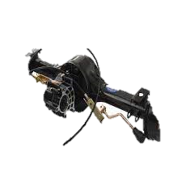
Components & specifications of transmission
Motor
Controller
Transaxle with reduction ratio 10.45
Fig : Transaxle with motor disc brake & hub assembly

Slide 31
Motor
Electric vehicles can utilize both DC and AC motors.
On the above power parameter we need a either 2kW or 3kW or 4kW motor which runs on the RPM of 3000 at 48 rated voltage which generates the Torque of 15.7 Nm.
On the above parameter various types of motor are present in the Market.
Classification Of Motors
Induction Motor
Permanent Magnet Synchronous Motor
Brushless DC Motor
Switched Reluctance Motor
From the above Parameters and Classification of motor Brushless DC Motor should be used because of following difference between the motors.

Slide 32
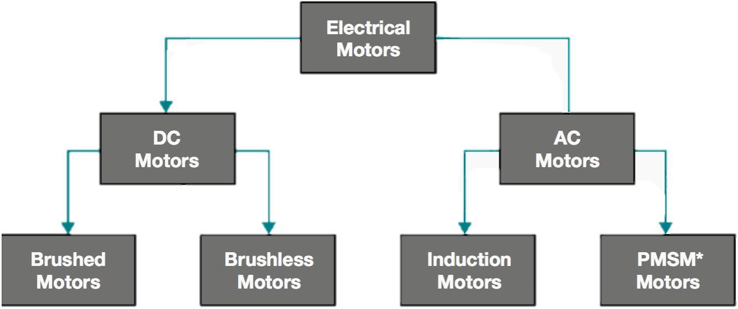
Fig : Classification of Electric Vehicle Motors

Slide 33
Classification of Motor
Characteristic | PMSM | BLDC | Induction | SRM
Cost | High | Medium | Low | Medium
Efficiency | High | High | Medium | High
Torque generated | High | Medium | Medium | High
Speed range | High | High | High | High
Power density | High | Medium | Medium | High
Control complexity | Medium | Medium | Low | Medium
Noise | Low | Medium | Low | High
Reliability | High | High | High | High
Maintenance | Low | Low | Low | Low
Applications | Electric vehicles, robotics, servo drives, aerospace | Electric vehicles, drones, fans, pumps, robotics | Industrial applications, appliances, power tools | Industrial applications, electric vehicles, aerospace

Slide 34
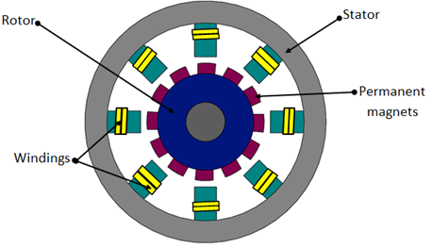
Construction of Brushless DC Motor
A brushless DC (BLDC) motor has two main parts: the stator and the rotor. The stator is the fixed part of the motor and contains the windings, while the rotor is the rotating part and contains the permanent magnets.
Stator
The stator of a BLDC motor is made up of a stack of laminated steel laminations. These laminations are slotted to accommodate the windings. The windings are typically arranged in a three-phase star connection.

Slide 35
How it works
A brushless DC (BLDC) motor works by using an electronic controller to switch DC currents to the motor windings, which produces a rotating magnetic field. The rotor magnets then follow the rotating magnetic field, causing the rotor to rotate.
In simple terms, a BLDC motor works like a spinning magnet following a moving electric field. The electric field is created by the motor windings, and the magnetic field is created by the rotor magnets.

Slide 36
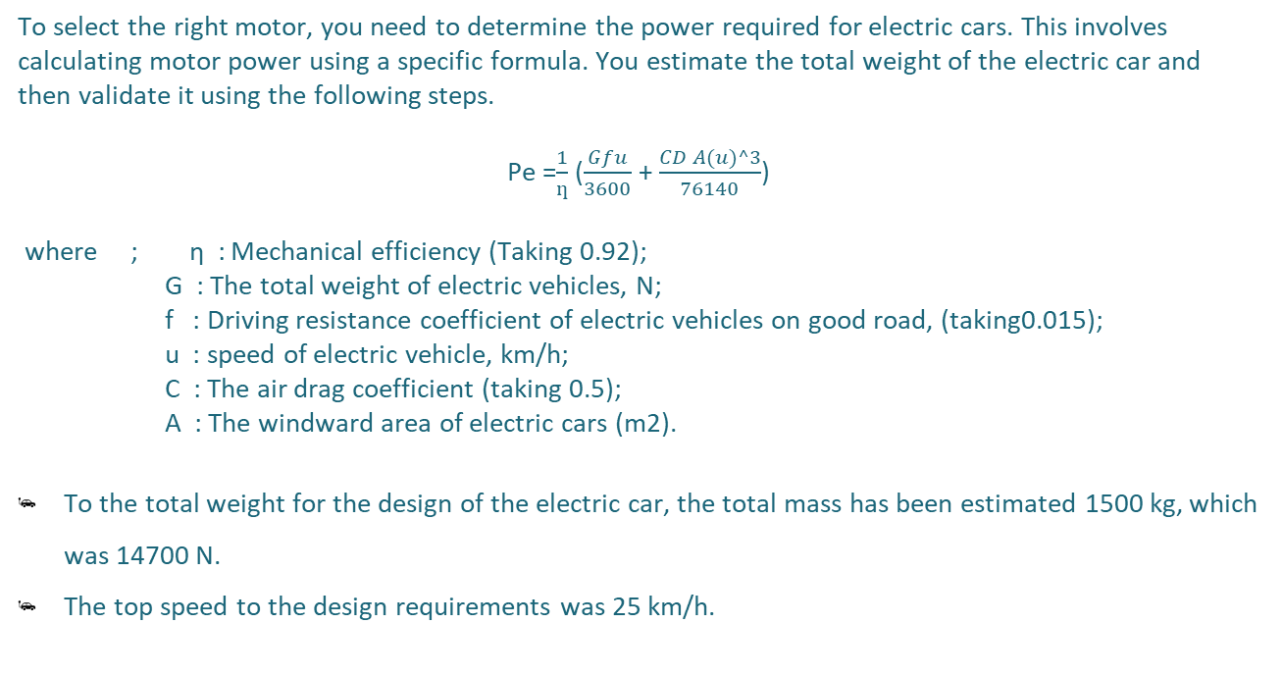
Calculation of Rated Power
To select the right motor, you need to determine the power required for electric cars. This involves calculating motor power using a specific formula. You estimate the total weight of the electric car and then validate it using the following steps.
Pe =$\frac{1}{ƞ}$ ($\frac{Gfu}{3600}$ + $\frac{CD A(u)^3}{76140}$)
where ; η : Mechanical efficiency (Taking 0.92);
G : The total weight of electric vehicles, N;
f : Driving resistance coefficient of electric vehicles on good road, (taking0.015);
u : speed of electric vehicle, km/h;
C : The air drag coefficient (taking 0.5);
A : The windward area of electric cars (m2).
To the total weight for the design of the electric car, the total mass has been estimated 1500 kg, which was 14700 N.
The top speed to the design requirements was 25 km/h.

Slide 37
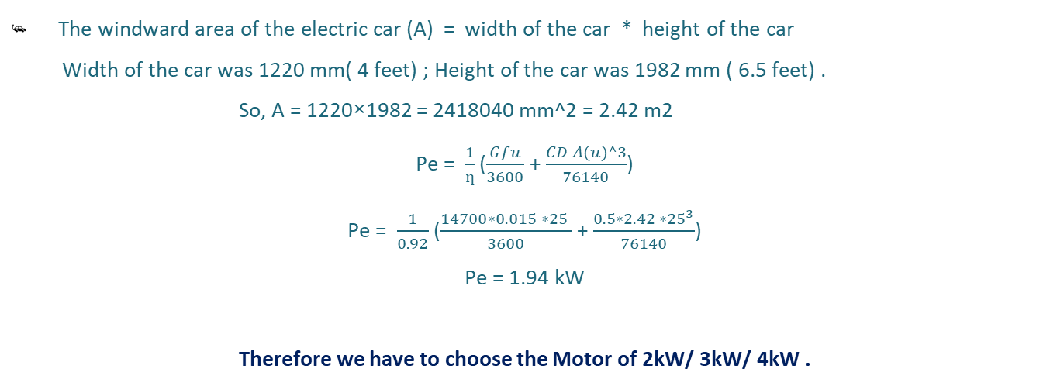
Calculation of Rated Power
The windward area of the electric car (A) = width of the car * height of the car
Width of the car was 1220 mm( 4 feet) ; Height of the car was 1982 mm ( 6.5 feet) .
So, A = 1220×1982 = 2418040 mm^2 = 2.42 m2
Pe = $\frac{1}{ƞ}$ ($\frac{Gfu}{3600}$ + $\frac{CD A(u)^3}{76140}$)
Pe = $\frac{1}{0.92}$ ($\frac{14700∗0.015 ∗25 }{3600}$ + $\frac{0.5∗2.42 ∗{25}^{3}}{76140}$)
Pe = 1.94 kW
Therefore we have to choose the Motor of 2kW/ 3kW/ 4kW .

Slide 38
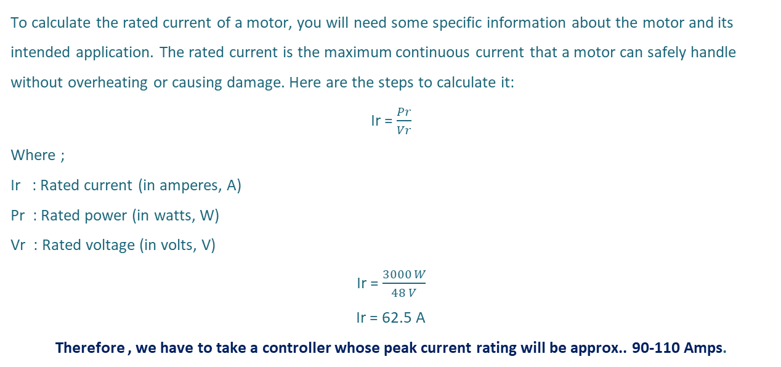
Calculation of Rated Current
To calculate the rated current of a motor, you will need some specific information about the motor and its intended application. The rated current is the maximum continuous current that a motor can safely handle without overheating or causing damage. Here are the steps to calculate it:
Ir = $\frac{Pr}{Vr}$
Where ;
Ir : Rated current (in amperes, A)
Pr : Rated power (in watts, W)
Vr : Rated voltage (in volts, V)
Ir = $\frac{3000 W}{48 V}$
Ir = 62.5 A
Therefore , we have to take a controller whose peak current rating will be approx.. 90-110 Amps.

Slide 39
Why 48 Volts Motor?
Power = voltage × current.
If we go for lower voltage level than current will increase. So then we will need thicker wires for the application. As current is high you have to consider effect of heating due to currents in electronics components
Using a higher voltage reduces the current flowing in the cables significantly. This reduces the cross-section of the cable along with the Ohmic losses. So, the higher the system voltage, the lower is the system current; hence, the lower is the system loss.
For instance , If a 48 V system is used instead of a 12 V system for the same load, then the current will decrease by 12÷48 = 25%.

Slide 40
Why 48 Volts Motor?
Lead-acid batteries have a nominal voltage of 12V. comprising six 2V cells connected in series. The batteries are connected in series to produce a higher voltage.
Voltage of battery are designed for -:
12V battery up to 750 W devices
24 V battery up to 1500 W
48 V battery up to 3000 W.
Therefore we have to choose a motor of 48V.

Slide 41
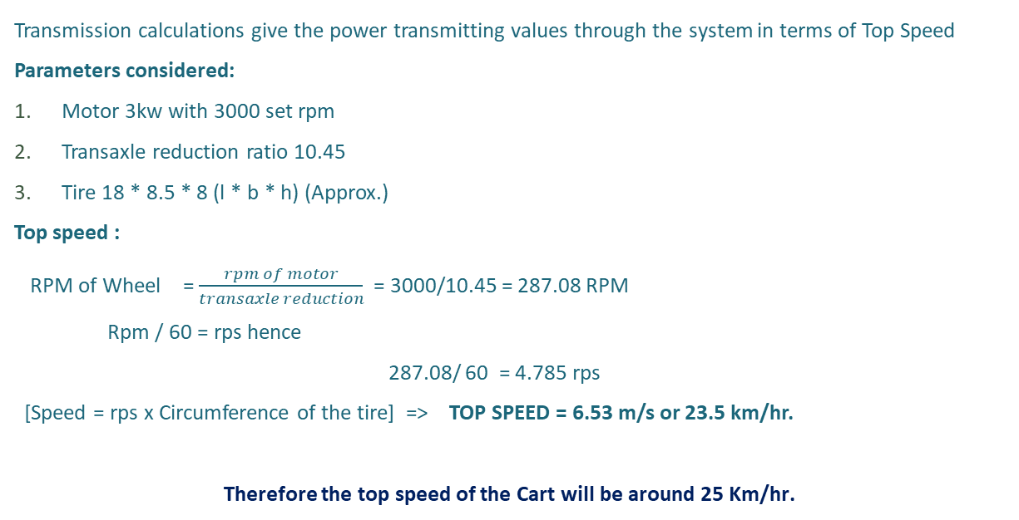
Calculation of Maximum Speed
Transmission calculations give the power transmitting values through the system in terms of Top Speed
Parameters considered:
Motor 3kw with 3000 set rpm
Transaxle reduction ratio 10.45
Tire 18 * 8.5 * 8 (l * b * h) (Approx.)
Top speed :
RPM of Wheel = $\frac{rpm of motor}{transaxle reduction}$ = 3000/10.45 = 287.08 RPM
Rpm / 60 = rps hence
287.08/ 60 = 4.785 rps
[Speed = rps x Circumference of the tire] => TOP SPEED = 6.53 m/s or 23.5 km/hr.
Therefore the top speed of the Cart will be around 25 Km/hr.

Slide 42
Calculation of Torque Generated
The motor constant can be used to calculate the torque output of the motor using the following equation:
Torque = Kit * Ia
Where:
Torque is the torque output of the motor in Nm
Kt is the motor constant in Nm/A
Ia is the armature current in A
Torque = 0.25 * 62.5
Torque = 15.625 Nm
Therefore the Torque of Motor is Around 15.7 Nm.

Slide 43
Golf Cart Controller
The Motor controller is the very important part of the golf cart drive.
The Motor Controller is a device that controls the power output from the batteries to the motor. It is similar to the gas pedal in a car, but instead of controlling the flow of fuel, it controls the flow of electricity.
Golf cart controllers are typically located under the seat of the golf cart. They are connected to the batteries, the motor, and the accelerator pedal.
When you press down on the accelerator pedal, the controller sends more electricity to the motor, which causes the golf cart to go faster. When you release the accelerator pedal, the controller sends less electricity to the motor, which causes the golf cart to slow down.
Golf cart controllers also play an important role in protecting the batteries and the motor. They have a number of safety features that prevent the batteries from being over-discharged and the motor from overheating.

Slide 44
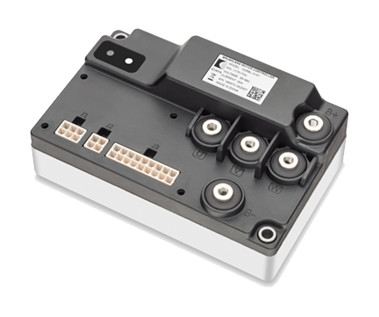
The Curtis Model 1226BL
Specification Of Controller :-
Motor Type Brushless DC (BLDC)
Application/Function Traction / Pump
Nominal Voltage Range (VDC) 24V / 36V / 48V
Maximum CurrentΔ 90-150 Amps
Curtis Motor 1226BL

Slide 45
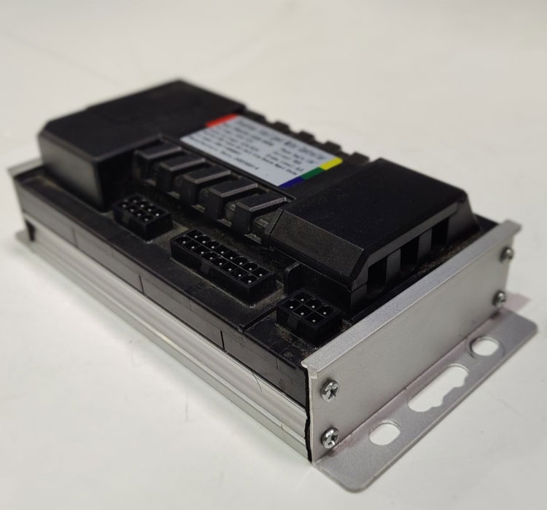
The Weber Drivetrain’s Controller
Specification Of Controller :-
Motor Type Brushless DC (BLDC)
Application/Function Traction / Pump
Nominal Voltage Range (VDC) 48 V / 60 V / 72 V
Maximum CurrentΔ 30 A – 150 A
Weber Drivetrain’s Controller

Slide 46
Some Other Controllers
1. Kelly Controller KLS-H Series:
Peak Current: Up to 120A
Voltage: 24V to 96V
2. Sevcon Gen4 Size 4 Motor Controller:
Peak Current: Up to 100A
Voltage: 24V to 96V
3. Adaptto Mini-E Motor Controller:
Peak Current: Up to 120A
Voltage: 48V to 100V

Slide 47
06
Conclusion

Slide 48
Conclusion
The following outcomes were made in the design and fabrication of the golf cart:
A lot of market research went into the design of the electric golf cart and desirable results were achieved.
Finalizing the design of the chassis and trying to innovate with different pipe sizes and shapes gave a unique looking cart with considerable strength and balance.
An excellent range of mileage of 60 km is obtained for such a heavy vehicle with lead acid batteries.
The performance of overall vehicle including its speed, braking distance and turning radius, which were achieved under the pre-set assumed values.

Slide 49
Conclusion
The suspension design was selected carefully to give the best performance at maximum loading conditions.
The transaxle ratio of 10.45 gives the most optimum output with the coupled motor. The Golf Cart is able to climb fully loaded in grassy/muddy terrain with 20° inclination from horizontal as per design.
The heavy batteries placed below the seats makes the majority of the weight carried by the cart at low height even after passenger is seated, which gives the entire cart a very low roll center that reduces the risk of cart rolling during uneven terrains.

Slide 50
Conclusion
Specification | Values
Motor Type | Brushless DC Motor
Rated Power | 2kW/ 3kW/ 4kW
Rated Voltage | 48V
Peak Current | 90-110Amps
Continuous Current | 65Amps
Controller | Curtis Controller 1226BL
Transaxle | 44 inch MS type

Slide 51
References
[1]. H. Zakaria, M. Hamid, E. M. Abdellatif and A. Imane, "Recent Advancements and Developments for Electric Vehicle Technology," 2019 IEEE International Conference of Computer Science and Renewable Energies (ICCSRE), Agadir, Morocco, 2019, pp. 1-6, doi: 10.1109/ICCSRE.2019.8807726.
[2]. Hybrid & Electric Vehicle Technology and its market feasibility by Sang Yeob Jeon (S.M. in System Design and Management)--Massachusetts Institute of Technology, Engineering Systems Division, 2010.
[3]. N. Hashemnia and B. Asaei, "Comparative study of using different electric motors in the electric vehicles," 2008 IEEE 18th International Conference on Electrical Machines, Vilamoura, Portugal, 2008, pp. 1-5, doi: 10.1109/ICELMACH.2008.4800157.
[4]. M. A. Hassanin, F. E. Abdel-Kader, S. I. Amer and A. E. Abu-Moubarka, "Operation of Brushless DC Motor to Drive the Electric Vehicle," 2018 IEEE Twentieth International Middle East Power Systems Conference (MEPCON), Cairo, Egypt, 2018, pp. 500-503, doi: 10.1109/MEPCON.2018.8635158.
[5]. A. Loganayaki and R. B. Kumar, "Permanent Magnet Synchronous Motor for Electric Vehicle Applications," 2019 IEEE 5th International Conference on Advanced Computing & Communication Systems (ICACCS), Coimbatore, India, 2019, pp. 1064-1069, doi: 10.1109/ICACCS.2019.8728442.

Slide 52
[6]. B. Pryymak, "Induction Motor Control System of Electric Vehicle with Improved Dynamics in Field Weakening Region," 2019 IEEE 2nd Ukraine Conference on Electrical and Computer Engineering (UKRCON), Lviv, Ukraine, 2019, pp. 615-620, doi: 10.1109/UKRCON.2019.8880012.
[7]. U. Mahapatra, "Energy Storages and Technologies for Electric Vehicle," 2021 IEEE Innovations in Energy Management and Renewable Resources(52042), Kolkata, India, 2021, pp. 1-3, doi: 10.1109/IEMRE52042.2021.9386526.
[8]. A. C. R and A. Ghosh, "Battery Management System in Electric Vehicle," 2021 IEEE 4th Biennial International Conference on Nascent Technologies in Engineering (ICNTE), NaviMumbai, India, 2021, pp. 1-6, doi: 10.1109/ICNTE51185.2021.9487762.
[9]. M. L. De Klerk and A. K. Saha, "A Comprehensive Review of Advanced Traction Motor Control Techniques Suitable for Electric Vehicle Applications," in IEEE Access, vol. 9, pp. 125080-125108, 2021, doi: 10.1109/ACCESS.2021.3110736. [10]. V. Totev, V. Gueorgiev and P. Rizov, "Regenerative braking of electric vehicles," 2019 IEEE 11th Electrical Engineering Faculty Conference (BulEF), Varna, Bulgaria, 2019, pp.1-5, doi: 10.1109/BulEF48056.2019.9030768.
[11]. L. Zhao, A. M. I. Mahbub and A. A. Malikopoulos, "Optimal Vehicle Dynamics and Powertrain Control for Connected and Automated Vehicles," 2019 IEEE Conference on Control Technology and Applications (CCTA), Hong Kong, China, 2019, pp. 33-38, doi: 10.1109/CCTA.2019.8920531.

Slide 53
[12]. J. Romo, E. Cañibano and J. C. Merino, "Lightweighting and passive safety for urban electric vehicle," 2017 IEEE Electric Vehicles International Conference (EV), Bucharest, Romania,2017, pp. 1-5, doi: 10.1109/EV.2017.8242113.
[13]. C. H. T. Lee, W. Hua, T. Long, C. Jiang and L. V. Iyer, "A Critical Review of Emerging Technologies for Electric and Hybrid Vehicles," in IEEE Open Journal of Vehicular Technology, vol. 2, pp. 471-485, 2021, doi: 10.1109/OJVT.2021.3138894
[14]. Sinha, R., and Bangia, S. (2021). Performance Analysis of Electric Vehicle Based on Various Working Scenarios. International Transaction Journal of Engineering, Management,& Applied Sciences & Technologies, 12(1), 12A1R, 1-15. http://TUENGR.COM/V12/12A1R.pdf DOI: 10.14456/ITJEMAST.2021.18
[15]. L. Zhao and Z. Jin, "Analysis of Intelligent Vehicle Climbing Force and Battery Selection," 2019 IEEE International Conference on Mechatronics and Automation (ICMA), Tianjin, China, 2019, pp. 2395-2400, doi: 10.1109/ICMA.2019.8816496.
[16]. S. Raveena and M. A. Berlin, "Broadcasting weather report to vehicles in urban roads," 2017 IEEE International Conference on Inventive Systems and Control (ICISC), Coimbatore, India,2017, pp. 1-5, doi: 10.1109/ICISC.2017.8068624.
[17]. K. Zhou, H. Fang and Y. Liu, "Driving–Charging Integrated Controller for Electric Vehicles," in IEEE Access, vol. 10, pp. 66545-66563, 2022, doi: 10.1109/ACCESS.2022.3185261.
[18]. J. Fan, "Solar Powered Golf Cart: Testing and Performance Analyses," 2018 IEEE 2ndInternational Conference on Green Energy and Applications (ICGEA), Singapore, 2018, pp. 74-78, doi: 10.1109/ICGEA.2018.8356302.

Slide 54
THANKS!

