Slide 1

UNIVERSITY INSTITUTE OF TECHNOLOGY RGPV, BHOPAL
Major Project Design and Performance Analysis of Electric Motor Drive System for a four seater Electric Vehicle
Presented By :-
Anshul Yadav (0101AU201015)
Guided By :-
Dr. Narayan Prasad Gupta

Slide 2
TABLE OF CONTENT
01 Introduction
02 Literature Review
03 Research Gaps And Objective
04 Technical Work Details
05 Conclusion

Slide 3
Abstract
This electric golf cart, designed specifically for UIT RGPV, comfortably seats four passengers. All components, from the frame to the motor and batteries, were designed and fabricated in-house to ensure optimal performance and durability.
The cart can handle a maximum load of 15 kN while navigating various terrains, including bumpy and uneven roads, at speeds up to 25 km/h. For safe and stable operation, the batteries are strategically positioned below the seats, minimizing space usage and lowering the center of gravity.
Throughout the design process, MATLAB software was utilized for comprehensive modeling of each component. This approach resulted in a highly efficient electric motor that delivers exceptional torque, reaching 2.1 Nm in just 0.35 seconds at key RPM ranges (800, 1360, and 1500).
This eco-friendly golf cart operates smoothly and efficiently on various terrains, making it an ideal solution for passenger transport within the UIT RGPV campus. The electric motor ensures quiet operation, eliminating noise pollution, and contributing to a cleaner environment.

Slide 4
01
Introduction
Designing of a four-seater electric golf cart-

Slide 5
Introduction
Project Objectives:
Design a high-quality electric golf cart with four seats suitable for various surfaces, including grassy, muddy, wet, and concrete.
Ensure the vehicle's reliability, comfort, efficiency, and long mileage by following industry standards and considering cost and technical aspects.
Contribute to eco-friendliness and cost-effectiveness by eliminating the need for liquid fuels, oil changes, and complex maintenance.

Slide 6
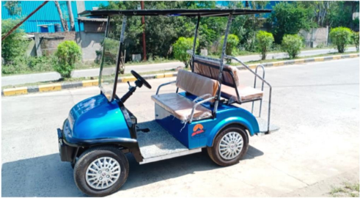
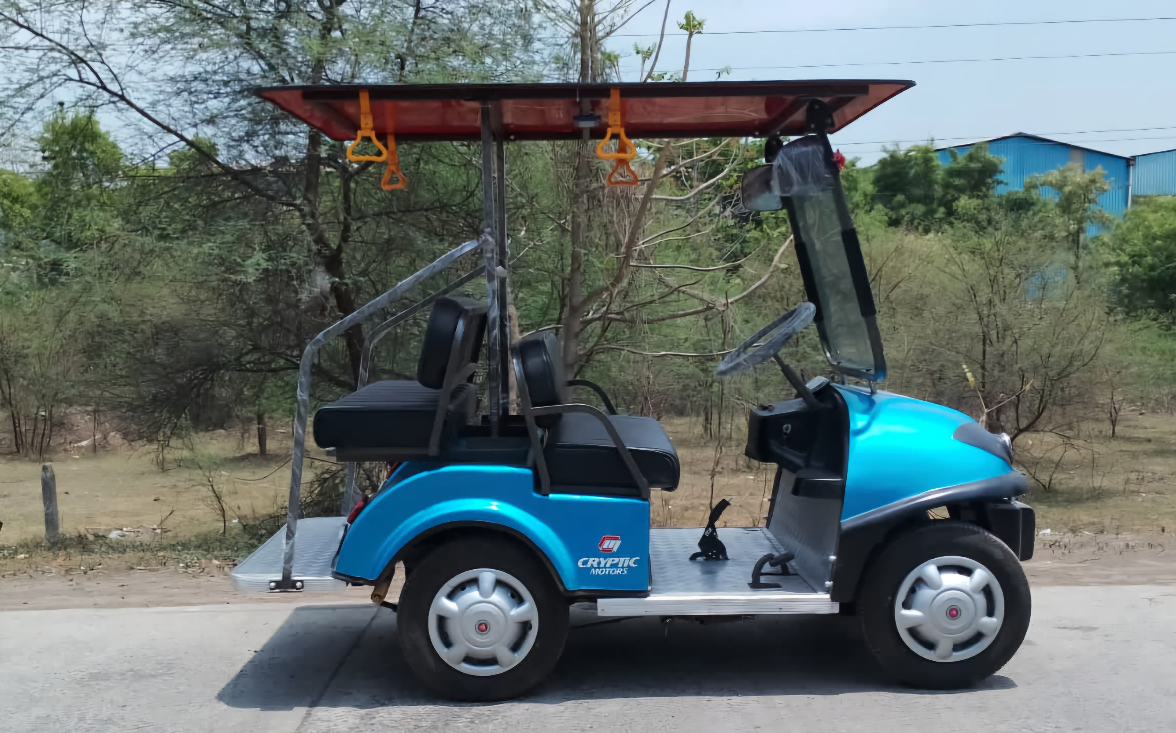
Electric Golf Cart

Slide 7
02
Literature Review
Exploring the Landscape of Electric Motor Drive Systems for EVs

Slide 8
Research Analysis
Electric Vehicle Technology
Electric Motor Drive System
DC/ BLDC Motor
Induction Motor
PMSM
Motor Control Algorithms
Regenerative Braking System

Slide 9
Structural Design of EVs
Lightweight EVs Material
Battery Technology for EV’s
Vehicle Dynamics in EV’s

Slide 10
Battery Management System
Charging Infrastructure System
Performance, Emerging Technologies, and Innovation for EV’s
Safety Standards for EVs

Slide 11
Research Gaps and Objectives

Slide 12
Research Gaps
Motor Selection and Torque Control
Transmission Systems and Regenerative Braking
Powertrain Efficiency Optimization through Simulation

Slide 13
Research Objective
Analyze the impact of different electric motor types (AC vs. DC, permanent magnet vs. induction) on the efficiency, power output, and cost-effectiveness of six-seater electric golf carts.
Develop advanced motor controller algorithms to precisely regulate torque delivery for improved vehicle dynamics and energy efficiency in six-seater electric golf carts.
Investigate the optimal transmission system (direct drive vs. geared vs. CVT) to maximize efficiency and performance across various operating conditions (low-speed acceleration, hill climbing) in six-seater electric golf carts.
Design and integrate regenerative braking strategies to maximize energy recuperation and minimize wear on mechanical brakes in six-seater electric golf carts.
Develop and validate a powertrain simulation model to predict the real-world performance of six-seater electric golf carts under different operating scenarios (terrain, payload, driving style).

Slide 14
Design Development
Safety and comfort
Standardization as per industry
Maneuverability (easy to move and direct)
Power and performance
High quality cost ratio
Safe engineering practices
Stability and long product life

Slide 15
02
General Specification of Golf Cart
Electrical Drive, Performance & Mechanical spare

Slide 16

General specification of Golf Cart
PERFORMANCE
Max. Speed : 25 Km/H
Max Travel : 60-65 Km In Single Full Charge
Slop Gradient : 40 Degree Climb 20% Reduces Speed
Weight Capacity : 600kg Average & Up To Max 800kg
Cart Weight : 390kg
Cart Dimension : 12ft Length * 4ft Width * 6.5ft Height
Roof Top : Fiber Body Roof Top

Slide 17
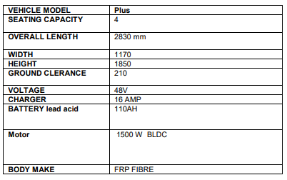
Specification

Slide 18
Design Development
Safety and comfort
Standardization as per industry
Maneuverability (easy to move and direct)
Power and performance
High quality cost ratio
Safe engineering practices
Stability and long product life

Slide 19
Motor Drives of Golf Cart

Slide 20
03
Motor Analysis
Selection of Motor

Slide 21
A vehicle transmission is a system that controls power delivery, adjusting speed and torque.
The main components of our transmission assembly are Transaxle, Motor and its Controller
In an electric golf cart, the traditional gearbox is replaced by a transaxle, which combines a differential gear and a single-speed reduction system.
The transaxle's reduction system slows down the power from the electric motor to the wheels.
Extensive market research led to the selection of a transaxle with a 10.45 reduction ratio for the electric golf cart.
This ratio was chosen because it provided the ideal speed performance for the cart, even under a full passenger load, and was cost-effective.

Slide 22
The vehicle traction motor of high density, high efficiency, and wide speed range and control system are the heart the electric car.
The controller plays a vital role in managing power flow, matching voltage and current ratings with the motor, and ensuring compatibility with the battery pack.
It should offer safety features, such as overcurrent protection and thermal shutdown, while also providing programmable options for customization and regenerative braking.
Efficiency, ease of maintenance, compliance with standards, cost considerations, and manufacturer support are essential factors to evaluate when selecting a suitable controller for a 6-seater electric golf cart.

Slide 23
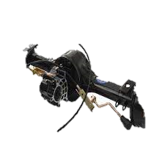
Components & specifications of transmission
Motor
Controller
Transaxle with reduction ratio 10.45
Fig : Transaxle with motor disc brake & hub assembly

Slide 24
04
Motor Parameters
Calculating Motor Parameters

Slide 25
Calculation of Rated Power
To select the right motor, you need to determine the power required for electric cars. This involves calculating motor power using a specific formula. You estimate the total weight of the electric car and then validate it using the following steps.
• Rolling resistance: Assuming rolling resistance co-efficient of 0.05, which is standard between Tires and Asphalt roads. Assuming gravitational acceleration as 9.81 ms-2.
Fr = 600 × 9.81 × 0.05 = 294.3 N
• Grade resistance: Assuming max gradient of 30 degrees, speed humps are designed with a maximum gradient of 6 degrees.
Fg = 600 × 9.81× sin(30) = 2934 N
• Aerodynamic resistance: The vehicle is being designed for campus drive and has an average speed of 25 Km/hr. (6.95 m/s). At such low speeds drag resistance can be ignored.
2. POWER REQUIREMENTS For drive on flat road, Minimum motor power required
P = Fr × v
P = 294.3 × 6.95
P = 2045.38 Watts.
Hence, a minimum 2 KW-2.5 KW motor will be needed to power the vehicle.

Slide 26

Calculation of Rated Current
To calculate the rated current of a motor, you will need some specific information about the motor and its intended application. The rated current is the maximum continuous current that a motor can safely handle without overheating or causing damage. Here are the steps to calculate it:
I_{r} = $\frac{Pr}{Vr}$
Where ;
I_{r} : Rated current (in amperes, A)
P_{r} : Rated power (in watts, W)
V_{r} : Rated voltage (in volts, V)
I_{r} = $\frac{1500W}{48 V}$
I_{r} = 31.25 A
Therefore , we have to take a controller whose peak current rating will be approx.. 90-110 Amps.

Slide 27
Why 48 Volts Motor?
Power = voltage × current.
If we choose lower voltage level then current will increase. Thereby, requiring thicker wires for the application. As current is high we have to consider the effect of heating due to currents in electronics components
Using a higher voltage reduces the current flowing in the cables significantly. This reduces the cross-section of the cable along with the Ohmic losses. So, the higher the system voltage, the lower is the system current; hence, the lower is the system loss.

Slide 28
Why 48 Volts Motor?
For instance , If a 48 V system is used instead of a 12 V system for the same load, then the current will decrease by 12÷48 = 25%
Lead-acid batteries have a nominal voltage of 12V. comprising six 2V cells connected in series. The batteries are connected in series to produce a higher voltage.
Voltage of battery are designed for -:
12V battery up to 750 W devices
24 V battery up to 1500 W
48 V battery up to 3000 W.
.

Slide 29

Calculation of Maximum Speed
Transmission calculations give the power transmitting values through the system in terms of Top Speed
Parameters considered:
Motor 3kw with 3000 set rpm
Transaxle reduction ratio 10.45
Tire 18 * 8.5 * 8 (l * b * h) (Approx.)
Top speed :
RPM of Wheel = $\frac{rpm of motor}{transaxle reduction}$ = 3000/10.45 = 287.08 RPM
Rpm / 60 = rps hence
287.08/ 60 = 4.785 rps
[Speed = rps x Circumference of the tire] => TOP SPEED = 6.53 m/s or 23.5 km/hr.
Therefore the top speed of the Cart will be around 25 Km/hr.

Slide 30
Calculation of Torque Generated
The motor constant can be used to calculate the torque output of the motor using the following equation:
Torque = Kit * Ia
Where:
Torque is the torque output of the motor in Nm
Kt is the motor constant in Nm/A
Ia is the armature current in A
Torque = 0.25 * 62.5
Torque = 15.625 Nm
Therefore the Torque of Motor is Around 15.7 Nm.

Slide 31
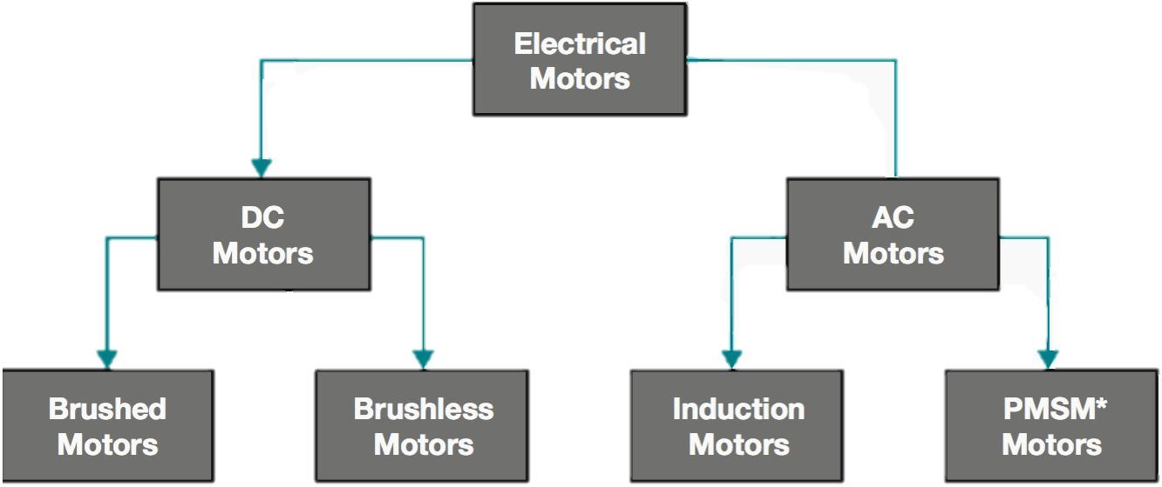
Fig : Classification of Electric Vehicle Motors

Slide 32
Motor
Electric vehicles can utilize both DC and AC motors.
On the above power parameter we need a either 2kW or 3kW or 4kW motor which runs on the RPM of 3000 at 48 rated voltage which generates the Torque of 15.7 Nm.
On the above parameter various types of motor are present in the Market.
Classification Of Motors
Induction Motor
Permanent Magnet Synchronous Motor
Brushless DC Motor
Switched Reluctance Motor
From the above Parameters and Classification of motor Brushless DC Motor should be used because of following difference between the motors.

Slide 33
Classification of Motor
Characteristic | PMSM | BLDC | Induction | SRM
Cost | High | Medium | Low | Medium
Efficiency | High | High | Medium | High
Torque generated | High | Medium | Medium | High
Speed range | High | High | High | High
Power density | High | Medium | Medium | High
Control complexity | Medium | Medium | Low | Medium
Noise | Low | Medium | Low | High
Reliability | High | High | High | High
Maintenance | Low | Low | Low | Low
Applications | Electric vehicles, robotics, servo drives, aerospace | Electric vehicles, drones, fans, pumps, robotics | Industrial applications, appliances, power tools | Industrial applications, electric vehicles, aerospace

Slide 34
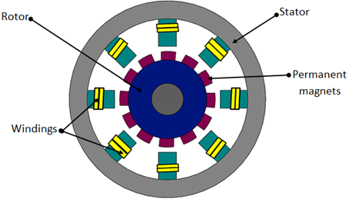
Construction of Brushless DC Motor
A brushless DC (BLDC) motor has two main parts: the stator and the rotor. The stator is the fixed part of the motor and contains the windings, while the rotor is the rotating part and contains the permanent magnets.
Stator
The stator of a BLDC motor is made up of a stack of laminated steel laminations. These laminations are slotted to accommodate the windings. The windings are typically arranged in a three-phase star connection.

Slide 35
Construction of Brushless DC Motor
Rotor
The rotor of a BLDC motor is made up of a shaft and a hub with permanent magnets arranged to form between two to eight pole pairs that alternate between north and south poles.
Construction
The stator and rotor are assembled into a housing. The housing is typically made of aluminum or steel. The shaft of the rotor extends through the housing and is supported by bearings.

Slide 36
Construction of Brushless DC Motor
Commutation
BLDC motors use electronic commutation to control the
rotation of the rotor. The electronic commutation circuit switches the current to the stator windings in a sequence that creates a rotating magnetic field. The rotor magnets then follow the rotating magnetic field, causing the rotor to rotate.

Slide 37
How it works
A brushless DC (BLDC) motor works by using an electronic controller to switch DC currents to the motor windings, which produces a rotating magnetic field. The rotor magnets then follow the rotating magnetic field, causing the rotor to rotate.
In simple terms, a BLDC motor works like a spinning magnet following a moving electric field. The electric field is created by the motor windings, and the magnetic field is created by the rotor magnets.

Slide 38
05
Controller
Determining suitable Controllers

Slide 39
Golf Cart Controller
The Motor Controller is a device that controls the power output from the batteries to the motor. It is similar to the gas pedal in a car, but instead of controlling the flow of fuel, it controls the flow of electricity.
Golf cart controllers are typically located under the seat of the golf cart. They are connected to the batteries, the motor, and the accelerator pedal.
When you press down on the accelerator pedal, the controller sends more electricity to the motor, which causes the golf cart to go faster. When you release the accelerator pedal, the controller sends less electricity to the motor, which causes the golf cart to slow down.
Golf cart controllers also play an important role in protecting the batteries and the motor. They have a number of safety features that prevent the batteries from being over-discharged and the motor from overheating.

Slide 40
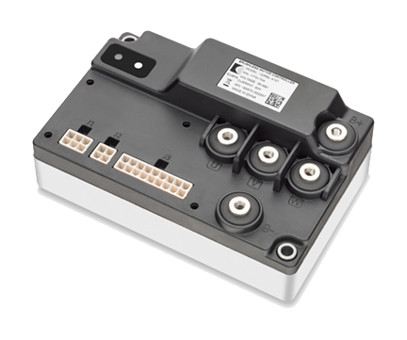
The Curtis Model 1226BL
Specification Of Controller :-
Motor Type Brushless DC (BLDC)
Application/Function Traction / Pump
Nominal Voltage Range (VDC) 24V / 36V / 48V
Maximum CurrentΔ 90-150 Amps
Curtis Motor 1226BL

Slide 41
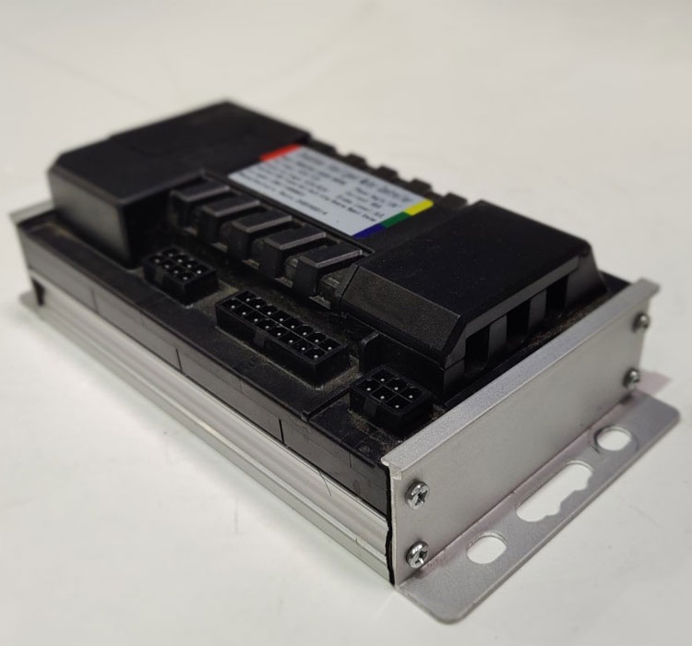
The Weber Drivetrain’s Controller
Specification Of Controller :-
Motor Type : Brushless DC (BLDC)
Application/Function : Traction / Pump
Nominal Voltage Range (VDC) : 48 V / 60 V / 72 V
Maximum Current : 30 A – 150 A
Weber Drivetrain’s Controller

Slide 42
Some Other Controllers
1. Kelly Controller KLS-H Series:
Peak Current: Up to 120A
Voltage: 24V to 96V
2. Sevcon Gen4 Size 4 Motor Controller:
Peak Current: Up to 100A
Voltage: 24V to 96V
3. Adaptto Mini-E Motor Controller:
Peak Current: Up to 120A
Voltage: 48V to 100V

Slide 43
06
Conclusion

Slide 44
Conclusion
The following outcomes were made in the design and fabrication of the golf cart:
A lot of market research went into the design of the electric golf cart and desirable results were achieved.
Finalizing the design of the chassis and trying to innovate with different pipe sizes and shapes gave a unique looking cart with considerable strength and balance.
An excellent range of mileage of 60 km is obtained for such a heavy vehicle with lead acid batteries.
The performance of overall vehicle including its speed, braking distance and turning radius, which were achieved under the pre-set assumed values.

Slide 45
Conclusion
The suspension design was selected carefully to give the best performance at maximum loading conditions.
The transaxle ratio of 10.45 gives the most optimum output with the coupled motor. The Golf Cart is able to climb fully loaded in grassy/muddy terrain with 20° inclination from horizontal as per design.
The heavy batteries placed below the seats makes the majority of the weight carried by the cart at low height even after passenger is seated, which gives the entire cart a very low roll center that reduces the risk of cart rolling during uneven terrains.

Slide 46
Conclusion
Specification | Values
Motor Type | Brushless DC Motor
Rated Power | 2kW/ 3kW/ 4kW
Rated Voltage | 48V
Peak Current | 90-110Amps
Continuous Current | 65Amps
Controller | Curtis Controller 1226BL
Transaxle | 44 inch MS type

Slide 47
References
[1]. H. Zakaria, M. Hamid, E. M. Abdellatif and A. Imane, "Recent Advancements and Developments for Electric Vehicle Technology," 2019 IEEE International Conference of Computer Science and Renewable Energies (ICCSRE), Agadir, Morocco, 2019, pp. 1-6, doi: 10.1109/ICCSRE.2019.8807726.
[2]. Hybrid & Electric Vehicle Technology and its market feasibility by Sang Yeob Jeon (S.M. in System Design and Management)--Massachusetts Institute of Technology, Engineering Systems Division, 2010.
[3]. N. Hashemnia and B. Asaei, "Comparative study of using different electric motors in the electric vehicles," 2008 IEEE 18th International Conference on Electrical Machines, Vilamoura, Portugal, 2008, pp. 1-5, doi: 10.1109/ICELMACH.2008.4800157.
[4]. M. A. Hassanin, F. E. Abdel-Kader, S. I. Amer and A. E. Abu-Moubarka, "Operation of Brushless DC Motor to Drive the Electric Vehicle," 2018 IEEE Twentieth International Middle East Power Systems Conference (MEPCON), Cairo, Egypt, 2018, pp. 500-503, doi: 10.1109/MEPCON.2018.8635158.
[5]. A. Loganayaki and R. B. Kumar, "Permanent Magnet Synchronous Motor for Electric Vehicle Applications," 2019 IEEE 5th International Conference on Advanced Computing & Communication Systems (ICACCS), Coimbatore, India, 2019, pp. 1064-1069, doi: 10.1109/ICACCS.2019.8728442.

Slide 48
[6]. B. Pryymak, "Induction Motor Control System of Electric Vehicle with Improved Dynamics in Field Weakening Region," 2019 IEEE 2nd Ukraine Conference on Electrical and Computer Engineering (UKRCON), Lviv, Ukraine, 2019, pp. 615-620, doi: 10.1109/UKRCON.2019.8880012.
[7]. U. Mahapatra, "Energy Storages and Technologies for Electric Vehicle," 2021 IEEE Innovations in Energy Management and Renewable Resources(52042), Kolkata, India, 2021, pp. 1-3, doi: 10.1109/IEMRE52042.2021.9386526.
[8]. A. C. R and A. Ghosh, "Battery Management System in Electric Vehicle," 2021 IEEE 4th Biennial International Conference on Nascent Technologies in Engineering (ICNTE), NaviMumbai, India, 2021, pp. 1-6, doi: 10.1109/ICNTE51185.2021.9487762.
[9]. M. L. De Klerk and A. K. Saha, "A Comprehensive Review of Advanced Traction Motor Control Techniques Suitable for Electric Vehicle Applications," in IEEE Access, vol. 9, pp. 125080-125108, 2021, doi: 10.1109/ACCESS.2021.3110736. [10]. V. Totev, V. Gueorgiev and P. Rizov, "Regenerative braking of electric vehicles," 2019 IEEE 11th Electrical Engineering Faculty Conference (BulEF), Varna, Bulgaria, 2019, pp.1-5, doi: 10.1109/BulEF48056.2019.9030768.
[11]. L. Zhao, A. M. I. Mahbub and A. A. Malikopoulos, "Optimal Vehicle Dynamics and Powertrain Control for Connected and Automated Vehicles," 2019 IEEE Conference on Control Technology and Applications (CCTA), Hong Kong, China, 2019, pp. 33-38, doi: 10.1109/CCTA.2019.8920531.

Slide 49
[12]. J. Romo, E. Cañibano and J. C. Merino, "Lightweighting and passive safety for urban electric vehicle," 2017 IEEE Electric Vehicles International Conference (EV), Bucharest, Romania,2017, pp. 1-5, doi: 10.1109/EV.2017.8242113.
[13]. C. H. T. Lee, W. Hua, T. Long, C. Jiang and L. V. Iyer, "A Critical Review of Emerging Technologies for Electric and Hybrid Vehicles," in IEEE Open Journal of Vehicular Technology, vol. 2, pp. 471-485, 2021, doi: 10.1109/OJVT.2021.3138894
[14]. Sinha, R., and Bangia, S. (2021). Performance Analysis of Electric Vehicle Based on Various Working Scenarios. International Transaction Journal of Engineering, Management,& Applied Sciences & Technologies, 12(1), 12A1R, 1-15. http://TUENGR.COM/V12/12A1R.pdf DOI: 10.14456/ITJEMAST.2021.18
[15]. L. Zhao and Z. Jin, "Analysis of Intelligent Vehicle Climbing Force and Battery Selection," 2019 IEEE International Conference on Mechatronics and Automation (ICMA), Tianjin, China, 2019, pp. 2395-2400, doi: 10.1109/ICMA.2019.8816496.
[16]. S. Raveena and M. A. Berlin, "Broadcasting weather report to vehicles in urban roads," 2017 IEEE International Conference on Inventive Systems and Control (ICISC), Coimbatore, India,2017, pp. 1-5, doi: 10.1109/ICISC.2017.8068624.
[17]. K. Zhou, H. Fang and Y. Liu, "Driving–Charging Integrated Controller for Electric Vehicles," in IEEE Access, vol. 10, pp. 66545-66563, 2022, doi: 10.1109/ACCESS.2022.3185261.
[18]. J. Fan, "Solar Powered Golf Cart: Testing and Performance Analyses," 2018 IEEE 2ndInternational Conference on Green Energy and Applications (ICGEA), Singapore, 2018, pp. 74-78, doi: 10.1109/ICGEA.2018.8356302.

Slide 50
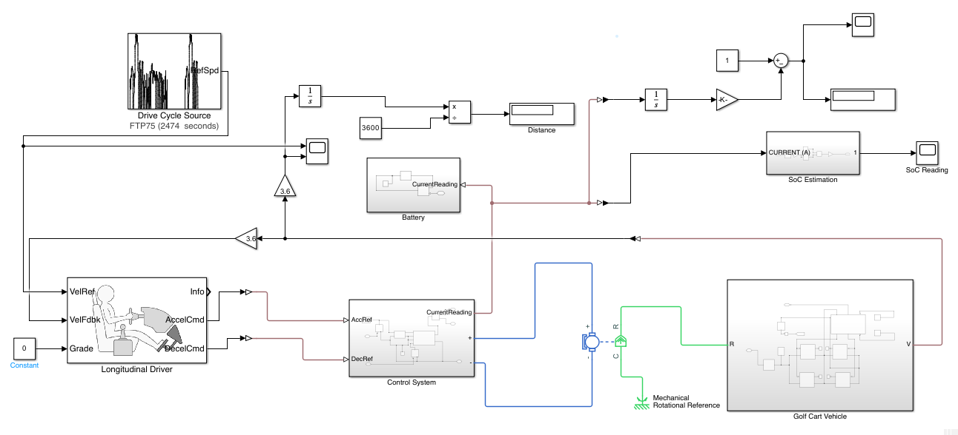
Appendix**

Slide 51
THANKS!

