Slide 1
Face Recognition using Eigen Face Decomposition
Sandeep Mishra 14EC35033 Arnab Mondal 14EC35031
Vineet Jain 14EC35020 Oindrila Saha 14EC35005

Slide 2
Abstract
An approach for the recognition of human faces is presented.
Face images are projected onto a feature space that best encodes the variation among known face images.
This feature space is defined by the 'eigenfaces', which are the eigenvectors of the set of faces.
In the recognition process, an eigenface is formed for the given face image, and the Euclidean distances between this eigenface and the previously stored eigenfaces are calculated.
The eigenface with the smallest Euclidean distance is the one the person resembles the most.

Slide 3
Objective
Show the average ‘ghost face’ learned from the dataset
Show the eigen faces for test subjects
Report mean accuracy of recognition

Slide 4
Dataset
The dataset has 152 persons with 20 images for each person.
Randomly select 15 images from each person for training purpose.
Remaining 5 images will be used for testing.

Slide 5
Theory
The basis of the eigenfaces method is the Principal Component Analysis (PCA)
An objective of PCA is the replacement of correlated vectors of large dimensions with the uncorrelated vectors of smaller dimensions.
The strategy of the Eigenfaces method consists of
extracting the characteristic features on the face and
representing the face in question as a linear combination of the so called ‘eigenfaces’ obtained from the feature extraction process

Slide 6
Theory (Continued)
The principal components of the faces in the training set are calculated
Recognition is achieved using the projection of the face into the space formed by the eigenfaces
Euclidean distance of the eigenvectors of the eigenfaces and the eigenface of the image under question is calculated.
If this distance is small enough, the person is identified.

Slide 7

Algorithm
First, the training images of dimensions N*N are read and they are converted to N^2*1 dimensions.
A training set of N2*M dimensions is thus created, where M is the number of sample images.
The average of the image set is calculated as:
where : average image, M: number of images, i: image vector.

Slide 8



Algorithm (continued)
Average face is calculated and subtracted from each face in the training set. A matrix (A) is formed using the results of the subtraction operation. The difference between each image and the average image is calculated as :
Where i is the difference between the image and the average image.
The matrix obtained by the subtraction operation (A) is multiplied by its transpose and thus covariance matrix C is formed:
where A is formed by the difference vectors, i.e.,

Slide 9
Algorithm (continued)
The dimensions of the matrix C is N*N. M images are used to form C. In practice, the dimensions of C is N*M. On the other hand, since the rank of A is M, only M out of N eigenvectors are nonzero.
The eigenvalues and eigenvectors of the covariance matrix are calculated.
The group of selected eigenvectors are called the eigenfaces.
Once the eigenfaces have been obtained, the images in the database are projected into the eigenface space and the weights of the image in that space are stored.
The eigenface of the image in question is formed. The Euclidean distances between the eigenface of the image and the eigenfaces stored previously are calculated.

Slide 10
Algorithm (continued)
The eigenface of the image in question is formed. The Euclidean distances between the eigenface of the image and the eigenfaces stored previously are calculated.
The person in question is identified as the one whose Euclidean distance is minimum below a threshold value in the eigenface database.
If all the calculated Euclidean distances are larger than the threshold, then the image is unrecognizable.

Slide 11
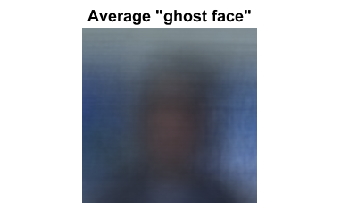
Results
The average ‘ghost face’ learned by the algorithm based on the training data is shown below.

Slide 12
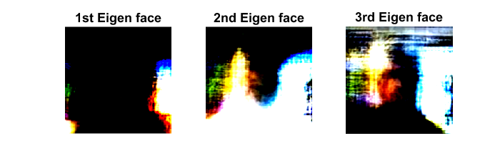
Results
The eigen faces, which are the eigen vectors of the covariance matrix multiplied by the matrix A, are shown below. Since there are a large number of such eigen faces, only those corresponding to the highest three eigen values are shown.

Slide 13
Results
For each person, 15 out of 20 images were randomly selected for training and the remaining were used for testing. After applying the algorithm on the test images, the accuracy was computed.

Slide 14
Conclusion
The eigenfaces method, which is based on the concept of Principal Component Analysis (PCA) is applied on the Faces-152 dataset.
Eigenfaces are obtained during training phase and recognition is achieved by projecting the faces onto this eigenface subspace.
The average ‘ghost face’, a few of the eigenfaces and the mean accuracy of recognition were reported.

