Slide 1
SimpleDB
File, Buffer and Log Management
Part2
Credits:
Edward Sciore – Database Design and Implementation book
Ronnie Ward (TAMU CS310 course)

Slide 2
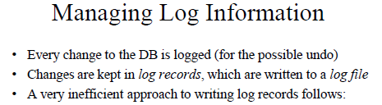
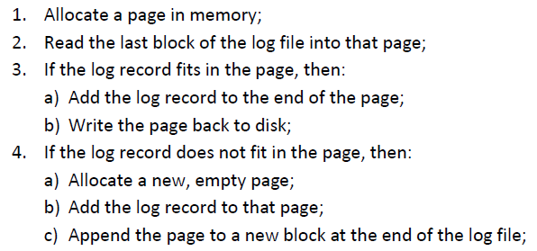

Slide 3
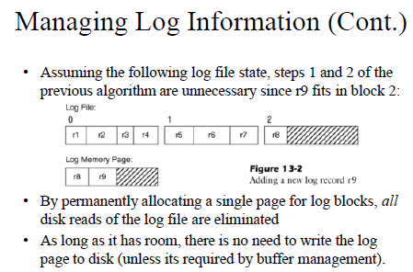
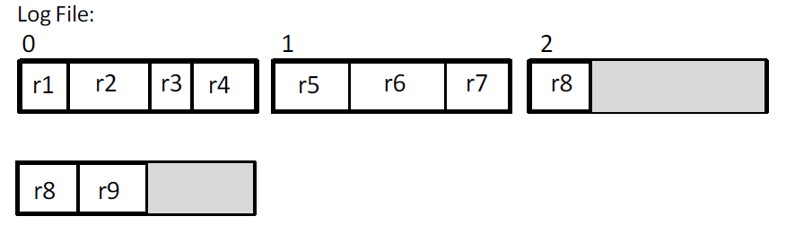

Slide 4
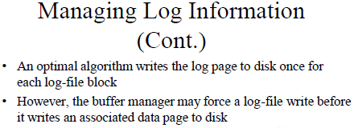
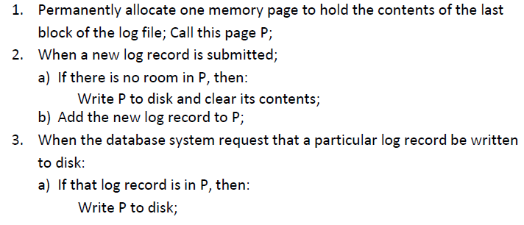

Slide 5
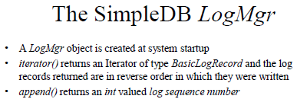
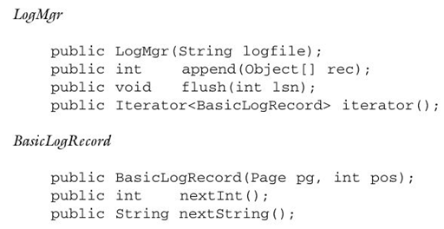
LSN

Slide 6
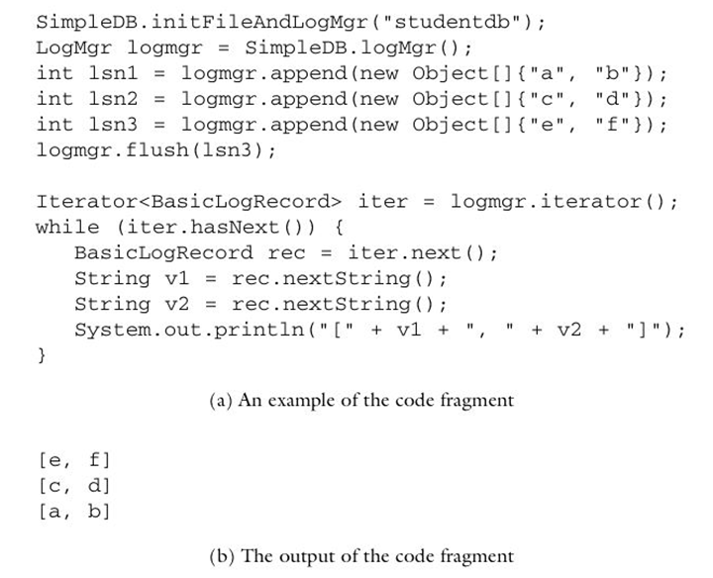
Using the LogMgr API

Slide 7
The Class LogMgr
The source code is in package simpledb.log
Class server.SimpleDB creates the only LogMgr object
The LogMgr object implements methods flush(), append(), and iterator()
An LSN is defined to be the block number -> all records in a block have the same LSN
The start of a log file block is the int offset to the last record chained into the block
If lsn < currentLSN(), the block is already on the disk

Slide 8
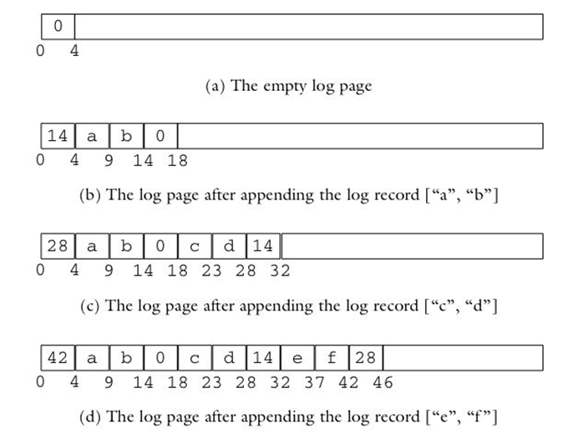
Log Block/Record Structure

Slide 9
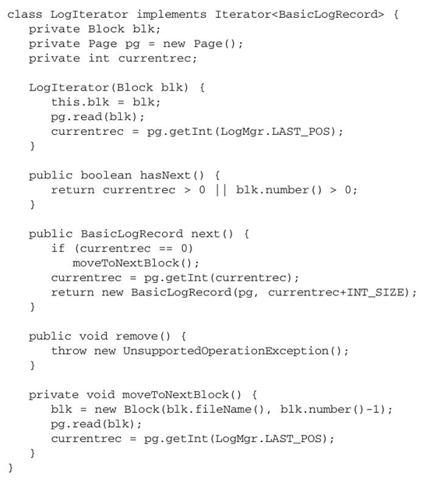
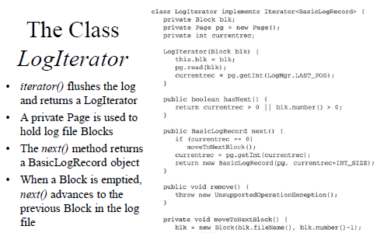

Slide 10
