Slide 1


Team Details
Team name: Clorex | Product: WasteRecast
  Team leader: Zuhaib Ahmed
  Members: Anshuman Pandey · Aliyan Ahmed
  Problem statement: Sustainability & Social Impact
Evidence-based material reuse and global matching
Notes:
Evidence: https://aibuildercup.com/ ; https://aibuildercup.com/themes.html ; https://github.com/anshuman542018/wasterecast (commit 00ad41d). Live prototype: https://wasterecast.web.app/ . Test date: 18 October 2026. Team and eligibility supplied by participants. Claims describe a prototype, not independently certified performance.

Slide 2
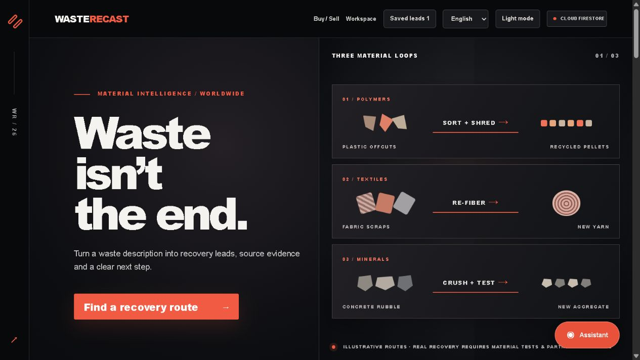
WasteRecast
Find a counterpart. Check acceptance conditions. Work through what needs to change.
Built by Clorex
Notes:
Evidence: https://aibuildercup.com/ ; https://aibuildercup.com/themes.html ; https://github.com/anshuman542018/wasterecast (commit 00ad41d). Live prototype: https://wasterecast.web.app/ . Test date: 18 October 2026. Team and eligibility supplied by participants. Claims describe a prototype, not independently certified performance.

Slide 3
Brief about the idea
A category match does not establish material acceptance.
THE BUSINESS PROBLEM
OUR WORKING SOLUTION
Generators and buyers describe the same material differently. A promising listing can still fail on moisture, contaminants, grade or usable cost.
A global exchange retrieves possible counterparts, checks sourced specifications and explains a supported change to investigate before a trade.
Theme: Sustainability & Social Impact — resource efficiency and informed decisions. No completed recovery or emissions savings claimed.
Notes:
Evidence: https://aibuildercup.com/ ; https://aibuildercup.com/themes.html ; https://github.com/anshuman542018/wasterecast (commit 00ad41d). Live prototype: https://wasterecast.web.app/ . Test date: 18 October 2026. Team and eligibility supplied by participants. Claims describe a prototype, not independently certified performance.

Slide 4
Opportunities
How is this different?
Search retrieves possibilities by meaning. Typed checks then distinguish a stated fit, an unknown fact, a failed condition and an incompatible material.
How will it solve the problem?
Translate evidence into comparable units. Investigate a documented process for a partial fit. Recalculate economics from quotes and measured yield.
Our proposed USP
A smallest-supported-change investigation explains what a partial match needs. It preserves the failed condition until a trial and retest support acceptance.
Existing exchanges also match materials. Our proposed distinction is the combined evidence, constraint and conditional-processing workflow. Pilot validation is pending.
Notes:
Evidence: https://aibuildercup.com/ ; https://aibuildercup.com/themes.html ; https://github.com/anshuman542018/wasterecast (commit 00ad41d). Live prototype: https://wasterecast.web.app/ . Test date: 18 October 2026. Team and eligibility supplied by participants. Claims describe a prototype, not independently certified performance.
Public catalog sources: https://mpcb.gov.in/sites/default/files/whats_new/2025-11/MPCB%20Circular%20Economy%20Directory%202025%20R3_compressed.pdf ; https://tnpcb.gov.in/PDF/Waste_Mngt/HazardousWaste/SolventRecoveryIndustries.pdf ; https://www.wbpcb.gov.in/files/Fr-02-2025-02-39-23haz_inventory_2023_24.pdf . Retrieval date: 12 October 2026. 771 + 12 + 129 = 912 catalog records; this is a record count, not independently verified unique active buyers.

Slide 5
List of features offered by the solution
01 / GLOBAL REGISTERED EXCHANGE
02 / HYBRID RETRIEVAL
Verified Google/email accounts; buyer requests and seller offers; country filters; owner controls; 30-day expiry.
Alias/IDF overlap + actual 768-dimensional Gemini vectors + curated process edges, fused by reciprocal rank.
03 / ACCEPTANCE PASSPORT
04 / DECISIONS AND FOLLOW-THROUGH
12 typed facts with quotations, references and review state. Compatible-unit checks return pass, fail or unknown.
Conditioning investigations, sourced landed costs, private review/outcomes; public recovery directory and Recast assistant.
Vector search requires verified sign-in. Missing vectors trigger a labelled alias/process fallback. Public directory listings are not registered users.
Notes:
Evidence: https://aibuildercup.com/ ; https://aibuildercup.com/themes.html ; https://github.com/anshuman542018/wasterecast (commit 00ad41d). Live prototype: https://wasterecast.web.app/ . Test date: 18 October 2026. Team and eligibility supplied by participants. Claims describe a prototype, not independently certified performance.
Public catalog sources: https://mpcb.gov.in/sites/default/files/whats_new/2025-11/MPCB%20Circular%20Economy%20Directory%202025%20R3_compressed.pdf ; https://tnpcb.gov.in/PDF/Waste_Mngt/HazardousWaste/SolventRecoveryIndustries.pdf ; https://www.wbpcb.gov.in/files/Fr-02-2025-02-39-23haz_inventory_2023_24.pdf . Retrieval date: 12 October 2026. 771 + 12 + 129 = 912 catalog records; this is a record count, not independently verified unique active buyers.

Slide 6
Process flow diagram or Use-case diagram
1 Describe
Offer or requirement
Optional evidence
2 Retrieve
Aliases + vectors
Process edges / RRF
3 Check
Typed pass/fail/unknown
Gemini explanation
4 Investigate
Supported operations
Quotes + usable yield
5 Confirm with the counterpart
Sample trial and retest → current authorization → written acceptance → commercial terms
AI interprets and explains; deterministic checks and calculations remain inspectable. A human confirms acceptance before any movement.
Notes:
Evidence: https://aibuildercup.com/ ; https://aibuildercup.com/themes.html ; https://github.com/anshuman542018/wasterecast (commit 00ad41d). Live prototype: https://wasterecast.web.app/ . Test date: 18 October 2026. Team and eligibility supplied by participants. Claims describe a prototype, not independently certified performance.

Slide 7
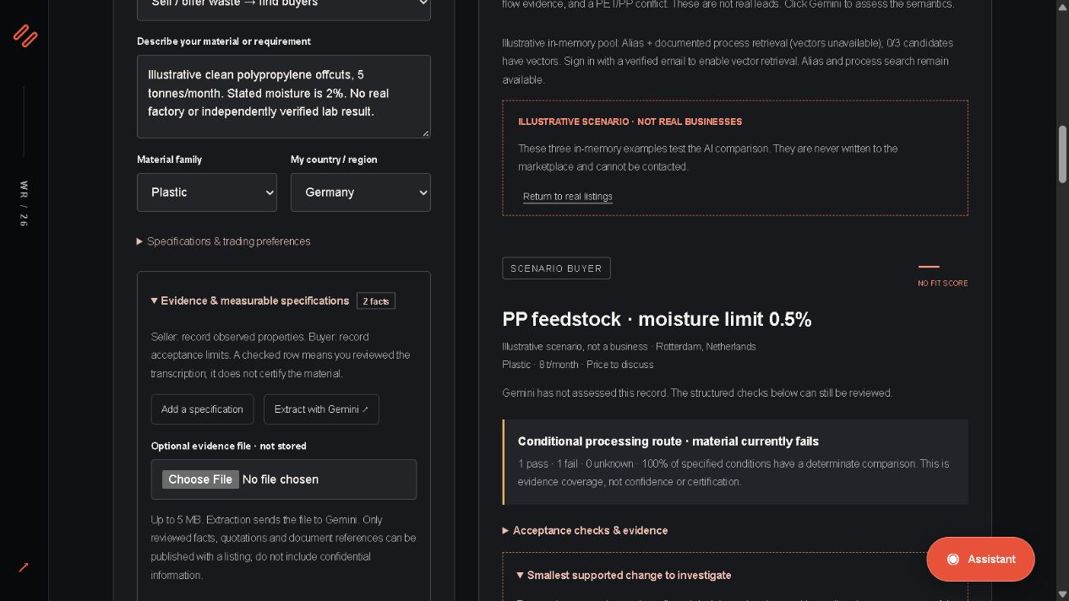
Wireframes/Mock diagrams of the proposed solution (optional)
ACTUAL INTERFACE
1. Compare meaning
2. Inspect each condition
3. Resolve evidence gaps
Actual deployed interface. Illustrative material and counterpart specifications. Facts retain review and source status.
Notes:
Evidence: https://aibuildercup.com/ ; https://aibuildercup.com/themes.html ; https://github.com/anshuman542018/wasterecast (commit 00ad41d). Live prototype: https://wasterecast.web.app/ . Test date: 18 October 2026. Team and eligibility supplied by participants. Claims describe a prototype, not independently certified performance.

Slide 8
Architecture diagram of the proposed solution
User browser / Firebase Hosting
Auth + evidence passport + acceptance checks
Cloud Firestore
Listings, private profiles
Reviews + quota counters
Firebase AI Logic
App Check → Gemini
Extract + explain
Private Vercel service
App Check; auth for vectors
Embeddings / Live tokens
Actual vectors + aliases + process edges → rank fusion → typed checks → conditional investigation.
Financial feasibility uses entered quotes and usable yield, separately from semantic fit.
Firebase is the deployed hosting path. Cloud Run is not deployed. API keys stay server-side; model and database free quotas apply.
Notes:
Evidence: https://aibuildercup.com/ ; https://aibuildercup.com/themes.html ; https://github.com/anshuman542018/wasterecast (commit 00ad41d). Live prototype: https://wasterecast.web.app/ . Test date: 18 October 2026. Team and eligibility supplied by participants. Claims describe a prototype, not independently certified performance.
Public catalog sources: https://mpcb.gov.in/sites/default/files/whats_new/2025-11/MPCB%20Circular%20Economy%20Directory%202025%20R3_compressed.pdf ; https://tnpcb.gov.in/PDF/Waste_Mngt/HazardousWaste/SolventRecoveryIndustries.pdf ; https://www.wbpcb.gov.in/files/Fr-02-2025-02-39-23haz_inventory_2023_24.pdf . Retrieval date: 12 October 2026. 771 + 12 + 129 = 912 catalog records; this is a record count, not independently verified unique active buyers.

Slide 9
Technologies to be used in the solution
Firebase Hosting + Auth
Public HTTPS app; Google/email sign-in; verified owners manage exchange listings.
Cloud Firestore
Global offers/requests, consented business contacts, private reviews and durable embedding quotas; sourced directory.
Gemini + Firebase AI Logic
Evidence extraction and constrained semantic explanations. App Check protects public requests.
Gemini embeddings + Live
768-dimensional semantic vectors; private Vercel endpoint; one-use Live voice tokens.
Application logic
Alias/IDF + cosine + RRF retrieval; typed unit checks; curated process solver; referenced landed-cost calculation.
No Cloud Run, Cloud SQL, BigQuery, paid vector database or Vertex AI deployment. Firebase is the chosen permitted hosting path.
Notes:
Evidence: https://aibuildercup.com/ ; https://aibuildercup.com/themes.html ; https://github.com/anshuman542018/wasterecast (commit 00ad41d). Live prototype: https://wasterecast.web.app/ . Test date: 18 October 2026. Team and eligibility supplied by participants. Claims describe a prototype, not independently certified performance.
Public catalog sources: https://mpcb.gov.in/sites/default/files/whats_new/2025-11/MPCB%20Circular%20Economy%20Directory%202025%20R3_compressed.pdf ; https://tnpcb.gov.in/PDF/Waste_Mngt/HazardousWaste/SolventRecoveryIndustries.pdf ; https://www.wbpcb.gov.in/files/Fr-02-2025-02-39-23haz_inventory_2023_24.pdf . Retrieval date: 12 October 2026. 771 + 12 + 129 = 912 catalog records; this is a record count, not independently verified unique active buyers.

Slide 10
Estimated implementation cost (optional)
Current prototype: configured for free tiers.
CURRENT SETUP
SCALING APPROACH
Firebase Spark + free Gemini quota + existing Vercel project. No Google Cloud billing account linked.
Static delivery; bounded 200-candidate initial pool; vector cache; durable 240-text/account/24-hour embedding budget; transparent fallback.
Before a paid rollout
Measure traffic and model usage. Add server retrieval indexes, durable vector caching, moderation and monitoring before broad rollout.
No cost or unlimited-availability guarantee. A paid production estimate requires measured traffic and current provider pricing.
Notes:
Evidence: https://aibuildercup.com/ ; https://aibuildercup.com/themes.html ; https://github.com/anshuman542018/wasterecast (commit 00ad41d). Live prototype: https://wasterecast.web.app/ . Test date: 18 October 2026. Team and eligibility supplied by participants. Claims describe a prototype, not independently certified performance.

Slide 11
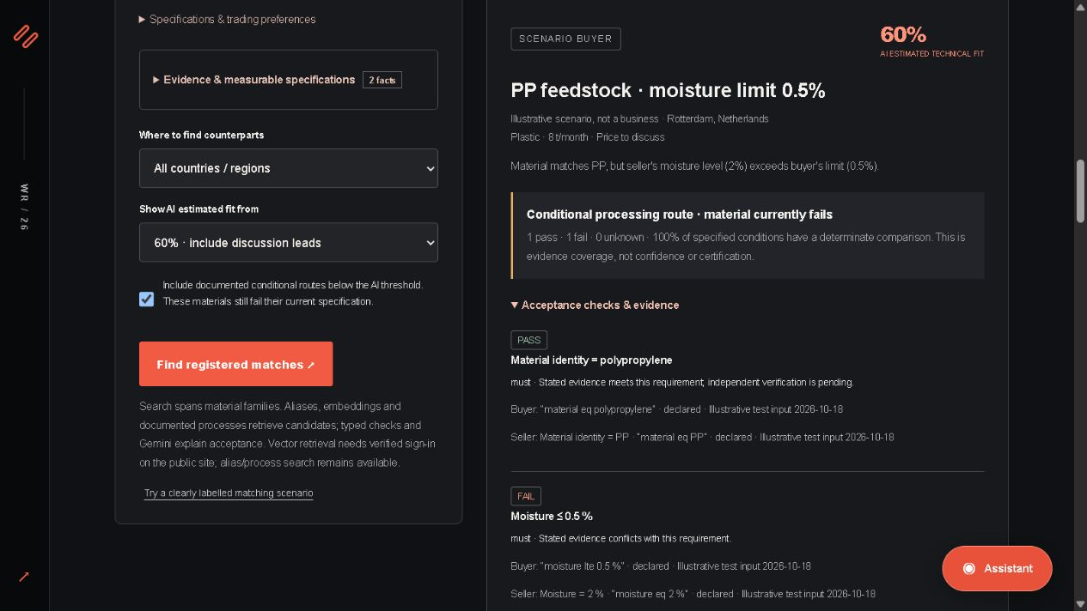
Snapshots of the prototype
PARTIAL FIT → NEXT STEP
PP identity: pass
Moisture: fail
Drying: investigate, then retest
Actual public-app capture. Illustrative PP facts and buyer requirements. A conditioning suggestion does not establish successful acceptance.
Notes:
Evidence: https://aibuildercup.com/ ; https://aibuildercup.com/themes.html ; https://github.com/anshuman542018/wasterecast (commit 00ad41d). Live prototype: https://wasterecast.web.app/ . Test date: 18 October 2026. Team and eligibility supplied by participants. Claims describe a prototype, not independently certified performance.
Public catalog sources: https://mpcb.gov.in/sites/default/files/whats_new/2025-11/MPCB%20Circular%20Economy%20Directory%202025%20R3_compressed.pdf ; https://tnpcb.gov.in/PDF/Waste_Mngt/HazardousWaste/SolventRecoveryIndustries.pdf ; https://www.wbpcb.gov.in/files/Fr-02-2025-02-39-23haz_inventory_2023_24.pdf . Retrieval date: 12 October 2026. 771 + 12 + 129 = 912 catalog records; this is a record count, not independently verified unique active buyers.

Slide 12
Prototype Performance report/Benchmarking
57 AUTOMATED TESTS PASS
24 AUTHORED ACCEPTANCE CASES
Regression tests cover retrieval, units, conflicting evidence, unknowns, economics, security and existing voice controls.
24/24 expected decisions. Tests include missing facts, contradictions, hard conflicts and process conditions. Expert labels pending.
LIVE SERVICE CHECKS
LIMITED LIVE EVALUATION
29 cloud/access checks and 13 Firebase SDK checks pass. Actual 768-dimensional vectors and public Gemini explanations tested.
One scenario, 3 model runs: conditional in all three; scores 55/70/65. Two 31-record retrieval fixtures: target ranked first.
18 October 2026. Authored fixtures and service tests are not market accuracy. No independent expert study, load benchmark or verified trade result.
Notes:
Evidence: https://aibuildercup.com/ ; https://aibuildercup.com/themes.html ; https://github.com/anshuman542018/wasterecast (commit 00ad41d). Live prototype: https://wasterecast.web.app/ . Test date: 18 October 2026. Team and eligibility supplied by participants. Claims describe a prototype, not independently certified performance.

Slide 13
Additional Details/Future Development (if any)
NEXT / VERIFIED PILOT
PILOT / PROVE THE VALUE
Onboard consenting buyers and sellers. Validate evidence, accepted specifications, sample outcomes and written commercial terms.
Measure time to qualified enquiry, acceptance rate and verified recovered mass with real generator–recycler pairs.
SCALE / OPERATE RELIABLY
EXPAND / QUOTED ECONOMICS
Server-side retrieval indexes, shared vector caching, abuse controls, monitoring and dated regional source refreshes.
Road-route distances, buyer-specific logistics quotes and auditable price comparisons. These are not live today.
Initial search coverage is bounded, with manual pagination. No claim of exhaustive global retrieval, perfect matching or measured environmental benefit.
Notes:
Evidence: https://aibuildercup.com/ ; https://aibuildercup.com/themes.html ; https://github.com/anshuman542018/wasterecast (commit 00ad41d). Live prototype: https://wasterecast.web.app/ . Test date: 18 October 2026. Team and eligibility supplied by participants. Claims describe a prototype, not independently certified performance.

Slide 14
Provide links to your:
FINAL PRODUCT LINK
https://wasterecast.web.app/
GITHUB PUBLIC REPOSITORY
https://github.com/anshuman542018/wasterecast
UPDATED DEMO VIDEO / 3 MINUTES
https://drive.google.com/file/d/1e1EyM-4qKs6WXAbR9nq35Z9UsCGghN5u/view
All links must be accessible without requesting access. Submit the PDF exported from this prescribed template.
Notes:
Evidence: https://aibuildercup.com/ ; https://aibuildercup.com/themes.html ; https://github.com/anshuman542018/wasterecast (commit 00ad41d). Live prototype: https://wasterecast.web.app/ . Test date: 18 October 2026. Team and eligibility supplied by participants. Claims describe a prototype, not independently certified performance.

Slide 15
Evidence, boundaries and evaluation readiness
Every proposed trade needs evidence and acceptance.
Two data sources
Registered listings are self-declared. The separate 912-record India directory and worldwide map leads need verification.
AI and fixed checks
Fixed checks preserve failures and unknowns. Gemini fit scores are uncalibrated estimates, never acceptance certificates.
Conditioning and cost
Processing needs a trial, retest and written acceptance. Costs require references; no yield or FX is invented.
Evaluation access
Public app and source. Free quotas apply. Expert validation and verified commercial outcomes remain pending.
Document uploads use Google free-tier processing terms. Business contacts need publication consent. Private profiles/reviews have owner-only access.
Notes:
Evidence: https://aibuildercup.com/ ; https://aibuildercup.com/themes.html ; https://github.com/anshuman542018/wasterecast (commit 00ad41d). Live prototype: https://wasterecast.web.app/ . Test date: 18 October 2026. Team and eligibility supplied by participants. Claims describe a prototype, not independently certified performance.
Public catalog sources: https://mpcb.gov.in/sites/default/files/whats_new/2025-11/MPCB%20Circular%20Economy%20Directory%202025%20R3_compressed.pdf ; https://tnpcb.gov.in/PDF/Waste_Mngt/HazardousWaste/SolventRecoveryIndustries.pdf ; https://www.wbpcb.gov.in/files/Fr-02-2025-02-39-23haz_inventory_2023_24.pdf . Retrieval date: 12 October 2026. 771 + 12 + 129 = 912 catalog records; this is a record count, not independently verified unique active buyers.

Slide 16

Notes:
Evidence: https://aibuildercup.com/ ; https://aibuildercup.com/themes.html ; https://github.com/anshuman542018/wasterecast (commit 00ad41d). Live prototype: https://wasterecast.web.app/ . Test date: 18 October 2026. Team and eligibility supplied by participants. Claims describe a prototype, not independently certified performance.

