Slide 1
Introduction
A group of 4 friends have come together and started a small band.
1
They are now looking to setup a small music cafe in a locale where people will be able to come and watch them perform or record music.
2
The music café has to be in a place where people of all ages conglomerate.
3

Slide 2


The Data Science Method
?
Data Description
The neighborhoods data has been pulled from the Wikipedia page provided
All the data including the latitude and longitude was made available with the course material itself.
Neighborhood data enabled superimposing the neighborhoods in ‘Etobicoke’. The foursquare API data helped in location venues.
How it solves problem
The foursquare data gives a neighborhood wise location of key areas of interest in a city such as a park, hotel, airport, café, coffee shops, restaurants etc.
he music band by the name of Wonders would like their cafe to be in an area where people hang out often and pass their time, the data leverage from foursquare will have this information.
Explore the data
All neighbourhoods were explored by means of K-means algorithm.
The algorithm enabled an easy search of neighbour hoods which have high level of commercial and business outlets. In this case Cluster 0
Results
Cluster 0 was narrowed down as the most suitable
Data from foursquare suggested that cluster zero was the most happening spot and had a popular rating
Alderwood, was selected as the prime choice for a music café since no cafes were present there
Continued…

Slide 3
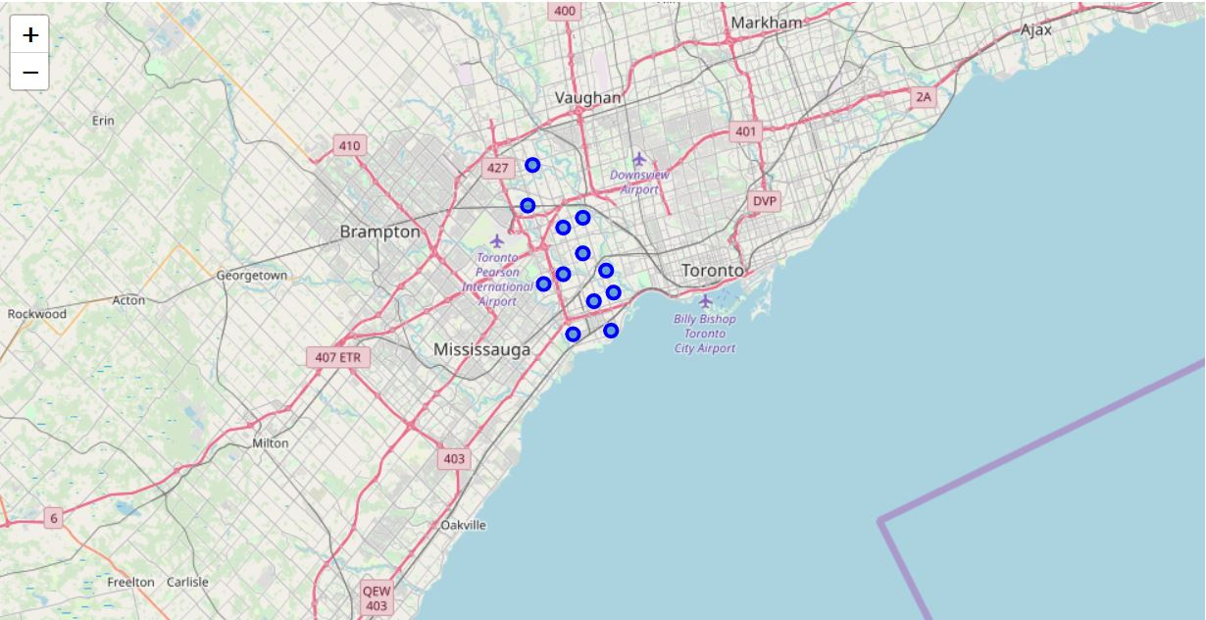
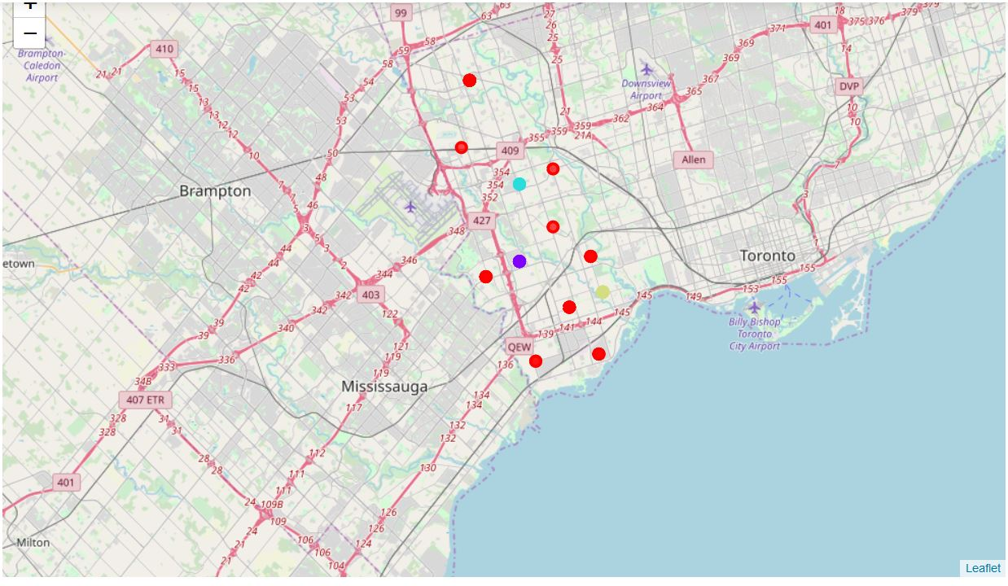
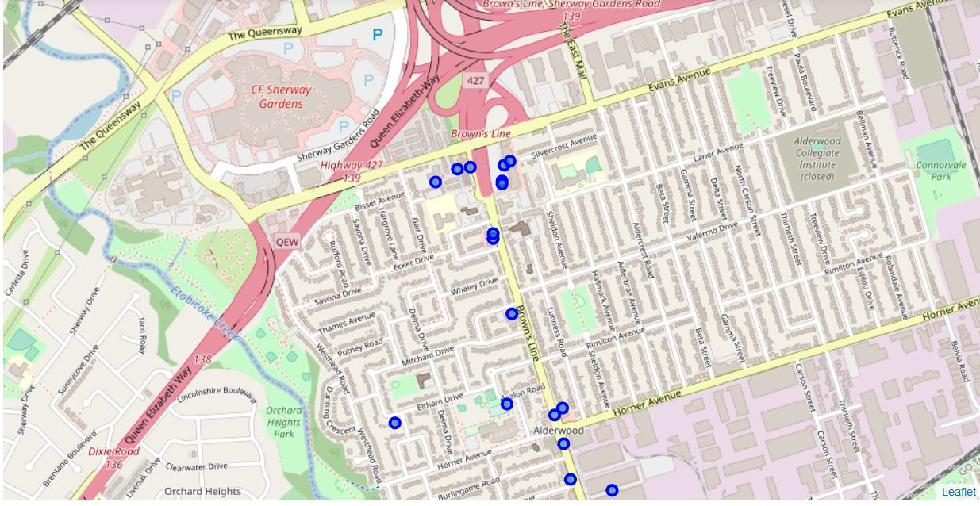
Neighborhoods of Etobicoke
K-means cluster -cluster neighborhoods of Etobicoke
Alderwood neighborhood Venues
Red- Cluster 0
Light blue- Cluster 2
Purple- Cluster 1
Light Brown- Cluster 3

Slide 4

Discuss and Conclude
Discussion
Conclusion
Cluster analysis reveals that a large number of neighborhoods are cluster into single cluster having common features
One can infer the likes and dislikes of the majority of the population in the city of Etobicoke from the K-means analysis.
This can be narrowed down right to neighborhood as well by leveraging the data from Foursquare.
Using similar such datasets, it is easy to infer the tastes of a certain section of the population, further any new startup can also leverage this type of data to start a new business and gain quick traction and revenue as well.
Cluster 3 has a baseball filed which also means it’s a large public gathering spot, conversely it has fewer number of eateries as compared to cluster 0. A good location thus for either a pizza place or foreign cuisine.

