Slide 1
Insurance Claims Analytics
Why is claim settlement delayed?
Presented by Anshuman Behera

Slide 2
Business context
KPI | Value
Claims analysed | 15,000
Settled claims | 10,773
Settlement rate | 71.8%
Median settlement | 14 days
Delay rate (> 20 days) | 12.1%
Pending claims | 3,030
A fictional insurer wants to know why claim settlement is delayed
Business question: where should the 30-day delay-improvement pilot start?
Pending and rejected claims have no settlement duration, so they are never counted as zero days
The 20-day delay limit is only an assumption

Slide 3
The four data tables
Table | Rows | Columns | What it holds
Customers | 8,000 | 5 | age, gender, region, customer since
Policies | 10,000 | 5 | insurance type, premium, coverage
Claims | 15,000 | 7 | claim type, amount, status, dates
Processing | 15,000 | 5 | complexity, verification / approval / payment days
One customer has many policies, one policy has many claims, and each claim has one processing record.

Slide 4
Data quality audit (before cleaning)
Column | Missing | Note
age | 65 | filled with region median
gender | 80 | set to Unknown
annual_premium | 90 | filled with product median
claim_amount | 95 | filled with product median
verification_days | 100 | filled with complexity median
settlement_date | 4,227 | not an error: open claims have none
Labels with different spellings
Region: SOUTH, north, " south"
Product: health, HOME, " MOTOR"
Status: " settled", " PENDING", rejected
Duplicates: none in any table

Slide 5
Cleaning each table
Customers: region labels fixed, 80 missing genders set to Unknown, 65 missing ages filled with region median
Policies: labels fixed, 90 bad premiums replaced with product median and flagged
Claims: labels fixed (Settled 10,773, Pending 3,030, Rejected 1,197), 12 amounts of zero or less set to missing
Processing: labels fixed, 100 missing verification days filled with the median of the same complexity

Slide 6
Merge and outlier flags
Left joins keep every claim: 15,000 rows before and after, all IDs unique
107 missing claim amounts filled with the median of the same product
149 claims have a claim type different from the policy type
688 high-amount claims flagged, not deleted: Health 290, Motor 244, Travel 97, Home 57
Limit = Q3 + 1.5 x IQR, calculated per product

Slide 7
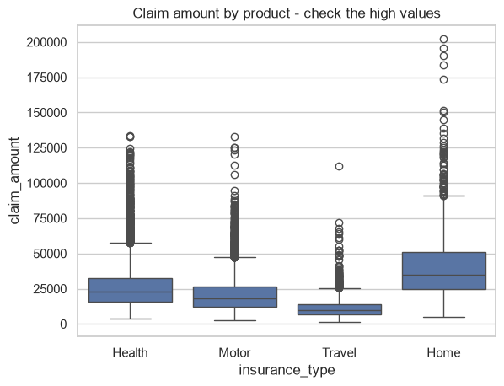
Claim amount by product
The boxplot shows claim amounts for each product. Dots above the boxes are high-value claims. Home has the largest typical claims and Travel the smallest, which is why the outlier limit is set per product.

Slide 8
Feature engineering and final checks
settlement_days, is_delayed: settlement date minus claim date; delayed if above 20 days
claim_month, settlement_month: monthly trends
claim_to_coverage_pct: claim as % of coverage
stage_days, other_wait_days: the three stages and the remainder
tenure_years, age_group, claim_size: customer and size groups
After cleaning
No duplicate claim IDs
No amount of zero or less
No settled claim without a date
Only 15 claims above coverage (rule review)
10,773 valid settled claims used for duration analysis

Slide 9
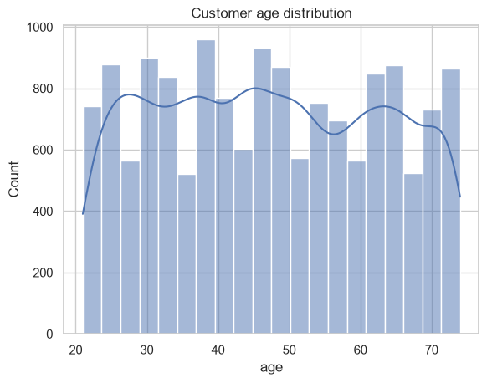
A. Customer age distribution
Ages of claimants are spread fairly evenly from about 20 to 75. The median age is 47.

Slide 10
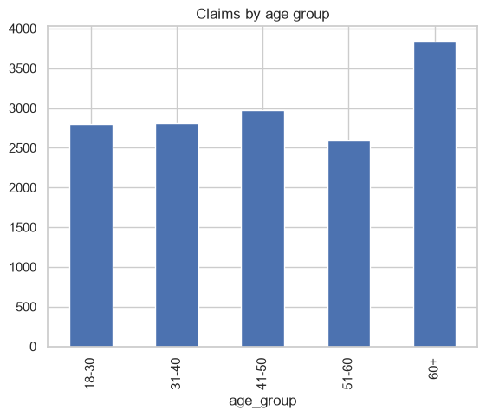
A. Claims by age group
The 60+ group has the most claims. This is the age mix of claimants only, not of all customers, so compare it with the customer master before acting.

Slide 11
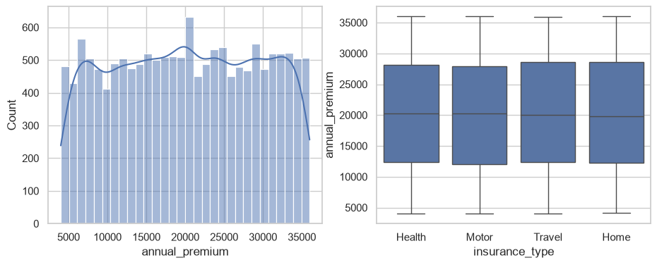
A. Annual premium
Premiums are spread between about 5,000 and 35,000 with a median of 20,203.5. The four products have similar premium ranges. A high premium is not necessarily wrong.

Slide 12
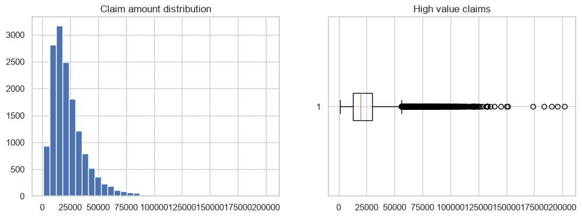
A. Claim amount
Most claims are small and a few are very large. Median claim 19,599, mean 23,832, 90th percentile 43,941. Report the typical claim and the high-value tail separately, and do not delete genuine large claims.

Slide 13
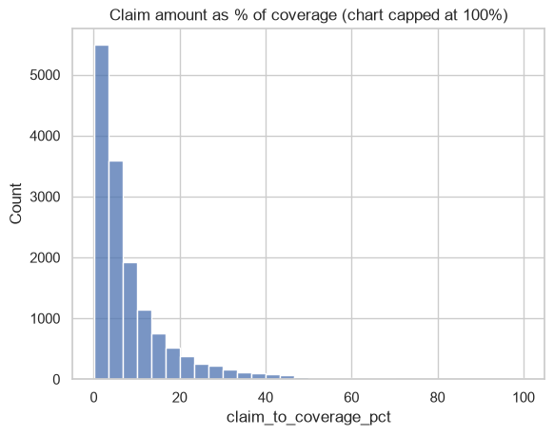
A. Claim amount as % of coverage
Most claims use only a small part of coverage. The median is 5.0%, and 15 claims are above 100%. Send these for a rule review, do not delete them.

Slide 14
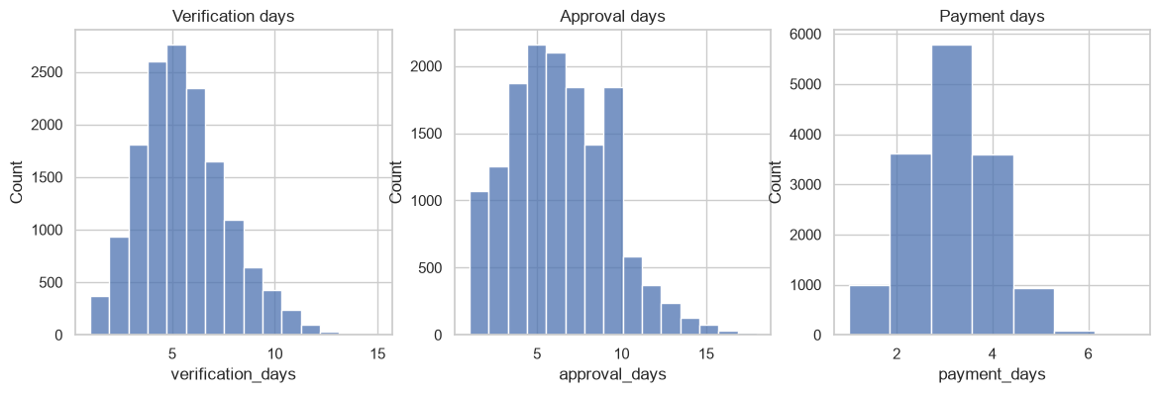
A. Verification, approval and payment days
Median days: verification 5, approval 6, payment 3. Approval is the longest stage, then verification. Payment is short. Check the claim mix before calling the longer stage the cause.

Slide 15
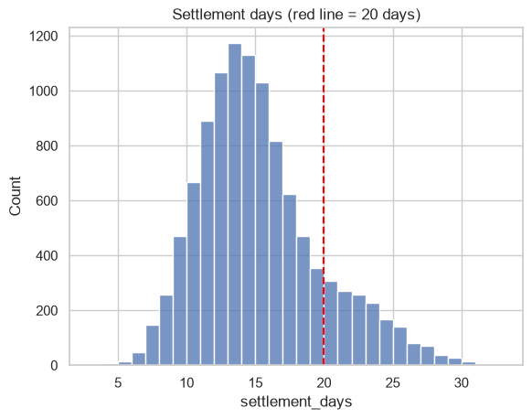
A. Settlement days
Most claims settle in about 10 to 20 days. Median 14 days, 90th percentile 21 days, and 12.1% are above the 20-day red line. A good median can hide a long tail, so track median, P90 and delay rate together.

Slide 16
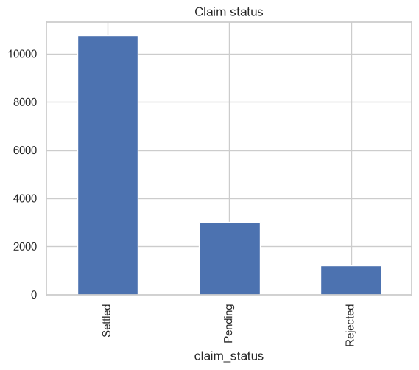
A. Claim status
10,773 claims are settled, 3,030 are pending and 1,197 are rejected. Pending claims are 20.2% of all claims: a backlog, never treated as settled.

Slide 17
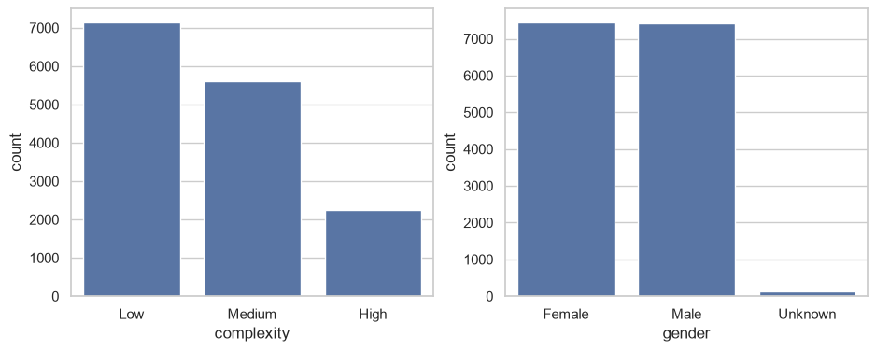
A. Complexity and gender
Low complexity is 47.6% of claims, Medium 37.4% and High 15.0%. Male and female claimants are almost equal. Always check complexity mix when comparing regions or teams.

Slide 18
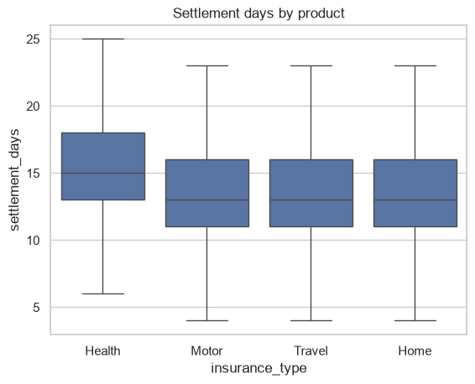
B. Settlement days by product
Health is slowest: median 15 days against 13 for Home, Motor and Travel. Delay rates are Health 15%, Home 10%, Motor 10% and Travel 11%. The gap may come from case mix.

Slide 19
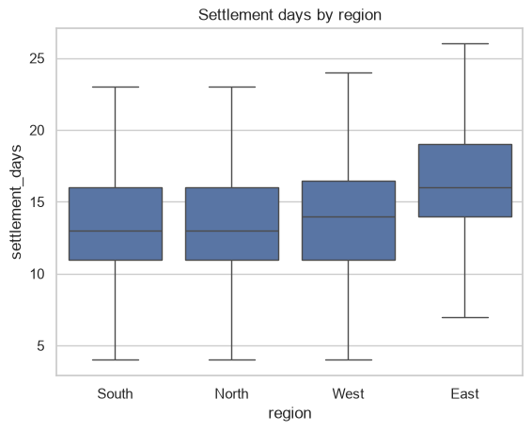
B. Settlement days by region
East is slowest: median 16 days and 18.3% delayed. North 9.5%, South 10.3% and West 11.8%. Region may be affected by product mix.

Slide 20
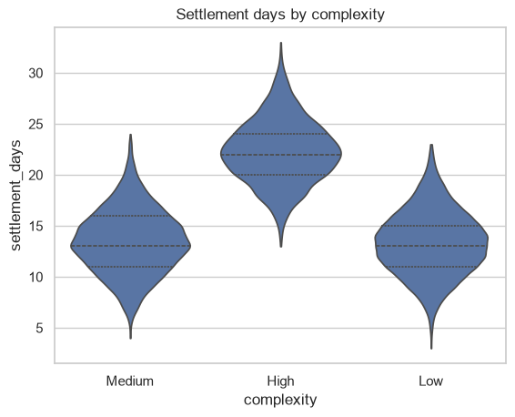
B. Settlement days by complexity
High-complexity claims centre around 22 days (72% delayed). Low and Medium centre around 13 days (1% and 2% delayed). This is the biggest difference found so far.

Slide 21
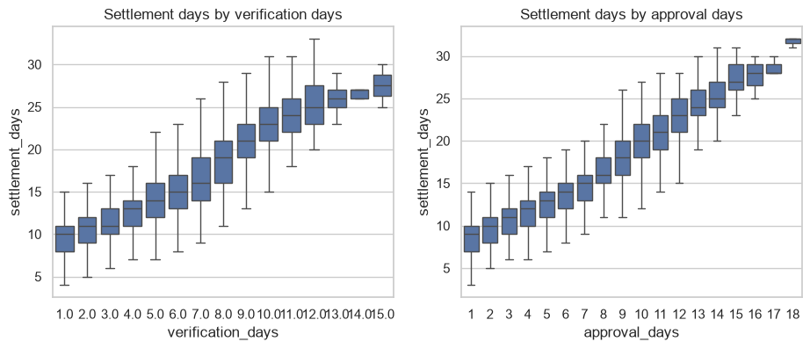
B. Stage days vs settlement days
Settlement time rises steadily with verification days and approval days. Correlation with settlement days: approval 0.85, verification 0.76, payment 0.23. A possible pilot is a document checklist at first submission.

Slide 22
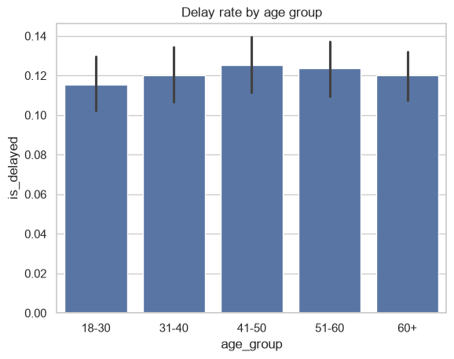
B. Delay rate by age group
The bars are almost equal: delay rate stays between 11.5% and 12.5% and the median is 14 days in every age group. Gender also shows no real difference.

Slide 23
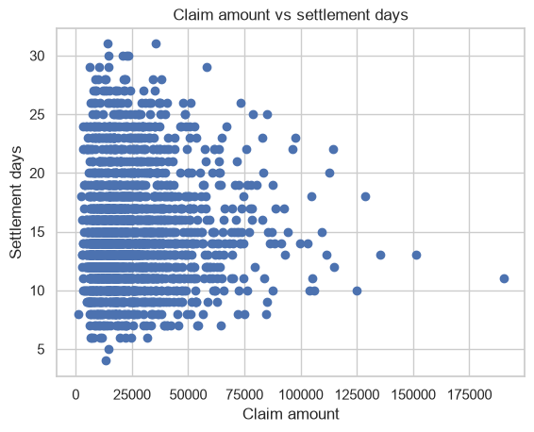
B. Claim amount vs settlement days
No clear pattern: bigger claims are not slower. The correlation is only 0.034, and the median is 14 days in all four claim-size groups.

Slide 24
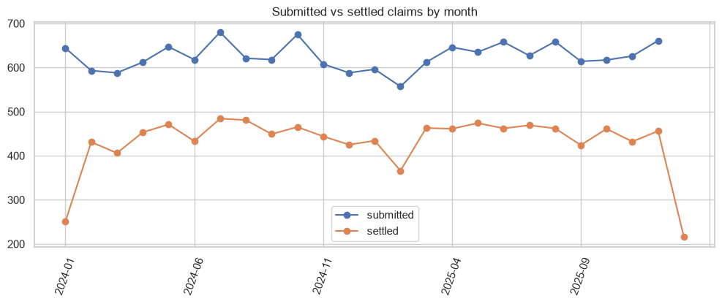
B. Submitted vs settled claims by month
Submitted claims stay steady at about 560 to 680 a month. Settled claims are lower because pending and rejected claims never settle. The first month (251) and last month (216) are incomplete.

Slide 25
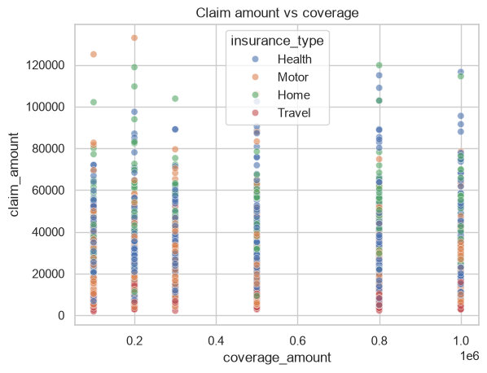
B. Coverage vs claim amount
Coverage comes in a few fixed levels and almost all claims sit well below the limit. Only 15 claims are above coverage; check them against the policy terms.

Slide 26
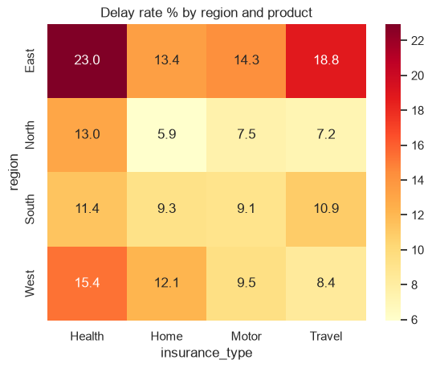
C. Delay rate by region and product
East is the highest region for every product. The hottest cell is East with Health at 23.0%. Check the complexity mix of that cell before using it for decisions.

Slide 27
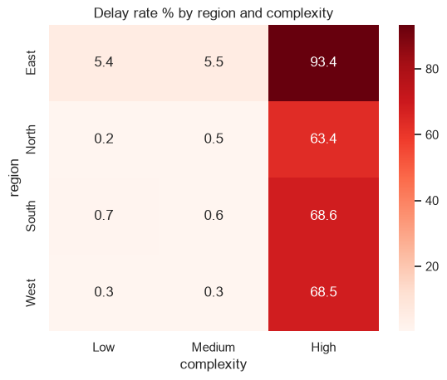
C. Delay rate by region and complexity
On Low and Medium complexity, North, South and West are below 1% but East is about 5.5%. On High complexity East is 93.4% against 63% to 69% elsewhere. East stays slower at the same complexity, so review its process.

Slide 28
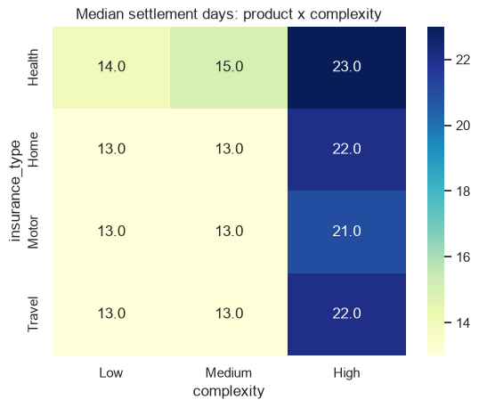
C. Median days: product by complexity
Inside Low and Medium complexity all products take about 13 to 15 days. High-complexity claims take 21 to 23 days in every product. The first product difference was mainly case mix.

Slide 29
C. Highest-delay segments
Region | Product | Complexity | Claims | Median days | Delay rate
East | Health | High | 124 | 25.0 | 97.6%
East | Motor | High | 103 | 23.0 | 92.2%
East | Travel | High | 55 | 25.0 | 87.3%
West | Health | High | 172 | 23.0 | 82.6%
South | Health | High | 176 | 23.0 | 81.8%
North | Health | High | 166 | 22.5 | 78.9%
West | Home | High | 51 | 22.0 | 66.7%
South | Travel | High | 88 | 21.0 | 61.4%
Segments with at least 50 claims. Every one is High complexity. Choose a segment large enough for a pilot, not the smallest one with an extreme percentage.

Slide 30
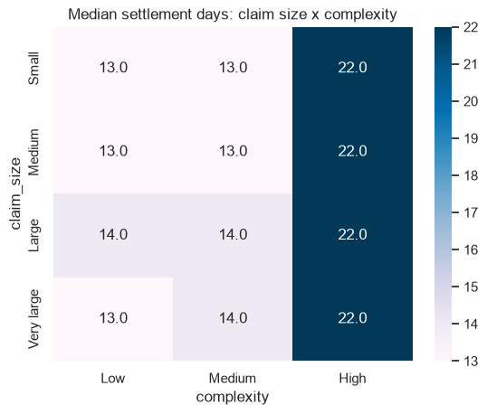
C. Median days: claim size by complexity
Claim size makes almost no difference. Low and Medium claims take 13 to 14 days at any size and High claims take 22 days at any size. Complexity matters, not the amount.

Slide 31
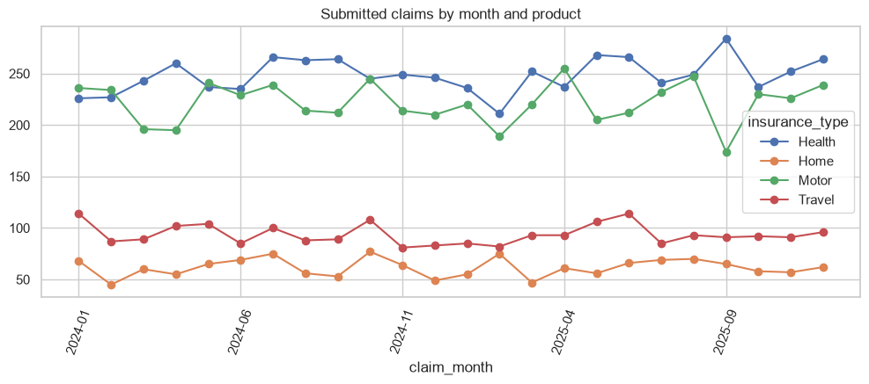
C. Submitted claims by month and product
Health and Motor bring most of the monthly claims; Travel and Home are much smaller. Use these trends for staffing plans, but do not conclude seasonality from a short period.

Slide 32
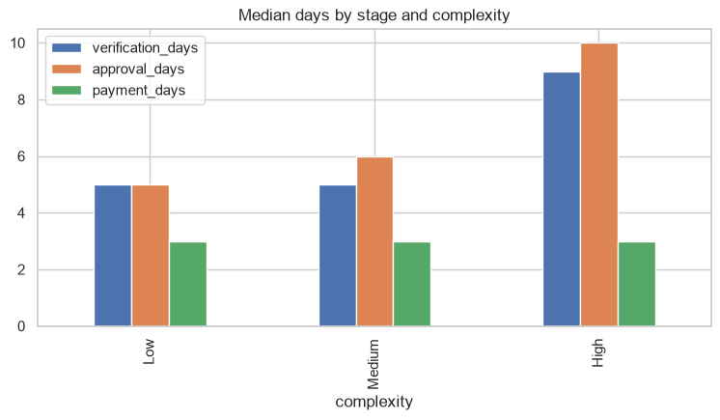
D. Where does the time go?
Low and Medium claims take about 5, 5 to 6 and 3 days in the three stages. For High complexity, verification and approval grow to about 9 and 10 days. Delayed claims spend about 4 more days in verification and 5 more in approval, and the three stages explain the full settlement time.

Slide 33
D. Pilot selection
Region | Product | Complexity | Claims | Delayed | Delay rate | Excess delays
South | Health | High | 176 | 144 | 81.8% | 123
West | Health | High | 172 | 142 | 82.6% | 121
North | Health | High | 166 | 131 | 78.9% | 111
East | Health | High | 124 | 121 | 97.6% | 106
South | Motor | High | 184 | 109 | 59.2% | 87
East | Motor | High | 103 | 95 | 92.2% | 83
West | Motor | High | 150 | 85 | 56.7% | 67
North | Motor | High | 130 | 70 | 53.8% | 54
Excess delays = delayed claims minus claims x 12.1%. Best starting point: South, Health, High complexity (176 claims, 81.8% delayed, 123 excess delays).

Slide 34
Executive summary
Measure | Result
Claims analysed | 15,000
Settled claims | 10,773
Median / 90th percentile settlement days | 14 / 21
Delayed share | 12.1%
Slowest product (median) | Health
Highest delay region | East
Highest delay complexity | High
Pending claims | 3,030
Top pilot segment | South | Health | High

Slide 35
Action plan
Document checklist pilot in South, Health, High. Owner: claims intake lead. Measure: incomplete-document rate, verification days, delay rate.
Fast routing of high-complexity claims. Owner: verification manager. Measure: P90 verification days.
Weekly tracking of verification, approval and other waiting time by region and product. Owner: claims analyst.
Updates to customers with old pending claims. Measure: complaints and satisfaction, when available.

Slide 36
THANK YOU

