Slide 1

Machine learning
ANSHUMAN
1901037

Slide 2
A Case Study on Face Position Detection using ML Algorithms
USES :-
Head pose estimation
Driving performance evaluation
Related Topics :-
Logistic Regression(output is discrete and 3 classes are possible)
Haar-cascades(Rapid Object Detection using openCV)

Slide 3
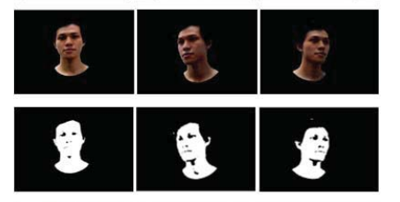
Literature Survey Reference : https://ieeexplore.ieee.org/search/searchresult.jsp?newsearch=true&queryText=face%20detection%20using%20ml%20algorithm
A Fast Face Detection Method for JPEG Image
According to analyzing the feature of face image, the combination of reconstruction of low resolution image in the compressed domain and face detection in the pixel domain method is proposed.
The proposed paper achieves higher detection speed and closely detection accuracy.
Rapid Face Detection and Annotation with Loosely Face Geometry
If someone is looking at inappropriate angle then what?
This paper focus on face detection with varying degree of face occlusion(hiding face).
This algorithm aims to automatically detect face components individually and it starts from mostly un-occluded face component called Nose.
Face Movement Detection Using Template Matching
Purposed about face detection use template matching method on movement face.
This technique used is to determine the face region by separating the skin region to non-skin region.
Methodologies
Linear Regression :- Output is not continuous, so can't use it
Logistic Regression:- Yes,we can use because Output belongs to class 0,1,2
Aartificial neural network(ANN) :-We have exact math models, so no need to implement ANN
Haar-cascades(BEST) :- Give more accurate result and identifing the pattern perfectly using OpenCV

Slide 4
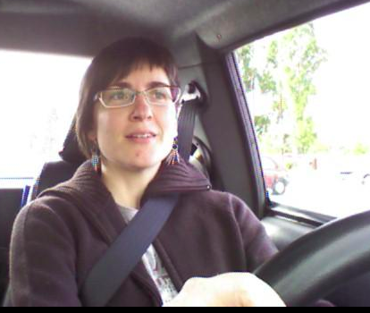
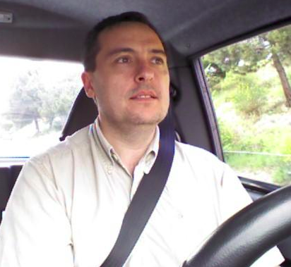
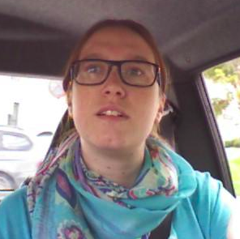
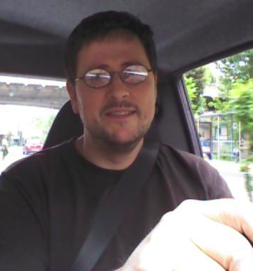
Dataset Analysis
A reduced feature set for driver head pose estimation.
The given dataset contains images(or frames) of men and women while driving car in real scenarios.
It is composed of 606 samples of 640×480 pixels each.
A set of labels assigning each image into 3 possible gaze direction classes are given.
The first class is the looking-right class and contains the head angles between -45º and -30º.
The second one is the frontal class and contains the head angles between -15º and 15º.
The last one is the looking-left class and contains the head angles between 30º and 45º.

Slide 5
Features
drivPoints.txt contains the ground truth in table's format, where the dataset have the follow information:
fileName :: Image's name
subject :: Person's ID number
imgNum :: Frame's number
label :: [0/1/2] (head pose class that corresponding to [lr/f/lf], respectively)
ang :: [-45, -30/ -15 0 15/ 30 15] (head pose angle)
[xF yF wF hF] :: face position
[xRE yRE] :: rigth eye position
[xLE yL] :: left eye position
[xN yN] :: Nose position
[xRM yRM] :: rigth corner of mouth
[xLM yLM] :: left corner of mouth
So these are the feature from which we have to give the output , wheather there is a face (belongs to class 0,1,2)or not

