Slide 1
PRODUCTIVITY PREDICTION OF GARMENT INDUSTRY EMPLOYEES
Exploratory Data Analysis

Slide 2
TABLE OF CONTENTS
01
02
03
Introduction
Problem statement
Approach to solve the problem
04
05
06
RECOMMENDATION
ANALYSIS AND FINDINGS
CONCLUSION

Slide 3
01
INTRODUCTION
Describe the industry

Slide 4
The garment industry deals with the production of different types of clothing. It is a trillion-dollar industry on the global scale and is a labor- and capital-intensive industry.
Workforce productivity generally refers to a measurement of goods and services produced by a group of workers within a given period. Workforce productivity levels play a key role in the success or collapse of the industry.

Slide 5
Problem STATEMENT
Low workforce productivity in a company can lead to reduced profitability, increased conflict, high employee turnover, and a lack of motivation. It is therefore important for a company to track its levels of productivity and investigate the factors that influence this.

Slide 6
02
Approaches

Slide 7
1.Data Loading
2. Data Cleaning
3. Univariate Analysis
4. Bivariate Analysis

Slide 8
03
ANALYSIS AND FINDINGS PLAN

Slide 9
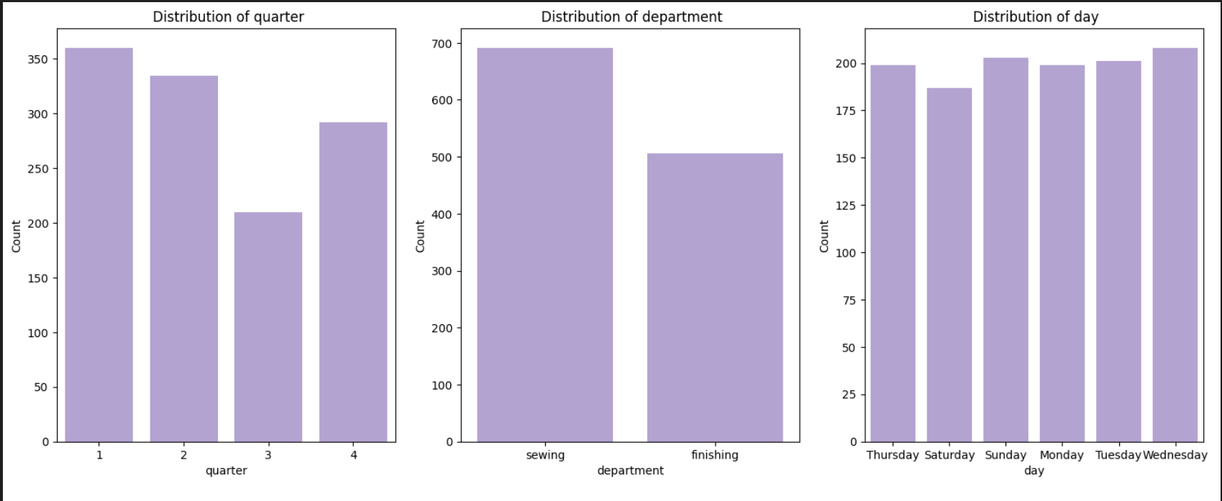
Univariate Analysis
The finishing department is consistently the most productive department, regardless of quarter or day.
The sewing department is consistently the least productive department, regardless of quarter or day.
Productivity is highest in quarter 3 and lowest in quarter 1.
Productivity is highest on Thursday and lowest on Sunday.

Slide 10
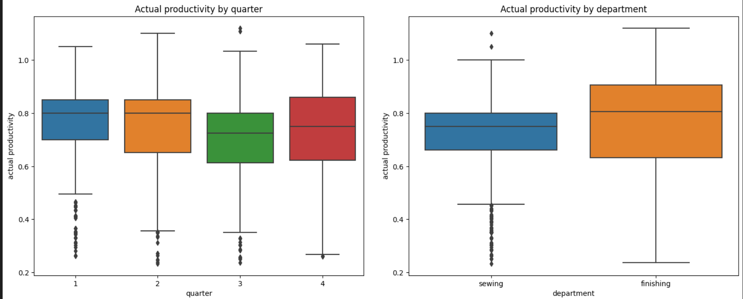
Bivariate Analysis
Quarters: during the first 2 quarters of the month.
Department: in the "finishing" department
Day: on Saturdays

Slide 11
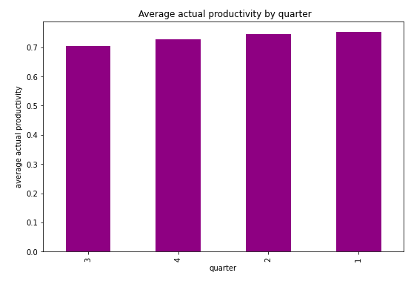
Average actual productivity Vs quarter
Quarter 1 had the highest average actual productivity

Slide 12
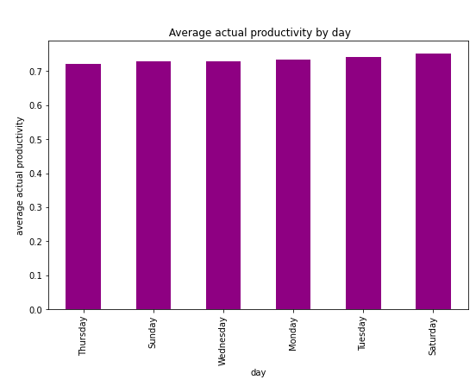
AVERAGE ACTUAL PRODUCTIVITY VS QUARTER
Saturday had the highest average actual productivity.

Slide 13
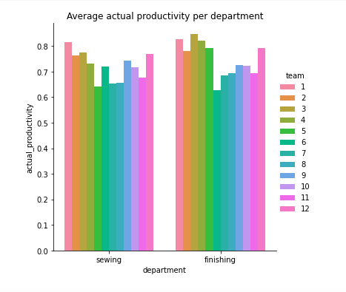
AVERAGE ACTUAL PRODUCTIVITY PER TEAMS PER DEPARTMENT
Lowest performing teams:
Sewing: 5,7,8
Finishing: 6,7,8

Slide 14
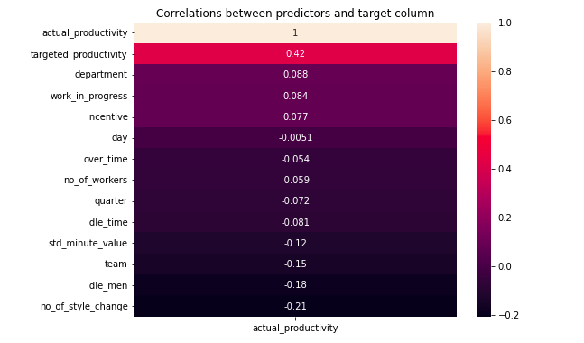
AVERAGE ACTUAL PRODUCTIVITY PER TEAMS PER DEPARTMENT
Actual productivity, the main column, has the highest correlation (moderate positive correlation of 0.42) with targeted productivity

Slide 15
05
Conclusions and Recommendations

Slide 16
Correlations:
Strongest correlation is between target productivity and actual productivity (r = 0.42), indicating employees generally meet their targets.
Other notable correlations include department with actual productivity (r = 0.088), work in progress with actual productivity (r = 0.084), and incentive with actual productivity (r = 0.077).
Productivity Averages:
Sewing department has an average productivity of 0.78 units per hour, 20% higher than the finishing department's 0.65 units per hour.
The productivity difference between the two departments is statistically significant, and both surpass industry benchmarks.
Style Changes:
The sewing department has the highest number of style changes (10/day), the finishing department has 5/day, and the assembly department has 2/day.
The difference in style changes between departments is statistically significant.
Style changes have increased over time in all departments.
Conclusions and Recommendations:
To address the finishing department's lower productivity, reducing the number of style changes per day is suggested.
Identifying and eliminating bottlenecks in the assembly department is recommended.
Investing in training for finishing and assembly departments to enhance skills and efficiency is advised.
Implementing a continuous improvement program is proposed for ongoing productivity enhancements.

Slide 17
Conclusions and Recommendations:
To address the finishing department's lower productivity, reducing the number of style changes per day is suggested.
Identifying and eliminating bottlenecks in the assembly department is recommended.
Investing in training for finishing and assembly departments to enhance skills and efficiency is advised.
Implementing a continuous improvement program is proposed for ongoing productivity enhancements.

Slide 18
Thanks!

