Slide 1
Lending Club Case Study
Anshuman Biswal Abhijit Kumar Manna October 11, 2023

Slide 2
Agenda
01. Problem Statement
02. Analysis Approach
03. Summary

Slide 3

Problem Statement
This company is the largest online loan marketplace, facilitating personal loans, business loans, and financing of medical procedures. Borrowers can easily access lower-interest-rate loans through a fast online interface.
Like most other lending companies, lending loans to ‘risky’ applicants is the largest source of financial loss (called credit loss). Credit loss is the amount of money lost by the lender when the borrower refuses to pay or runs away with the money owed. In other words, borrowers who default cause the largest amount of loss to the lenders. In this case, the customers labelled as 'charged-off' are the 'defaulters'.
If one is able to identify these risky loan applicants, then such loans can be reduced thereby cutting down the amount of credit loss.
.

Slide 4
Business Objective
To be able to identify these risky loan applicants, then such loans can be reduced thereby cutting down the amount of credit loss. Identification of such applicant's using EDA is the aim of this case study.
In other words, the company wants to understand the driving factors (or driver variables) behind loan default, i.e., the variables which are strong indicators of default. The company can utilise this knowledge for its portfolio and risk assessment.

Slide 5

Analysis Approach
Data cleaning
Univariate analysis
Segmented univariate analysis
Bivariate analysis

Slide 6

Date Cleaning
Removed the duplicate values
Cleaned data with null values
Removed columns which had only single values in all the rows
Removed certain columns which did not add any value for defaulter analysis
To find out if the current user would default or not, we do not need the data of users whose loan is currently running. So we removed the rows with loan status as current

Slide 7
Date Cleaning
Made the term and emp_length column to have only numbers.
Removed % sign from int_rate and revol_utlil column
Converted 'loan_amnt’, 'int_rate’, 'emp_length’ to numeric data type

Slide 8

Observations
Around 85% is fully paid and 15% is charged off
Most of the loans were taken for debt consolidation(47%) and Credit card bill payments. Other is also one of the main areas where loans were taken.

Slide 9
Observations
When Annual income is low then dti is high and vice versa
Annual income increases by employment length
The loan amount also increases with an increase in annual_inc and also the installment increases with annual_inc
Most of the Loan amounts are in the range of 5000 – 10000
Most of the Interest Rates on loans are in range of 12% - 15%

Slide 10
Observations
Most of the borrower’s Annual incomes are in the range of 60000- 80000
Annual income increases by employment length
The loan amount also increases with an increase in annual_inc and also the installment increases with annual_inc
Most of the Loan amounts are in the range of 5000 – 10000
Most of the Interest Rates on loans are in the range of 12% - 15%

Slide 11
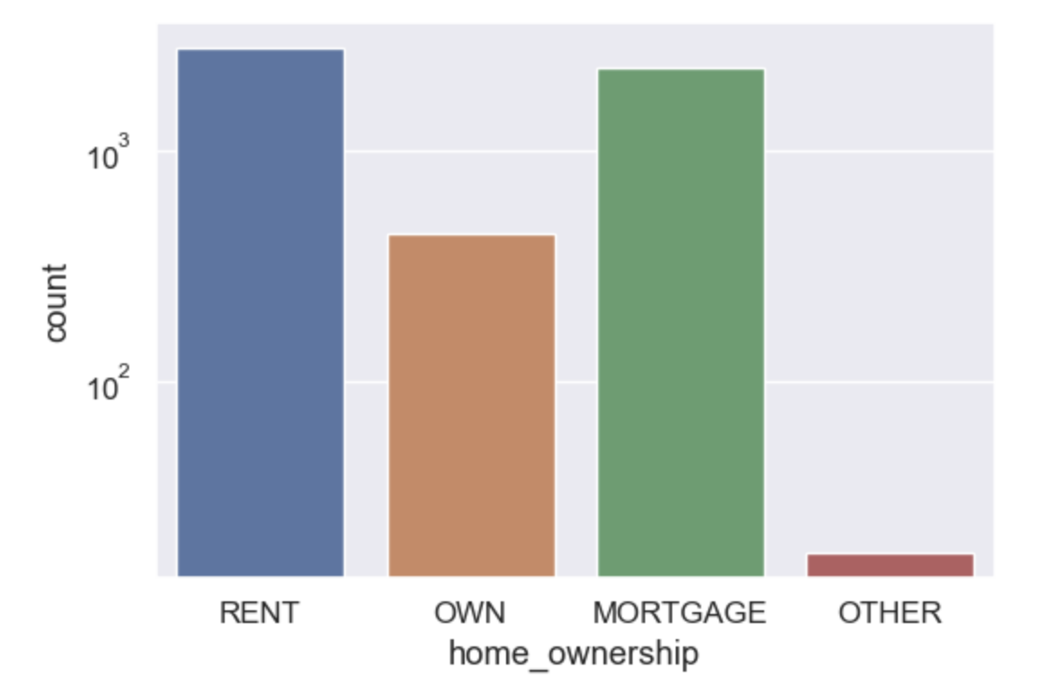
Observations
It is observed that Mortgage and Rent homeowners contribute towards the defaulter

Slide 12
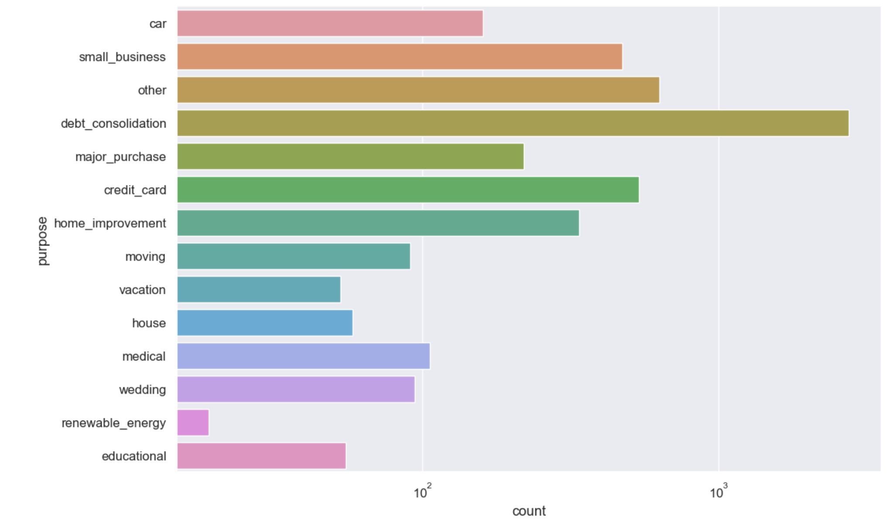
Observations
Most of the loans were taken for the purpose of debt consolidation & paying credit card bill.
Number of charged off count also high too for these loans.

Slide 13
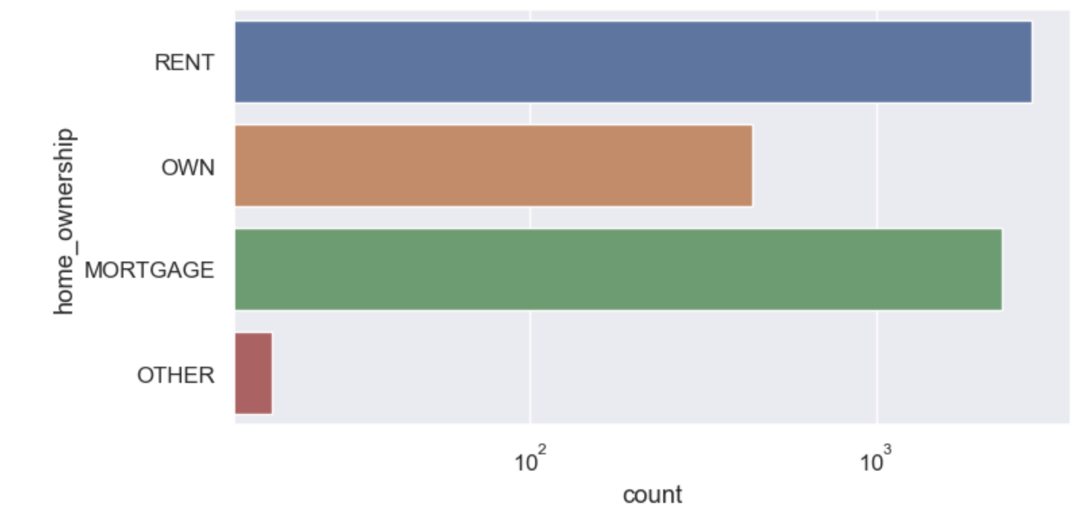
Observations
Most of the applicants stay in rented home or mortgaged their home. Applicant numbers are high from these categories so charged off is high too.

Slide 14
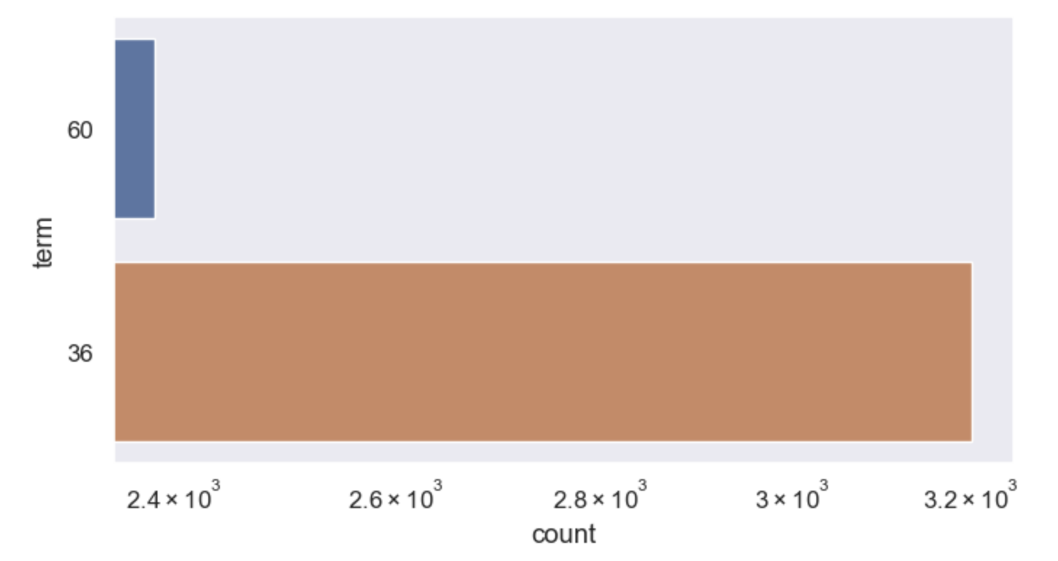
Observations
Those who had taken a loan to repay in 36 months had more % of the number of applicants getting charged off as compared to applicants who had taken a loan for 60 months.

Slide 15
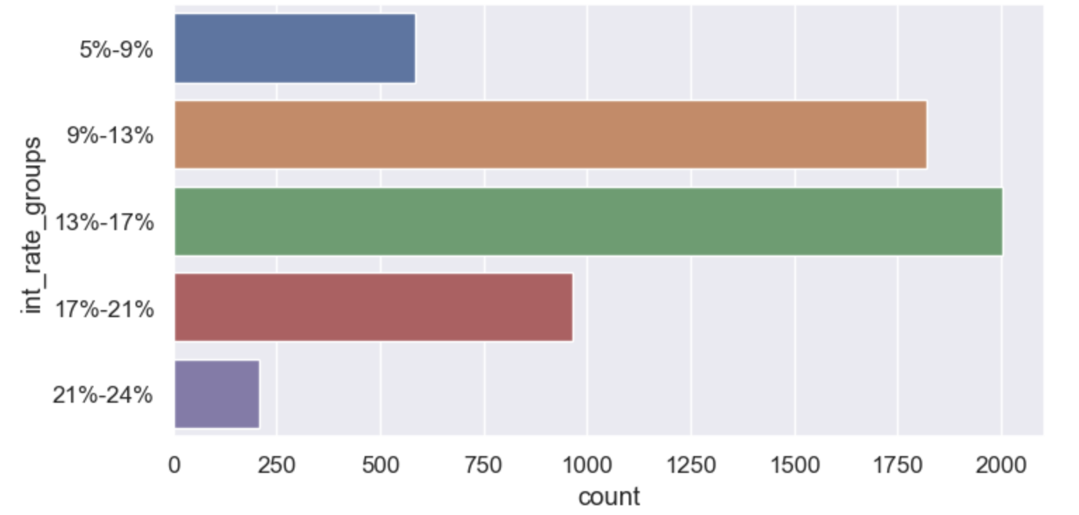
Observations
Charged off is seen more when the interest rates are between 13-17% and 9-13%

Slide 16
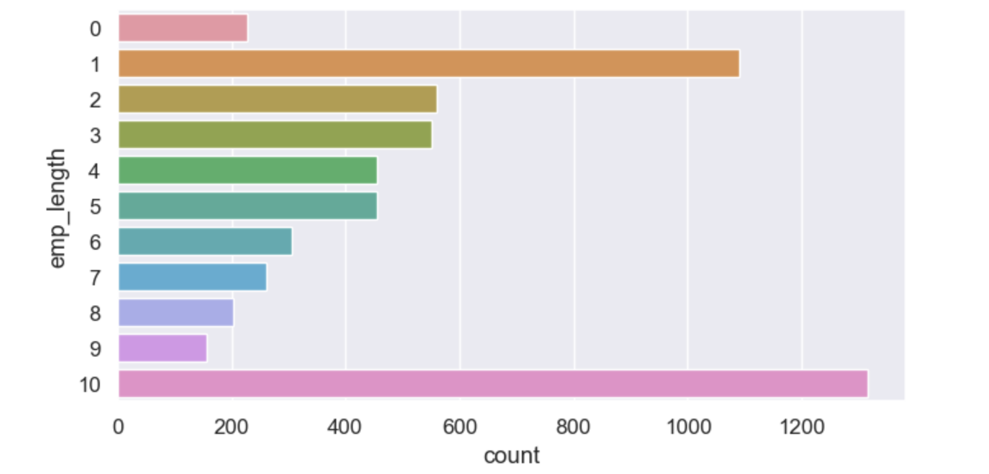
Observations
Charged off is more for people with work experience 10 years or with people with experience of 1 year

Slide 17
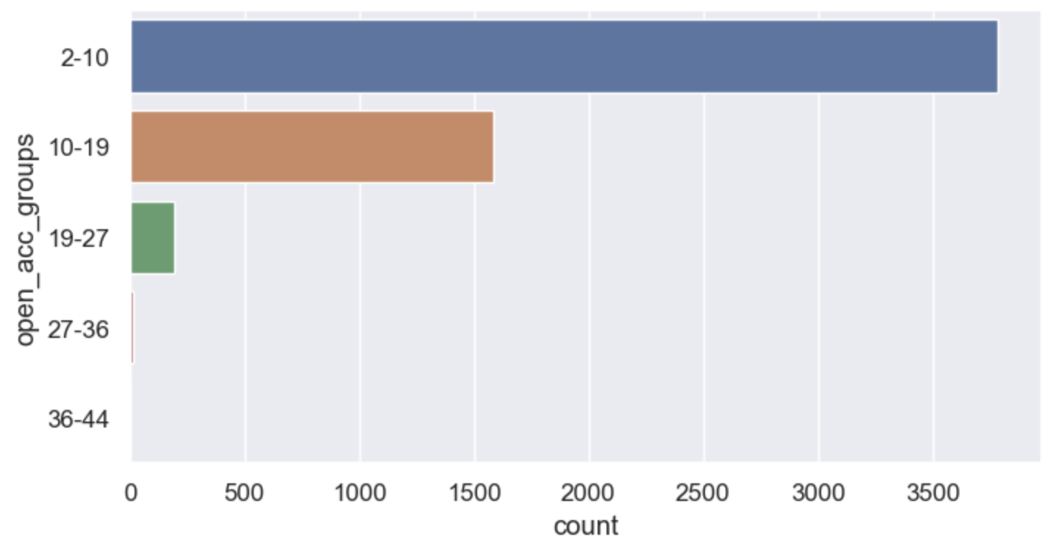
Observations
charged off is seen more when the open acc groups (The number of open credit lines in the borrower's credit file) is between 2-10

Slide 18
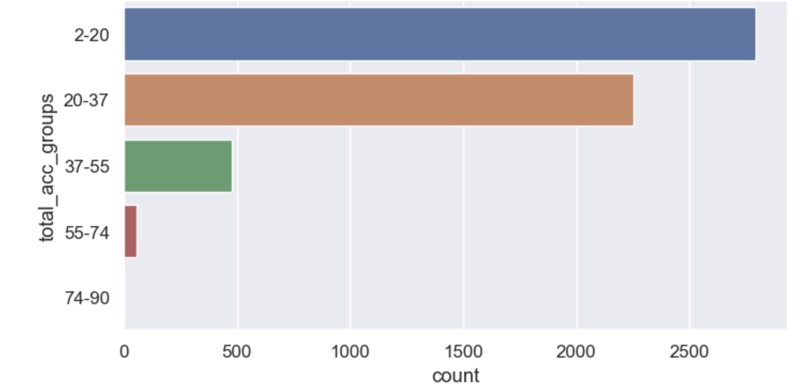
Observations
charged off is seen more when the total_acc (The total number of credit lines currently in the borrower's credit file) is between 2-20 and then 20-37

Slide 19
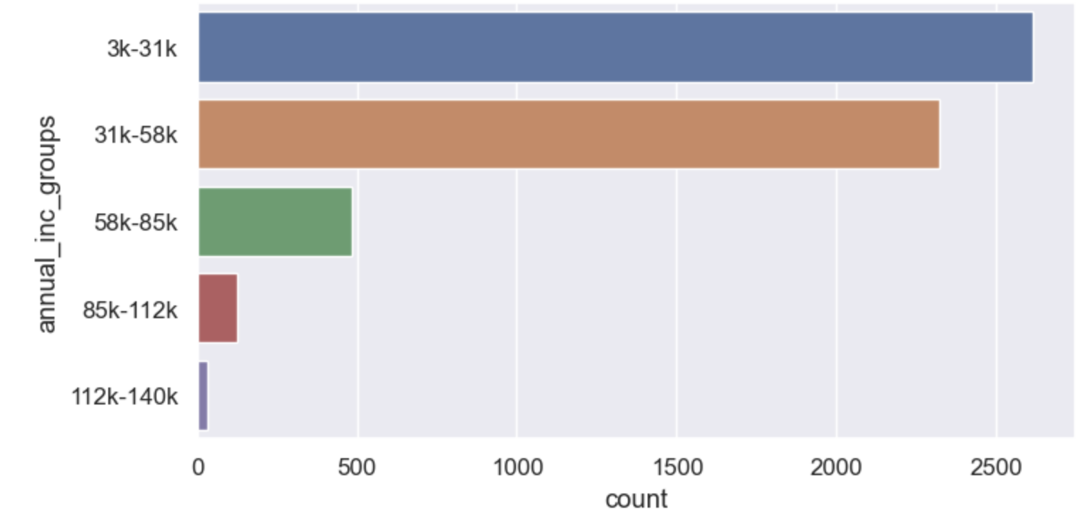
Observations
charged off is seen more when the annual inc is between 3k to 58k. More defaulters are seen in the annula income between 3K - 31K

Slide 20
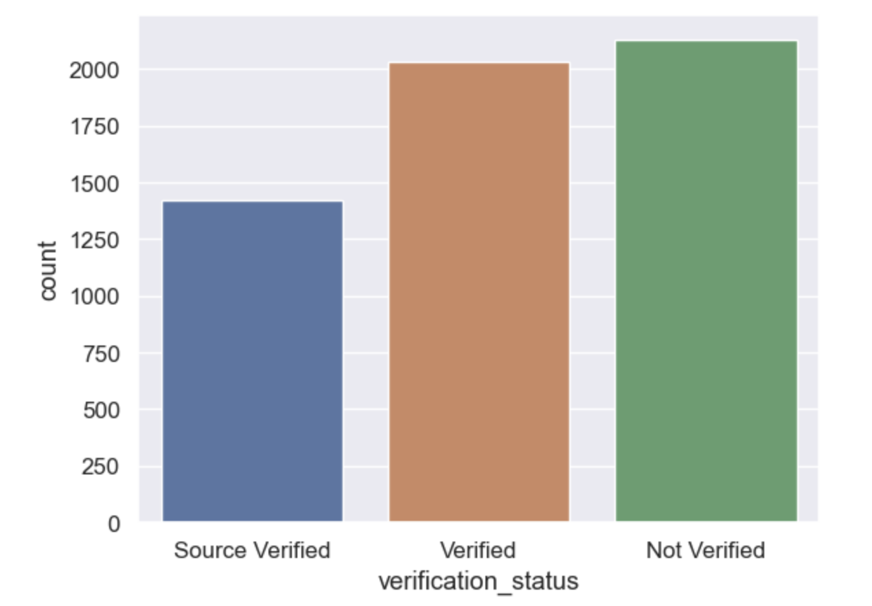
Observations
More defaulters are seen when the application is not verified and also for verified application

Slide 21
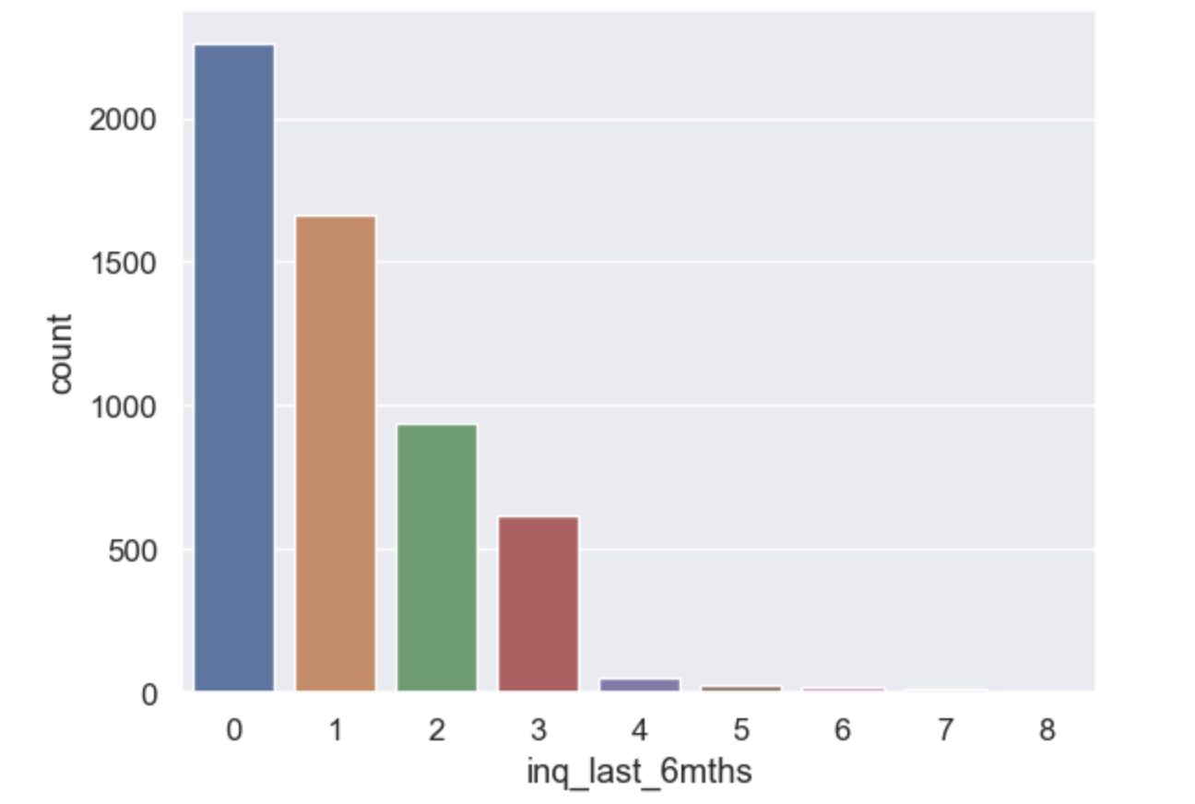
Observations
More defaulters are seen when the inquiries in last 6 months is between 0-3

Slide 22
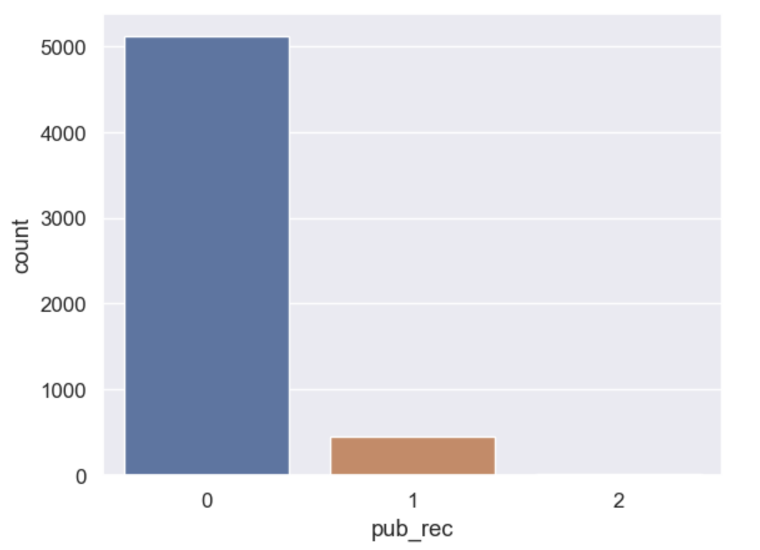
Observations
More defaulters are seen when the Number of derogatory public records is 0

Slide 23
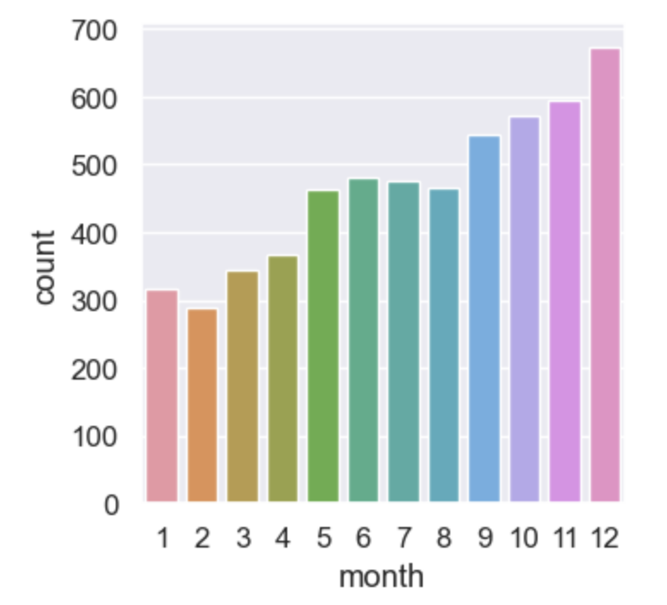
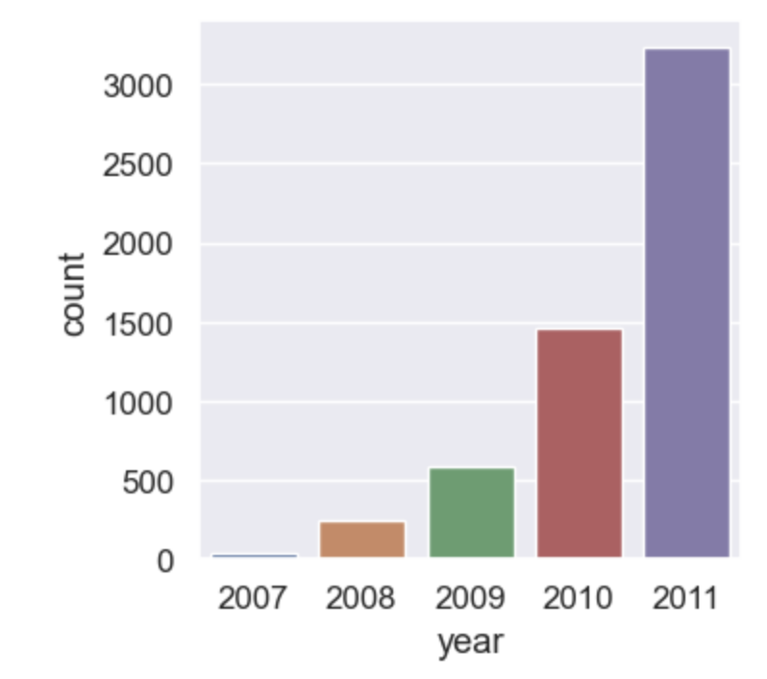
Observations
Charged off is seen more in dec 2011

Slide 24
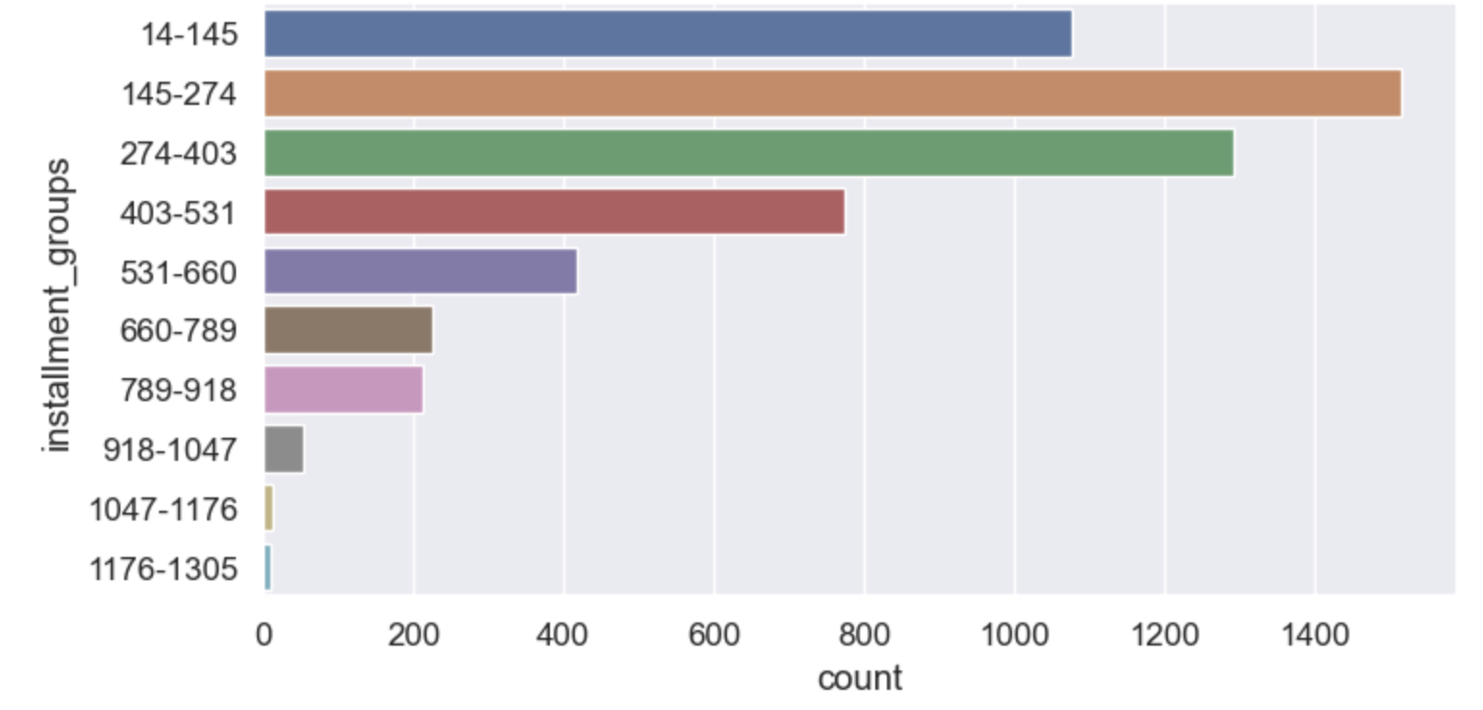
Observations
More defaulters are seen for 145-274 installment group

Slide 25
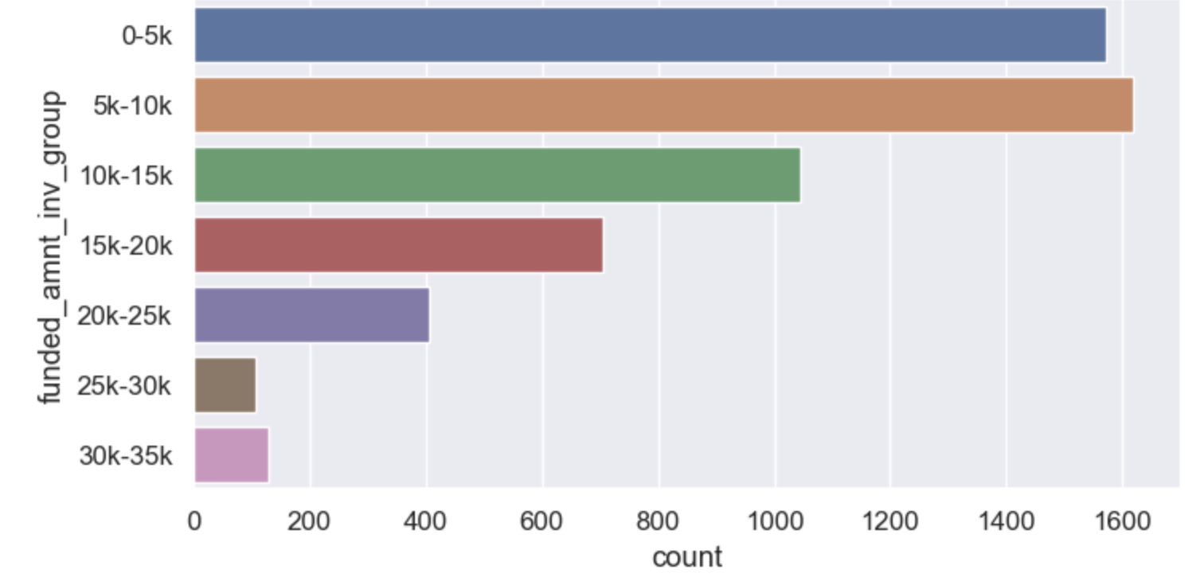
Observations
More defaulters are seen for funded_amt_inv amount between 5k-10k

Slide 26
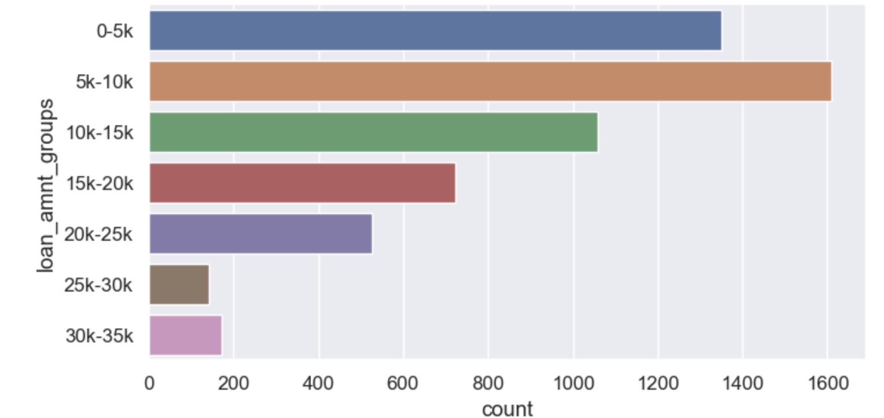
Observations
more defaulters are seen for 5k-10k loan amount

Slide 27
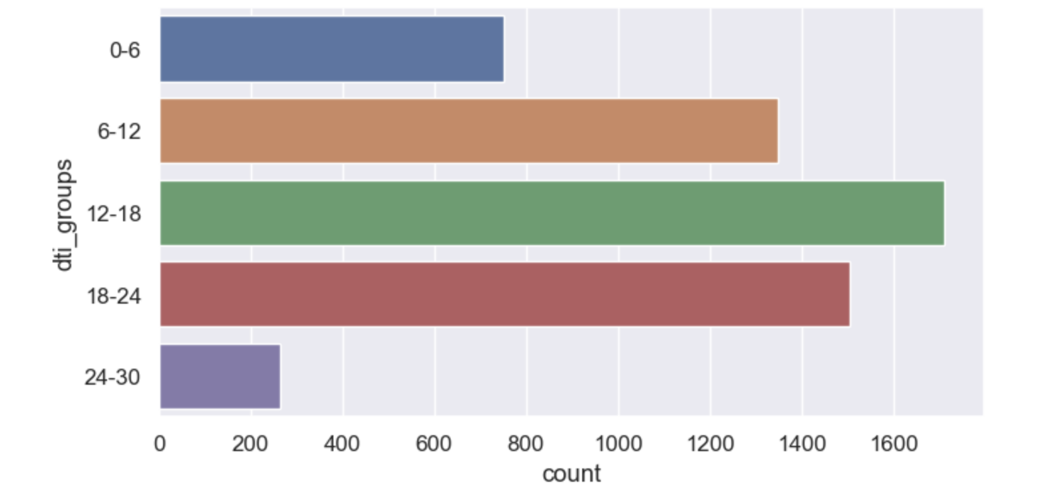
Observations
more defaulters are seen for 12-18 dti group, however more defaulters are seen from 6-24 dti with 12-18 dti is the highest.

Slide 28
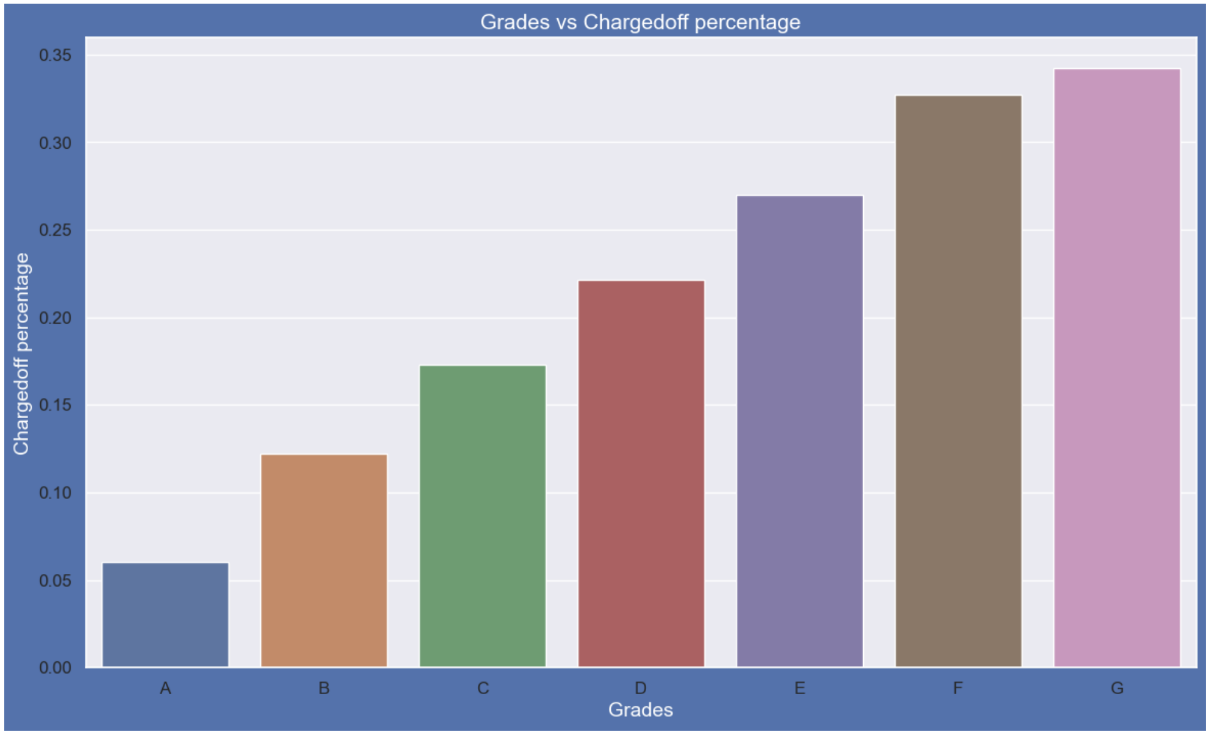
Observations
Grade "F" and "G" have very high chances of charged off.Chances of charged of is increasing with grade moving from "A" towards "G"

Slide 29
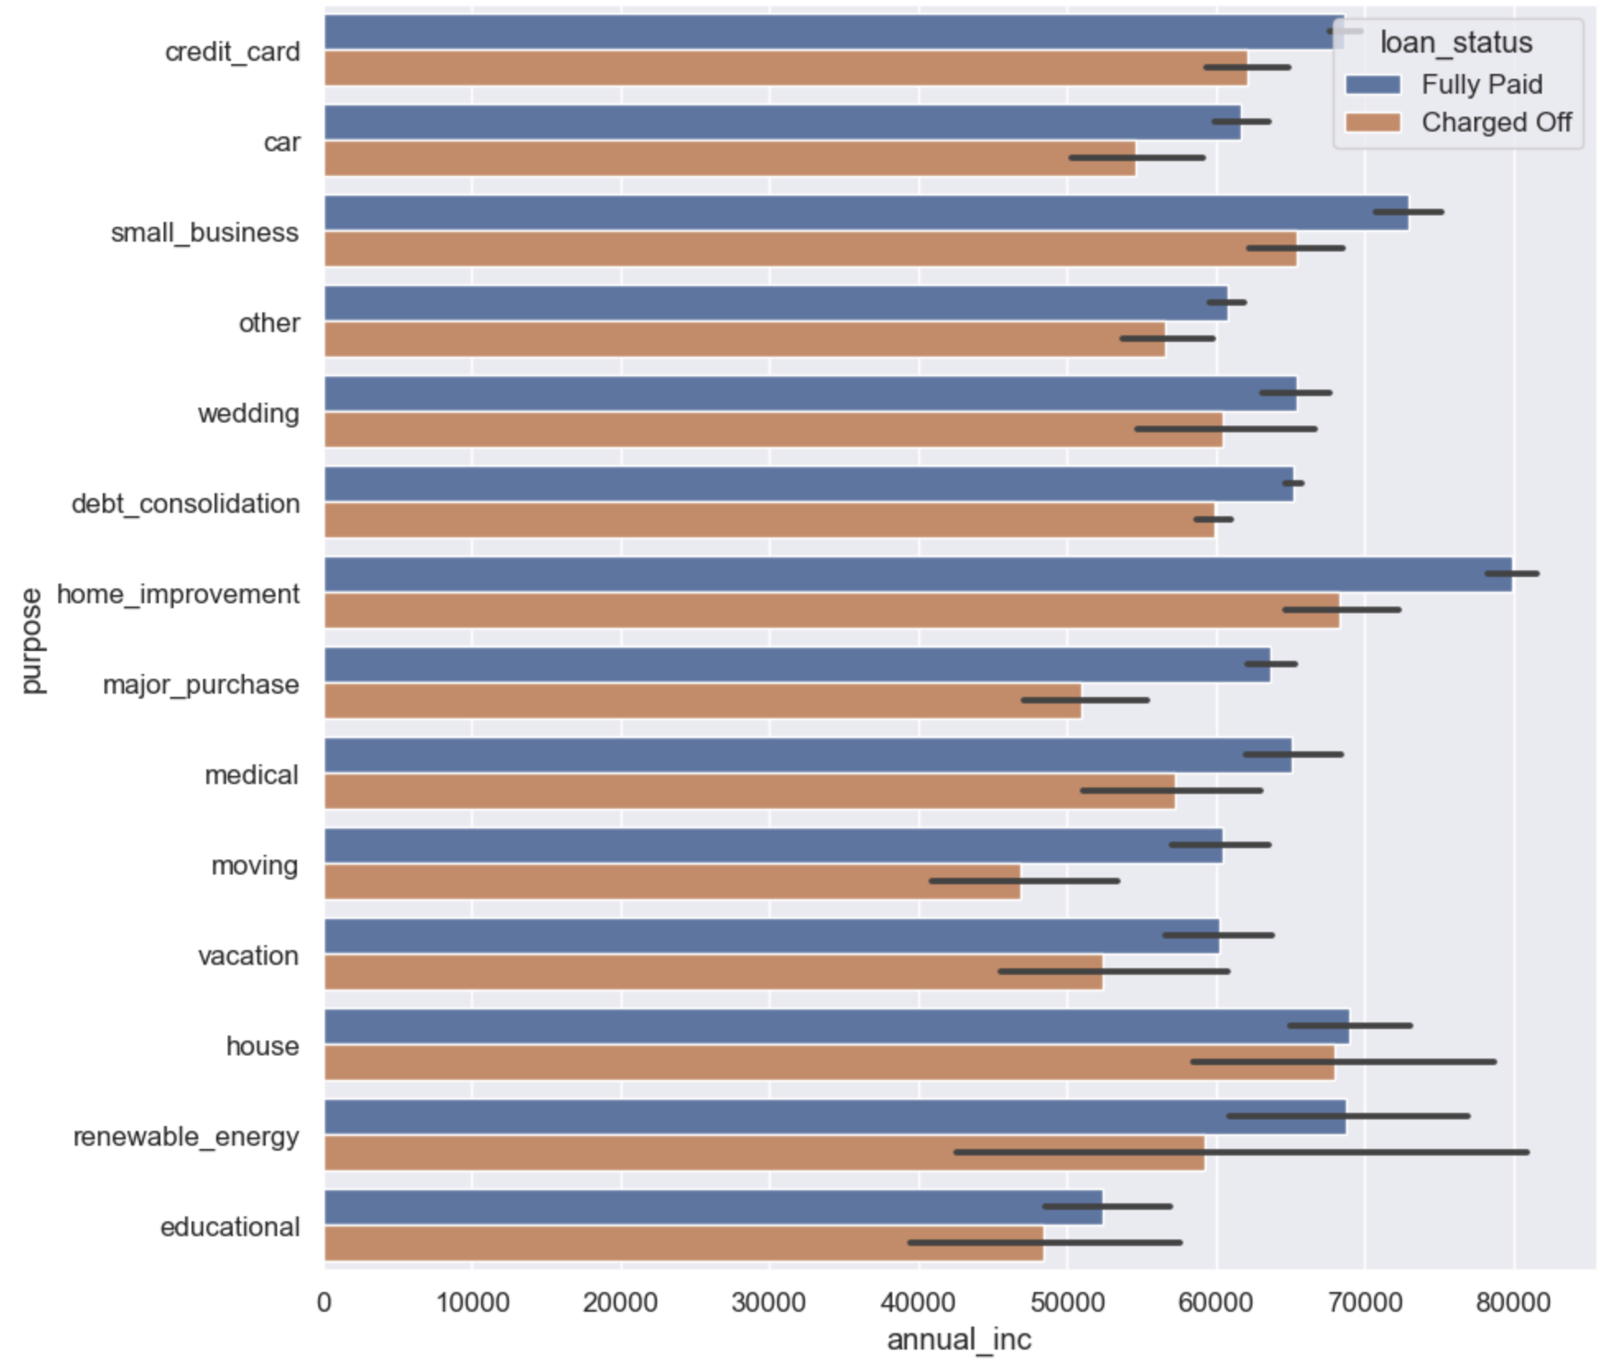
Observations
charge off is seen more in home_improvement and house and these people had low income in that purpose than the people who fully paid
Applicants with higher salary mostly applied loans for "home_improvment", "house", "renewable_energy","credit_card" and "small_businesses"

Slide 30
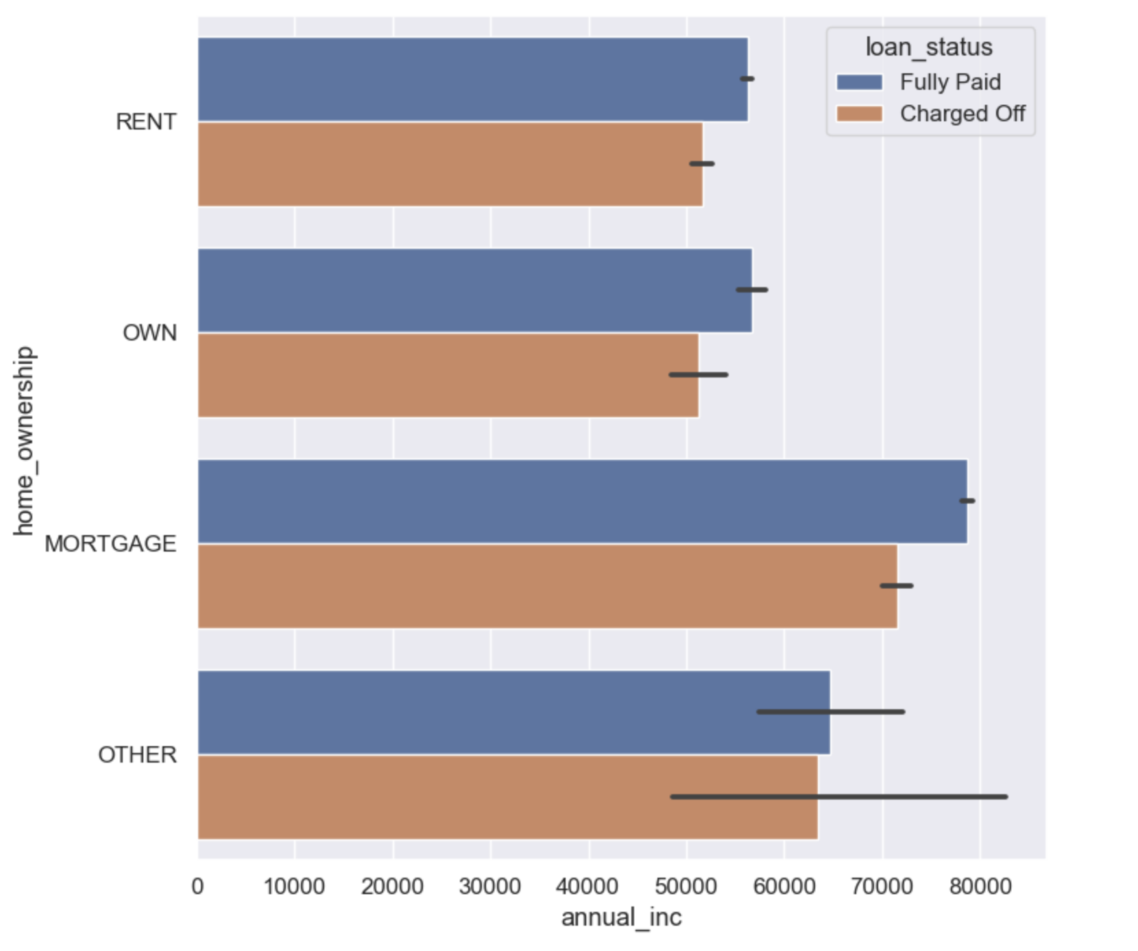
Observations
charged off is seen high for mortage home_ownership with lower annual income

Slide 31
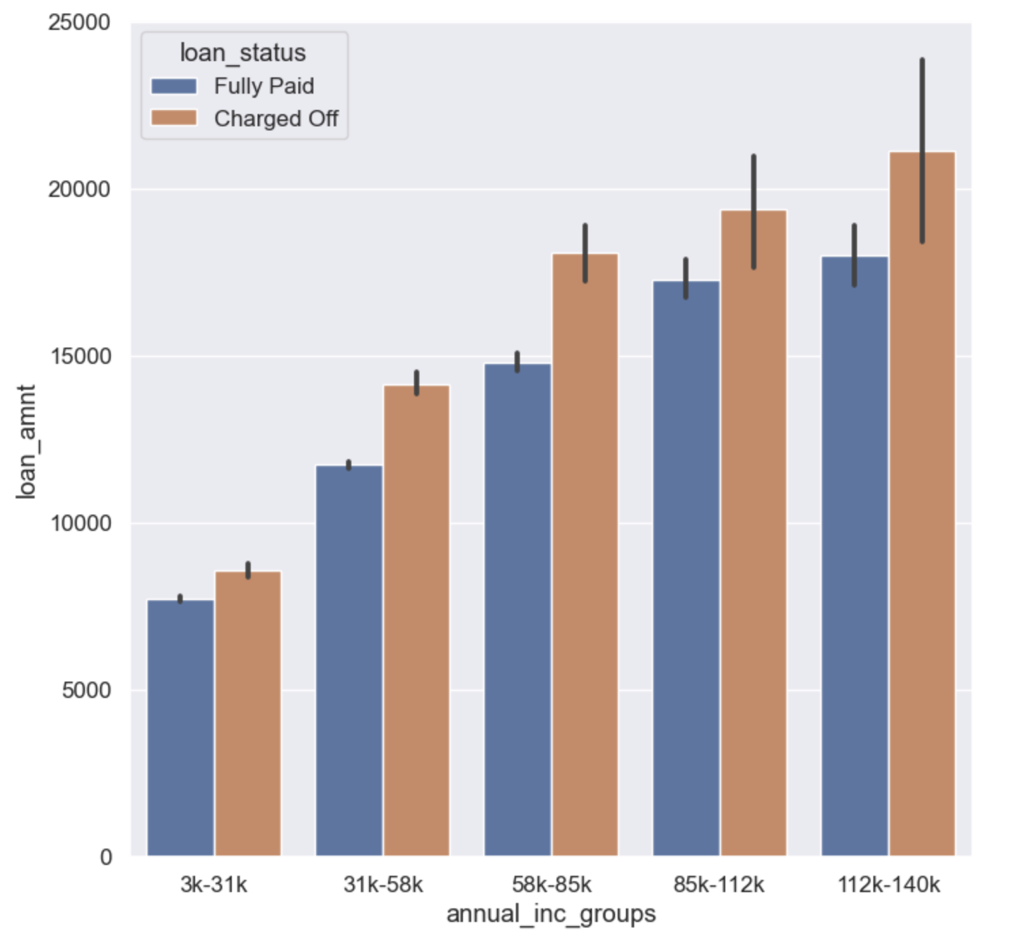
Observations
Across all the income groups, the defaulters are those who took higher loan amount

Slide 32
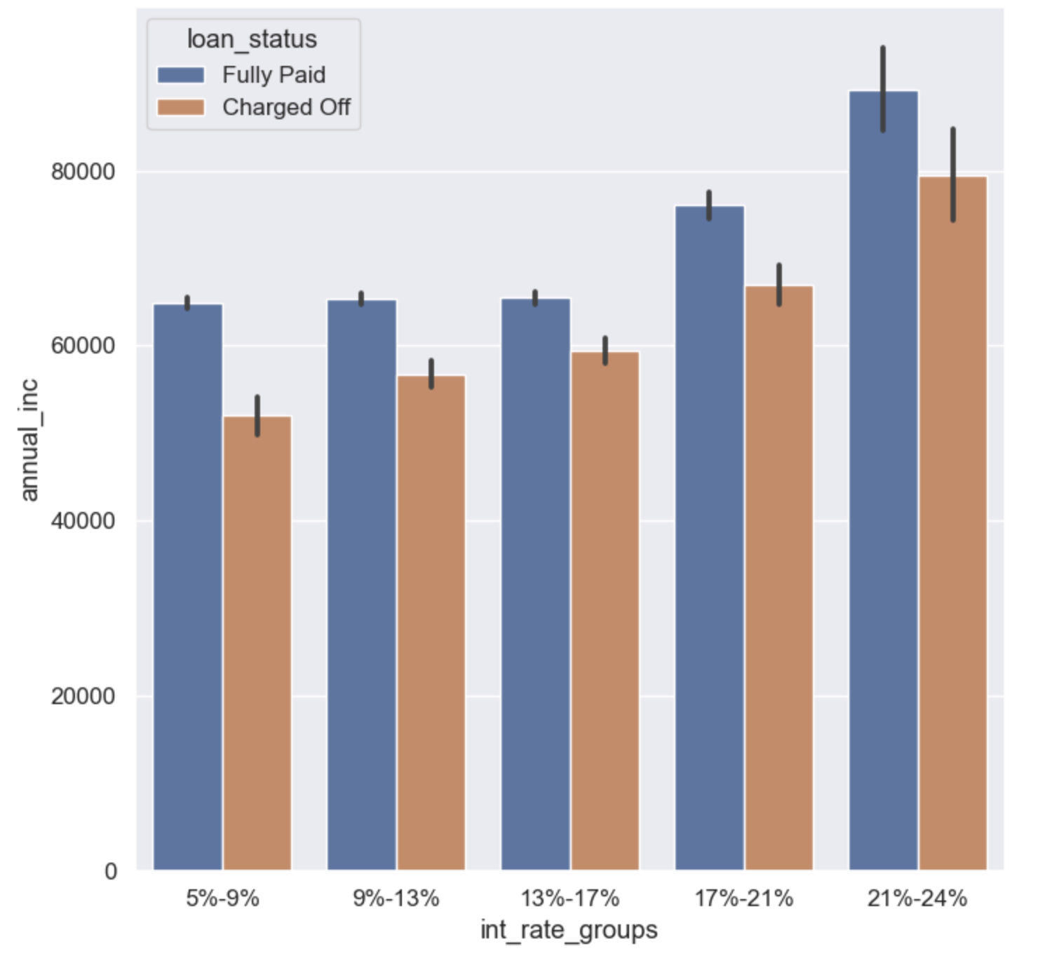
Observations
across all the interest rate the charge off is higher for lowe annual inc and is most charge off is seen in interest rate of 21-24%

