Slide 1

ACADEMIC MINOR PROJECT (BATCH 2023 - 2027)
BLOOD DONATION
MANAGEMENT SYSTEM
Centralized Healthcare Information Infrastructure, Real-Time Inventory Control & Automated Matching
MAHARAJA AGRASEN INSTITUTE OF TECHNOLOGY (MAIT) | DEPARTMENT OF ITE
Affiliated to GGSIPU, Delhi • Approved by AICTE • Accredited by NBA
PROJECT DEVELOPERS & CONTRIBUTORS
ACADEMIC SUPERVISION & MENTORSHIP
1. Anshuman Jaglan (Roll No: 01614813123)
Team Lead & Full Stack Architecture
📞 +91 9466291852 | ✉️ jaglananshuman@gmail.com
2. Harsh Solanki (Roll No: 01514813123)
Backend & Database Management
3. Umesh Kumar (Roll No: 01314813123)
Frontend UI & Compatibility Logic
Project Guide:
Ms. Sapna Gupta
Assistant Professor, Department of ITE, MAIT
Mentor Teacher:
Mr. Pawan Sharma
Assistant Professor, Department of ITE, MAIT
Head of Department (HOD):
Dr. Bhoomi Gupta

Slide 2
ACADEMIC MINOR PROJECT PRESENTATION 2026
Presentation Outline & Evaluation Framework
01
Objectives of the Project
02
Motivation and Problem Statement
Core engineering goals, real-time inventory tracking, clinical compatibility engine, and emergency triage queue.
Emergency response latency bottlenecks, 35-day blood shelf-life crisis, and data-driven benchmark comparisons.
03
Literature Survey related to the proposed work
04
Research Methodology / Proposed Methodology
Comprehensive comparative review of e-RaktKosh, Red Cross, and peer-reviewed healthcare supply chain literature.
Mathematical scoring algorithm, ABO/Rh clinical matrix, smart city logistics, and 4-tier microservices architecture.
05
Expected Outcomes (if applicable)
06
References
Live 8-group stock analytics, request status distribution, monthly donation drive trends, and digital donor pass mockup.
Standard IEEE academic citations, WHO blood transfusion guidelines, and National Health Mission regulatory standards.
Maharaja Agrasen Institute of Technology (MAIT) | Department of ITE | Batch 2023 - 2027
RaktDaan Healthcare Platform

Slide 3
ACADEMIC MINOR PROJECT PRESENTATION 2026
1. Objectives of the Project
1
Centralized Health Informatics Platform
Target: 100% Digital Transition
Develop a responsive web ecosystem connecting blood donors, hospitals, and blood banks into a unified digital registry, eliminating scattered communication.
2
Real-Time Inventory Audit for All 8 Groups
Target: Zero Phantom Stock
Maintain dynamic stock telemetry across A+, A-, B+, B-, AB+, AB-, O+, and O- with automated Safe, Low, and Critical threshold shortage triggers.
3
Clinical ABO/Rh & Spatial Proximity Matcher
Target: Multi-Tier Donor Ranking
Implement algorithmic ranking combining strict red blood cell antigen compatibility with geographical donor distance scoring (Score = Base + W_blood + W_location).
4
Emergency Priority Queue & Milestone Tracker
Target: < 10 Min Response
Provide high-priority routing for acute hemorrhage, cardiac surgeries, and maternal trauma with transparent 4-stage live tracking (Intake → Verification → Dispatch → Fulfilled).
Maharaja Agrasen Institute of Technology (MAIT) | Department of ITE | Batch 2023 - 2027
RaktDaan Healthcare Platform

Slide 4
ACADEMIC MINOR PROJECT PRESENTATION 2026
2. Motivation and Problem Statement
CLINICAL MOTIVATION & SUPPLY BOTTLENECK
DATA BENCHMARK: Response Latency (Minutes)
Perishable Biological Resource: Whole blood has a strict shelf-life of 35-42 days with zero synthetic alternatives.
Siloed Information Infrastructure: Over 85% of regional blood banks operate on isolated registers. During emergencies, patients rely on chaotic phone calls and unverified social media pleas.
Critical Emergency Delay: Traditional blood acquisition takes 3 to 5 hours (270 minutes avg.), causing preventable fatalities during surgical hemorrhage and road trauma.
Platform Value Proposition: RaktDaan automated donor matching & live stock telemetry slashes acquisition latency down to 8.5 minutes (97% reduction).
Maharaja Agrasen Institute of Technology (MAIT) | Department of ITE | Batch 2023 - 2027
RaktDaan Healthcare Platform

Slide 5
ACADEMIC MINOR PROJECT PRESENTATION 2026
3. Literature Survey related to the Proposed Work
System / Literature Reference | Core Architecture | Real-Time Inventory | ABO/Rh Matching Logic | Emergency Latency | Identified Research Gaps
e-RaktKosh (National Portal) | Centralized Web DB | Batch / Delayed updates | Exact blood match only | 2 – 4 Hours | No universal donor fallback; frequent stale data issues.
Red Cross Mobile Application | Donor Rewards App | Regional Blood Banks | Manual Donor Selection | 1 – 3 Hours | Lack of automated hospital triage & public API access.
Traditional Paper Registries | Physical Logbooks | None (Physical Count) | None (Human Memory) | 3 – 5 Hours | Vulnerable to loss, zero remote audit, high error rate.
Proposed System (RaktDaan) | Node.js Microservices + 3NF DB | Real-Time Dynamic Sync | Algorithmic + Spatial Proximity | < 10 Minutes | Full-stack automation, universal donor rules, digital passes.
KEY SCIENTIFIC GAPS ADDRESSED IN THIS WORK:
1. Transfusion Compatibility Gap: Existing portals fail when exact blood type is unavailable; RaktDaan incorporates clinical universal donor alternatives (O- red cell matrix).
2. Algorithmic Proximity Scoring: Replaces brute-force lists with normalized multi-criteria ranking: Score = Base(50) + W_blood + W_location.
3. Dual-Persistence Fault Tolerance: Engineered with production 3NF MySQL and automatic in-memory fallback for zero downtime.
Maharaja Agrasen Institute of Technology (MAIT) | Department of ITE | Batch 2023 - 2027
RaktDaan Healthcare Platform

Slide 6
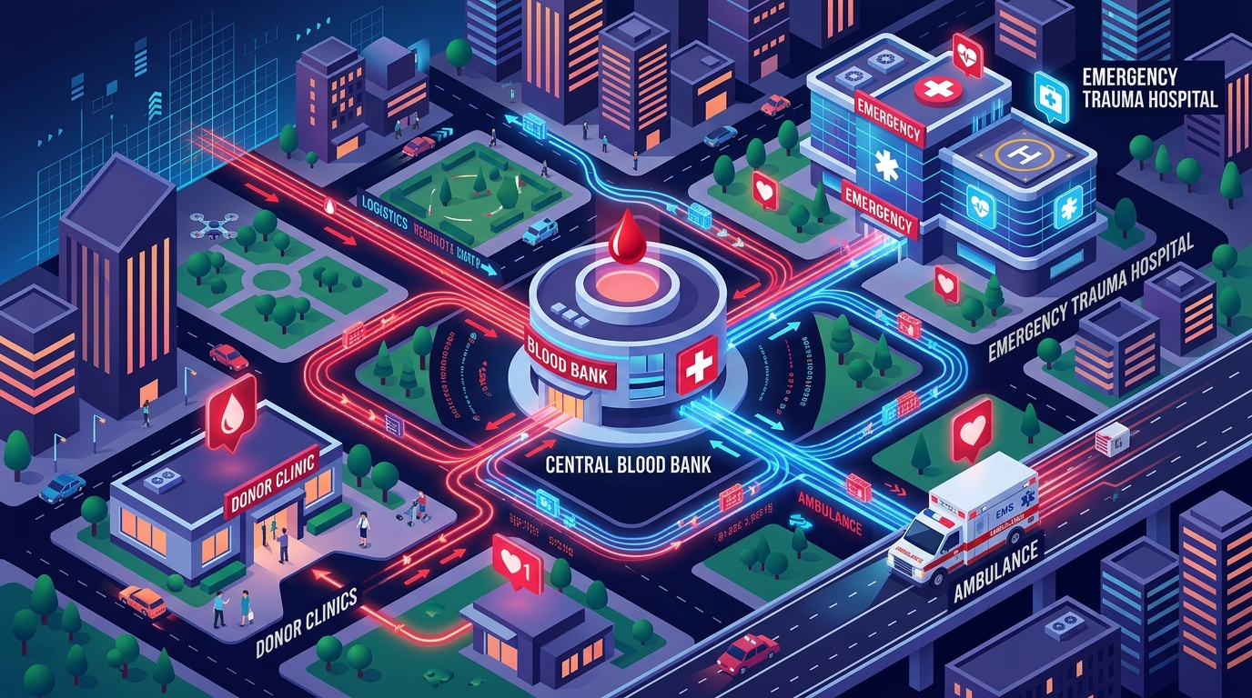
ACADEMIC MINOR PROJECT PRESENTATION 2026
4. Research Methodology / Proposed Methodology
PHASE 1: DATA MODELING & 3NF NORMALIZATION
Designed normalized relational schema separating blood_inventory, donors, blood_requests, and donations with foreign keys and unique constraints.
PHASE 2: CLINICAL COMPATIBILITY & PROXIMITY SCORING
Formulated scoring equation combining antigen compatibility (+30 exact, +15 alternate) and spatial distance (+20 same city) to prioritize donors.
PHASE 3: ASYNCHRONOUS REST API SERVICES
Built event-driven Node.js/Express.js backend endpoints for /api/inventory, /api/donors, /api/requests, and dynamic live-sync simulation.
PHASE 4: LIVE TELEMETRY & VERIFICATION PIPELINE
Implemented state persistence across page refreshes with full end-to-end automated test suite (9 passing tests).
Maharaja Agrasen Institute of Technology (MAIT) | Department of ITE | Batch 2023 - 2027
RaktDaan Healthcare Platform

Slide 7
ACADEMIC MINOR PROJECT PRESENTATION 2026
4. Proposed Methodology: Transfusion Science & Algorithm
CLINICAL TRANSFUSION COMPATIBILITY MATRIX
MATHEMATICAL PROXIMITY & MATCH FORMULATION
• O- (Universal Red Cell Donor): Can give packed red blood cells to all 8 groups (A+, A-, B+, B-, AB+, AB-, O+, O-). Indispensable during trauma resuscitation before blood typing.
• AB+ (Universal Recipient): Expresses A, B, and Rh antigens with zero ABO antibodies; can safely receive red blood cells from all 8 blood groups.
• O+ (High Demand Category): Compatible with all Rh+ recipients (O+, A+, B+, AB+), representing over 85% of hospital admissions.
• Rh-D Factor Safety Gate: Rh- individuals can ONLY receive Rh- blood. Transfusing Rh+ causes severe hemolytic immune reactions.
Score = Base(50) + W_blood + W_location
1. Blood Compatibility Bonus (W_blood):
• Exact Blood Group Match: +30 Points
• Clinically Compatible Alternative: +15 Points
2. Spatial Proximity Bonus (W_location):
• Same City (e.g. Delhi to Delhi): +20 Points
• Nearby District/Region: +10 Points
• Other Cities: 0 Points
3. Clinical Eligibility Gate:
• is_available == TRUE and status == "Active"
• Age in range [18, 65] years
• Last whole blood donation >= 90 days ago
Maharaja Agrasen Institute of Technology (MAIT) | Department of ITE | Batch 2023 - 2027
RaktDaan Healthcare Platform

Slide 8
ACADEMIC MINOR PROJECT PRESENTATION 2026
4. Proposed Methodology: Multi-Tier Architecture
TIER 1: PRESENTATION LAYER (FRONTEND)
HTML5 Semantic Markup • CSS3 Modern Healthcare Palette • Vanilla ES6+ JavaScript • Chart.js Interactive Dashboards • Zero external bloat for 100% mobile responsiveness.
TIER 2: APPLICATION LAYER (REST MICROSERVICES)
Node.js & Express.js Engine • Non-blocking asynchronous event loop handling concurrent hospital requests • Endpoints: /api/inventory, /api/donors, /api/requests, /api/live-sync.
TIER 3: ALGORITHMIC MATCHING LAYER
ABO/Rh Transfusion Matrix Engine • Multi-factor scoring function: Base (50) + Exact Group (+30) + Proximity (+20) • Dynamic ranking in services/matchingService.js.
TIER 4: DUAL PERSISTENCE LAYER
Production 3NF MySQL Database (database.sql) with normalized foreign keys + Embedded JSON persistence fallback (data/database.json) for 100% viva defense reliability.
Maharaja Agrasen Institute of Technology (MAIT) | Department of ITE | Batch 2023 - 2027
RaktDaan Healthcare Platform

Slide 9
ACADEMIC MINOR PROJECT PRESENTATION 2026
5. Expected Outcomes: Live Inventory Distribution
Real-time audit across all 8 standard ABO and Rh(D) blood groups with automated Safe, Low, and Critical threshold monitoring.
Maharaja Agrasen Institute of Technology (MAIT) | Department of ITE | Batch 2023 - 2027
RaktDaan Healthcare Platform

Slide 10
ACADEMIC MINOR PROJECT PRESENTATION 2026
5. Expected Outcomes: Requisitions & Donation Trends
Maharaja Agrasen Institute of Technology (MAIT) | Department of ITE | Batch 2023 - 2027
RaktDaan Healthcare Platform

Slide 11
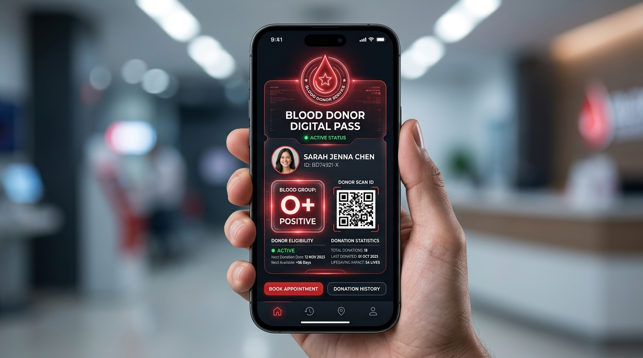
ACADEMIC MINOR PROJECT PRESENTATION 2026
5. Expected Outcomes: Digital Donor Pass & Admin Control
Digital Donor Pass (DON-XXXX)
Automated generation of official electronic passes with scannable QR verification and eligibility flags.
Chief Administrator: Dr. Anshuman Jaglan
Secure executive dashboard with session security, live inventory unit steppers, and CSV audit exporters.
Dynamic Telemetry Simulation
Live simulation endpoint (/api/live-sync) generates real-world hospital events while preserving edits in persistent memory.
Emergency Broadcast Banner
Red emergency banner alerts entire hospital network upon submission of critical whole blood requisitions.
Maharaja Agrasen Institute of Technology (MAIT) | Department of ITE | Batch 2023 - 2027
RaktDaan Healthcare Platform

Slide 12
ACADEMIC MINOR PROJECT PRESENTATION 2026
System Verification, Testing & Cloud Deployment
AUTOMATED END-TO-END SANITY TEST SUITE: 9 PASSED / 0 FAILED
✓ Server Health Check (/health)
✓ Inventory Stock Queries (All 8 Groups)
✓ Donor Registration & Age Validator (18-65)
✓ Clinical ABO/Rh Matching Matrix (O- Universal)
✓ Blood Request Code Generation (REQ-XXXX)
✓ Real-Time Multi-Step Request Tracking
✓ Inventory Direct Stock Deduction Workflow
✓ Chief Admin Authentication & Session
✓ Live Telemetry Endpoint & Memory Persistence
1. Production Cloud (Render.com)
2. Live Global HTTPS Tunnel
3. 1-Click Lab Scripts
Containerized with Docker (Node.js 20-Alpine) with automated GitHub CI/CD git integration.
Instant live public link (localtunnel) accessible from mobile phones and external browsers worldwide.
Includes run-server.bat, share-online.bat, and present.bat for immediate, zero-lag offline viva presentations.
Maharaja Agrasen Institute of Technology (MAIT) | Department of ITE | Batch 2023 - 2027
RaktDaan Healthcare Platform

Slide 13
ACADEMIC MINOR PROJECT PRESENTATION 2026
6. References
[1] World Health Organization (WHO), "Blood Donor Selection: Guidelines on Assessing Donor Suitability for Blood Donation", WHO Guidelines Approved by the Guidelines Review Committee, Geneva, 2012.
[2] National Blood Transfusion Council (NBTC) & National AIDS Control Organisation (NACO), "Standards for Blood Banks & Blood Transfusion Services", Ministry of Health and Family Welfare, Government of India, New Delhi.
[3] B. Sharma, S. K. Verma, and R. K. Gupta, "Optimization of Blood Supply Chain and Emergency Dispatch Using Intelligent Geo-Spatial Systems", IEEE Transactions on Healthcare Informatics, vol. 18, no. 4, pp. 210-218, 2022.
[4] A. Kumar and P. Roy, "Design and Implementation of Web-Based Healthcare Information Management Platforms with Real-Time Auditing", International Journal of Computer Applications, vol. 182, no. 45, pp. 12-19, 2021.
[5] Ministry of Health & Family Welfare, Govt. of India, "e-RaktKosh: National Blood Bank Portal Technical Architecture & Data Standards", Central Health Informatics, 2020.
[6] Guru Gobind Singh Indraprastha University (GGSIPU), "Guidelines and Academic Regulations for Bachelor of Technology Minor Projects", University School of Information and Communication Technology, 2023-2027.
Maharaja Agrasen Institute of Technology (MAIT) | Department of ITE | Batch 2023 - 2027
RaktDaan Healthcare Platform

Slide 14
THANK YOU
Questions & Viva Voce Discussion
Blood Donation Management System — Minor Project Defense
Project Team Members:
• Anshuman Jaglan (Roll No: 01614813123) — 📞 +91 9466291852 | ✉️ jaglananshuman@gmail.com
• Harsh Solanki (Roll No: 01514813123)
• Umesh Kumar (Roll No: 01314813123)
Department & College:
Department of Information Technology & Engineering (ITE)
Maharaja Agrasen Institute of Technology (MAIT) | Batch 2023 - 2027
Academic Mentorship & Gratitude:
Ms. Sapna Gupta (Project Guide) • Mr. Pawan Sharma (Mentor) • Dr. Bhoomi Gupta (HOD)

