Slide 1
Megaproject 2019
TOPIC
COUNTING FINGERS WITH NEURAL NETS
___by Anshuman Srivastava

Slide 2
dATASET collection
Why Not Data From Other Sources?
Data captured from sources with high resolution
Distribution problem with train and test data
Challenge: Best performance with minimum data
Created own dataset with help of a script which captures the images with cam of given label and put it in the respective label folder
Labels Used :1,2,3,4,5
Initial image size of dataset : 300x300
Flipped Images Horizontally to double the datasetsize

Slide 3
Libraries USED
Numpy and pandas : for handling arrays arithmetics and creating data frames
Glob – for reading images from directory
Cv2,PIL, and skimage- for preprocessing of images
Keras layers ,optimizers… - for creating my model
Matplotlib – for plotting images to see results
Sklearn – for train_test_split

Slide 4




Preprocessing IMageS
While reading images :
Resized it to 64x64
Converted to grayscale (threshold 137)
Threshed it with a 2D filter
Converted back to numpy array

Slide 5
Model architecture
Here I have used a LeNET-5 Architecture consisting of
2 Convolutional Layers (5x5)
2 Average Pooling Layers
1 Convolutional Layer(3x3)
1 Average Pooling Layer
2 Dense Layers of 256, 128
Output Layer
Convolution(5,5) AvgPooling(2,2) x2
Convolution(3,3) AvgPooling(2,2)
Flatten
Dense 256
Dense 128
Output 5

Slide 6
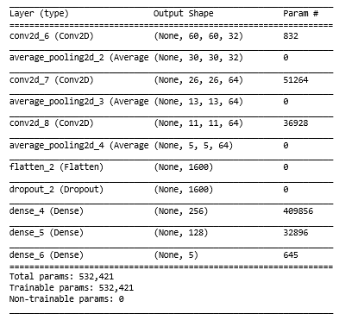
Model summary
Total Parameters= 532K

Slide 7
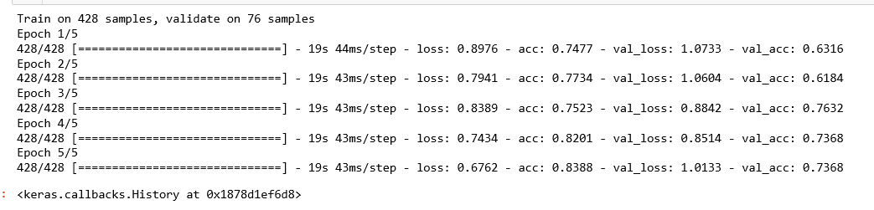
Training and evaluation
Total trained for 15 epochs
Last 5 epochs
Train Accuracy ~ 84%
Validation Accuracy ~ 74%

Slide 8
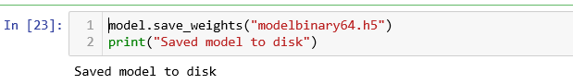
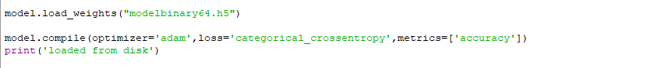
Saving and Loading weights

Slide 9
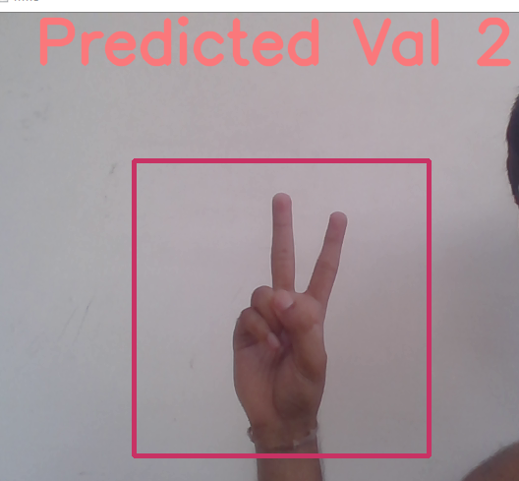
Creating Frame for user
Drew a rectangle of 300x300 defining input boundary
Pre-processed the image within boundary
and input it to our model
Writing the predicted value to output frame

Slide 10
Thank you

