Slide 1
Tool Integration with LLMs
Anshu Pandey

Slide 2
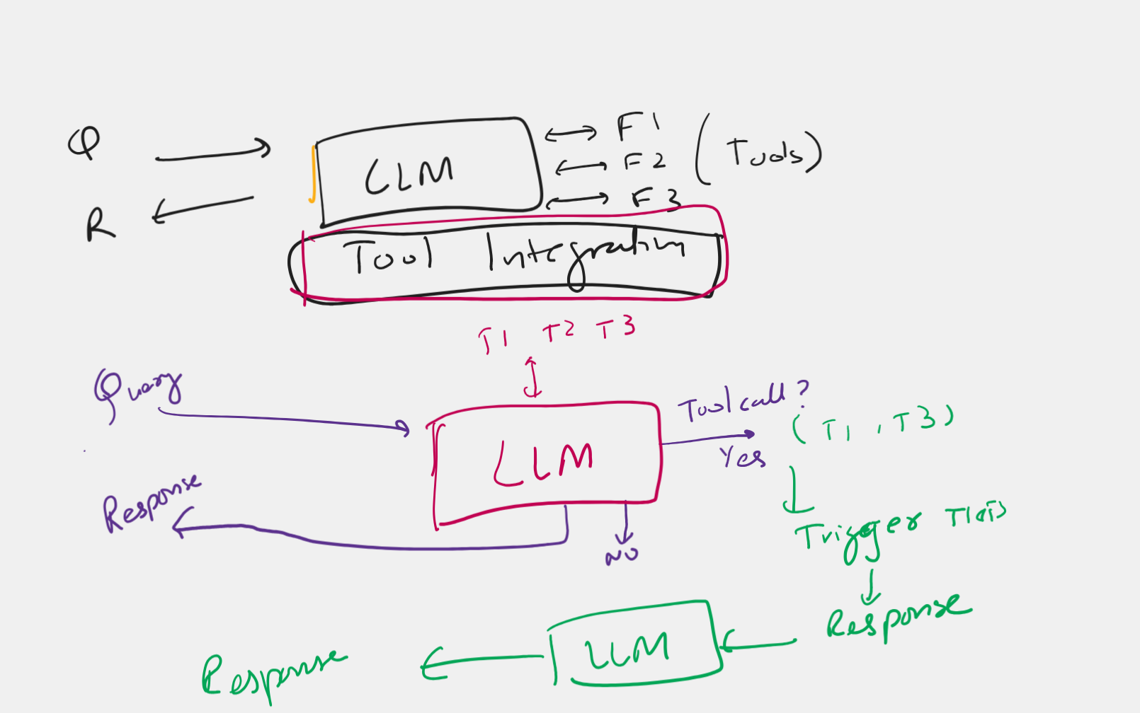

Slide 3
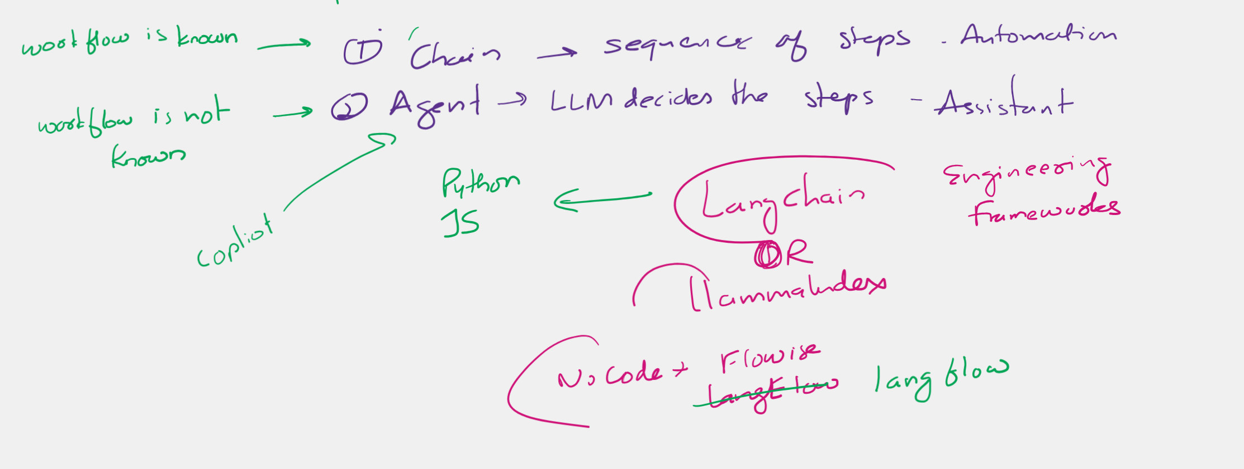
Chains and Agents

Slide 4
Retrieval Augmented Generation
Anshu Pandey

Slide 5
Embeddings
Embeddings are a way to convert complex data like texts, images, or any kind of information into a list of numbers (a vector) that a computer can work with.

Slide 6
Vector Embeddings
Vector embeddings are a way of converting items like words, sentences, or even entire documents into a series of numbers (a vector) so that a computer can understand and work with them.
These numbers represent the meaning of the items and their relationship to each other, allowing the computer to perform tasks such as finding similar words or understanding the topic of a document.

Slide 7
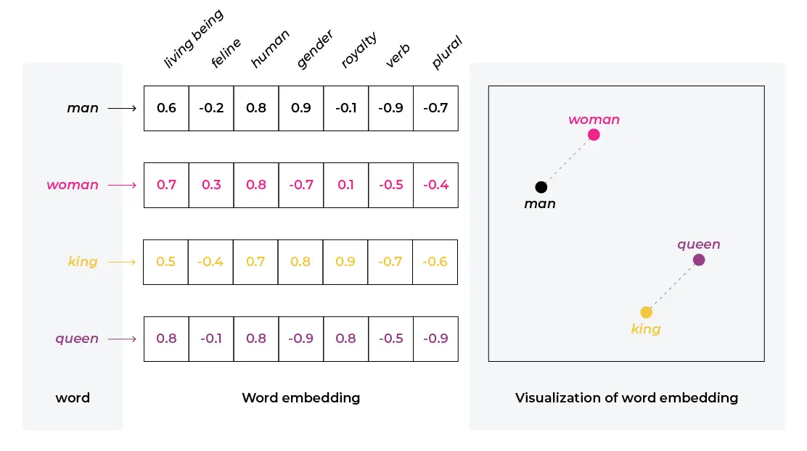
Text Embeddings
A semantic relationship refers to the way words or phrases relate to each other in terms of meaning.
Example: Word2Vec is a popular model for generating word embeddings. If you take words like "king" and "man" and perform vector arithmetic by subtracting "man" from "king" and then adding "woman," you often get a result close to the vector for "queen."

Slide 8
Vector Databases Vector databases are specialized databases optimized for storing and querying vector embeddings. These embeddings are high-dimensional vectors that represent complex data in a form that machines can understand and process.

Slide 9

Role of Vector Database in AI
In machine learning, particularly in areas like natural language processing (NLP) and computer vision, data is often transformed into vectors using models like word embeddings or image embeddings.
Vector databases allow for efficient storage and retrieval of these embeddings, enabling features like similarity search, where you can query database with a vector and find other vectors that are similar to it.
Vector databases are optimized for vector-specific operations, such as cosine similarity, Euclidean distance, and nearest neighbor search.
This all makes them suitable for applications like recommendation systems, image recognition, and semantic text search.

Slide 10
Vector Databases
 | Vector Database | Traditional Database
Data Representation | Stores data as high-dimensional vectors, representing complex relationships and similarities between data points. | Stores data in structured formats such as tables with rows and columns, often relying on relational models.
Querying Approach | Utilizes similarity-based queries, where vectors closely resembling a query vector are retrieved based on distance or similarity metrics. | Typically uses exact matching queries based on specified criteria, such as SQL queries.
Data Types | Capable of handling diverse data types including text, images, audio, and more, by converting them into numerical representations (vectors). | Suited for structured data types like text, numbers, and dates.
Indexing & Retrieval | Utilizes specialized indexing techniques like k-NN, LSH, or HNSW to efficiently retrieve vectors based on similarity metrics. | Relies on indexing methods optimized for structured data, such as B-tree or hash-based indexing.

Slide 11

Pinecone
Pinecone is a vector database specifically designed for machine learning applications.
It's built to handle the complexities of vector search at scale, enabling efficient management and retrieval of high-dimensional data.
Pinecone is often used in scenarios where similarity search is essential, such as recommendation systems, image and text retrieval, and anomaly detection.

Slide 12

Chroma
Chroma is an open-source vector database designed specifically for storing and retrieving high-dimensional vector data.
Unlike traditional relational databases, which struggle with vector representations, Chroma is optimized for vector operations and supports efficient nearest neighbor search, a critical capability for many AI applications.

Slide 13
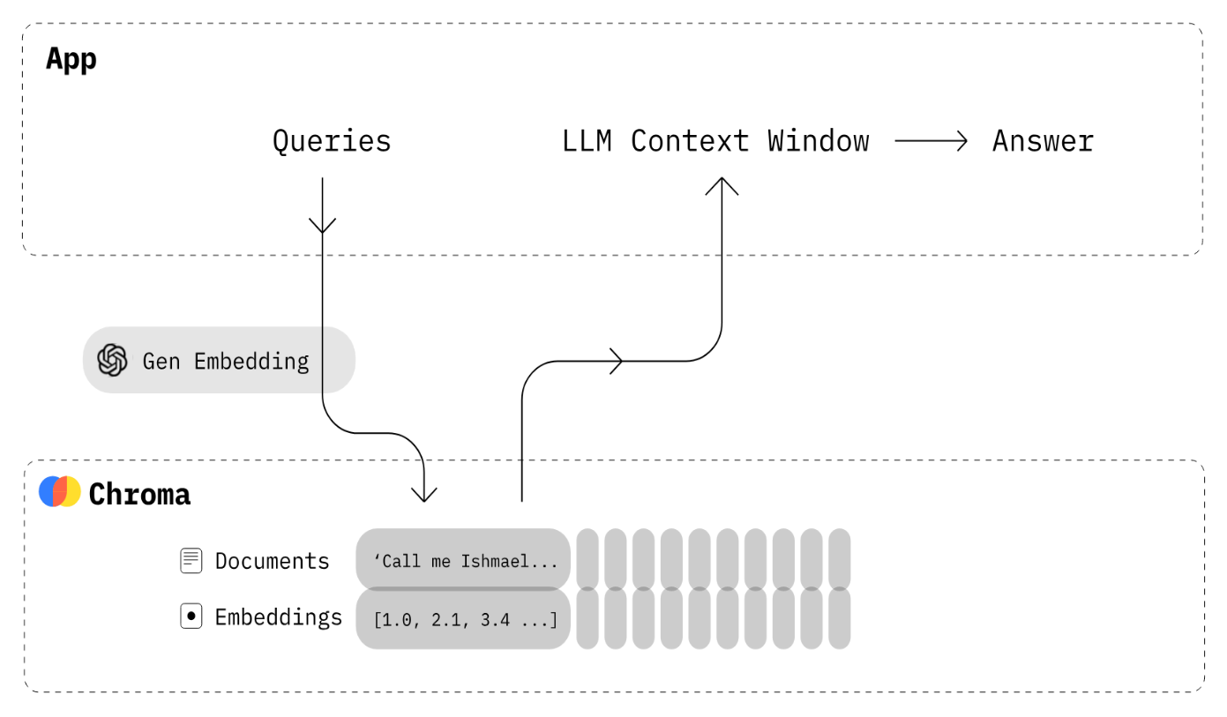
Key features of Chroma
Key Features
Open-source and Free: Chroma is free to use and modify, allowing for customization and community-driven improvements.
Scalability and Performance: Chroma handles large datasets efficiently and offers fast retrieval times for nearest neighbor searches.
Flexibility: Chroma supports multiple storage options (DuckDB for standalone, Click House for scalability) and various embedding models (Sentence Transformers, OpenAI, Cohere, custom models).
Simplicity and Analysis: Chroma is user-friendly, with straightforward APIs and visualization tools to explore and analyze data relationships.
Cross-Platform Support: Chroma works on Linux, macOS, and Windows, offering easy integration with various development environments.

Slide 14

Vectara
Vectara is a cloud-based vector search platform designed for creating and managing sophisticated search and recommendation systems.
It's particularly geared towards enterprise-level applications, offering features and capabilities that support complex, high-volume search requirements.

Slide 16
Retriever-Augmented Generation (RAG)

Slide 17
Why RAG?
LMs can reason about wide-ranging topics, but their knowledge is limited to the public data up to a specific point in time that they were trained on.
If you want to build AI applications that can reason about private data or data introduced after a model’s cutoff date, you need to augment the knowledge of the model with the specific information it needs.
The process of bringing the appropriate information and inserting it into the model prompt is known as Retrieval Augmented Generation (RAG).

Slide 18
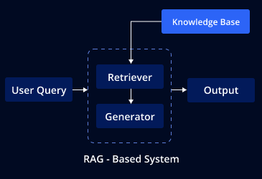
Understanding RAG
Hybrid Model : RAG is a hybrid model that brings together the strengths of both retrieval-based and generative approaches in NLP.
Retriever Component : The retriever is responsible for fetching relevant documents or data snippets that might contain the information needed to answer a question or address a query. This component typically uses techniques like semantic search to find documents that are contextually similar to the input query.
Generator Component : The generator then takes the context provided by the retriever and generates a coherent and contextually accurate response. This part of the model is often a large language model, similar to those used in generative AI for text generation.

Slide 19
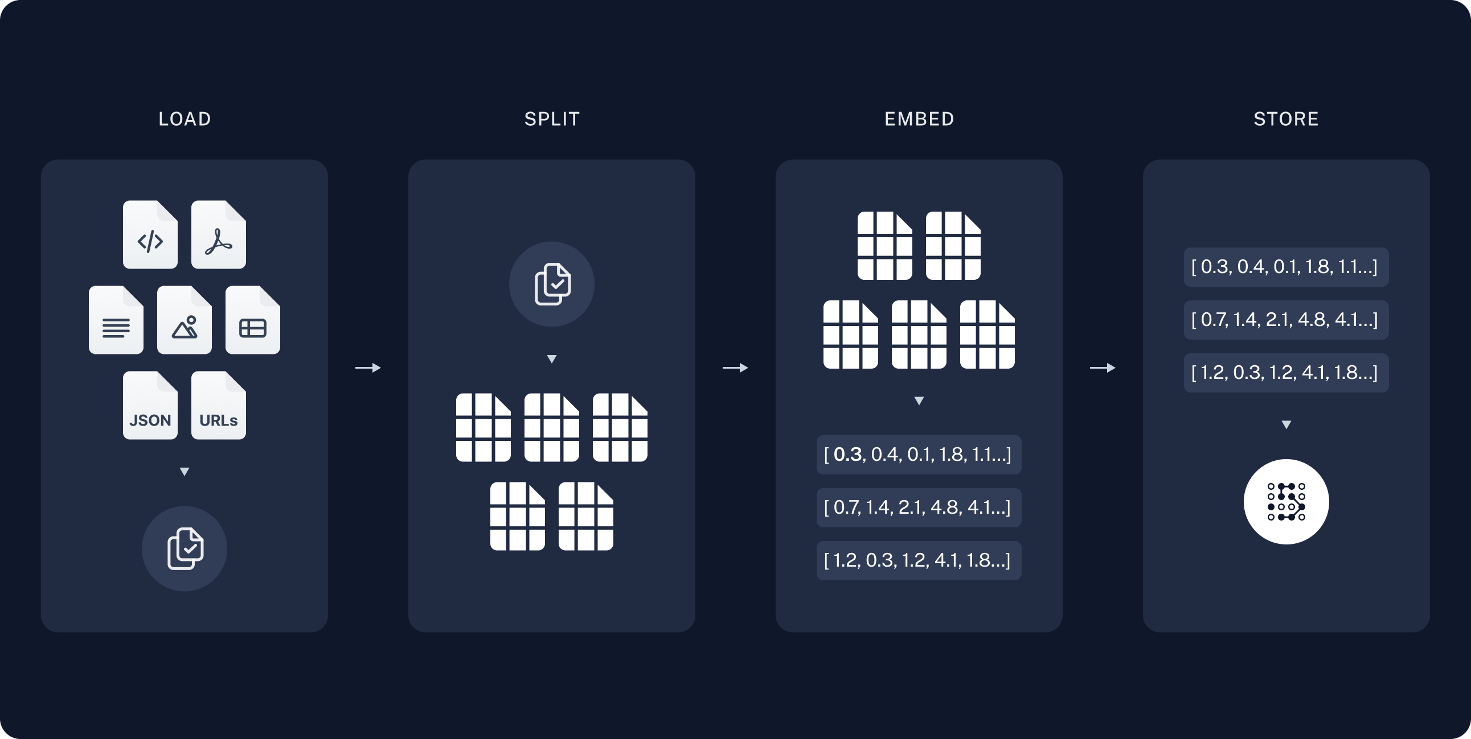
Architecture of RAG - 1
Indexing: a pipeline for ingesting data from a source and indexing it. This usually happens offline.
It’s a 3 step process:
Load: First we need to load our data. This is done with DocumentLoaders.
Split: Text splitters break large Documents into smaller chunks. This is useful both for indexing data and for passing it in to a model, since large chunks are harder to search over and won’t fit in a model’s finite context window.
Store: We need somewhere to store and index our splits, so that they can later be searched over. This is often done using a VectorStore and Embeddings model.

Slide 20
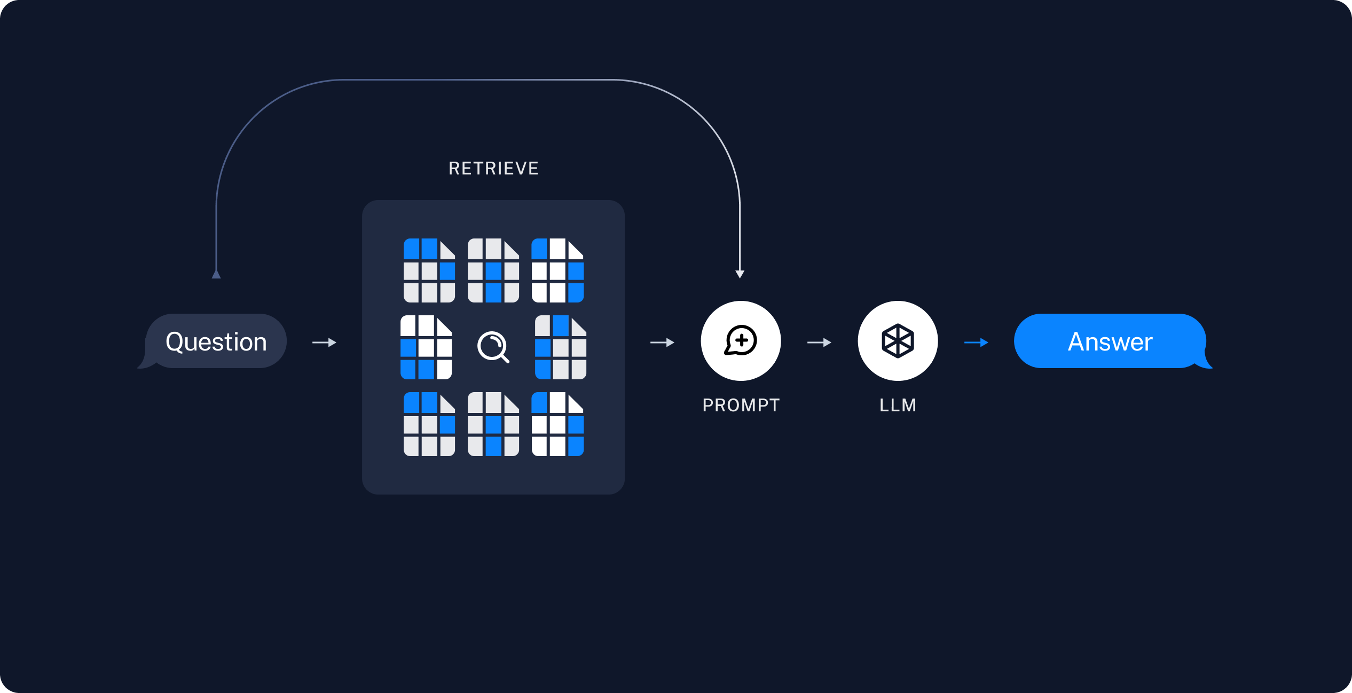
Architecture of RAG - 2
Retrieval and generation: the actual RAG chain, which takes the user query at run time and retrieves the relevant data from the index, then passes that to the model.
It’s a 2 step process:
Retrieve: Given a user input, relevant splits are retrieved from storage using a Retriever.
Generate: A ChatModel / LLM produces an answer using a prompt that includes the question and the retrieved data

Slide 21
How RAG works?
1
Input Processing
When a query or a question is input into a RAG model, the retriever first processes this input.
Data Retrieval
2
The retriever searches a database or a document set to find relevant information.
This database could be a pre-compiled corpus of text, like Wikipedia or a specialized knowledge base.
3
Context Integration
Large language models achieve impressive performance on diverse tasks, such as translation, summarization, conversation, and even coding.
Response Generation
4
The generator model, using both the original query and the context from the retrieved documents, generates a response that is informed by this additional data.

Slide 22

Applications of RAG
Question Answering Systems : RAG is particularly effective in question-answering systems where the answer might not be contained in a single document or may require synthesis from multiple sources.
Chatbots and Virtual Assistants : Improving the quality of responses in conversational AI by providing more accurate and detailed answers.
Information Retrieval : Enhancing search systems to provide more relevant results by combining retrieval with generation.

