Slide 1

Blood Group Prediction using Fingerprint Pattern Analysis
Maulana Azad National Institute of Technology Bhopal India
Department of Mathematics, Bioinformatics, and Computer Applications
Submitted by: Shivam Verma(24204031116)
        Anshu Raj (24204031158)
Supervisor: Dr Kuldeep Singh Yadav

Slide 2
Introduction & Problem Statement
Introduction
• Fingerprints are unique biometric patterns formed before birth.
• They remain unchanged throughout life.
• Ridge and minutiae features are used for identification.
• Fingerprint patterns may relate to blood group.
• Deep learning can analyze these patterns for prediction.
Problem Statement
• Traditional blood group detection requires blood samples and lab testing.
• The process is invasive and time-consuming.
• A fast, automated, and non-invasive solution is needed.
Objectives
• Develop a fingerprint-based blood group prediction system.
• Compare deep learning models using accuracy metrics.

Slide 3
Literature Review
1. An Association Between Fingerprint Patterns with Blood Group and Lifestyle Based Diseases: A Review (2021)
• Presented at I2CT 2021, Pune, India.
• Reviewed possible relationship between fingerprint patterns, blood group, and diseases.
• Suggested dermatoglyphics may help in health prediction.
2. A Novel Approach to Predict Blood Group using Fingerprint Map Reading(2025)
• Used fingerprint image processing on dataset of 82 students.
• Applied Multiple Linear Regression (OLS) for prediction.
• Achieved around 62% accuracy.
• Showed low reliability for real-world practical use.
3.Blood Group Detection Using Fingerprint (2025)
• Proposed fingerprint-based blood group prediction system.
• Used image processing and machine learning techniques.
• Showed feasibility of non-invasive blood group detection..
4. Automated Blood Group Detection Using Fingerprint Biometrics and Deep Learning (2025)
• Used 6000+ fingerprint images across 8 blood group classes.
• Hybrid CNN + GNN model achieved 92.4% accuracy.
• Demonstrated strong potential for real-world applications.

Slide 4
Problem Formulation & Deep Learning Technologies
Problem Formulation
• Objective: Predict blood group using fingerprint images
• Task: 8-class image classification
• Input: Fingerprint image
• Output: Predicted blood group
• Challenge: Learning complex fingerprint patterns
Deep Learning Models Used
• LeNet
• VGG16
• ResNet50
• Swin Transformer
Technology Stack
• Core: Python, TensorFlow, Keras
• Processing: NumPy, Pandas, Albumentations
• Visualization: Matplotlib, Seaborn
• Deployment: Streamlit
• Dataset: Kaggle Fingerprint Images

Slide 5
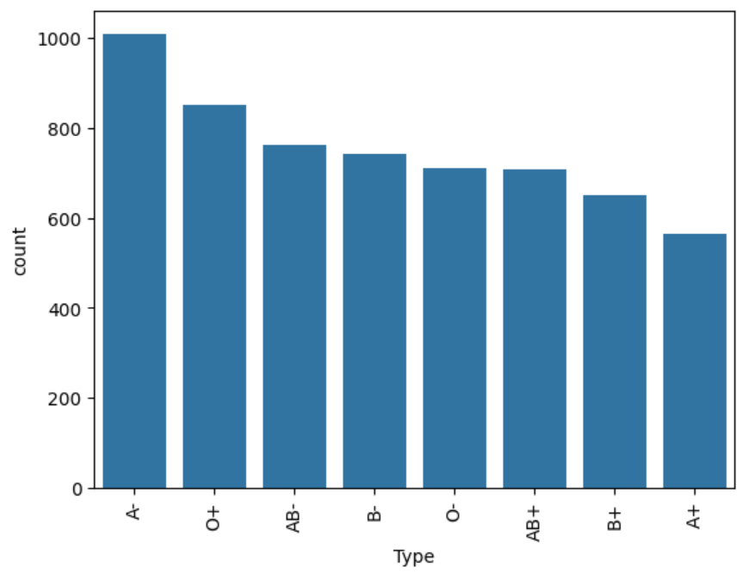
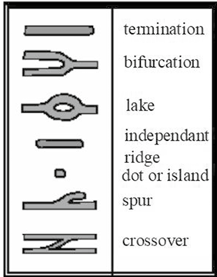
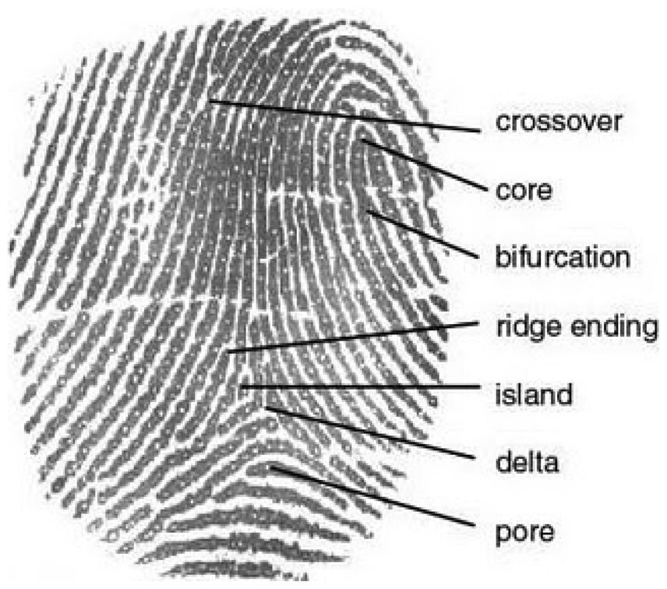
Dataset Description
Dataset from Kaggle
Approximately 6,000 fingerprint images
8 blood group classes
A
A−
B+
B−
AB
−

Slide 6
System Workflow
Data Collection
Dataset Understanding
A−
B+
B−
Image Preprocessing
AB
−
Model Training & Testing
Blood Group Prediction

Slide 7
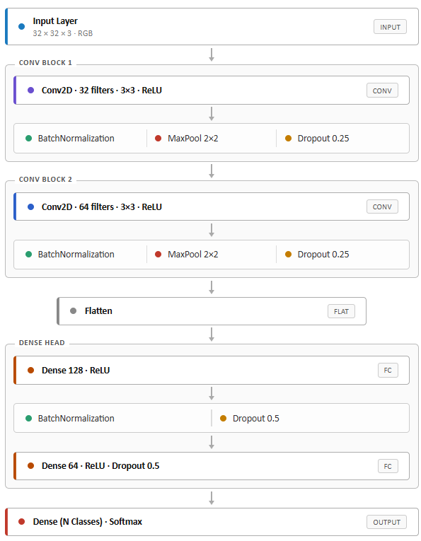
LeNet Architecture & Training Performance
Model Purpose
• Predict blood group from fingerprint images
• 8-class classification
Key Components
• Convolution + ReLU
• Max Pooling
• Fully Connected
• Softmax Output
Training Setup
• TensorFlow / Keras
• Adam Optimizer
• Data Split: 80% Train / 20% Test
• Epochs: 30
• Batch Size: 32 + Augmentation
Performance
• Train Accuracy: 72.71%
• Val Accuracy: 82.92%
• Val Loss: 0.4845

Slide 8
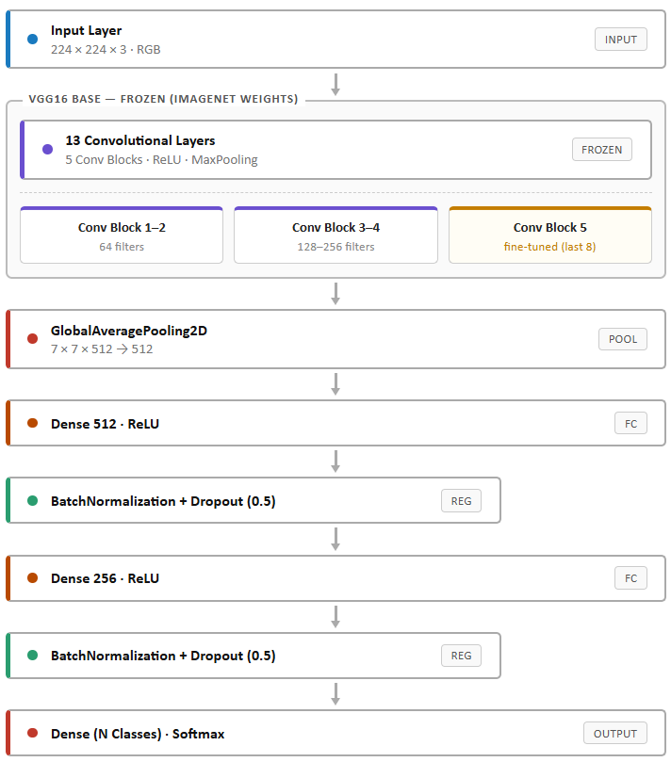
VGG16 Architecture & Training Performance
Model Purpose
• Predict blood group from fingerprint images
• 8-class classification
Key Components
• Pretrained VGG16 Base
• Convolution + ReLU Layers
• Global Average Pooling
• Dense + Softmax Output
Training Setup
• TensorFlow / Keras
• Adam Optimizer
• Data Split: 80% Train / 20% Test
• Epochs: 30 + 10 Fine-Tuning
• Batch Size: 32
Performance
• Train Accuracy: 73.92%
• Val Accuracy: 87.67%
• Val Loss: 0.3730

Slide 9
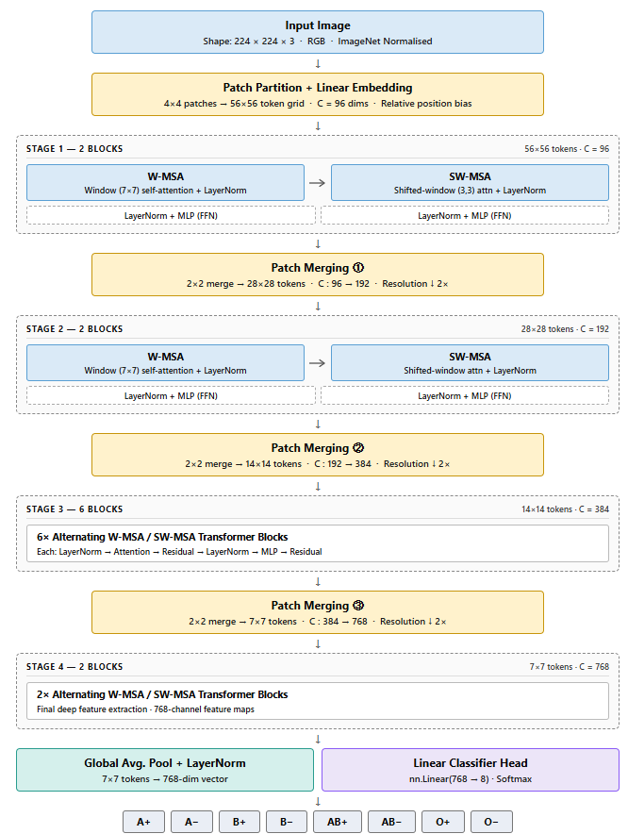
Swin Transformer Architecture & Training Performance
Model Purpose
• Predict blood group from fingerprint images
• 8-class classification
Key Components
• Patch Partition + Embedding
• Window Based Self-Attention
• Shifted Window Attention
• Linear Classifier + Softmax
Training Setup
• PyTorch
• Data Split: 80% Train / 10% Val / 10% Test
• Epochs: 12
• Batch Size: 32
Performance
• Train Loss: 0.0267
• Validation Accuracy: 93.59%
• Validation Loss: 0.2114
• Best Performing Model`
87.67%

Slide 10
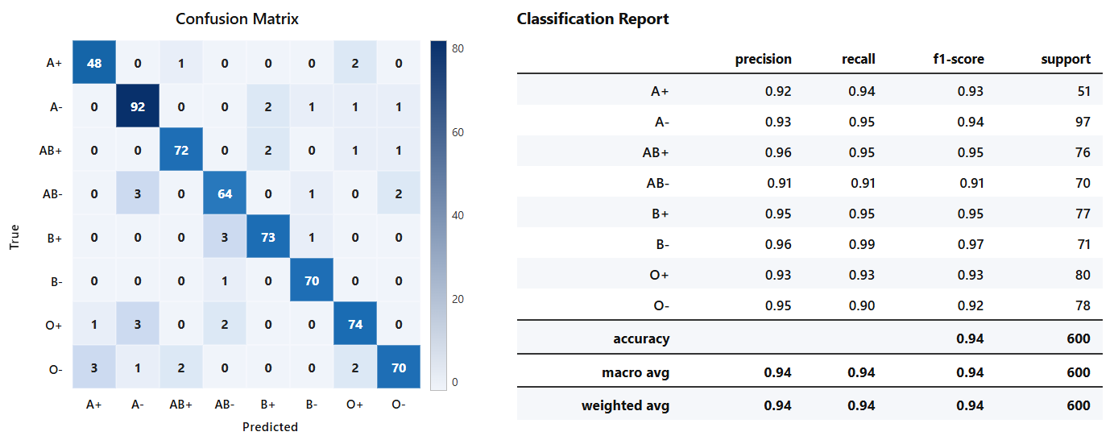
Performance Comparison of All Models
Model | LeNet | VGG16 | ResNet-50 | Swim Transformer
Accuracy | 82.92% | 87.67% | 89.00% | 93.83%
87.67%

Slide 11
Conclusion & Future Scope
Conclusion
• Fingerprint-based blood group prediction using deep learning is feasible and effective.
• Models evaluated: LeNet, VGG16, ResNet50, and Swin Transformer.
• Swin Transformer achieved the highest accuracy: 94%.
• The system is non-invasive, fast, and cost-effective.
• Suitable for medical and forensic applications.
Future Scope
• Increase dataset size for better accuracy and generalization.
• Integrate with real-time fingerprint scanners.
• Develop hybrid models (CNN + Transformer).
• Optimize models for mobile and edge devices.
• Perform clinical validation for real-world deployment.
▶ Live Demo

Slide 12
References
1. An Association Between Fingerprint Patterns with Blood Group and Lifestyle Based Diseases: A Review (2021)
https://pubmed.ncbi.nlm.nih.gov/32836652/
2. A Novel Approach to Predict Blood Group Using Fingerprint Map Reading (I2CT 2021)
https://ieeexplore.ieee.org/document/9418090
3. Blood Group Detection Using Fingerprint (Related Research)
https://ijop.net/index.php/mlu/article/view/3669
4. Automated Blood Group Detection Using Fingerprint Biometrics and Deep Learning (2025)
https://arxiv.org/abs/2506.02062
5. Finger Print Based Blood Group Dataset, Kaggle
https://www.kaggle.com/datasets/rajumavinmar/finger-print-based-blood-group-dataset
6. Swin Transformer Research Paper
https://arxiv.org/abs/2103.14030
7. TensorFlow Official Documentation
https://www.tensorflow.org

Slide 13
Thank you

