Slide 1

Presentation on Modelling and Deployment in Microsoft Azure
Anshu Singh Internship from 6/24/2019 – 8/16/2019

Slide 2
Internship Goal
Goal: Research and provide solution for Data preparation, model building and deployment in the Azure cloud environment and Redpoint for their project.
Steps
Environment
Tools
Validation
Deployment
Importing data
Import data from database or desktop
Data Preparation Feature Selection
Data Imputation
Data Transformation
Data Binning
Feature Selection
Model building
Classification
Regression
Incremental Response Model
Model Evaluation
Metrics for Model quality
Lift curve/ROC
Model Scoring Options
Code
API
Model Deployment
In Redpoint
Other applications
Model Updates
Updating the models with new Data
Model quality evaluation to identify deterioration
Azure
Machine Learning Studio
Validate the model against SAS
Redpoint
Machine Learning Services
Other Options

Slide 3





Three platforms
Database Interface
Platform for coding
portal.azure.com
Virtual Azure notebooks
Microsoft Azure Storage Explorer
Language

Slide 4

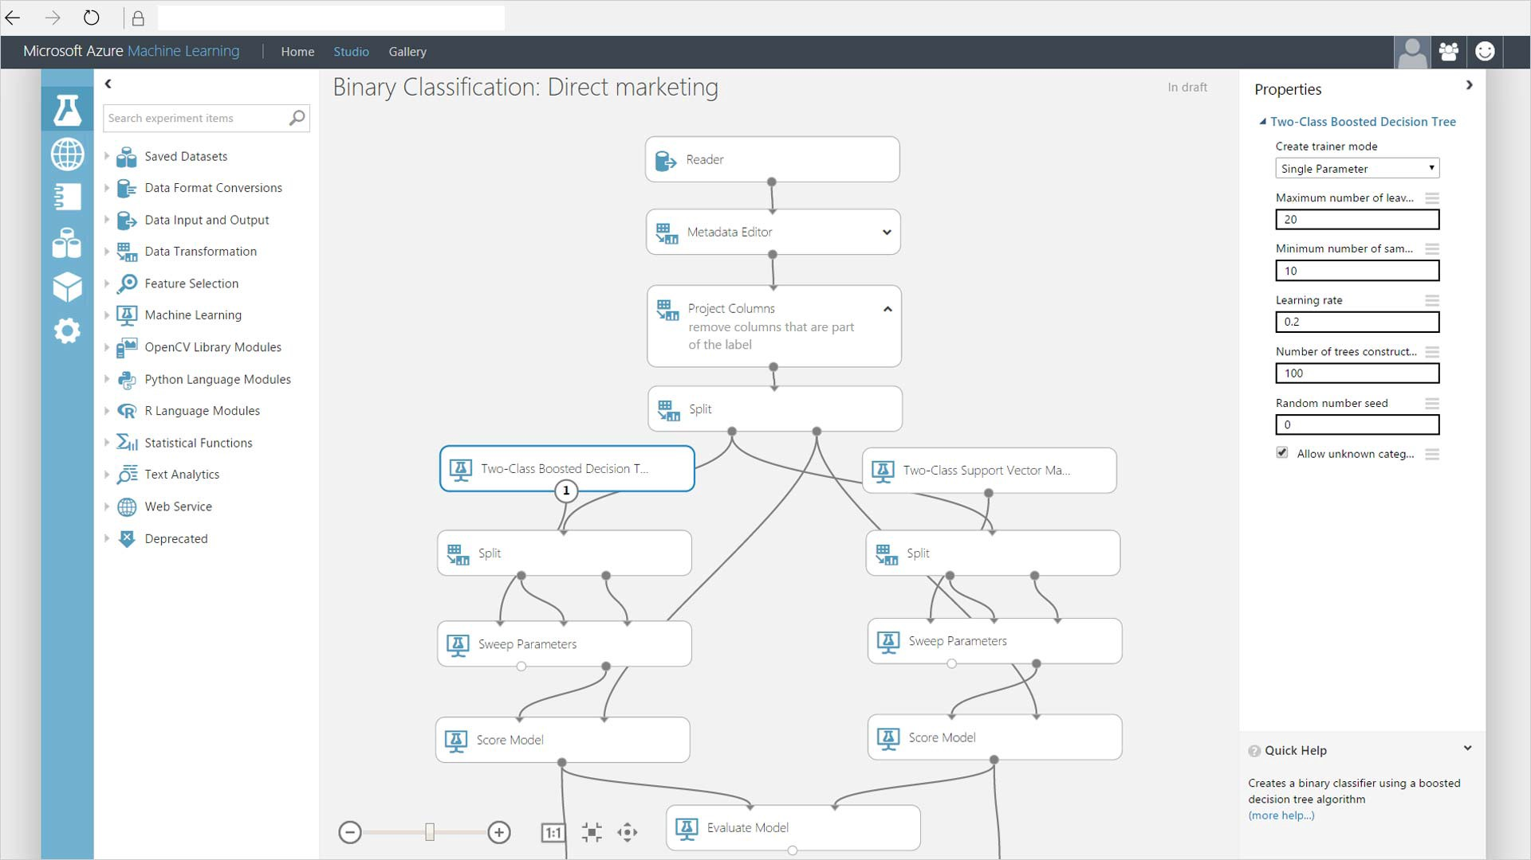

Tools used/explored
Visual Studio
Notebook.Azure.com
Azure ML studio
Azure VM Notebook
- Local Modelling
- Lots of packages to install
- Can't directly connect to
our data lake
Easy to use
Already installed packages
Not secure to use your
personal data
- Easy for quick model
- Hard to implement python/R code in it.
Easy to use
It is secure
Most of the packages
are already there.

Slide 5
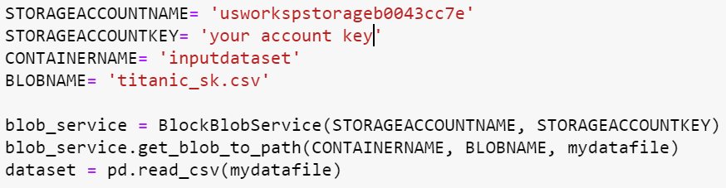
Importing and Exporting the Data
Azure Data Lake

Slide 6

Data Preparation
Convert Categorical data into dummy variables.
Binning is done which will group continuous values in small bins.
Feature Selection is applied which gives us best columns to choose.

Slide 7

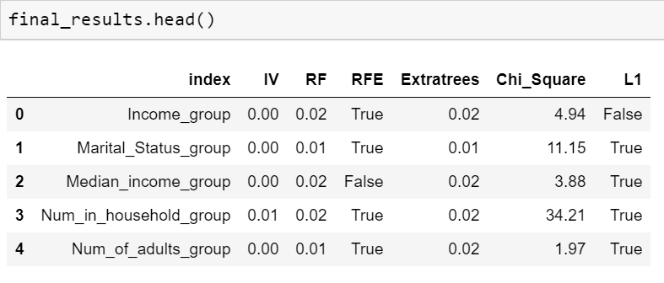
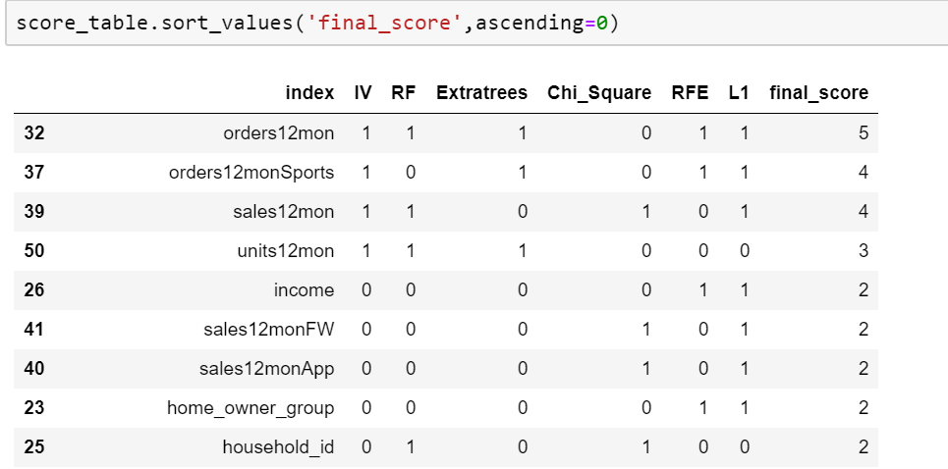
Feature Selection
Logistic Regression
Voting variable
Random Forest
Variables are ranked on the basis of voting done using all the algorithm and then the best variables are chosen.
Extra Tree classifier
Chi-square
Multicollinearity(VIF)

Slide 8

Statistical Modeling
Algorithms
Logistic Regression
For statistical modeling, we are using these algorithms and concepts.
We check the accuracy of all of them and then choose the best algorithm
to proceed for our final data model.
Random Forest
Extra Tree classifier
Neural Network
Also, we use ROC curve to see how close our model is to the true positive or sensitivity. The more it is close to 1 at Y-axis, the more better our model is.
Naives Bayes
Gradient Boosting

Slide 9

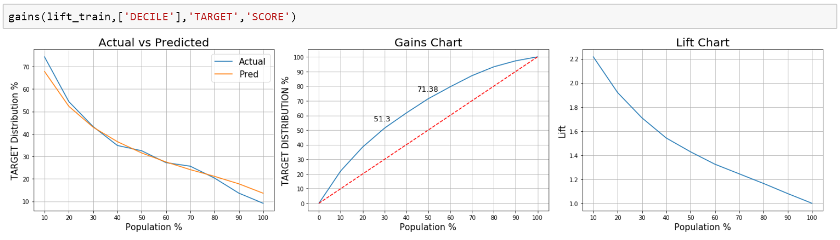
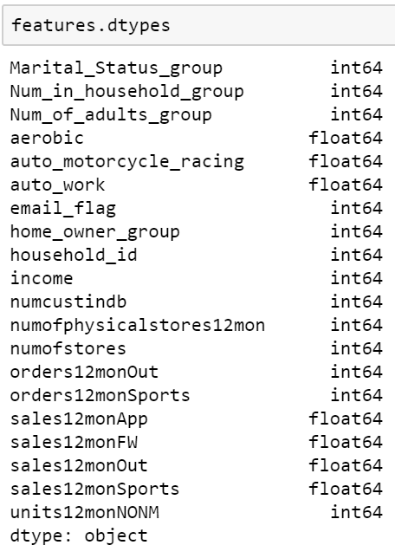
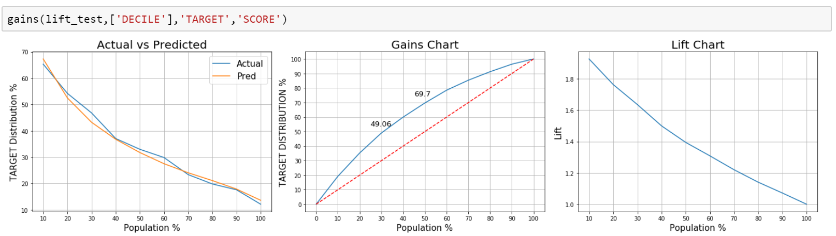
Model Evaluation
Gain or lift charts is a measure of the effectiveness
of a classification model calculated as the ratio
between the results obtained with and without the
model.
After applying different feature selection and classification
Model, we get 20 important variable (from 58 ) which
will be used in the final data modelling process.

Slide 10

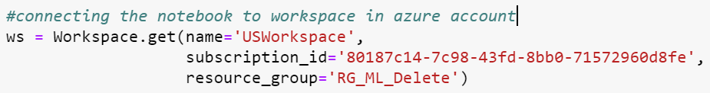

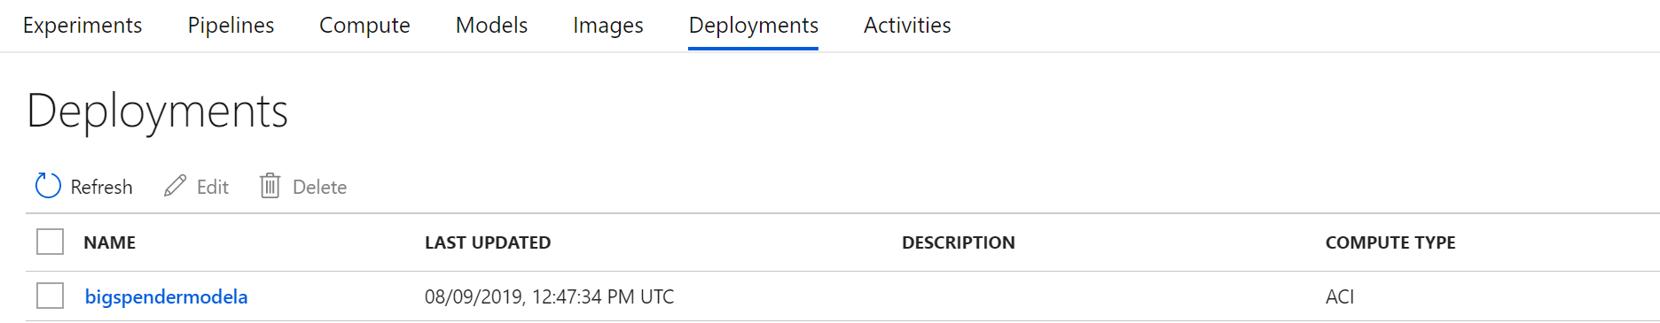
Model Scoring
Connect your notebook to Azure account workspace and run the code in azure notebooks.
You need to create model to store the final model created and provide the ACI configuration before running the deployment.
Once the deployment is done, our experiment will be created in azure workspace and will be seen under the deployment tab in your Azure account.
Scored Output

Slide 11
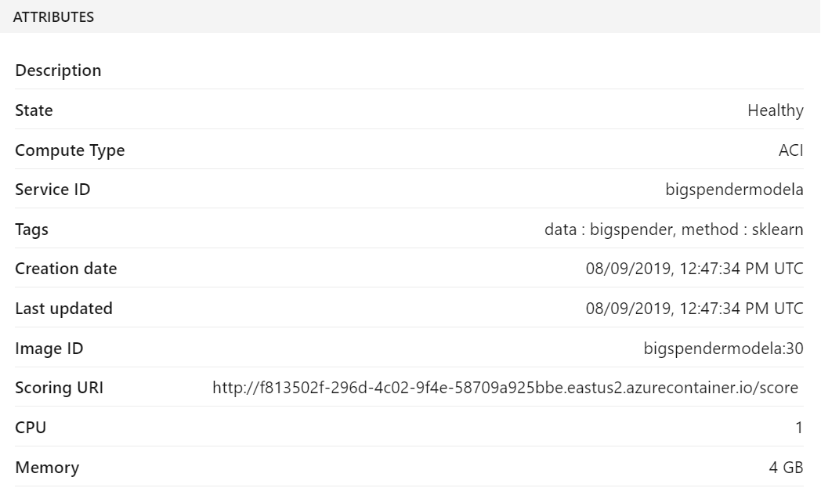

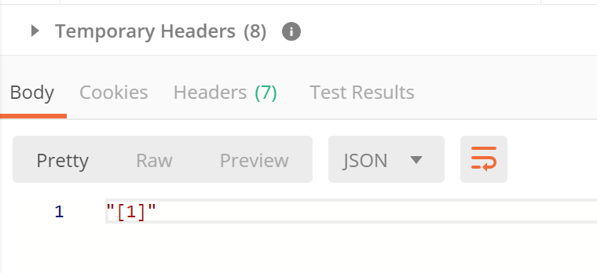

Model Deployment
Scoring URL is used to check the scored test output.
Paste the URL in the Postman software and click Send.
Read input file from Blob Container
Save the scored file in the blob container

Slide 12
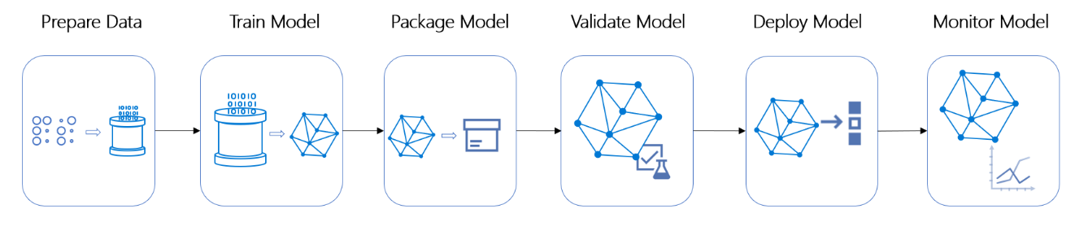
Additional Topic: Pipeline
Pipelining process
Pipeline enables data scientists to create and manage multiple simple and complex workflows concurrently.
A typical pipeline would have multiple tasks to prepare data, train, deploy and evaluate models
Using distinct steps makes it possible to rerun only the steps you need as you tweak and test your workflow.

