Slide 1
Data Analysis on Google Apps Rating
TEAM MEMBERS:
Sayli Hulji (12)
Vishakha Upadhye (59)
Anshu Varma (62)

Slide 2
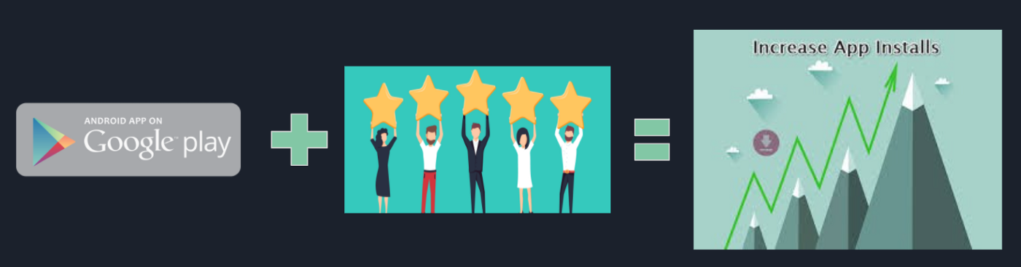
OBJECTIVE
With around 3 million apps available on google play store, developing apps that stand out amongst the competition poses a challenge for app developers.
To differentiate themselves in this oversaturated market, they need to pinpoint essential factors that play a role in customers’ decision-making process.
The objective of this project is to deliver insights to understand customer demands better and thus help developers to popularize the product.

Slide 3
WORKFLOW
Importing Necessary Libraries
Data Visualization
Data Extraction & Cleaning

Slide 4
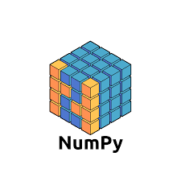
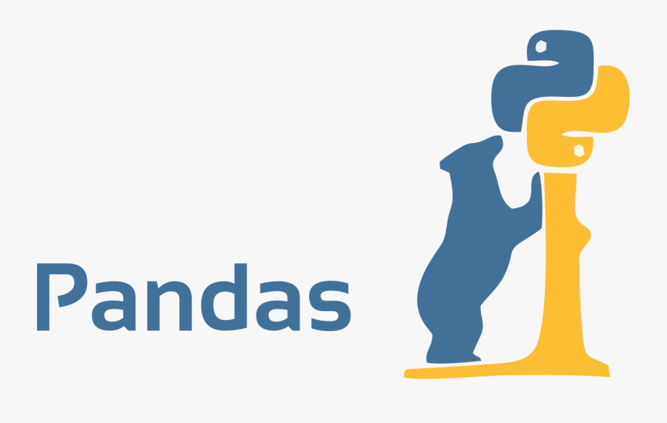
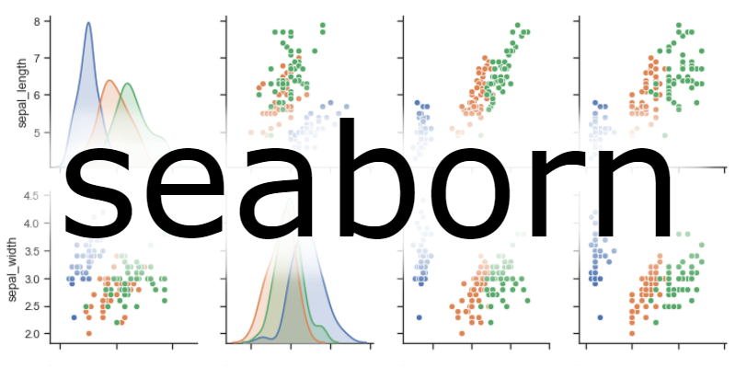
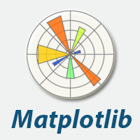
TECHNOLOGY/LIBRARIES USED
NUMPY: Numpy is a python library used for working with arrays.
It is an open source project and you can use it freely.
PANDAS: Pandas is a python library.
Pandas is used to analyze data.
SEABORN: Seaborn is a library that uses matplotlib underneath to plot graphs
MATPLOTLIB: Matplotlib is a low level graph plotting library in python that serves as a visualization utility.

Slide 5
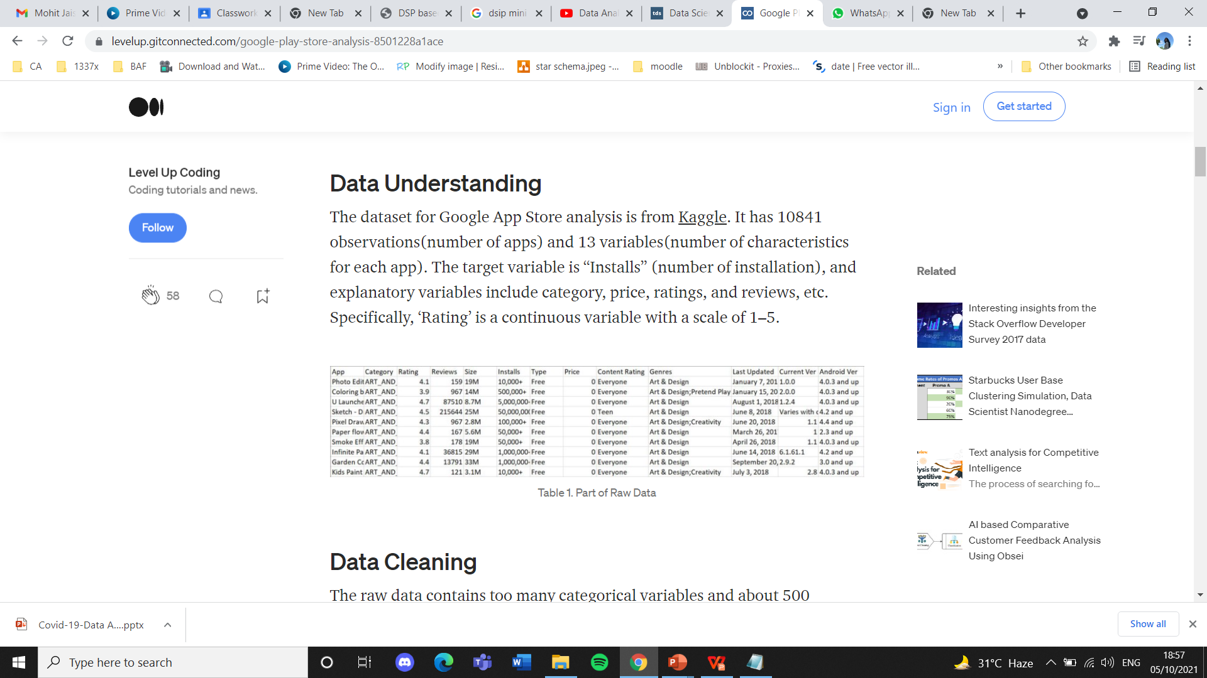
DATA UNDERSTANDING AND DATA CLEANING
The dataset for google app store analysis is from kaggle.
The target variable is “installs” (number of installation), and explanatory variables include category, price, ratings, and reviews, etc. Specifically, ‘rating’ is a continuous variable with a scale of 1–5.
The raw data contains too many categorical variables and about 500 missing values in the rating column. Data cleaning includes:
Dropped all the observations with missing values
Converted the ‘last updated’ column into the number of days

Slide 6
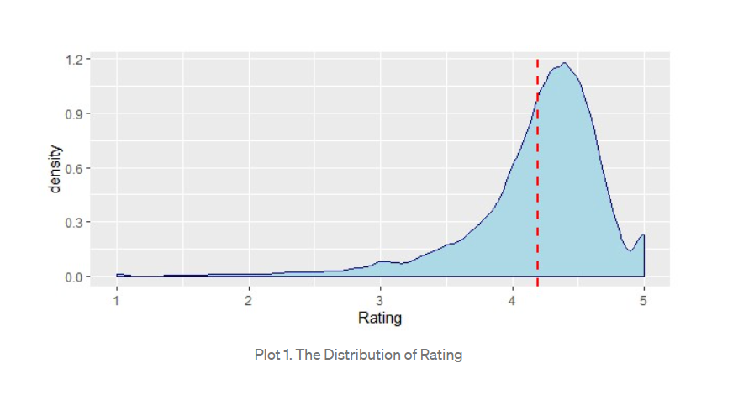
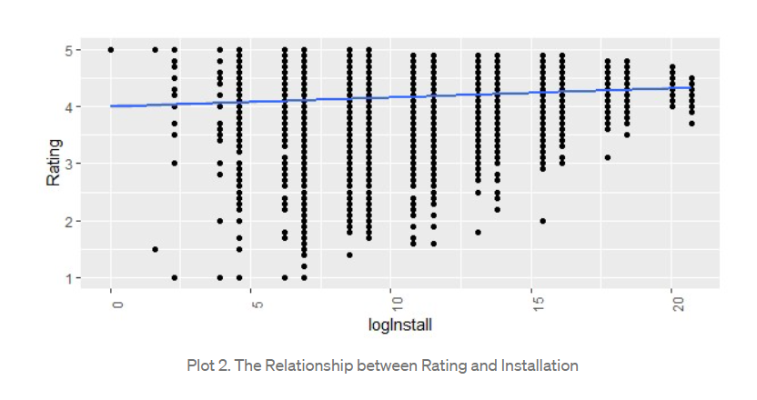
DATA EXPLORATION
DISTRIBUTION OF RATING
RATING V/S INSTALLATION

Slide 7
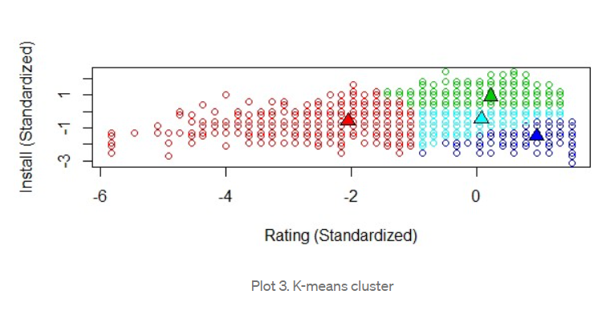
k-means clustering classified various apps
Apps in Google Play Store fall into four clusters:
High ratings but low installations (dark blue)
Both low rating and installations (red)
Both medium rating installations (light blue)
Both high ratings and installations (green)

Slide 8
THANK YOU

