Slide 1


AMAZON ALEXA
Team Details :
SAYLI HULJI (05)
ANSHU Varma (27)
Vishakha Upadhye (30)

Slide 2
OUTLINE
Introduction along with literature Survey
Results, Conclusion and Future Scope.
Aim & Objective, and
Methodology

Slide 3
INTRODUCTION
WHAT IS AMAZON ALEXA ?????
Amazon Alexa, also known simply as Alexa, is a virtual assistant technology. largely based Amazon introduced Alexa in 2013. It was first used in the Amazon Echo Smart Speaker and the Echo Dot, Echo Studio and Amazon Tap speakers developed by Amazon Lab.
It is capable of voice interaction, music playback, making to-do lists, setting alarms, streaming podcasts, playing audiobooks, traffic, sports, and other real-time information such news, weather conditions and many more

Slide 4
WHAT IS A VIRTUAL ASSISTANT ?????
An intelligent virtual assistant (IVA) or intelligent personal assistant (IPA) is a software agent that can perform tasks or services for an individual based on commands or questions. The term "chatbot" is sometimes used to refer to virtual assistants generally or specifically accessed by online chat.
Some virtual assistants are able to interpret human speech and respond via synthesized voices. Users can ask their assistants questions, control home automation devices and media playback via voice, and manage other basic tasks such as email, to-do lists, and calendars with verbal commands

Slide 5
LITERATURE REVIEW
The current generation of IPAs includes Google Assistant/Now, Apple Siri, Microsoft Cortana, and Amazon Alexa.
The IPAs are designed to accept user input from a touch screen virtual keyboard, handwritten or voice-controlled interfaces, answer user queries in a natural language and perform other tasks, such as play music, place online shopping orders, and set calendar reminders.
Current IPAs differ in their interface designs, hardware requirements, and the types of tasks they are designed for. A recent comparison of IPAs suggests that Google Assistant/Now performs better than other IPAs on travel, traffic, flight, and translation requests. Microsoft’s Cortana excels in task reminders (e.g. chores, calendar, communications). Alexa’s strengths include support for the voice-activated purchases from Amazon’s website and for “skills”, applications designed for specific types of tasks including control of a growing number of smart home devices and even cars

Slide 6
AIM AND OBJECTIVES
The main aim is to aid the users in tasks such as sending a text message, making phone calls, checking the weather or setting up an alarm.
Over time, it has developed to provide restaurant recommendations, search the internet, and provide driving directions.
Virtual assistants save a lot of time by automation: they can take appointments, or read the news while the consumer does something else. It is also possible to ask the virtual assistant to schedule meetings, hence helping to organize time.

Slide 7
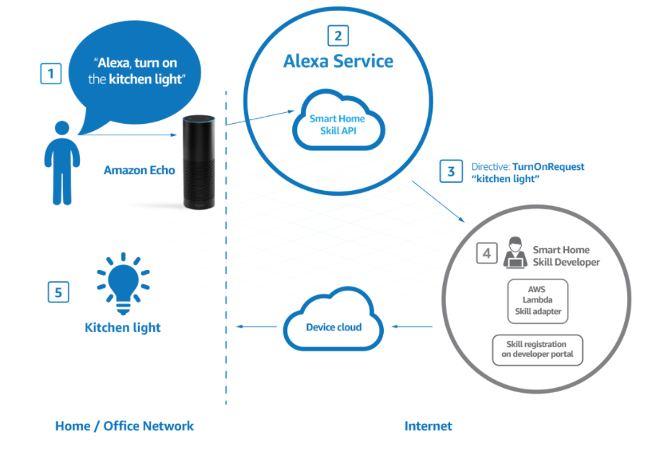
METHODOLOGY

Slide 8
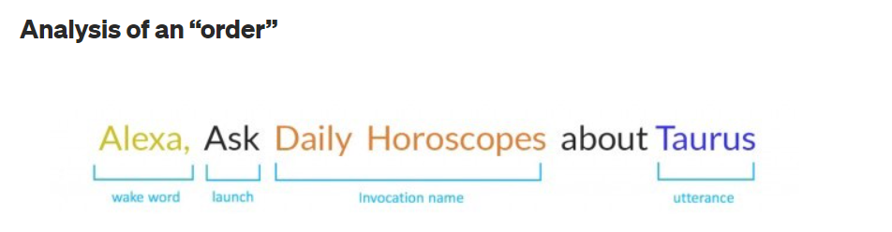
The above command has 3 main parts: Wake word, Invocation name, Utterance.
Wake word When users say ‘Alexa’ which wakes up the device. The wake word put the Alexa into the listening mode and ready to take instructions from users.
Invocation name Invocation name is the keyword used to trigger a specific “skill”. Users can combine the invocation name with an action, command or question. All the custom skills must have an invocation name to start it.
Utterance ‘Taurus’ is an utterance. Utterances are phrases the users will use when making a request to Alexa. Alexa identifies the user’s intent from the given utterance and responds accordingly. So basically the utterance decide what user want Alexa to perform.

Slide 9
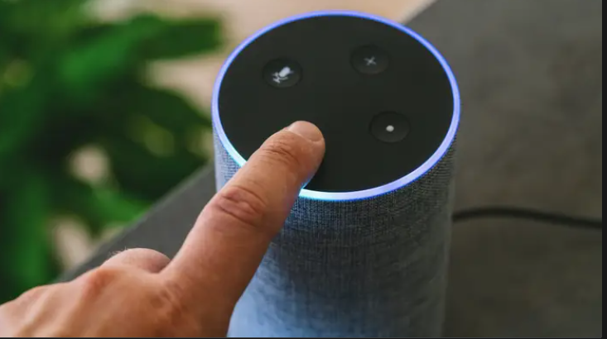
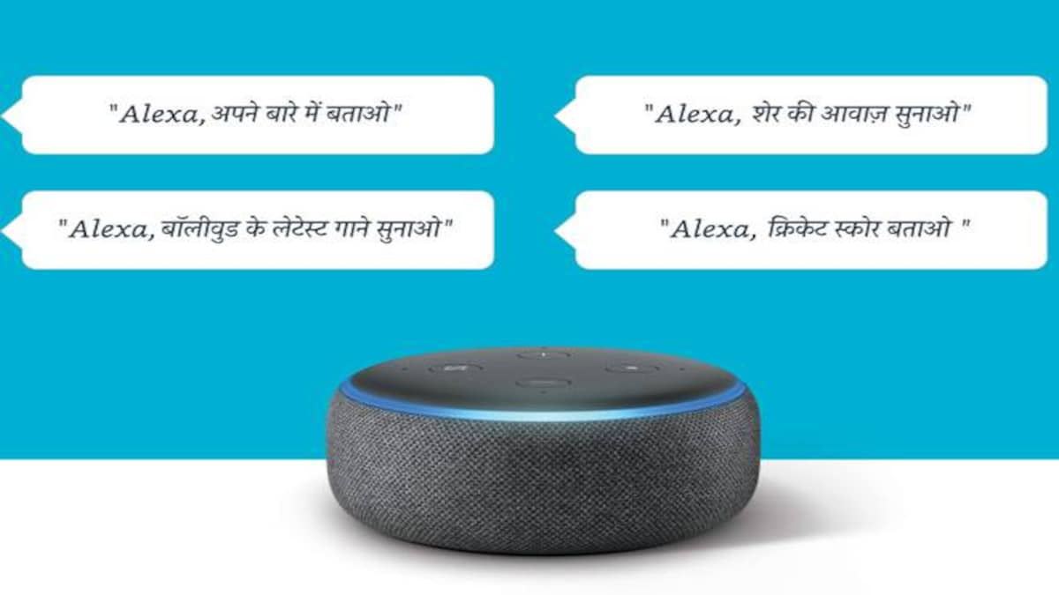
RESULTS

Slide 10
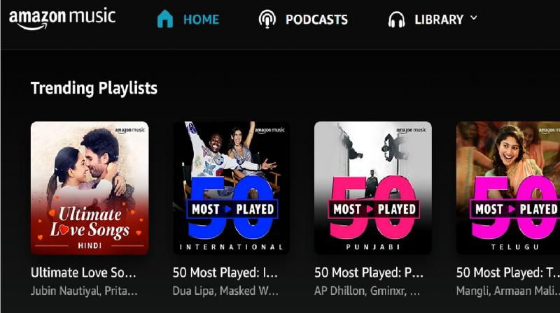

RESULTS

Slide 11
CONCLUSION
An excellent virtual assistant will save time and money by doing the small tasks for you and doing them accurately and with high quality. If you handle the virtual assistant correctly, it will be a boom in your business.
Virtual assistants are a secret weapon for startup heads for success. Unlike a regular employee, you will pay your VA on a hourly basis. What’s more, you won’t have to spend any money on training if you take a VA on board. So hiring a VA is a sure fire way to success.

Slide 12
FUTURE SCOPES
Robo-pets, companions and AI friends
A number of home robots have entered the market in recent years that promise to either become an assistant, act as a replacement pet or even offer physical assistance.
Companies like Jibo, Sony Aibo, Anki Vector and Zoetic Kiki have launched social robots that are both pets and personal assistants.
Companion robots, like Kiki, can do a range of things, including looking at you and recognizing your face, using sensors to respond to touch and some have their own Alexa-style AI assistant to help you check messages, call friends and more.

Slide 13
REFERENCES
R. Belvin, R. Burns, and C. Hein, “Development of the HRL route navigation dialogue system,” in Proceedings of ACL-HLT, 2001
V. Zue, S. Seneff, J. R. Glass, J. Polifroni, C. Pao, T.J.Hazen,and L.Hetherington, “JUPITER: A Telephone Based Conversational Interface for Weather Information,” IEEE Transactions on Speech and Audio Processing, vol. 8, no. 1, pp. 85–96, 2000.
M. Kolss, D. Bernreuther, M. Paulik, S. St¨ucker, S. Vogel, and A. Waibel, “Open Domain Speech Recognition & Translation: Lectures and Speeches,” in Proceedings of ICASSP, 2006.
Sadun, E., &Sande, S. (2014). Talking to Siri: Mastering the Language of Apple’s Intelligent Assistant.

Slide 14

Thank You

