Slide 1
Diseasen Prediction Using Machine Learning
Anshu Yadav
Springboard(Data Science career track)

Slide 2
Problem Statement
Our problem is that we want to predict disease by given some features of users. This is important to medical fields. If such a prediction is accurate enough, we can not only avoid wrong diagnosis but also save human resources
We use several algorithms such as Logistic Regression, SVM, Naïve Bayes, Random Forest, Artificial Neural Network to output a binary number 1 or 0

Slide 3
The Source Data
This dataset is from Kaggle
This dataset has 132 parameters on which 42 different types of disease can be predicted
This Dataset consists of 2 csv files. One of them is training and other is for testing the model
These symptoms are mapped to 42 diseases which can classify these set of symptoms to.

Slide 4
Feature Creation
The following features were created to help with the modeling and data analysis:
Training dataset has 4920 rows and 134 columns whereas the test dataset has 42 rows and 133 columns
Checked if any of the features contain any null value
Dataset was groupby based on “ Prognosis”
Number of positive sample size calculated for a particular disease
All the columns except prognosis have value either 0 or 1
“Unnamed: 133” column deleted from the training dataset

Slide 5
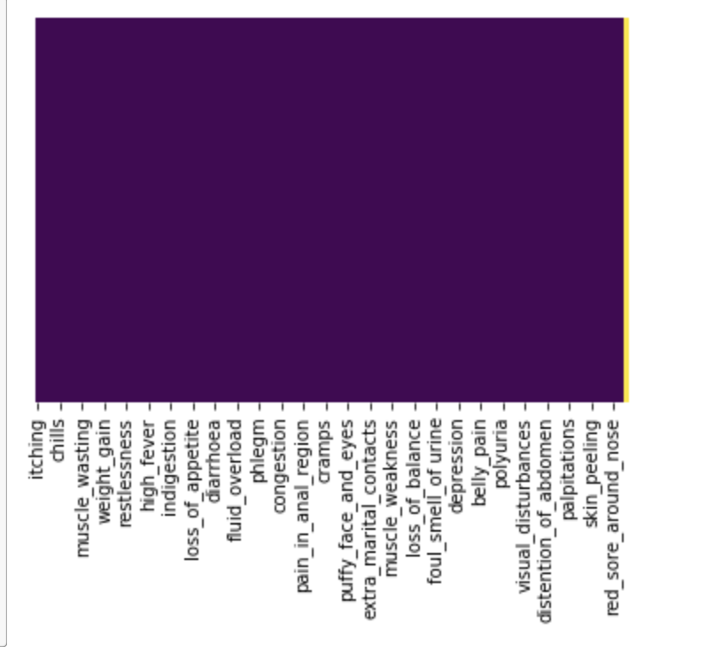
Exploratory Data Analysis
Heatmap of training dataset of 134 columns to see if null values

Slide 6
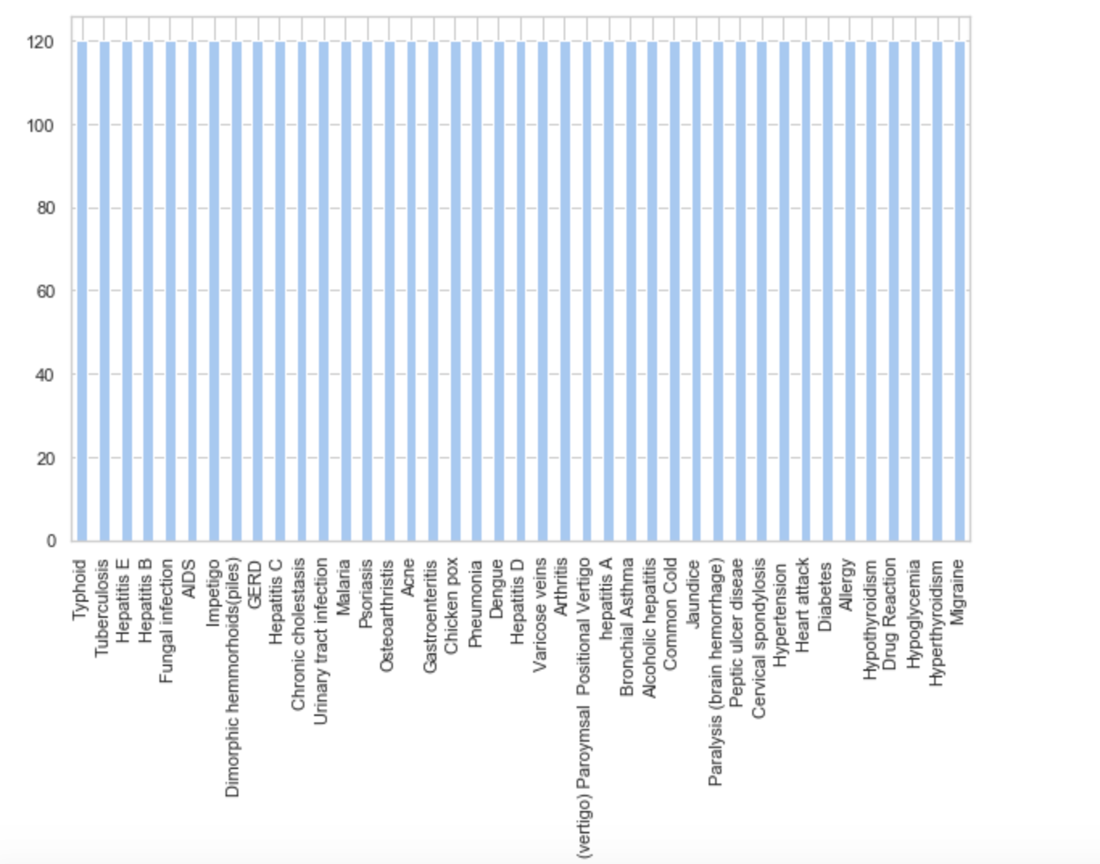
Exploratory Data Analysis
Representation of positive sample size on the basis of disease

Slide 7
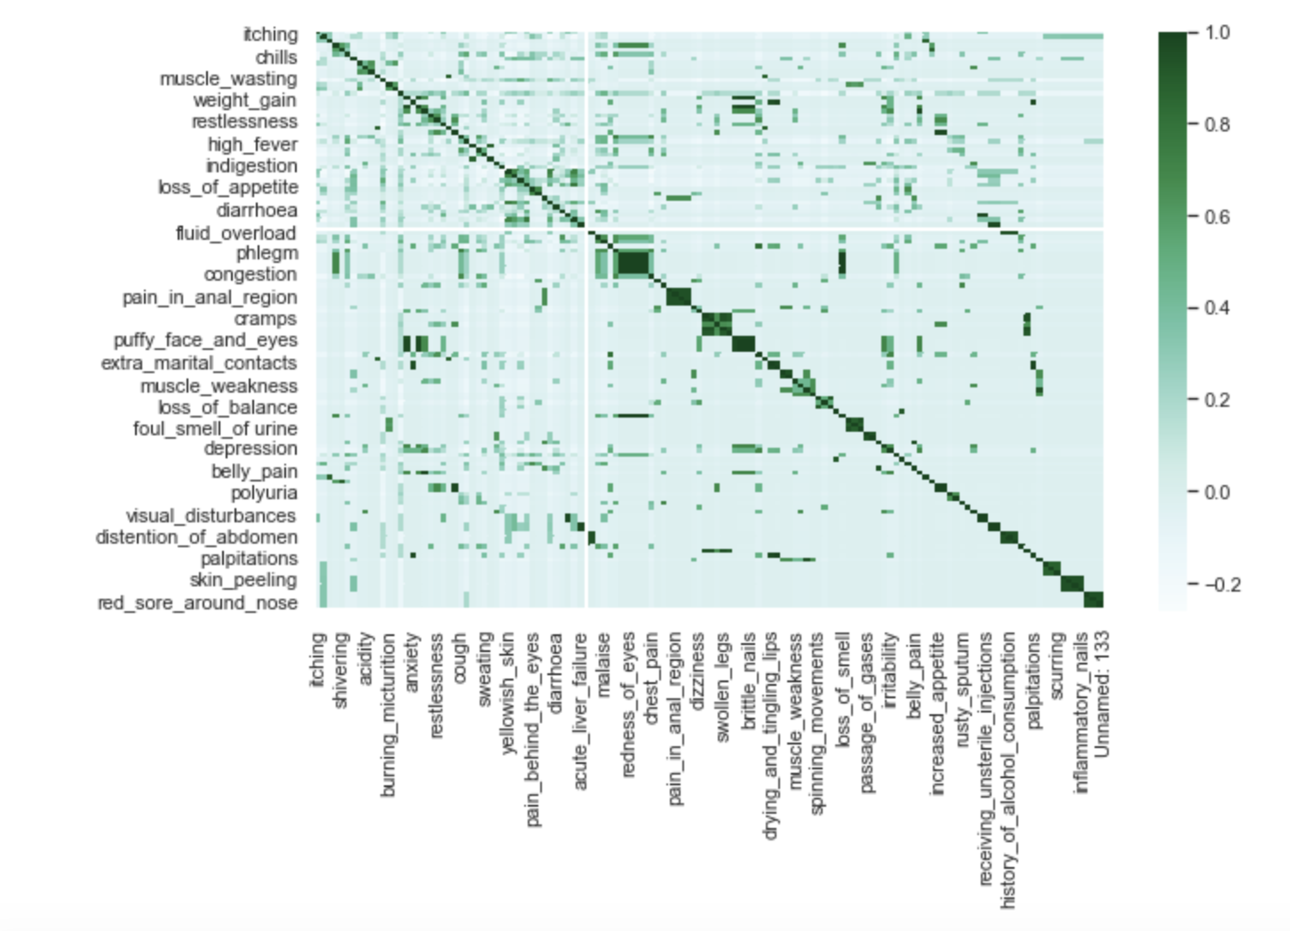
Exploratory Data Analysis
Correlation Matrix of selected features

Slide 8
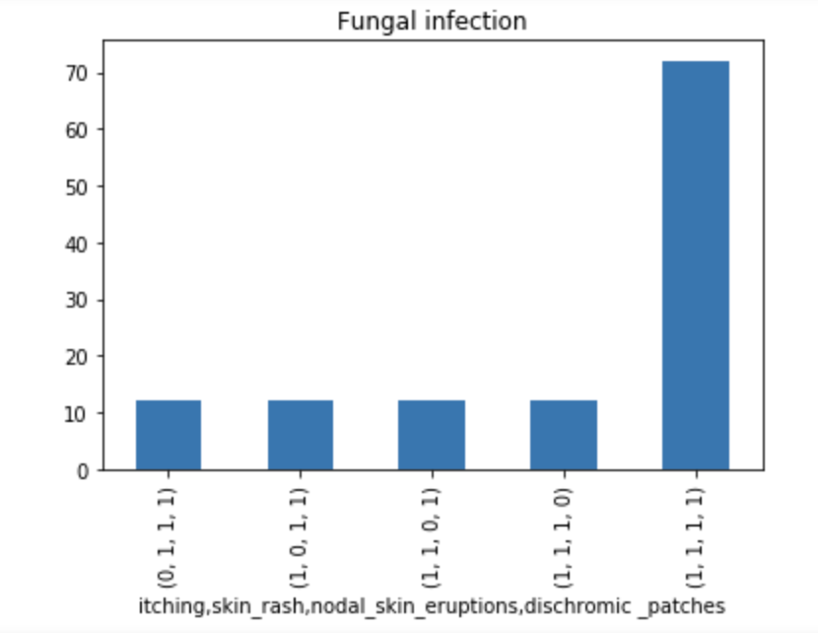
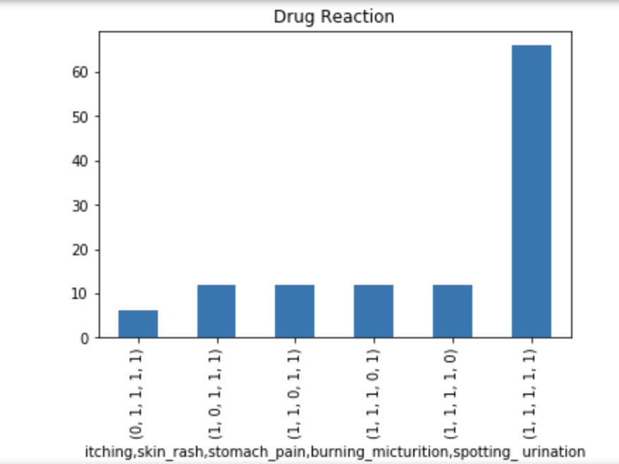
Exploratory Data Analysis
Histogram of all the symptoms of “Fungal Infection” & “Drug reaction”

Slide 9
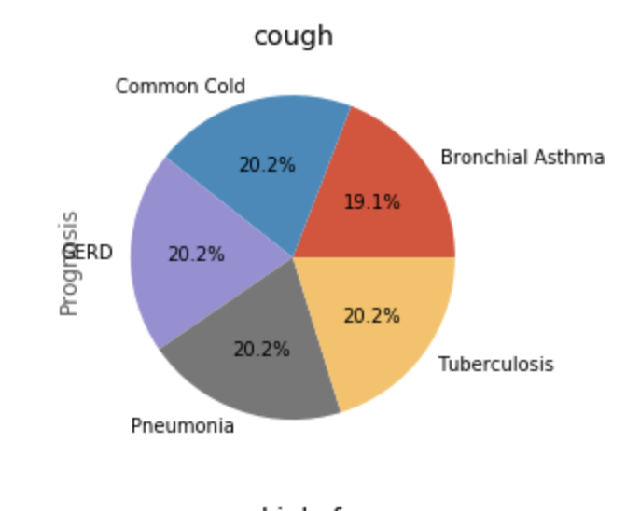
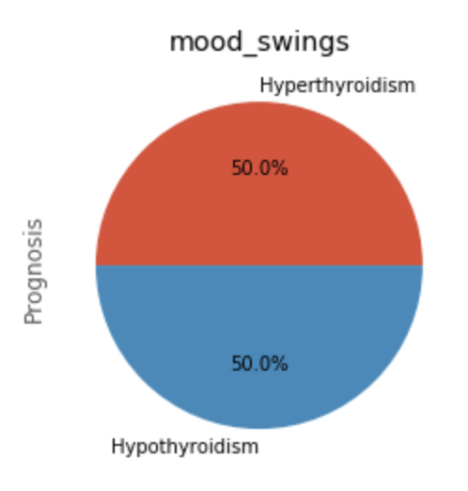
Exploratory Data Analysis
Pie chart of selected symptoms based on prognosis

Slide 10
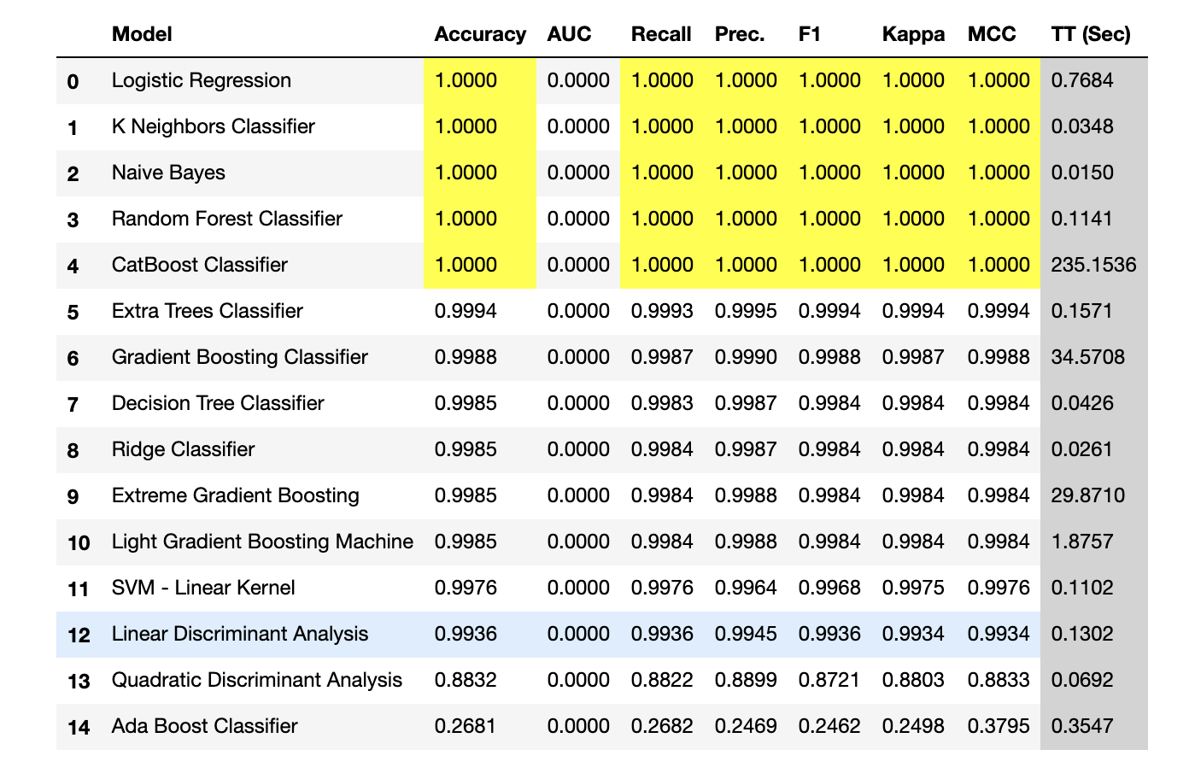
Data Modeling - Initial Findings

Slide 11
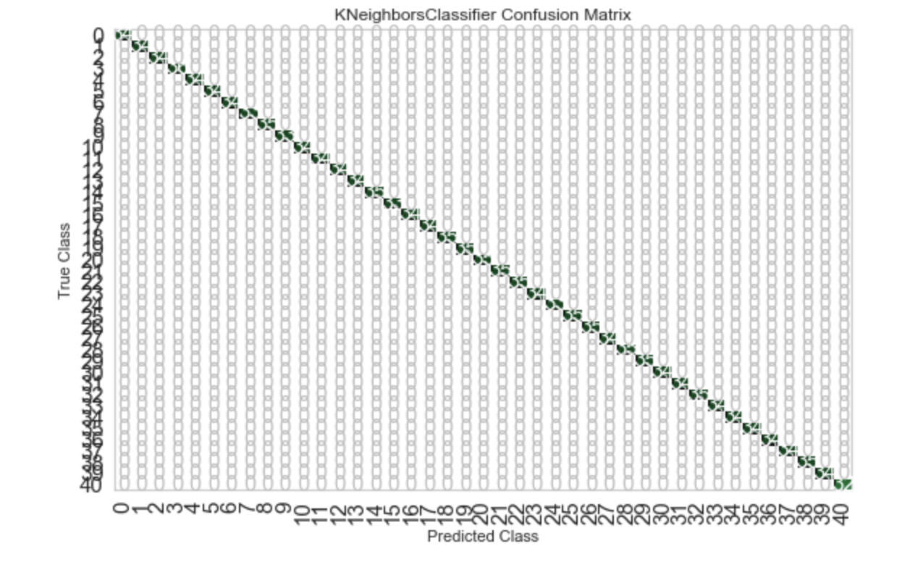
Data Modeling - Initial Findings
Confusion Matrix for KneighborsClassifier

Slide 12
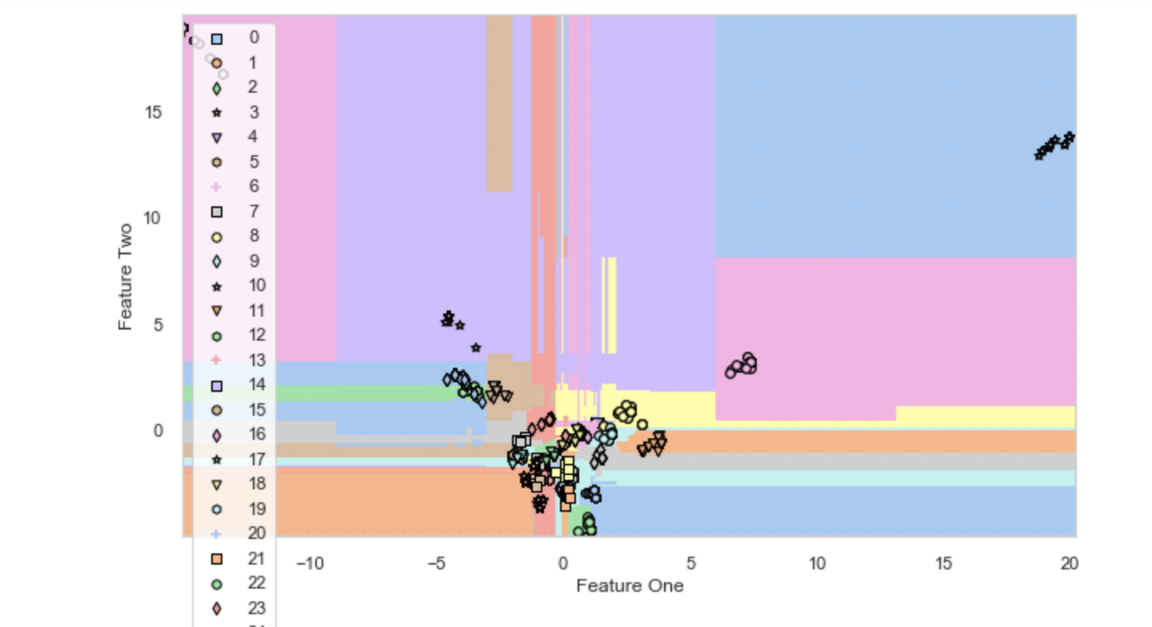
Data Modeling - Initial Findings
Clusters for KneighborsClassifier

Slide 13
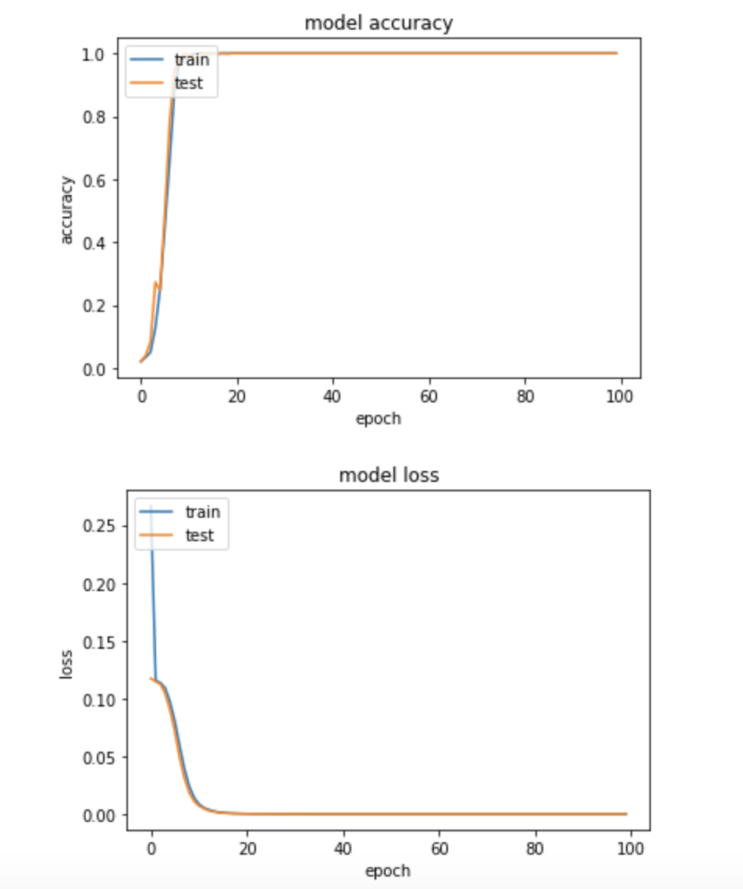
Data Modeling - Initial Findings
Accuracy(top) and loss(bottom) of Neural Network model

Slide 14
Conclusions
Naïve Bayes,Random Forest, K nearest Neighbors, Logistic regression gives us the best test accuracy, which is 100%
Got 97.83% accuracy with SGD whereas 100% accuracy with Adam optimizer.
To better predict, we hope to require more dataset

Slide 15
Future Research
It would be helpful to obtain a larger dataset as well as a more recent dataset.
In the future, to predict disease want to try different diseases s by using image detection. In this way, the dataset becomes complicated and we can apply convolutional neural networks to make accurate predictions.

