Slide 1
BANK CRM ANALYSIS
A Data‑Driven Story using SQL Analytics & Business Intelligence
Customer Retention & Risk Analysis
Prepared By: Ansh VERMA

Slide 2
Agenda
Problem Statement & Business Objective
Dataset & Data Model Overview
Objective Analysis – Key SQL Insights
Customer Behavior & Churn Drivers
Risk, Geography & Product Analysis
Strategic Insights & Recommendations
Dashboard Vision & Conclusion

Slide 3
Problem Statement
The bank is experiencing customer churn, impacting revenue and long-term growth.
There is a need to analyze customer demographics, transaction behavior, exit data, and active customer profiles to identify churn patterns.
The objective is to extract actionable insights that help predict and reduce customer attrition.
The bank aims to improve service delivery by understanding customer behavior and engagement trends.

Slide 4
Business Objective
Understand customer behavior and churn patterns
Identify high‑risk customer segments and regions
Evaluate product engagement and retention effectiveness
Provide actionable insights to reduce churn and protect capital
Support CRM, marketing, and risk‑management decision‑making

Slide 5
Dataset Overview
Total Customers: 10,000
Primary Fact Table: Bank_Churn
Supporting Dimension Tables: Customer_Info, Geography, Gender, Credit Card Status, Active Status, Exit Status
Time Period: Multi‑year customer onboarding data
Tools Used: SQL, Power BI, Statistical Analysis

Slide 6
Data Model & Schema Design
Star‑Schema based analytical model
Bank_Churn as central fact table
Lookup tables ensure data consistency & scalability
Optimized for churn, retention, and CRM analysis
Supports slicing by geography, gender, tenure, products, and activity

Slide 7
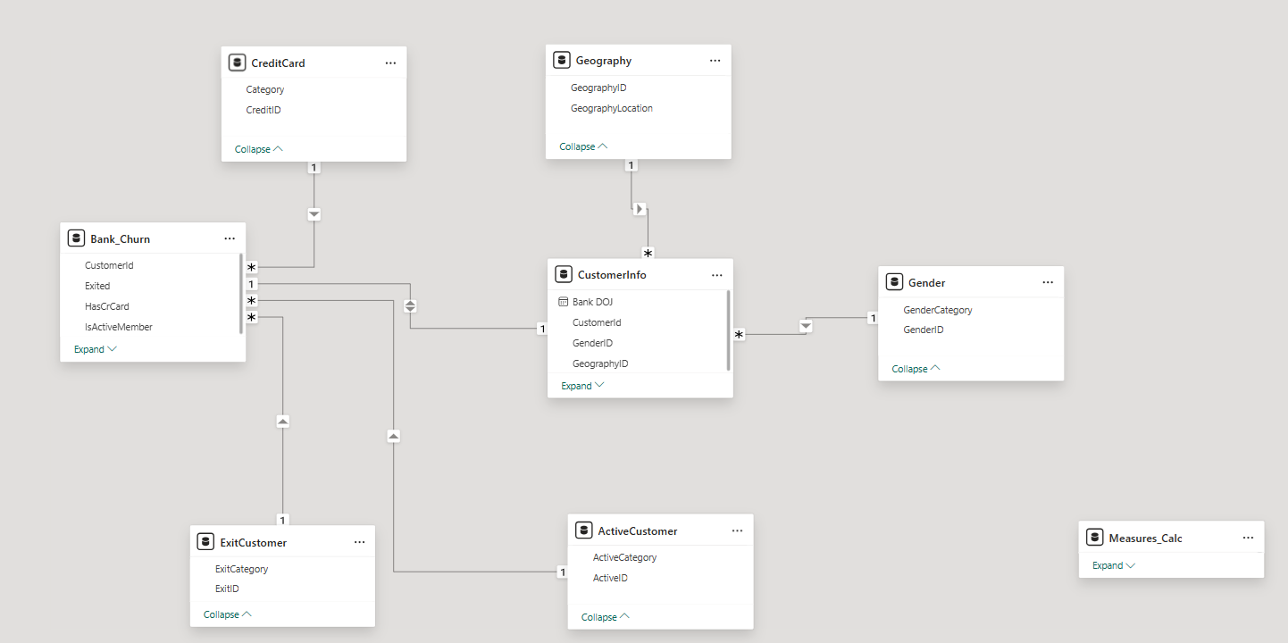
Database Schema

Slide 8
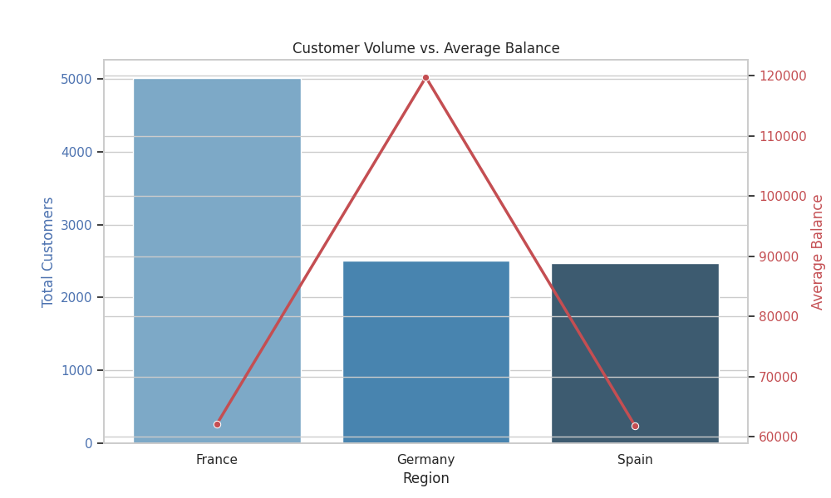
Regional Distribution of Account Balances
France: Largest customer base and total balance
Germany: Highest average balance per customer
Spain: Smallest market by total balance
Key Risk: Germany holds high‑value customers with elevated churn risk

Slide 9
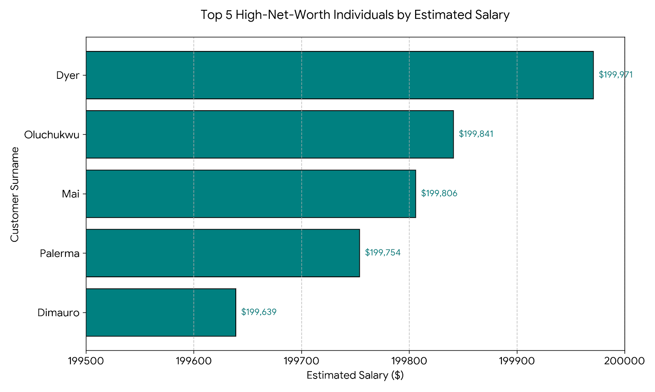
High‑Value Customer Acquisition
Top 5 salaries exceed $199K
Strong acquisition of high‑net‑worth individuals
Indicates success of year‑end campaigns
Opportunity to retain these customers with premium offerings

Slide 10
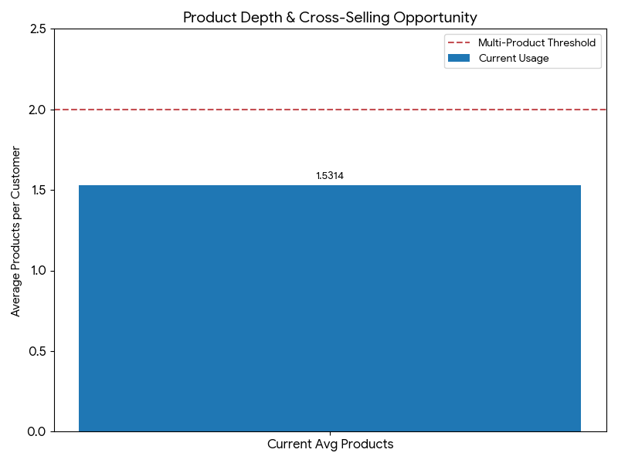
Product Usage – Credit Card Holders
Average products used: ~1.53
Credit card alone does not guarantee loyalty
Cross‑selling opportunity to increase product depth
Focus on converting 1‑product users to multi‑product customers

Slide 11
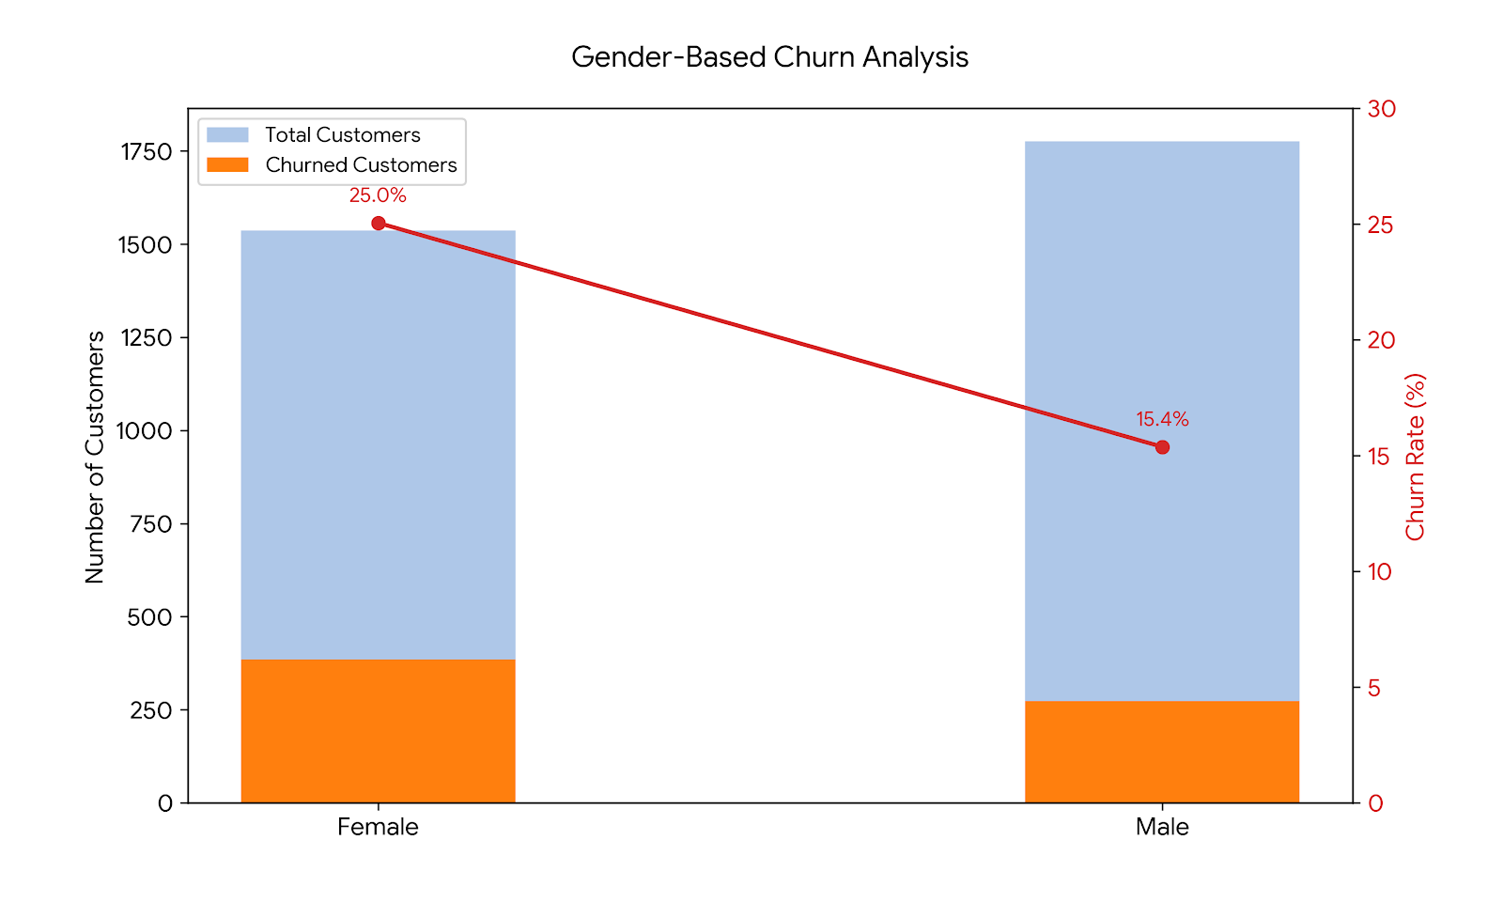
Churn Analysis by Gender
Female customers show higher churn rate (~25%)
Male customers show stronger retention (~15%)
Indicates potential service or product mismatch
Opportunity for targeted female‑focused engagement strategies

Slide 12
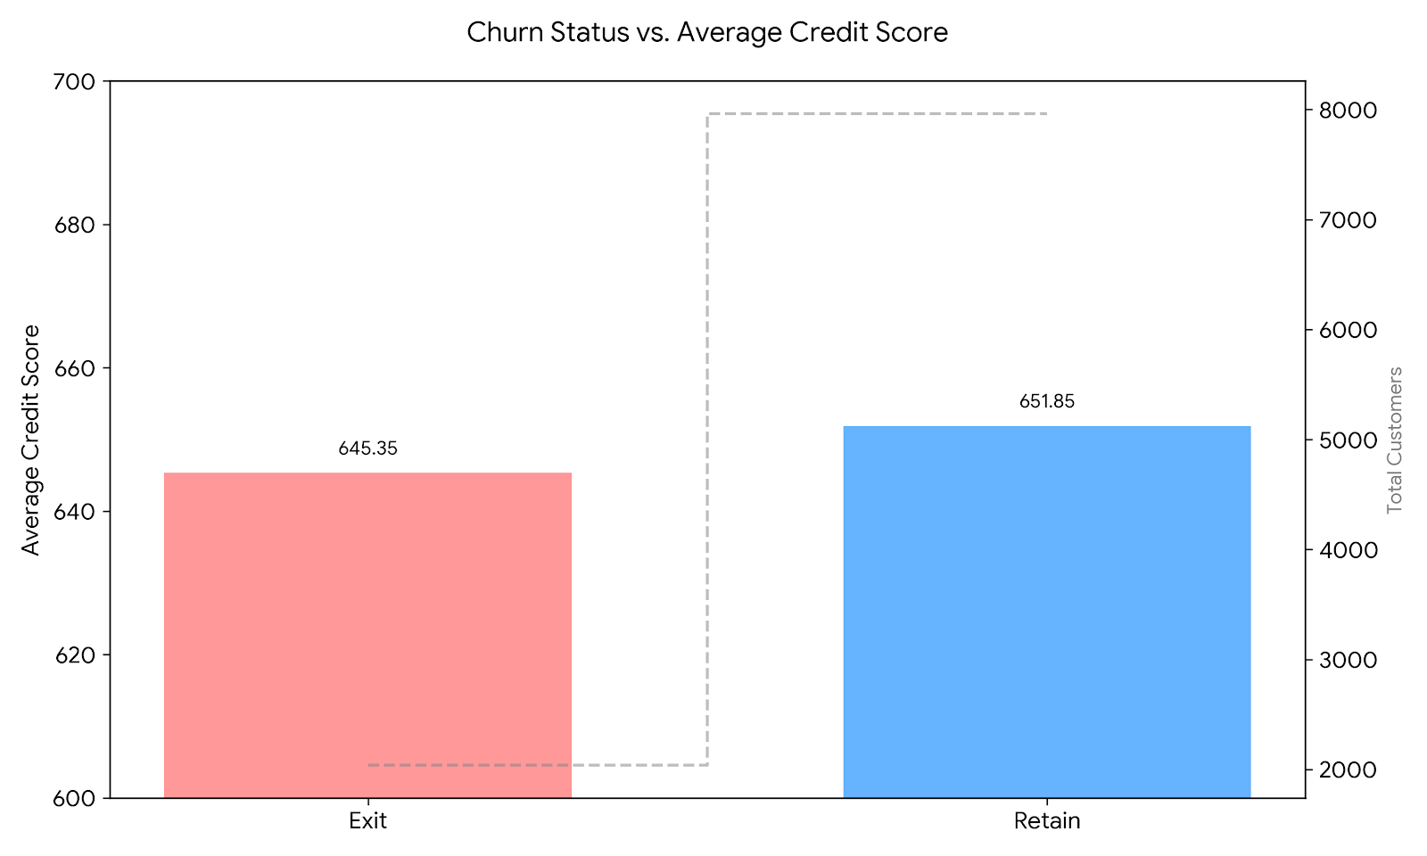
Credit Score – Churn vs Retained Customers
Minimal difference in average credit score
Credit score is NOT a primary churn driver
Churn driven more by engagement & product usage
Retention strategies should go beyond credit profiling

Slide 13
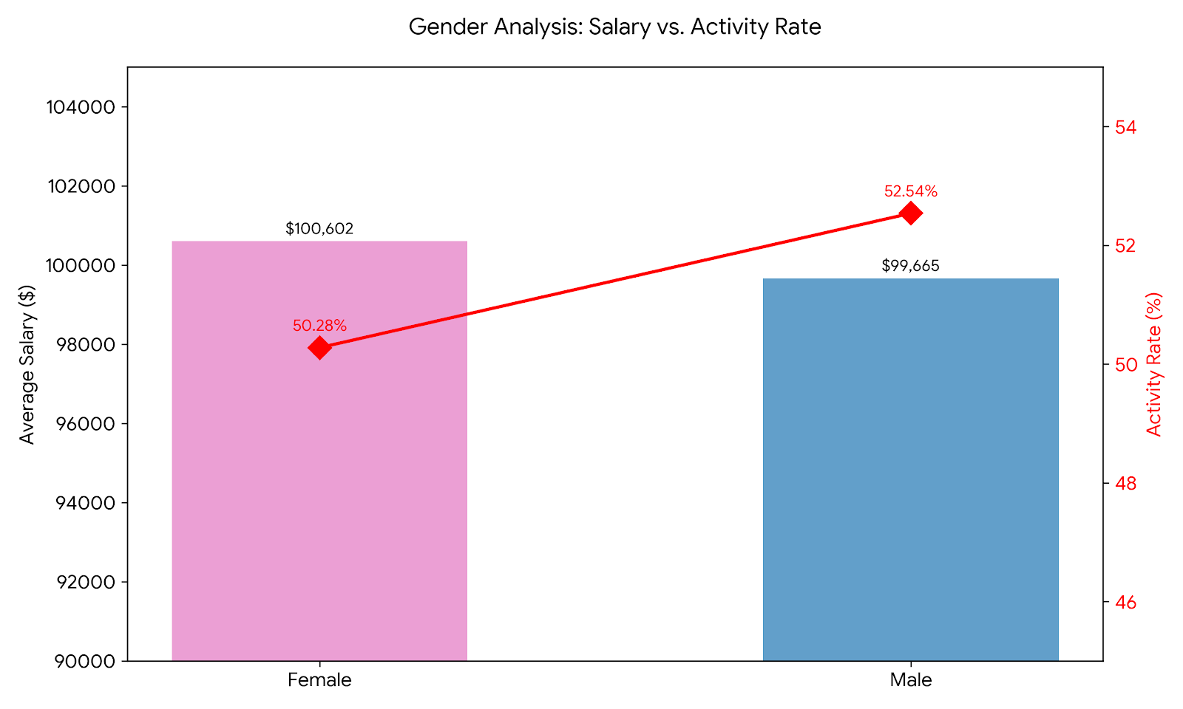
Salary vs Account Activity
Females have slightly higher average salaries
Males show higher active‑account percentage
Higher income does not equal higher engagement
Need personalized engagement for high‑earning customers

Slide 14
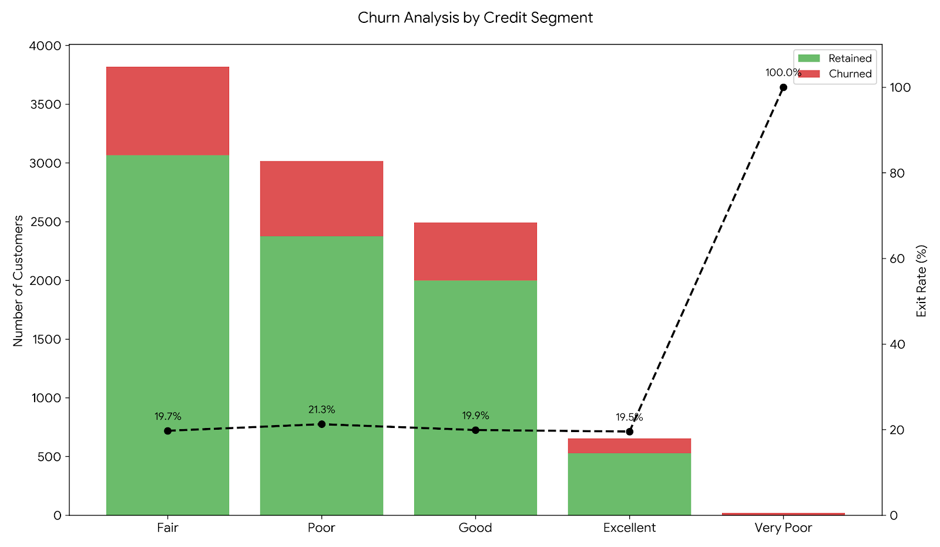
Credit Score Segmentation & Exit Rates
Very Poor credit segment shows highest exit rate
Fair segment contributes maximum churn volume
Excellent credit customers are most stable
Retention focus should be on mid‑credit customers

Slide 15
Long‑Tenure Active Customers (>5 Years)
France leads in long‑tenure active customers
Represents stable, low‑risk customer base
Best practices from France should be replicated
Strengthens long‑term capital stability
Metric | France | Germany | Spain
Total Customers | 5,014 | 2,509 | 2,477
Total Balance | 311,332,507 | 300,402,890 | 153,123,566
Stability Profile | High Tenure/Low Risk | High Value/High Risk | Smallest Market Share

Slide 16
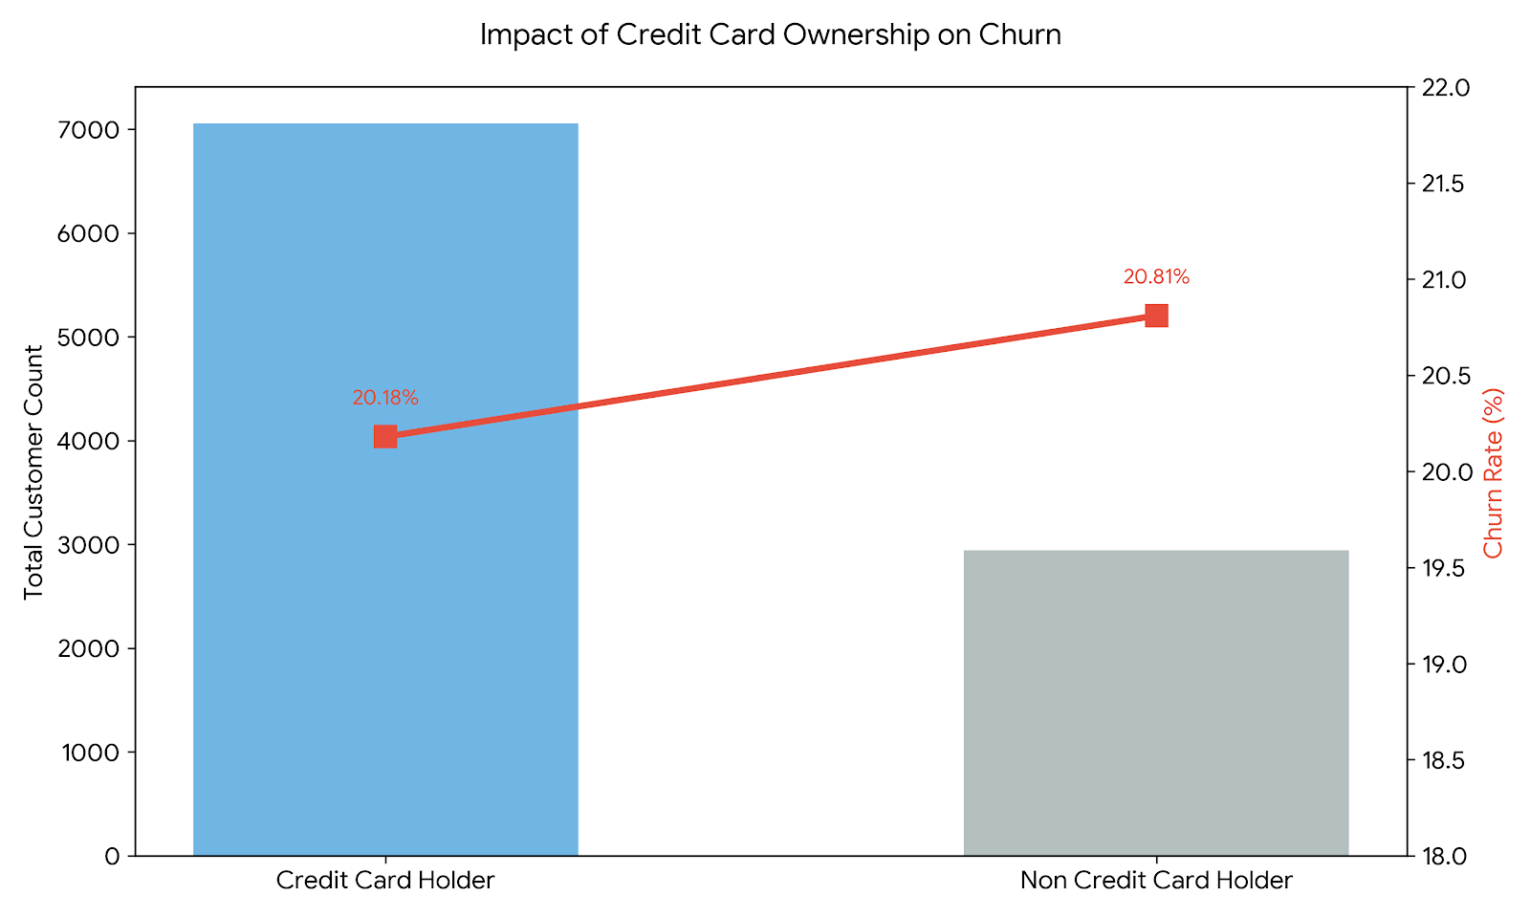
Impact of Credit Card on Churn
Churn rates nearly identical for card & non‑card holders
Credit cards alone are not retention drivers
Retention depends on engagement & service quality
Rewards programs need enhancement to show impact

Slide 17
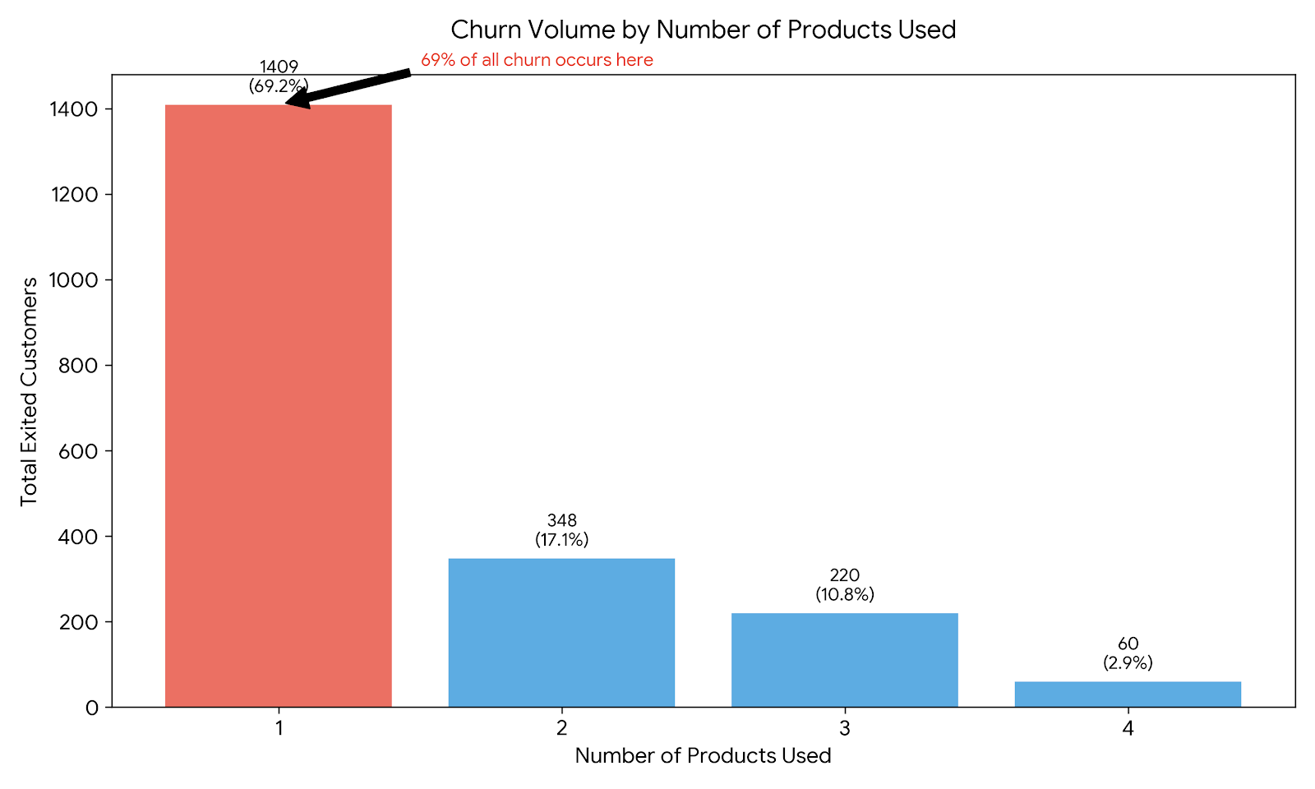
Product Count Among Churned Customers
69% churned customers used only one product
Sharp churn reduction at two or more products
Single‑product users are highest risk segment
Early cross‑sell is critical for retention

Slide 18
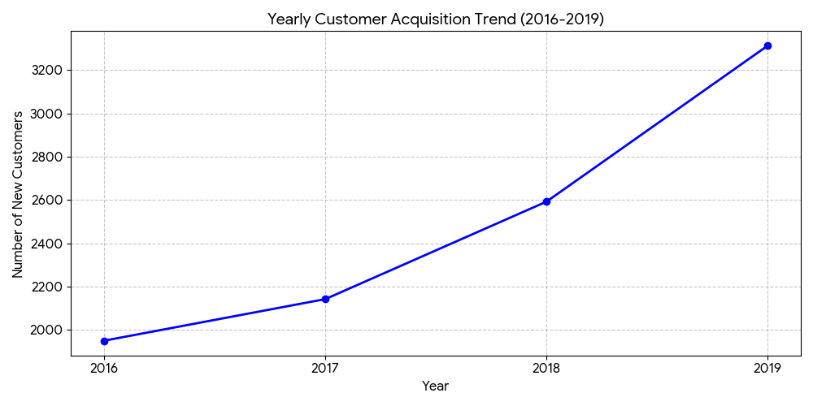
Customer Onboarding Trends
Consistent growth year‑over‑year
Strong seasonality in (Sep‑Dec)
Lowest onboarding in early months (Jan‑Feb)
Marketing optimization needed for Q1

Slide 19
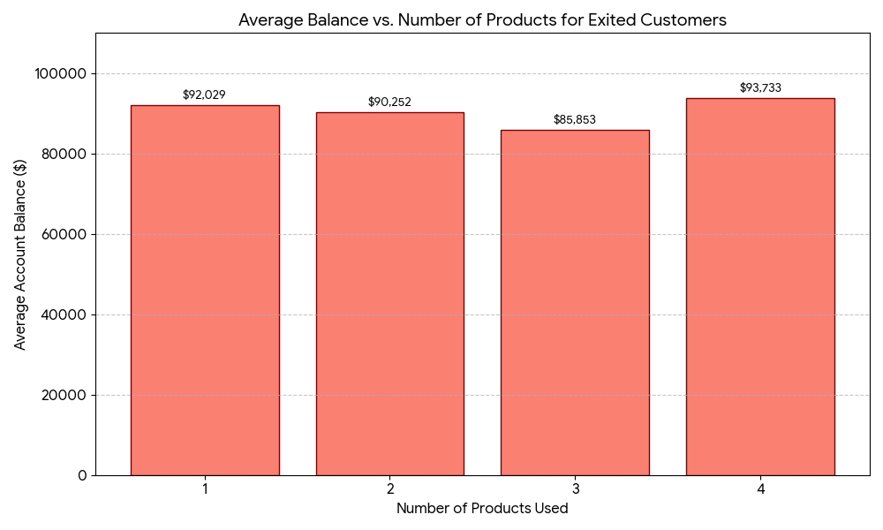
Balance vs Product Count (Churned Customers)
High balances across all product counts
High‑value customers are exiting the bank
Even multi‑product customers are not immune
Indicates premium service gaps

Slide 20
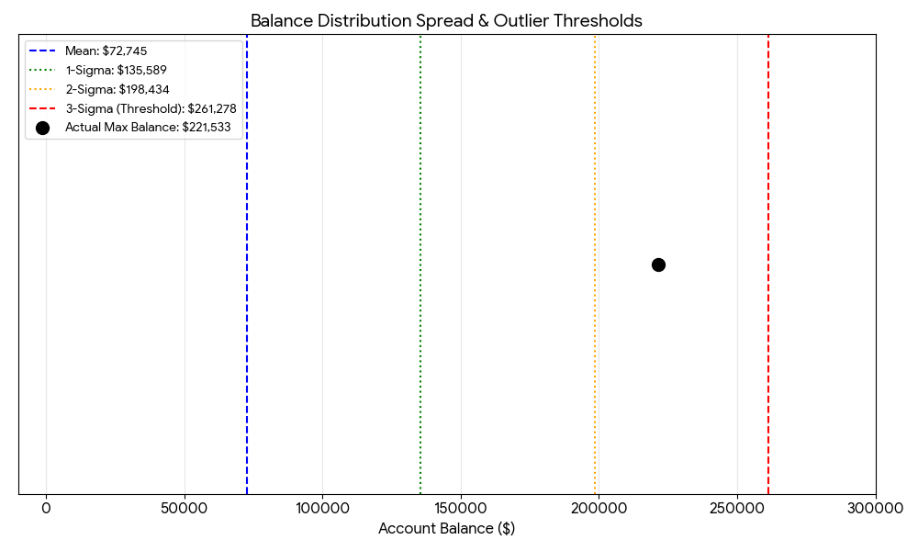
Outlier Analysis – Retained Customers
Wide balance distribution
No extreme statistical outliers detected
Presence of zero‑balance retained accounts
Inactive but retained customers inflate KPIs

Slide 21
Data Integrity & Discrepancy Analysis
735 customers marked Active but also Exited
Logical conflict in status flags
Exited status confirmed as accurate
IsActiveMember flag requires correction

Slide 22
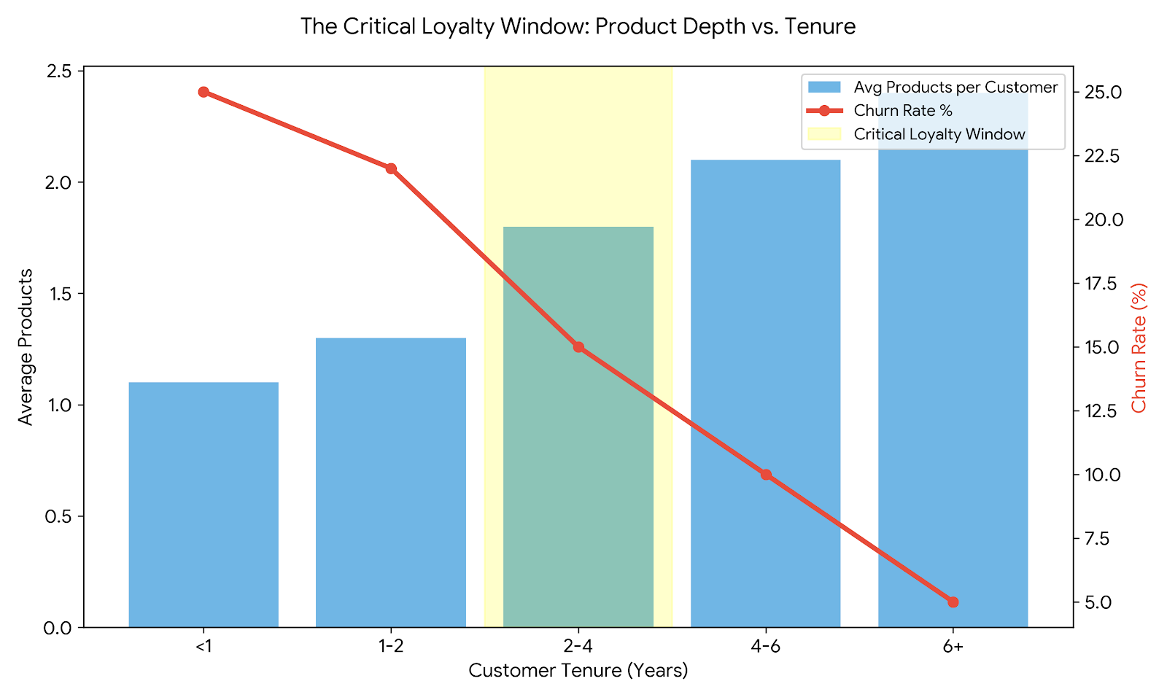
Customer Behavior Insights
Multi‑product customers show higher loyalty
Wealth accumulation increases with tenure
Critical loyalty window between Years 2‑4
Product migration drives long‑term value

Slide 23
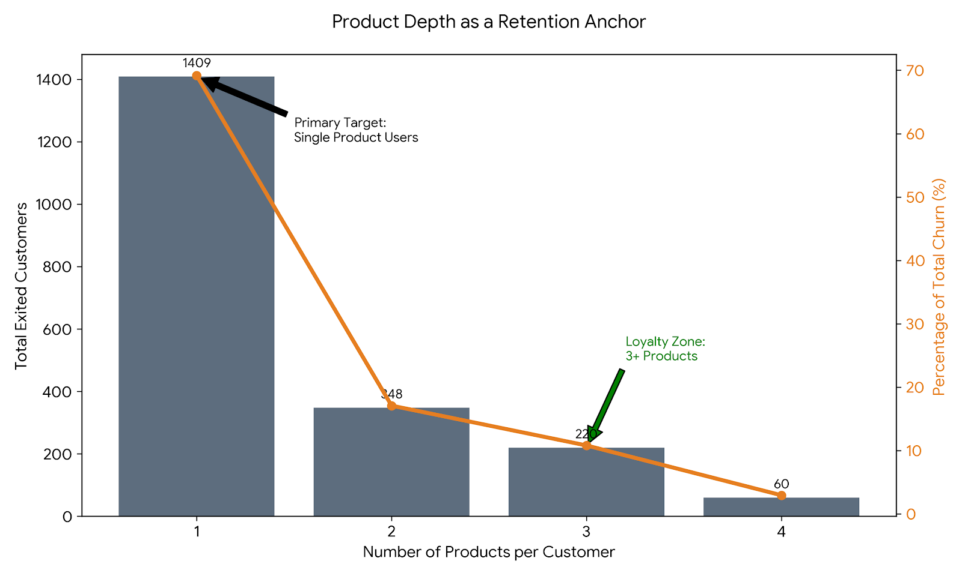
Product Affinity & Cross‑Sell Strategy
Credit card acts as anchor product
1‑product customers are under‑utilized
Target single‑product users for card adoption
Focus shifts to retention after 3+ products

Slide 24
Geographic Risk Assessment
Germany: Highest churn & highest balances
France: Stable & loyal customer base
Spain: Lowest churn and lower balances
Germany requires urgent retention strategy

Slide 25
Risk Management Perspective
Highest risk: High‑balance, mid‑age customers
Credit score alone is not risk indicator
Churn causes capital loss, not just volume loss
Retention is more critical than acquisition

Slide 26
Key Churn Predictors
IsActiveMember – strongest predictor
Number of Products – high impact
Tenure – churn spike around 5 years
Estimated Salary – low predictive power

Slide 27
Strategic Recommendations
Introduce retention triggers at Year 4
Cross‑sell second product aggressively
Launch Germany‑focused loyalty programs
Design premium services for high‑balance customers
Fix data quality issues in activity flags

Slide 28
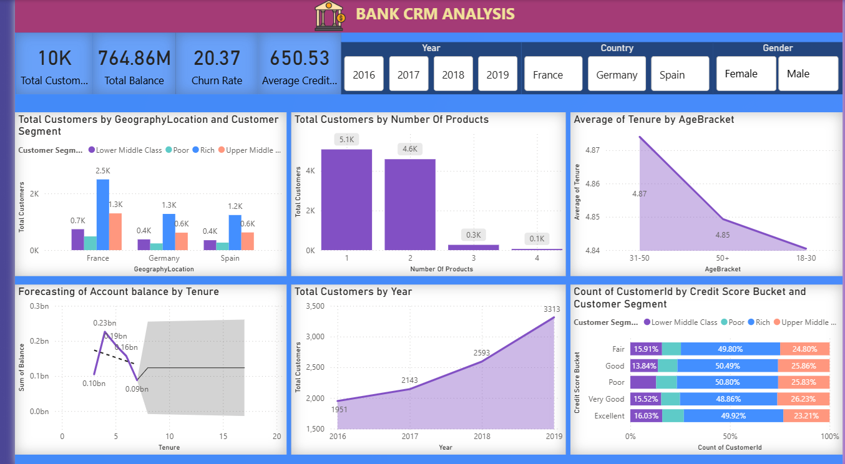
Dashboard Vision (Customer Demographics)

Slide 29
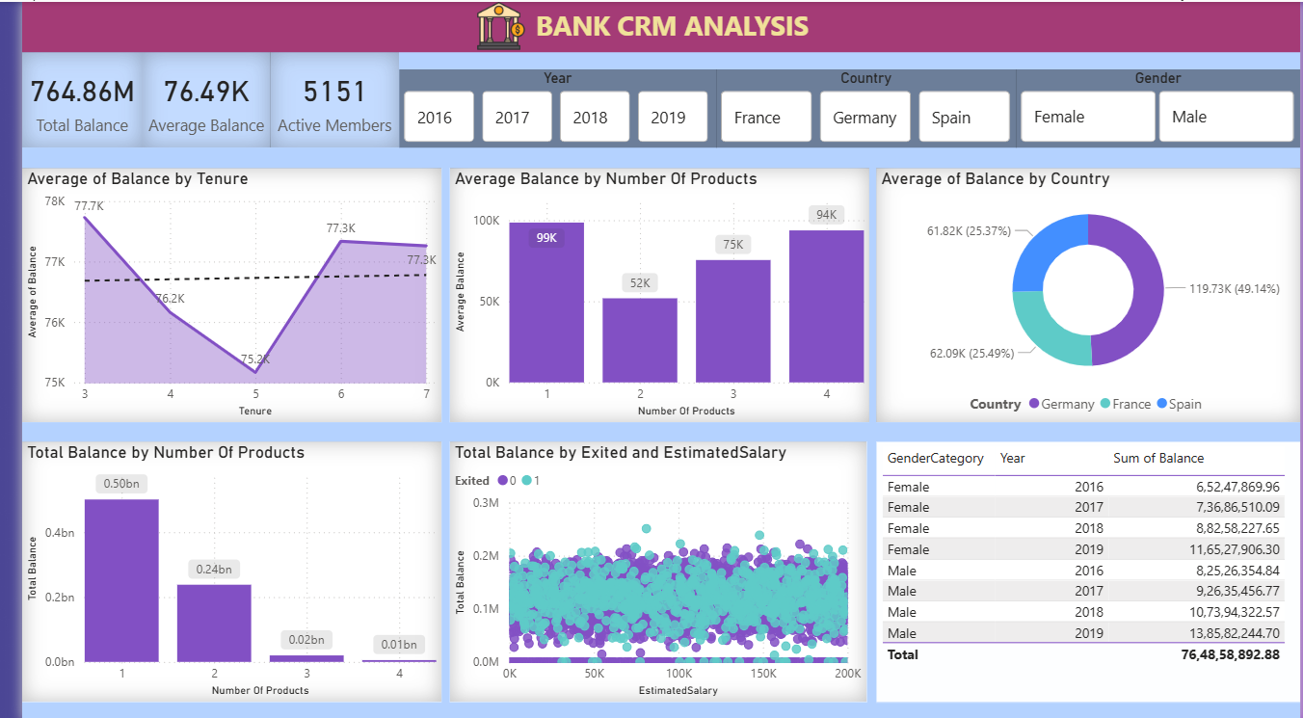
Dashboard Vision (Product Analysis)

Slide 30
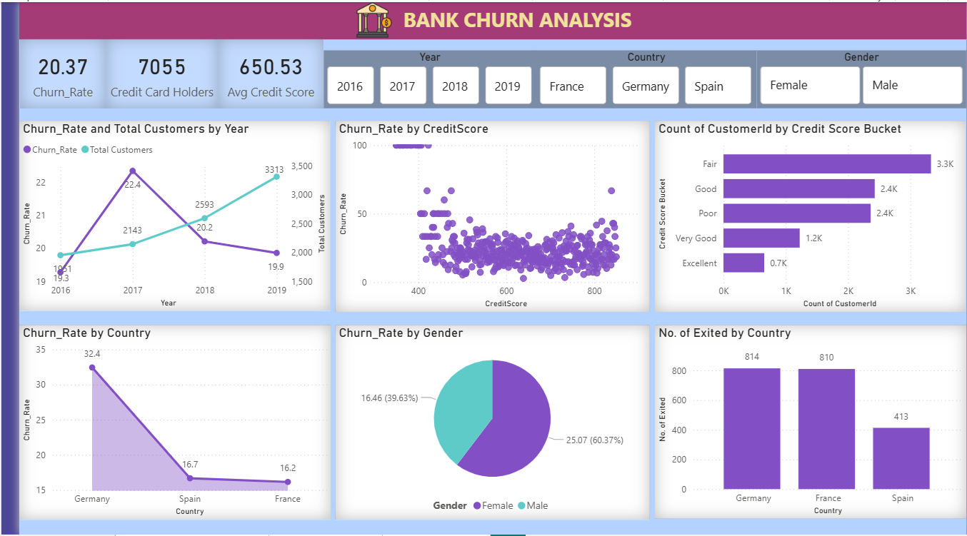
Dashboard Vision (Churn Analysis)

Slide 31

Conclusion
Churn is driven by engagement, not income
High‑value customer exits pose biggest threat
Single‑product customers are most vulnerable
Data‑driven CRM strategy can significantly reduce churn

