Slide 1

Spreadsheet Project
IT Ticket Analysis
Presented By: Ansh Verma
Date : 30-09-2025

Slide 2
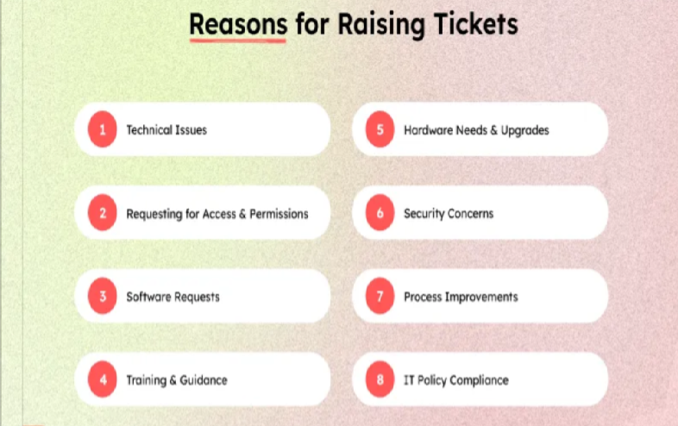
What is IT Ticket Analysis
Manages customer inquiries and issues through digital tickets.
Tracks conversations, notes, and files for each case.
Ensures no issue is missed or overlooked.
Provides structured, faster resolution process.
Improves organization and customer support efficiency.

Slide 3


Agenda
01
Data Overview
02
Problem Statement and Dataset
03
Data Description & Methodology
04
Key Metrics &
Insights
05
Strategic Recommendation and Dashboard

Slide 4
Problem Statement
The objective is to analyze the IT support ticket management system to understand the performance of IT agents, the efficiency of ticket resolution, and the satisfaction levels of employees. The analysis aims to identify high and low performers among IT agents, assess the overall effectiveness of the team, and pinpoint areas for improvement in the ticket resolution process. The ultimate goal is to make informed staffing decisions, including hiring, firing, and training, to enhance overall service quality and team performance.

Slide 5

Data Overview
Dataset: 97,498 tickets (2016–2020).
Handled by 50 agents.
Avg. Resolution Time: 4.55 days.
Avg. Satisfaction Score: 4.10.
Covers key fields: Request Category, Severity, Priority, Resolution Time, Satisfaction.
Focus: Ticket Volume, Resolution Efficiency, Customer Experience, Agent Performance.

Slide 6
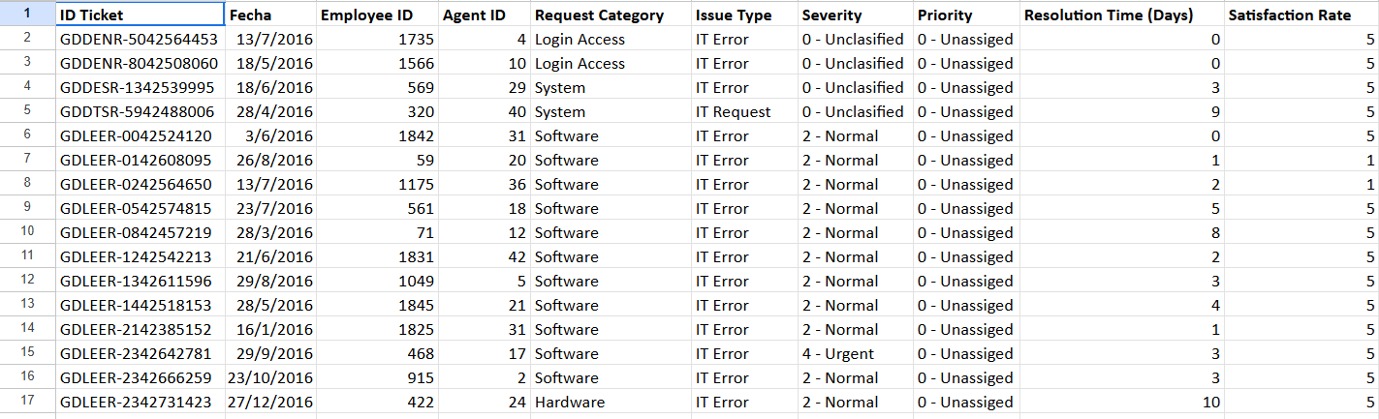
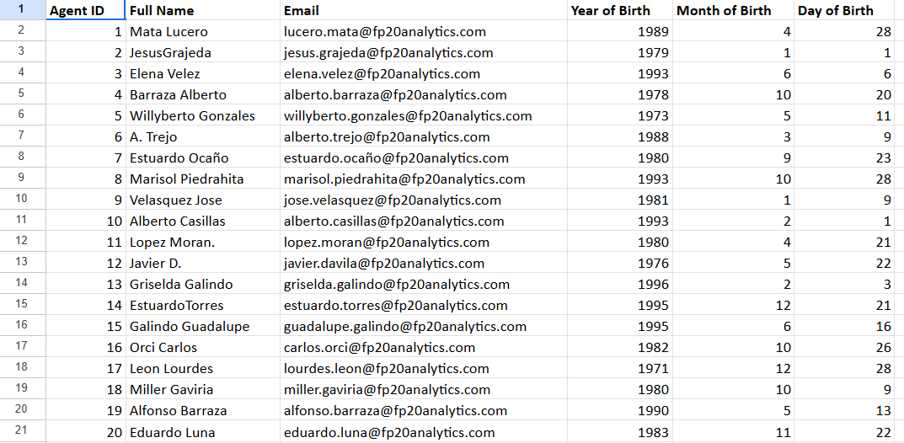
Problem Dataset
DATASET PROVIDED: IT Tickets , Agent ID

Slide 7
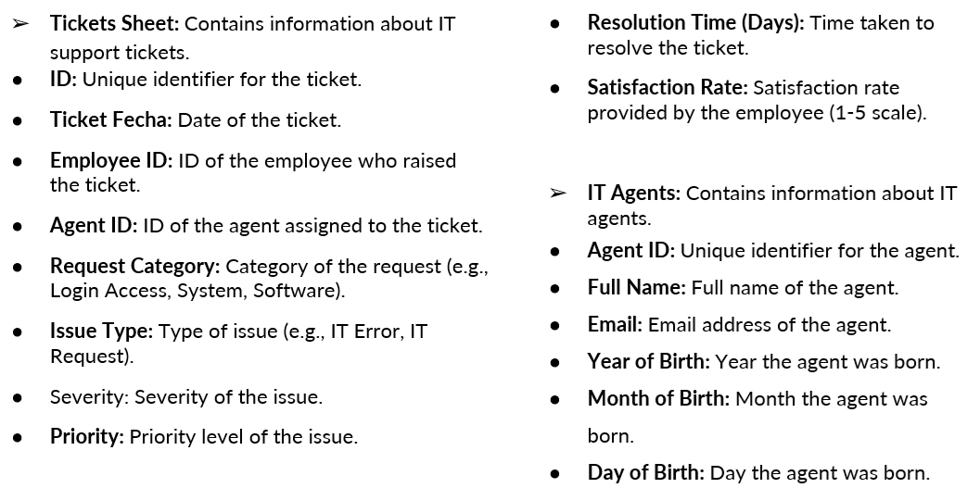
Data Columns Description

Slide 8

Methodology
Data Cleaning
Removed blanks & missing values
Fixed data types & formats
Corrected typos/inconsistencies
Standardized categories
Data Preparation – IT Ticket Sheet
Extracted Day, Month, Year
Split Severity & Priority (Text-to-Columns)
Added required columns, removed unused
Data Preparation – Agent Sheet
Calculated Age (TODAY + DATEDIF)
Removed DOB split columns
Added analysis columns (Tickets, Avg. Satisfaction)
Defined seniority bands:
Junior (≤35)
Mid-Level (36–45)
Senior (>45)

Slide 9
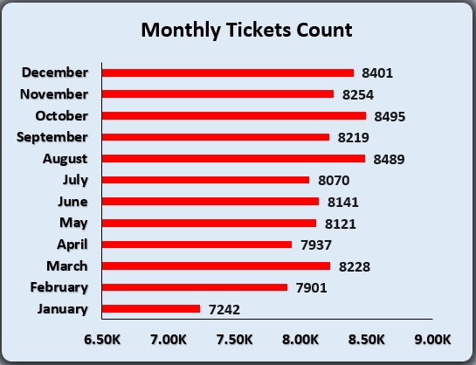
Insights
Monthly Tickets Distribution Analysis
Insights
Ticket volumes are fairly stable across months (7K–8.5K).
Highest: October (8,495) and August (8,489).
Lowest: January (7,242).
Slight peaks in Q3–Q4 → heavier workload in second half of year.
Recommendation
Plan staffing/resources for Aug–Oct to manage peak load efficiently.

Slide 10
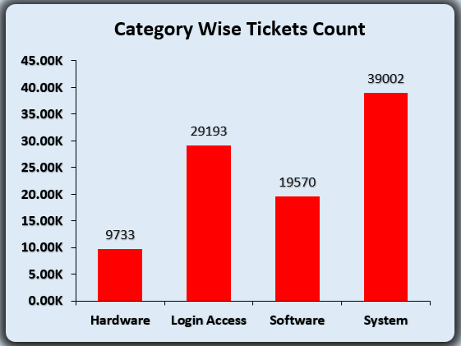
Category Wise Tickets Distribution Analysis
Insights
System tickets dominate (39,002, ~40%).
Login Access is second (29,193, ~30%).
Software accounts for ~20% (19,570).
Hardware has the lowest share (9,733, ~10%).
Recommendation
Focus optimization on System & Login Access since they form ~70% of total workload.

Slide 11
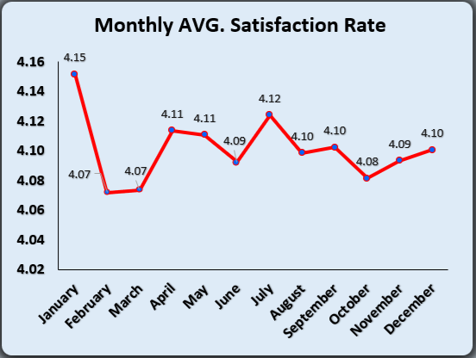
Monthly Avg. Satisfaction Analysis
Insights
Satisfaction is stable around 4.07–4.15.
Highest in January (4.15).
Lowest in Feb & March (4.07).
Recommendation
Investigate dips in Feb–Mar to maintain consistent satisfaction.

Slide 12
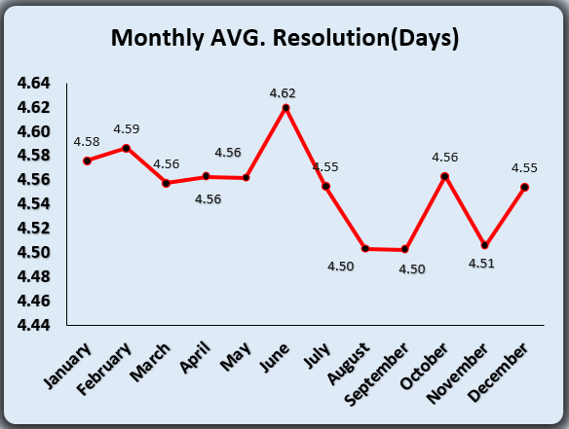
Monthly Avg. Resolution Analysis
Insights
Resolution time is stable ~4.50–4.62 days.
Highest in June (4.62).
Lowest in August & September (4.50).
Recommendation
Review June workflows to reduce delays.

Slide 13
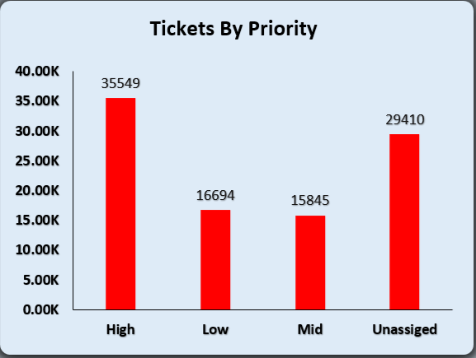
Priority Wise Tickets Analysis
Insights
High priority tickets: 36% (35,549).
Unassigned tickets are very high (29,410 → 30%).
Mid (15,845) and Low (16,694) are balanced but smaller share.
Recommendation
Reduce unassigned tickets with stricter priority mapping.

Slide 14
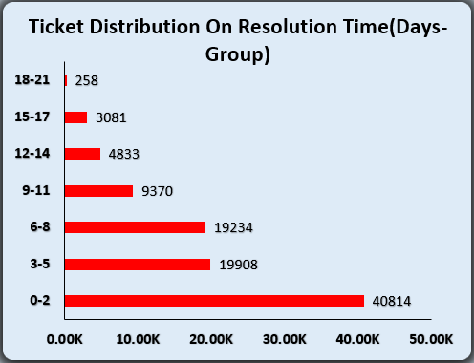
Tickets Distribution On Resolution Days
Insights
42% of tickets are resolved within 0-2 days → majority resolved quickly.
79% of tickets are resolved within 8 days → most issues handled efficiently.
9% of tickets take 12+ days → small proportion faces long delays.
<0.3% of tickets take 18-21 days → extreme delays are rare.
Recommendations
Investigate tickets taking 9+ days to identify bottlenecks.

Slide 15
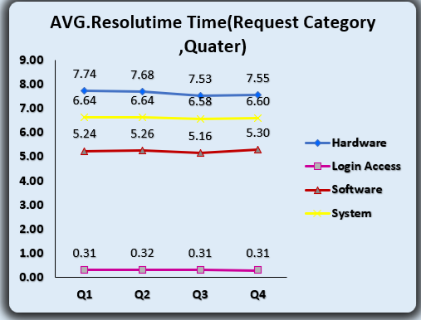
Avg. Resolution Time Analysis On Category Quarterly
Insights
Hardware issues take the longest to resolve (~7.6 days on average).
Software and system requests are moderate (~5.2–6.6 days).
Login/access requests are resolved fastest (~0.31 days).
Quarterly trends are stable → resolution times consistent across Q1–Q4.
Recommendations
Focus on reducing hardware and system resolution time.
Maintain current efficiency for login/access requests.

Slide 16
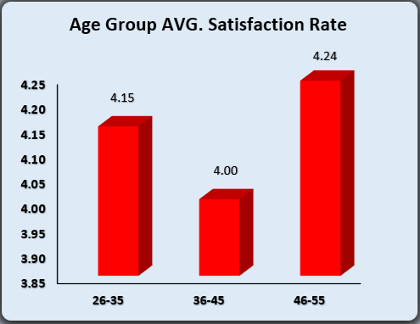
Age Group Avg. Satisfaction Analysis
Insights
46-55 age group reports the highest satisfaction (4.24).
36-45 age group reports the lowest satisfaction (4.00).
Overall average satisfaction is 4.10, indicating generally positive feedback.
Recommendations
Investigate lower satisfaction in the 36-45 group to identify improvement areas.
Maintain or reinforce practices contributing to high satisfaction in the 46-55 group.

Slide 17
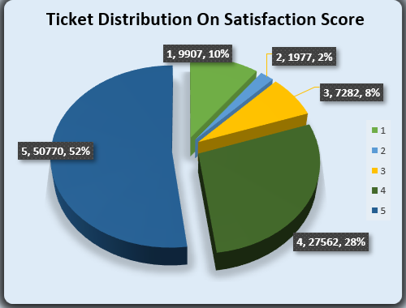
Tickets Distribution On Satisfaction Analysis
Insights
Majority of tickets have high satisfaction scores:
Score 5 → 50,770 tickets (~52%)
Score 4 → 27,562 tickets (~28%)
Low satisfaction (scores 1–3) account for ~20% of tickets.
Recommendations
Maintain practices leading to high satisfaction scores (4–5).
Investigate tickets with low satisfaction (1–3) to identify areas for improvement.

Slide 18
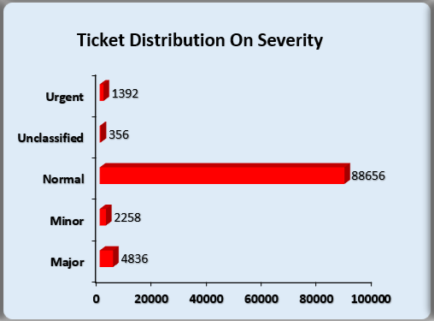
Severity Ticket Distribution Analysis
Insights
Most tickets are Normal severity → 88,656 tickets (~91%).
Major and Urgent tickets are a small proportion → 4,836 (~5%) and 1,392 (~1.4%) respectively.
Minor and Unclassified tickets account for ~2.6% of total tickets.
Recommendations
Focus resources on Major and Urgent tickets to ensure timely resolution.
Maintain efficiency for Normal tickets, as they form the bulk of workload.
Investigate Unclassified tickets to properly categorize and handle them.

Slide 19
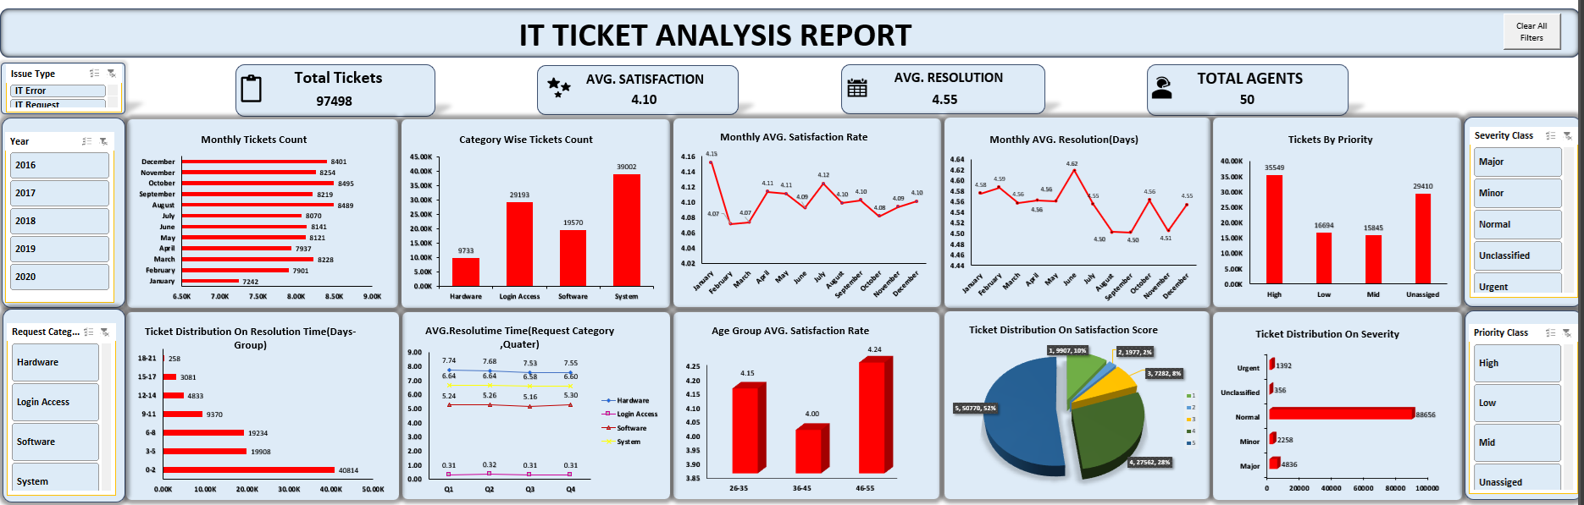
FINAL DASHBOARD

Slide 20

Prioritize High & Urgent tickets: Ensure faster handling of Major/Urgent tickets (High priority: 36%, Unassigned: 30%).
Optimize hardware & system requests: Hardware takes longest (~7.6 days); System & Login Access form ~70% of workload
Focus on resolution efficiency:
0–8 days → 79% tickets resolved quickly.
Target 3–8 day tickets to shift more into 0–2 day range.
Manage peak months: August–October see higher ticket volumes → allocate resources/staffing accordingly.
Maintain high customer satisfaction:
Overall satisfaction ~4.10.
Investigate dips (Feb–Mar, 36–45 age group, low-score tickets) to sustain quality.
Monitor trends quarterly: Keep tracking monthly/quarterly resolution times and satisfaction to detect early delays.

Slide 21

Ticket Prioritization: Only 36% of Major/Urgent tickets are correctly marked High priority; 30% remain unassigned.
Request Category Bottlenecks: Hardware requests take the longest (~7.6 days); System and Login Access tickets together make up ~70% of total workload.
Resolution Efficiency: Majority (79%) of tickets resolved within 0–8 days; 3–8 day tickets indicate potential delays.
Peak Periods: Ticket volumes highest in August–October.
Customer Satisfaction: Overall ~4.10; slight dips observed in Feb–Mar and among mid-level (36–45) age group tickets.
Trend Stability: Monthly and quarterly resolution times and satisfaction rates are generally stable, with minor fluctuations.

Slide 22


