Slide 1
Pneumonia Diagnosis Detection and Localization
34
Project 34 | UE24CS352A Machine Learning Mini-Project
Ansh Vardhan Singh
PES1UG24AM046
Aditya Narayan Dandia
PES1UG24AM017
DenseNet121 + Grad-CAM

Slide 2
Problem: detect pneumonia, then locate it
1
Detection
2
Localization
Chest X-ray in, P(pneumonia) and a Pneumonia / Normal label out.
A Grad-CAM heatmap and box around the suspected region, learned without any location labels in training.
Reference: Stanford CS229 (2018), project #56: CNN + CAM localization. We adapt it with transfer learning + Grad-CAM, without U-Net lung segmentation or DFS clustering.
Educational prototype, not a clinical diagnostic tool.

Slide 3
RSNA Pneumonia Detection dataset
70 / 15 / 15
Chest X-rays in DICOM format, from Kaggle
Label per image: Target 1 = pneumonia, 0 = not
Pneumonia images also have bounding boxes, used only to evaluate localization, never for training
Fewer pneumonia than normal images, so we use a weighted loss
One row per X-ray; the stratified split keeps the class ratio
stratified train / validation / test split
~18k
training images (final model)
500
test images: 106 pneumonia, 394 normal

Slide 4
Method: DenseNet121 + Grad-CAM
X-ray
Preprocess
DenseNet121
Prediction
Grad-CAM
DICOM, RSNA
224x224 RGB, ImageNet norm.
ImageNet-pretrained, 1-output head
P(pneumonia), weighted BCE loss
7x7 map, threshold, box
Why transfer learning?
How Grad-CAM works
A DenseNet121 pretrained on ImageNet already knows edges and textures, so we only adapt it to X-rays. This works with limited data and needs no CNN built from scratch.
It weights the last feature maps by their gradient for the pneumonia output, sums them and upsamples to a heatmap. Thresholding gives a region, compared with true boxes by IoU.

Slide 5
Baseline overfit, final model fixed it
0.853 to 0.881
best validation AUC, baseline to final model
Baseline
3k images, no augmentation, lr 1e-4. Validation loss rose after epoch 1.
Final model
Full train split (~18k), flip / rotation / jitter, lr 3e-5, weight decay, LR scheduler, early stopping. Best epoch 3.

Slide 6
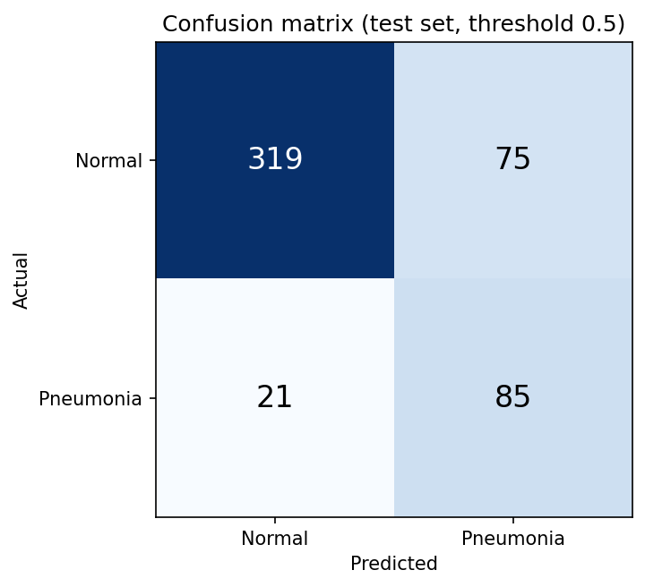
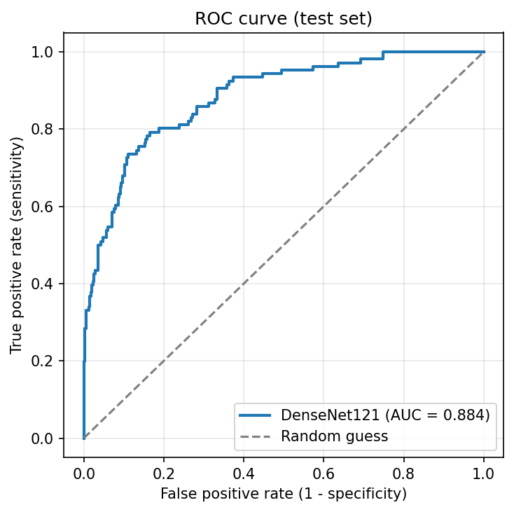
Results on the 500-image test set
0.884
0.808
0.531
0.802
0.639
0.810
ROC-AUC
Accuracy
Precision
Recall
F1-score
Specificity
85 of 106 pneumonia cases caught
21 missed (false negatives)
75 false alarms on 394 normals, so precision is 0.53

Slide 7
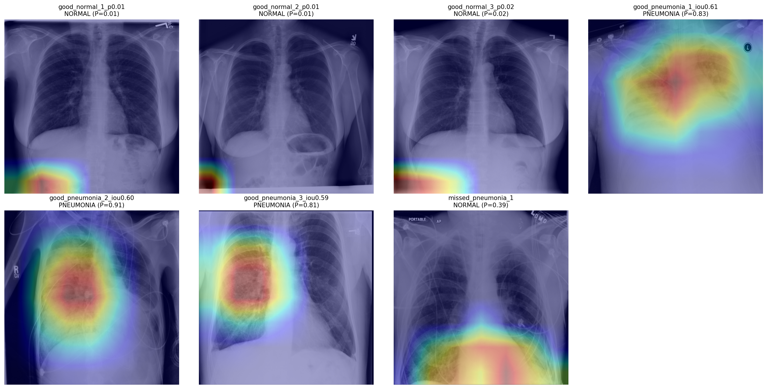
Localization and demo examples
Selected examples, not average performance: best-localized detections (IoU 0.59 to 0.61), confidently cleared normals, and one missed case (P = 0.39, bottom right).
0.28
47.2%
mean IoU (thr 0.5)
pointing-game hit rate

Slide 8
Conclusion, limitations, future work
What worked
Limitations
Future work
AUC 0.884 and recall 0.80 on the test set
Localization with no box labels: IoU 0.28, hit rate 47%
More data, augmentation and regularization fixed overfitting
Single split, no cross-validation
500-image test sample
Moderate precision (75 false alarms)
7x7 Grad-CAM gives coarse regions
Some heatmaps hit non-lung areas
No external validation; not clinical
Evaluate on the full held-out test split
Higher-resolution CAM, or a detector (Faster R-CNN) with lung segmentation
Tune the threshold for sensitivity
External validation

