Slide 1

Exploring New Possibilities with the AWS Ansible Automation
Rahul Sharma
Amazon Web Services
@rahul031092
Sean Cavanaugh
Red Hat Ansible
@IPvSean
Notes:
Intro in the cloud (AWS) (Intro to what Ansible Hybrid Cloud Automation is) (3)
Rahul and Cloud Control API (5-6 slides, ~15 minutes)
New modules. What’s new in 5.0.0. Maybe roles. (3)
Demo? (~3)
CCAPI
If not enough questions? 2nd demo of AWS roles?
Questions
Massimo: show AWS roles https://github.com/ansible-collections/cloud.aws_roles

Slide 2
AGENDA
Exploring New Possibilities with the AWS Ansible Automation
Intro to Ansible Hybrid Cloud Automation
Intro to AWS Cloud Control API
Cloud Control API collection
Demo of Cloud Control API
What’s new in Ansible AWS content collection 5.0.0
Q&A
Notes:
5.0.0 @ Ansiblefest
https://www.ansible.com/blog/exploring-new-possibilities-with-the-aws-cloud-control-collection

Slide 3




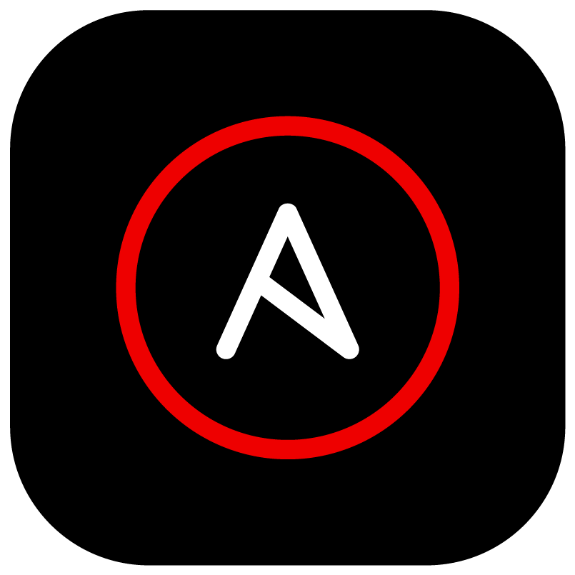
Intro to Ansible Hybrid Cloud Automation
Exploring New Possibilities with the AWS Ansible Automation

Slide 4






Ansible Automation for the hybrid cloud
Orchestrate
Operationalize
Govern
Public cloud
Cloud native
Private cloud

Slide 5
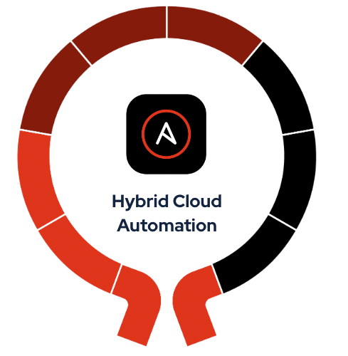



Orchestrate
Operationalize
Govern
Public cloud
Cloud native
Private cloud

Slide 6

Orchestrate
Operationalize
Govern
Cloud operations
Automated troubleshooting
Infrastructure visibility
Infrastructure optimization
Cloud migration
Hybrid Cloud Automation
Business continuity
Infrastructure orchestration
Compliance
Deployment and retirement
Public cloud
Cloud native
Private cloud

Slide 7
Intro to AWS Cloud Control API
Exploring New Possibilities with the AWS Ansible Automation

Slide 8
Opportunity #1: Access the latest AWS innovation faster
Developers using APN Partner solutions to build and manage application infrastructure want to accelerate their pace of innovation and time to market for their applications
?
?
Can new AWS features and services be supported closer to launch?
?
Notes:
First, we heard from developers who use a variety of APN Partner solutions to manage and monitor their cloud infra that they want to increase their pace of innovation and time to market for their applications. For example, there are situations where there is a lag between supporting a new AWS release in APN Partner solutions [Insert example]
The open question for us was can we help our mutual customers adopt new AWS features and services closer to their launch or on the day of launch?

Slide 9
Opportunity #2: Automatic support for new AWS capabilities
AWS continues to innovate rapidly on behalf of its customers
200+ fully featured services
3,084 significant new features in 2021
Ongoing investments to support new AWS services and features
Few weeks to months for each new AWS resource
80
2011
160
2012
280
2013
significant new services and features
2,345
2019
2,757
2020
3,084
2021
How can we automate supporting new AWS capabilities?
Notes:
AWS Continues to innovate on behalf of its customers to help them unlock new capabilities on cloud. We learnt that APN Partners keep up with AWS’ innovation through ongoing investments. Naturally, our question was can we automate supporting new capabilities on behalf of partners through a one-time integration.

Slide 10



Opportunity #3: Standardized APIs to manage AWS services
Multiple AWS services
Service-specific API
Author custom code
Applications are becoming increasingly sophisticated
AWS services and third-party APIs equipped with specific implementation
Variety of API implementation requires engineering effort
How can you use a consistent API method to interact with hundreds of AWS services?
Notes:
Finally, we recognized that we have an opportunity to standardize the APIs that interact with all the AWS features and services. You may wonder why? Multiple AWS services: As applications become increasingly sophisticated, builders need to work across several AWS and third-party services. Service-specific animation: Each of these services have distinct APIs that builders have to familiarize themselves with. While these APIs are descriptive and intuitive, some builders prefer a consistent set of APIs to manage cloud resources across various services. Author custom code animation: These builders, who prefer using a consistent set of APIs want to minimize authoring and maintaining custom code to interface with underlying services that are part of their application infrastructure.

Slide 11
Opportunity #3: Standardized APIs to manage AWS services
How can you use a consistent API method to interact with hundreds of AWS services?
Service-specific API operations
Workflow-based API operations
aws ec2 run-instances \
--image-id ami-xxxxxxxx --count 1 \
--instance-type t2.micro \
--key-name MyKeyPair \
--security-group-ids sg-903004f8 \
--subnet-id subnet-6e7f829e
aws kinesis create-stream \
--stream-name samplestream \
--shard-count 3
aws lambda create-function \
--function-name my-function \
--runtime nodejs10.x \
--zip-file fileb://my-function.zip \
--handler my-function.handler \
--role arn:aws:iam::123456789012:role/service-role/My-Function-role
aws kinesis add-tags-to-stream \
--stream-name samplestream \
--tags samplekey=example
aws ecs run-task \
--cluster default \
--task-definition my-task-def:1
aws kinesis increase-stream-retention-period \
--stream-name samplestream \
--retention-period-hours 168
Notes:
For example, as you can see on the LHS of the screen. Each service as a unique API naming convention, input parameters, and corresponding responses. On the RHS — to achieve a single workflow operation, we often need several API calls to be stitched together

Slide 12

Introduction to AWS Cloud Control API
Cloud Control API: is a new AWS capability that introduces new standardized APIs that make it easy for developers to leverage the latest AWS capabilities, typically on the day of launch and manage their cloud infrastructure consistently.
CreateResource
GetResource
UpdateResource
DeleteResource
ListResources
AWS::Amplify::App
AWS::ECS::Cluster
AWS::Logs::LogGroup
…
AWS::S3::Bucket
AWS::Xray::Group
Handlers
Error codes
AWS Cloud Control API
Consistent CRUD-L
Resource types
Standardized behavior
Notes:
Cloud Control API is essentially a set of common APIs that is designed to make it easy for developers to manage their cloud infrastructure consistently and leverage the latest AWS capabilities faster or even better, on the day of launch. It introduces consistent APIs to manage the end-to-end lifecycle of AWS resources. For example. Using single Create command - I can create a <talk about examples>. And by using single Get command, I can describe all resources supported by AWS Cloud Control API, consistently. Let’s dive deeper into it. You may wonder, how do these standard APIs work? Animation — Consistent CRUD+L Cloud Control API introduces the 5 CRUD+L resource-oriented APIs. Animation for Resource Types Each of these APIs can operate on the supported set of resources (hundreds of AWS resources, and over a dozen 3P). A resource includes the set of attributes and handler logic that control API interactions with the underlying AWS or third-party service. Animation for Consistent Schema: All these Cloud Control API supported resources have a consistent schema, response output and error handling.

Slide 13
How can users benefit?
Faster access to new AWS services and features, typically on the day of launch
Unified interface for one-time integration that automatically exposes new AWS launches
Consistent CRUD + L APIs designed to make it easy to manage cloud infrastructure consistently.
+
+
Notes:
You may wonder — while these consistent APIs are great from a simplification standpoint — how does it address the problem we stated earlier. Cloud Control API benefits you and our mutual customers by addressing the 3 problems we identified: Animation for Faster Access (1) Faster access to new features or services. This works because AWS Cloud Control API uses the AWS CloudFormation Registry to expose resources built by AWS service teams and third-parties that build their solutions. For new AWS services and features, these resources are typically available on the day of launch or shortly afterwards. Animation for Unified Interface (2) Unified interface — with one-time integration it helps enable you to keep up with AWS’ pace of innovation. Partners such as yourself can now build a unique API Codebase, using unified API verbs, common input parameters and predictable response. You can integrate once and expose the latest features as resources. With one-time integration you can potentially save hundreds of hours annual recurring development effort. Animation for Consistent CRUD+L (3) Consistent CRUDL interface designed to make it easy to manage cloud infrastructure consistently. [Share examples]

Slide 14







Introducing the Red Hat AWS Cloud Control Collection
Experimental alpha Collection of generated modules using the AWS Cloud Control API for interacting with AWS Services.
AWS Cloud Control API
AWS CloudFormation Public Registry
Hundreds of AWS modules and more
Amazon EC2
AWS Transit Gateway
Amazon S3
Amazon Kinesis
Amazon Kendra

Slide 15
Benefits of Red Hat AWS Cloud Control Collection
Auto-generated modules based on resources developed and maintained by AWS service teams
Rapid introduction of new AWS services and implementation of new features to existing ones.
Enable more comprehensive coverage of the vast number of AWS services available.

Slide 16
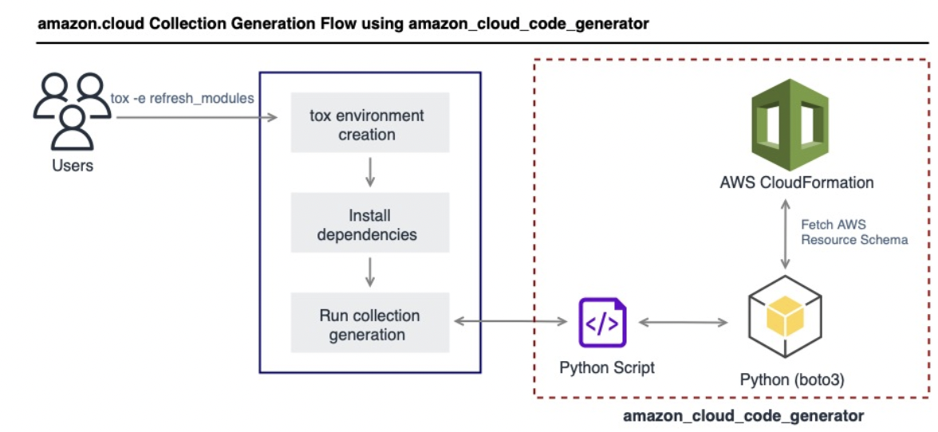
How does the Ansible AWS Cloud Control Collection Work?
Module Generation: modules contained in this Collection are generated using a tool called amazon_cloud_code_generator - developed and open sourced by the Ansible Cloud team.
Using the amazon.cloud collection:
All the modules of this Collection use boto3 (Amazon Web Services (AWS) Software Development Kit (SDK) for Python) and AWS Cloud Control API (CloudControlApi) client.
boto3 >=1.20.0 and botocore >=1.23.0

Slide 17

Red Hat Ansible AWS Cloud Control collection
Exploring New Possibilities with the AWS Ansible Automation

Slide 18
What’s next with Ansible AWS Cloud Control Collection?
More coverage across AWS services such as Amazon EC2, Amazon S3

Slide 19
Demo
Demonstration of Cloud Control API
Demo - Screen Share

Slide 20
What’s new in Ansible AWS content collection 5.0.0
Optional section marker or title
What’s new?!

Slide 21




NEW!
Released October 4th, 2022
AWS content collection 5.0.0
amazon.aws
Minimum Versions
botocore 1.21.0
boto3 1.18.0
Python 3.7
ansible-core 2.11
40 modules migrated from the community.aws collection to the amazon.aws collection.
Including:
autoscaling
cloudtrail
cloudwatch
ec2_eip
iam
lambda
rds
route53
Bug Fixes
8 bug fixes:
aws_ec2
cloudtrail
ec2_instance
ec2_metadata_facts
3 NEW modules.
amazon.aws.cloudtrail_info
amazon.aws.cloudwatch_metric_alarm_info
amazon.aws.s3_object_info
module_utils/botocore
module_utils/elbv2 (two bugs squashed)
s3_object

Slide 22
Thank you
Red Hat is the world’s leading provider of enterprise open source software solutions. Award-winning support, training, and consulting services make
Red Hat a trusted adviser to the Fortune 500.

