Slide 1


Tips that make my Ansible playbooks better

Slide 2
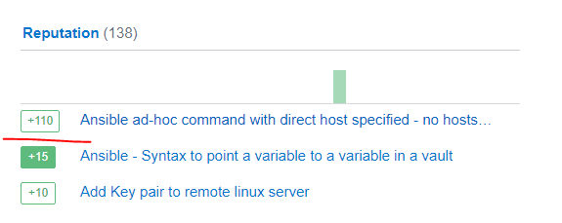
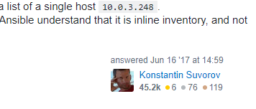


About me
Tomasz Papir-Zwierz - Big Data Platform Engineering @ G-Research (2+ years)
https://www.gresearch.co.uk/article/tips-that-make-my-ansible-playbooks-better/
Trying to persuade the community that Ansible is seriously broken (2017):
https://bit.ly/373XznD

Slide 3
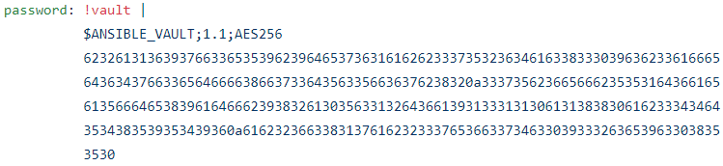
Problem – store secrets in Ansible playbooks without knowing them
Passwords and other secrets can be stored inside the playbook (variable-level encryption):
To open the vault you need to provide --ask-vault-pass option (and know the vault password)
We often do not need to know the secret (e.g. one app authenticating against another app)
How to quickly generate a ready-to-paste Ansible code with a stored secret?
Use:
pwgen 10 1 | ansible-vault encrypt_string -n password
Password will end up in audit.log:
a0="/usr/bin/python2" a1="/usr/bin/ansible-vault" a2="encrypt_string" a3="-n" a4="password" a5="ieresif0pi“
ansible-vault encrypt_string -n password $(pwgen 10 1)
Let’s make a demonstration!

Slide 4
Problem – parse problematic characters in variable value
In Ansible variables are referred with double curly brackets:
{{ message_format }}
What if a variable’s value contains “problematic” characters?
message_format: {{{ docker.container.id }}} : {{{ message }}}
In this case the triple curly brackets are specific syntax of a configuration file we want to create from a template. We want this line to appear in the configuration file as-is.

Slide 5
Problem – parse problematic characters in variable value
Attempt #1:
message_format: “{{ “{{{“ }} docker.container.id {{ “}}}” }} : {{ “{{{“ }} message {{ “}}}” }}”
It works, but looks horrible! Does not even fit the line of this slide.
Attempt #2:
message_format: !unsafe “{{{ docker.container.id }}} : {{{ message }}}”
!unsafe is one of the YAML tags used in Ansible, another is !vault
Note: inside the Jinja2 template file we can use raw markers: {% raw %} and {% endraw %} to mark the block as a raw string.

Slide 6
File module gotcha – setting file’s mode
Very simple task to change file permissions:
- name: change file permissions
file:
state: file
path: /tmp/test.txt
mode: 400
Will that work?
[tomasz@test playbooks]$ ls -ls /tmp/test.txt
4 -rw--w---- 1 tomasz group1 6 Jan 9 11:13 /tmp/test.txt

Slide 7
File module gotcha – setting file’s mode
What happened?
-rw--w---- *nix notation
110010000 binary notation
620 octal notation
400 decimal notation
For those used to /usr/bin/chmod remember that modes are actually octal numbers. You must either add a leading zero so that Ansible's YAML parser knows it is an octal number (like 0644 or 01777) or quote it (like '644' or '1777') so Ansible receives a string and can do its own conversion from string into number.
Giving Ansible a number without following one of these rules will end up with a decimal number which will have unexpected results.
https://docs.ansible.com/ansible/latest/modules/file_module.html

Slide 8

www.gresearch.co.uk

